Slide 2

Text Features
Text features are included in nonfiction text to help the reader better understand the material.
Many different types of text features provide
unique information to the reader.
These features can:
tell or explain new information
help the reader find information

Slide 3
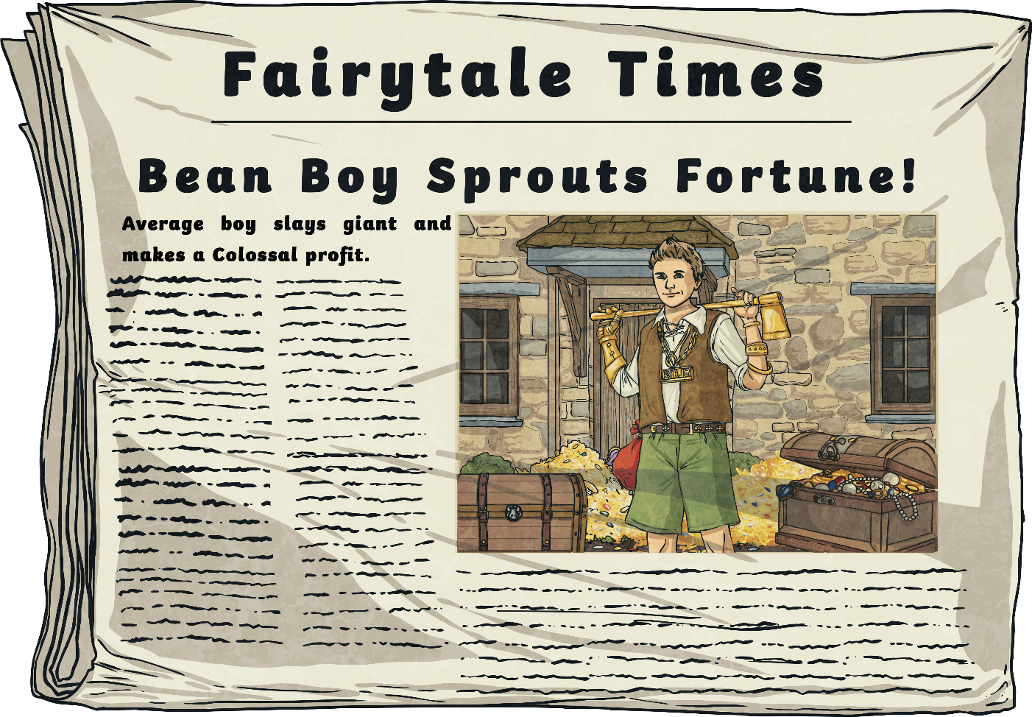
Headings and Subheadings
A heading is included at the top of the text. It tells the reader what the text is about.
A subheading tells the reader what information they will find in the following paragraphs before the next subheading.

Slide 4
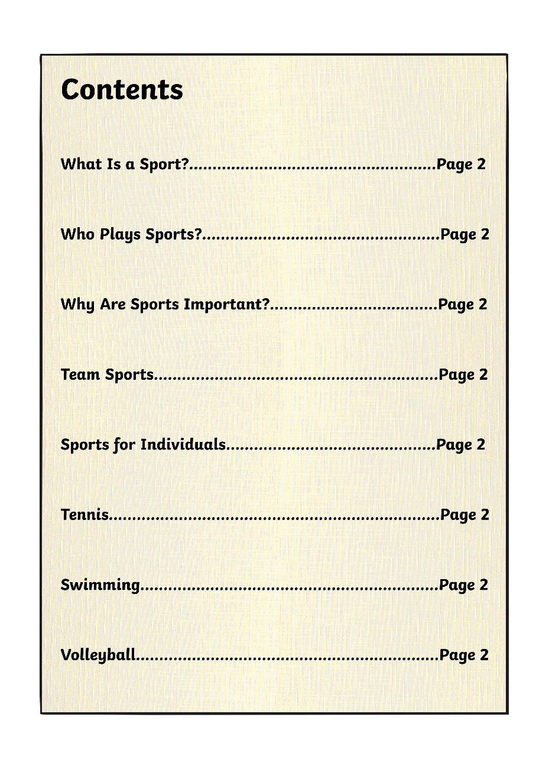
Table of Contents
A table of contents is often included at the very beginning of a book.
The table of contents shows a list of headings within the book and the page number where you can look to find that heading.
The table of contents makes it easier for the reader to find specific information they are looking for.

Slide 5
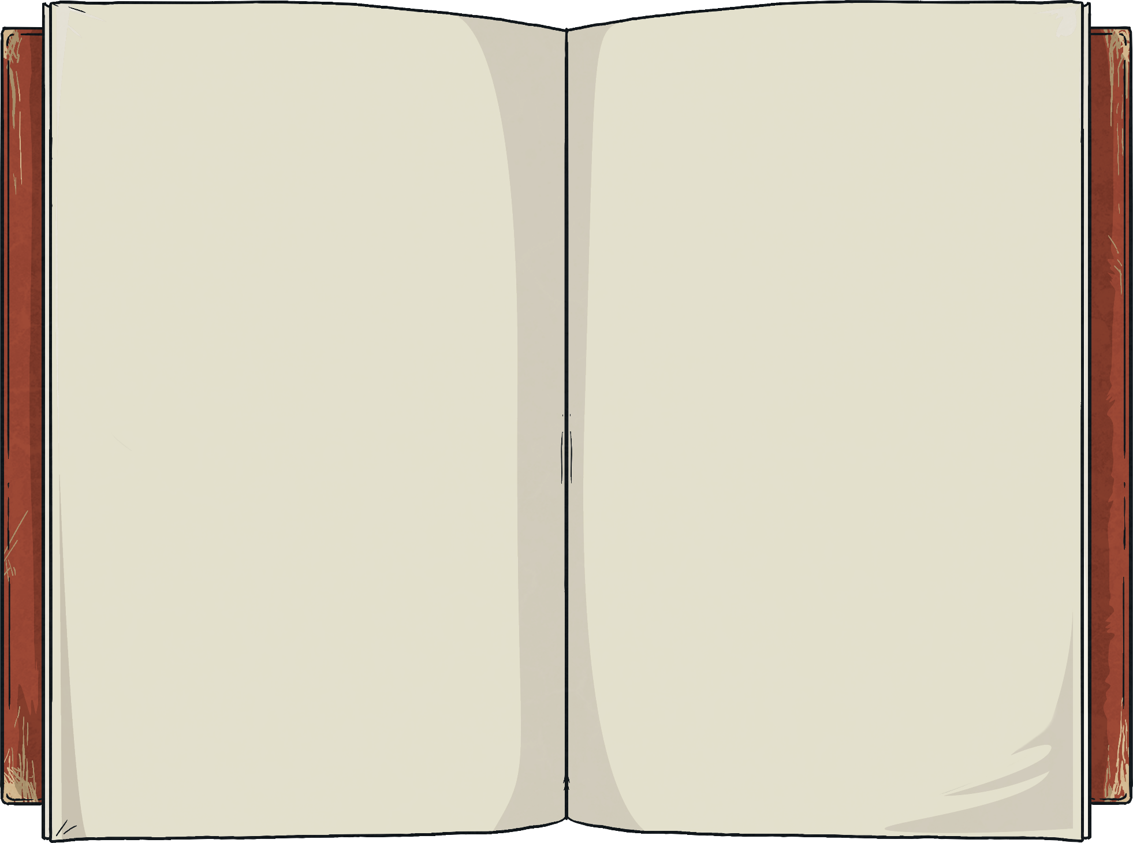
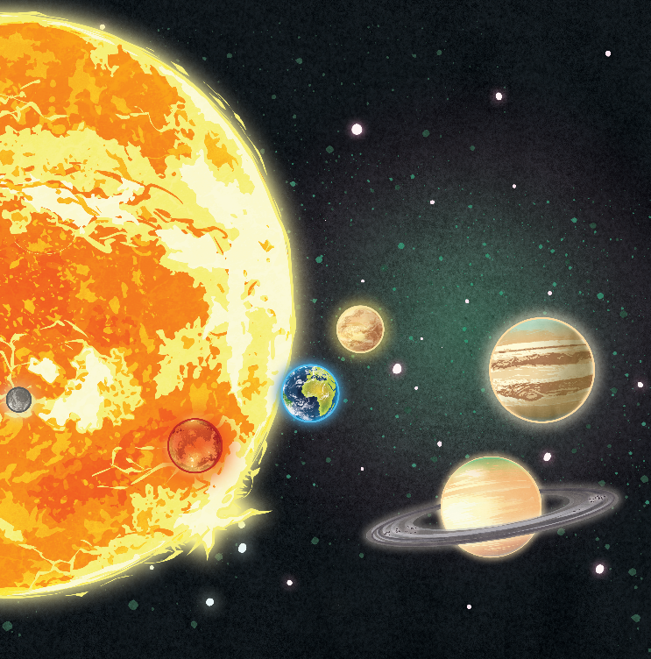
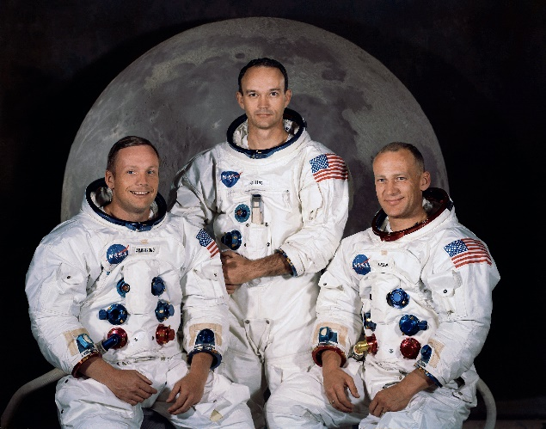
Photographs and Illustrations
Authors often choose to include photographs or illustrations to help the reader better understand the information.
A photograph may be an actual picture from an event or person in history, or it could be of an animal or place.
An illustration may be a diagram that explains a complex body system or scientific process.

Slide 6
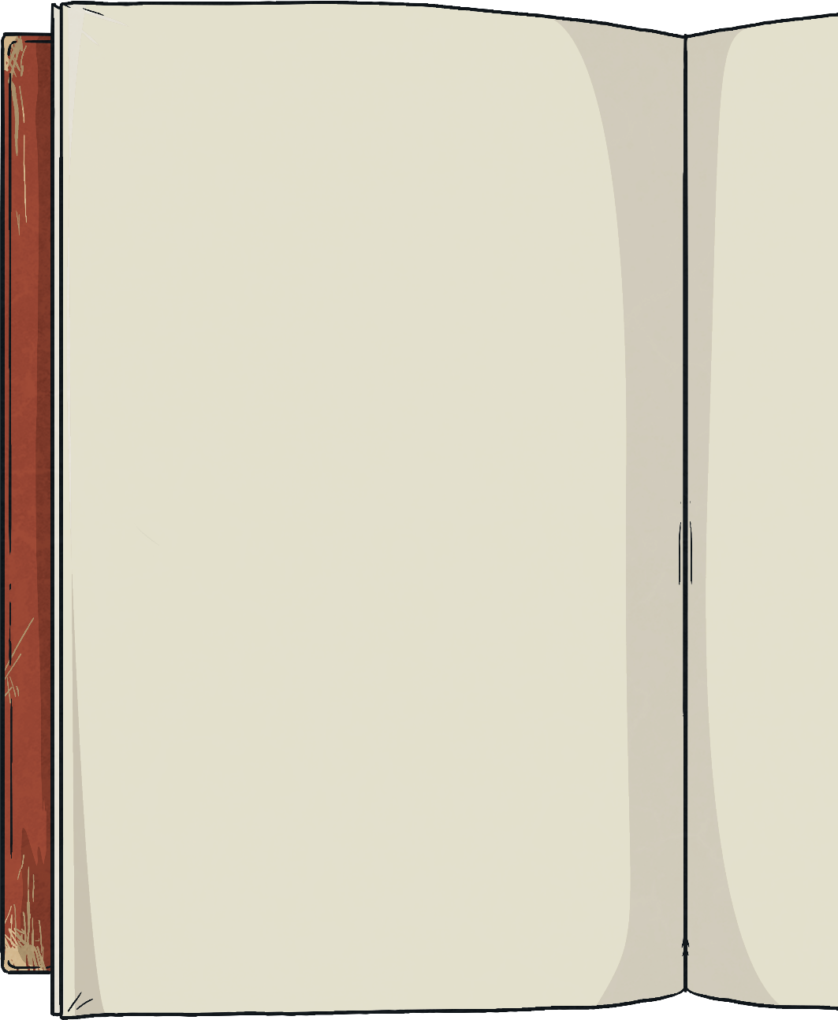
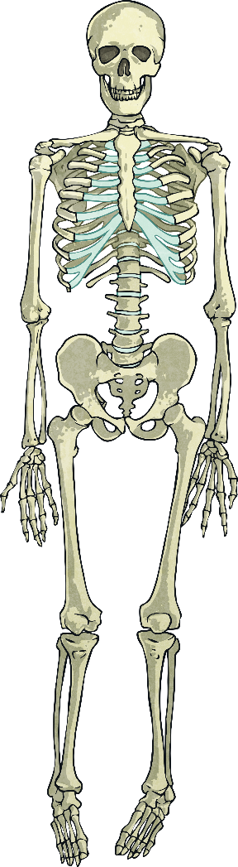
Captions and Labels
skull
A caption briefly explains what a photograph or illustration is. It is often a short phrase or sentence that is located directly next to or under the image.
ribs
pelvis
A label points to a specific part of a photograph, illustration, or diagram and tells you the name of that part.
femur
Skeletal system of a human

Slide 7
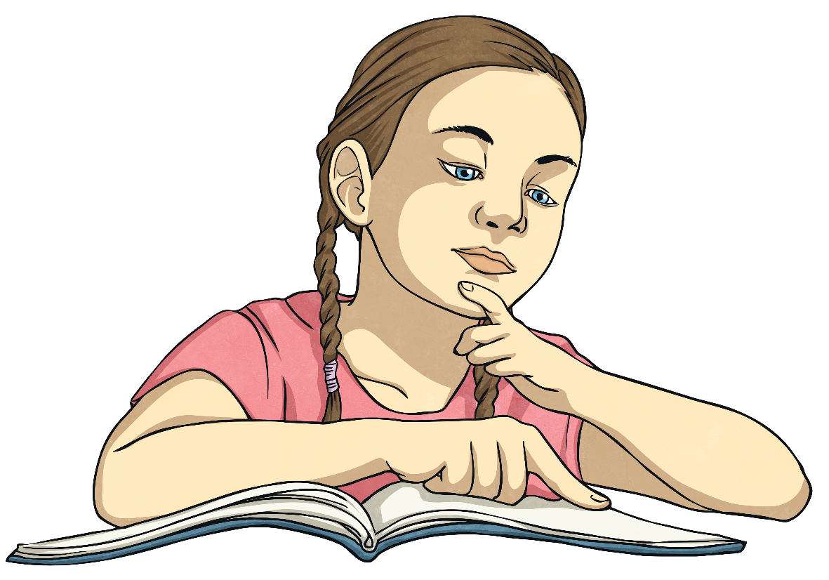
Bold Words
Throughout the text, an author may choose to make a word bold.
A bold word is often an important word to the subject of the text or a difficult word that the reader may not know.
If you see a bold word, there is a good chance you can find the definition in the glossary.

Slide 8

Glossary
A glossary is included at the end of a book.
Bold words throughout the text are listed in alphabetical order.
Next to each word is a definition of the word to help the reader better understand the information.
mechanical system noun contains related components which act together to create a motion

Slide 9

Index
Index
A the Arctic 68, 69, 71
B
business 48, 68, 69, 75
C
city life 41, 54, 72, 74, 98,
108, 116, 135
D
dog’s life 12,16, 21, 22, 34,
40, 53
An index is also found at the end of a book. It is like a roadmap to the book.
Important words from the text are listed in alphabetical order to help a reader quickly find a topic within the book.
Next to a word in the index is the page number where that word is discussed in more detail. Sometimes a word can be found on multiple pages of a book.

