Slide 2


What is “Author’s Purpose?”
An author’s purpose explains why the author wrote the text.
It is what the author was hoping the reader would get from reading his or her writing.

Slide 3

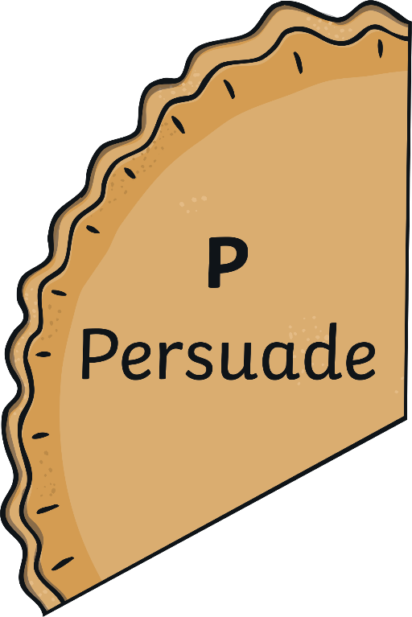


Author’s Purpose

Slide 4




Persuade
Sometimes authors write to try to persuade the reader to do something or believe what he or she is writing about.
Examples include:
commercials
billboards
presidential campaign speeches

Slide 5




Inform
Other times, an author may write to share information about a topic with the reader.
Examples include:
a thesaurus
non-fiction books
newspaper articles

Slide 6




Entertain
Some authors write to entertain the reader. This may be to tell an interesting story or to make the reader laugh.
Examples include:
fiction books
mysteries
joke books

Slide 7

What’s the Purpose?
I love learning about dinosaurs. I want to write an article that is full of facts about dinosaurs, so others can read and learn about them. What is my purpose?

Slide 8

What’s the Purpose?
I think everyone needs to recycle. So many people don’t recycle because they don’t know how much it helps the environment. I am going to write an article that will tell people all the reasons they should recycle. What is my purpose?

Slide 9


What’s the Purpose?
I have this idea of a silly book about a turtle that tries to grow a mustache. I think my little brother would really love to read and laugh at that story. What is my purpose?

