Slide 2
Aim
To understand the purpose of a persuasive text.
Success Criteria
State your opinion about a topic.
List two reasons to support your opinion.

Slide 3

What Is a Persuasive Text?
What is a persuasive text?
A persuasive text is a text which argues a point of view,
to convince the reader to agree with the author.
What’s in a persuasive text?
Opening statement: Introduce your point of view.
Arguments: State your point of view and reasons for each argument.
Conclusion: Summarise your arguments and repeat your point of view.

Slide 4

Organisation
How is a persuasive text organised?
A persuasive text is organised into paragraphs to make it easier to read.
What’s in a persuasive text?
Opening paragraph:
Include opening statement and a list of arguments.
Main body paragraphs:
Include one argument in each paragraph.
Support your argument with two reasons.
Concluding paragraph:
Summarise your arguments and restate your point of view.

Slide 5
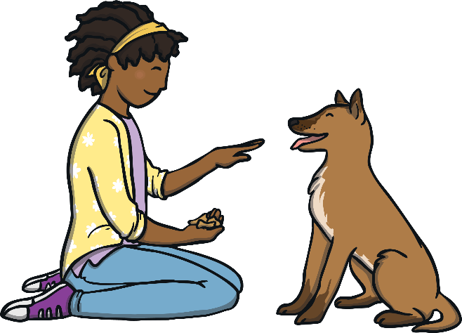
Features
Persuasive writing is written in the present tense.
Children spend too much time doing homework.
Dogs are the greatest pets for kids.
Fidget spinners are a popular toy.
Logical connectives are used in persuasive writing to make the arguments flow.
For example: because, however, this shows, therefore.
Time connectives are used to begin the main body paragraphs.
For example: firstly, secondly, finally.

Slide 6
Features
When writing persuasive text, always use facts.
It gives evidence and proof to your arguments.
Give a reasonable argument to get the reader
interested and on your side.
Interest the reader by using interesting, strong and emotive words.
Simple sentences help the reader to understand your arguments.
Persuasive writing is about informing the reader about a subject and convincing them to agree with you. Choose a topic you believe in.

Slide 7
Features
Using strong, clear, emotive language helps the reader to agree with you.
Below, are some helpful phrases that are used in persuasive writing.
Persuasive phrases:
It is outrageous that…
I strongly believe…
It’s disgraceful that…
It’s concerning that…
How could we possibly…

Slide 8

Features
Finally, reread your persuasive text.
Would you be persuaded?

Slide 9
Persuasive Text Example
Read this example of a persuasive text. Underline the title, the point of view, arguments, reasons and persuasive language.
Children Should Stop Watching Television!
I strongly believe that watching television is bad for children. It is not educational, it creates laziness and it increases bad behaviour.
Firstly, because television involves watching, not thinking, it is not educational. When children are not thinking, they are not using their imagination, which is tragic! A lack of thinking and imagination can also affect a child’s schoolwork.
Secondly, when watching television, students are sat for long periods of time. Sitting still for a long time can create bad habits like not wanting to play outside, which in turn can affect a child’s health, weight
and friendships.
Continues on next page

Slide 10
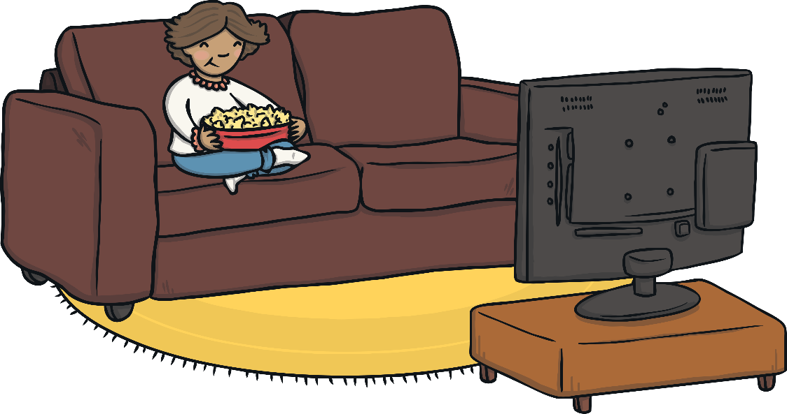
Finally, there are countless shows on television that are not appropriate for children to watch. Some of these show swearing, being mean, bad manners and fighting. If children watch shows that have these things in them, it’s possible they will think these behaviours are OK in real life. This means that children could become rude and violent.
In conclusion, it’s obvious that children watch too much television and should be stopped. This is because children’s education, physical fitness and behaviour are at risk. Make yourself smarter, fitter and better behaved TODAY by not watching television!

Slide 11

Topics for a Persuasive Text
Here are some examples of topics you could use for a persuasive text. Which ones are you passionate about?
Fidget spinners should be banned.
All children should receive pocket money.
All children should do homework every night.
Dogs are the best pets for children.
Every child should play a team sport.
The beach is more fun than a pool.
All children should read at least one book a week.
Weekends should be three days.

Slide 12

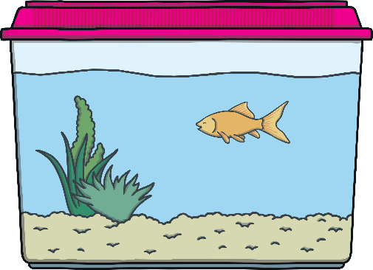
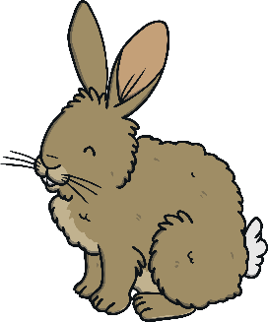


Plenary
‘All Children Should Have Pets.’
Using the above topic, state your opinion and two reasons.
Compare these with your partner’s opinion and reasons.

