Slide 1
Kube Camp
刘 智

Slide 2
app
用户空间
lib
system call
内核空间
Kernel
Hardware

Slide 3
Guest OS
Guest OS
Guest OS
sys call
kernel
kernel
kernel
转换
Hypervisor
Kernel
Hardware

Slide 4

What ???
rm -f /
init 0
Container
Container
Container
用户空间
Kernel
内核空间
Hardware

Slide 5




Docker
push
Docker
registry
tag
build
Images
pull
Dockerfile
commit
run
Containers
stop
start
restart
Docker Deamon HOST
local docker instance

Slide 6
容器网络架构
Closed
container
Bridged
container
Joined
container A
Joined
container B
Open
container
loopback
interface
private
interface
loopback
interface
private
interface
loopback
interface
container
virtual interface
joined container
virtual interface
Operating system
network stack
docker bridge virtual interface
Logical network interface
loopback
interface
Physical network interface

Slide 7
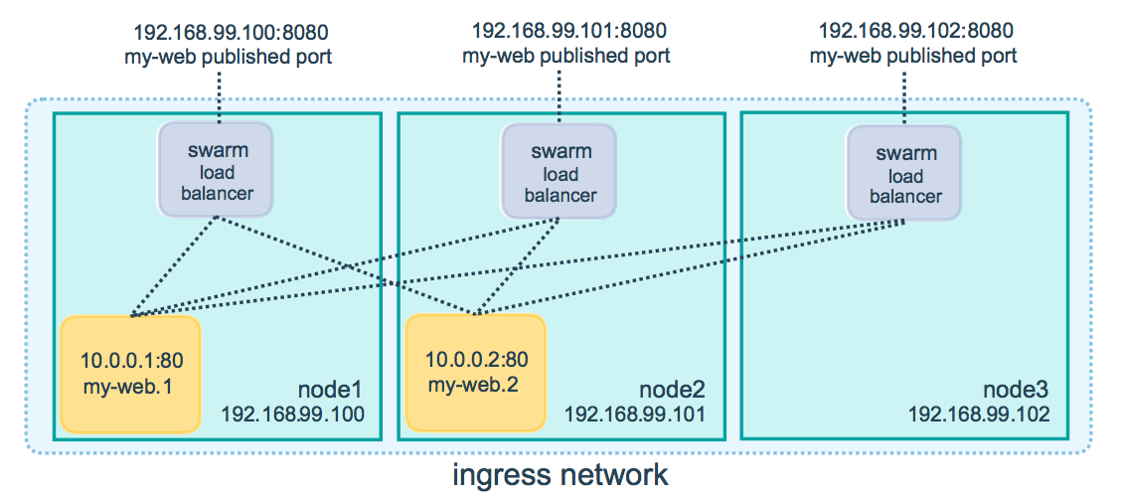

Slide 8
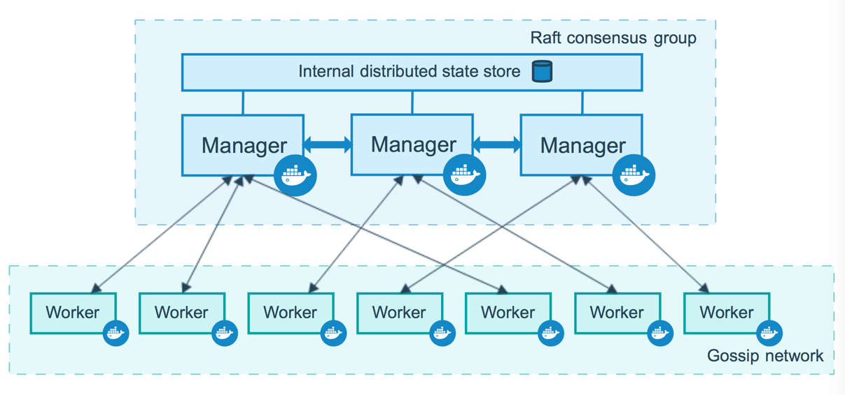

Slide 9


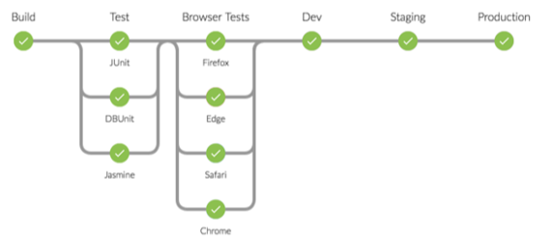











微服务Miro Service
Monitor
Registry
CI
agile需求
Trigger
Build Once
Run anywhere
Commit
CD
需求
Pro Release
Pre Release
canary
User
DDD
AB Test
PRO
PRE
Test
Flow Routing
价值流反馈
AlertManager
Metrics
Events
Policy Center
Center of Analysor
Alert Router
DEVOPS 价值流

Slide 10
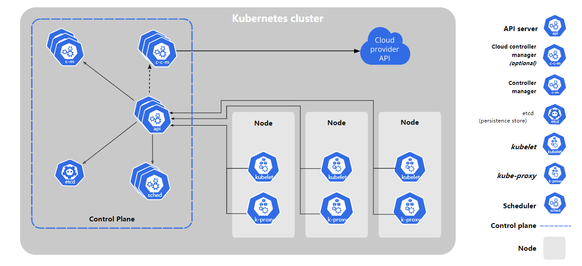

Slide 11
container
container
container1
container2
bridge
bridge
bridge
bridge
container
container
vetp
vetp
route tables
eth0
eth0
eth0
eth0
eth0
eth0
underlay
大二层
三层路由
underlay

Slide 12
container1
container2
container3
container4
calixxxxx
calixxxxx
calixxxxx
routers
calixxxxx
routers
eth0
eth0
三层路由

Slide 13
用户
Authentication
Proxy
ETCD
Rancher
API Server
Rancher CLI
Rancher API
kubectl
k8s API
Cluster
Controller
Cluster
Controller
Cluster
Agent1
Cluster
Agent2
RKE
API
GKE or Other Provider
Nodes
Nodesr
Nodes
Nodesr
Nodes
Nodesr

Slide 14
根网络名称空间
eth0
othernetns
mynetns
OS

Slide 15
eth0
根NetworkNS
Pod1
POD1 NNS
Pod2
POD2 NNS
c1
c2
c3
c4

Slide 16
eth0
cni0
veth...
veth...
Pod1
eth0
Pod2
eth0

Slide 17
Pod1
Pod2
eth0
eth0
veth...
veth...
cni0
eth0
eth0
cni0
veth...
veth...
Pod3
eth0
Pod4
eth0

Slide 18
kube02
eth0
src: kube02.eth0
dst: kube03.eth0
dport: 8258
pro: UDP
---------------
src: centos-1.ip
dst: centos-3.ip
kube03
eth0
flannel.1
flannel.1
cni0
cni0
centos-1
centos-2
centos-3

Slide 19
kube02
eth0
kube03
eth0
flannel.1
tunnel
flannel.1
以太封装
外部IP头
-------------------------
udp头
vxlan包头
-------------------------
src: centos-1.ip
dst: centos-3.ip
cni0
cni0
centos-1
centos-2
centos-3

Slide 20
kube02
eth0
eth0
kube03
cni0
cni0
centos-1
centos-2
centos-3

Slide 21
原始IP包
IPIP
VXLAN
宿主ethernet头
宿主机IP头
原始IP包
宿主ethernet头
宿主机IP头
UDP头
vxlan头
overlay ethernet头
原始IP包

Slide 22
PROD
PROD
PROD
认证授权
Team 1
STAGIN
STAGIN
STAGIN
DEV
DEV
DEV
安全策略
Team 2
访问控制
rke or other kubernetes distribution
Team 3
成本控制
Rancher
DevOps Team ...
Container Management
IT Admin

Slide 23
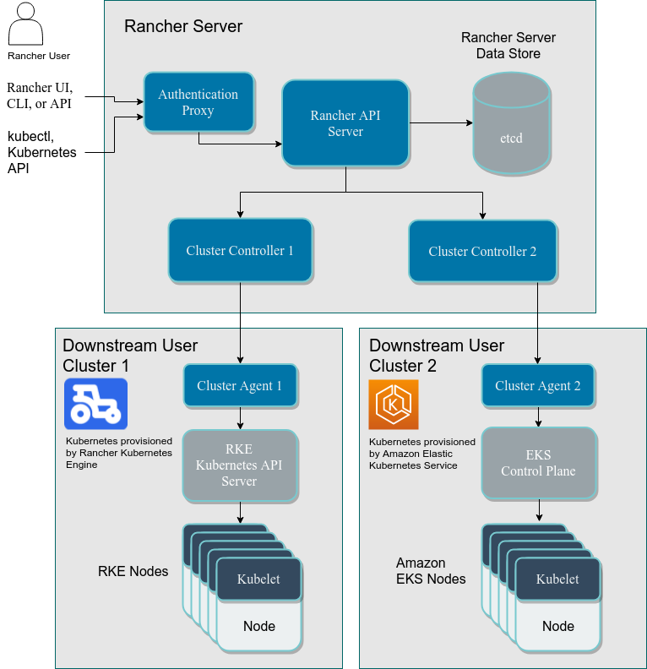

Slide 24
正常stop
Pending
Running
Succeeded
异常stop
Failed

Slide 25
POD
defaultGracePeriod: 30s
APIServer
kubectl delete pod POD

Slide 111
THANK YOU

