Slide 1
Kube Camp
刘 智

Slide 2
app
用户空间
lib
system call
内核空间
Kernel
Hardware

Slide 3
Guest OS
Guest OS
Guest OS
sys call
kernel
kernel
kernel
转换
Hypervisor
Kernel
Hardware

Slide 4

What ???
rm -f /
init 0
Container
Container
Container
用户空间
Kernel
内核空间
Hardware

Slide 5




Docker
push
Docker
registry
tag
build
Images
pull
Dockerfile
commit
run
Containers
stop
start
restart
Docker Deamon HOST
local docker instance

Slide 6
容器网络架构
Closed
container
Bridged
container
Joined
container A
Joined
container B
Open
container
loopback
interface
private
interface
loopback
interface
private
interface
loopback
interface
container
virtual interface
joined container
virtual interface
Operating system
network stack
docker bridge virtual interface
Logical network interface
loopback
interface
Physical network interface

Slide 7
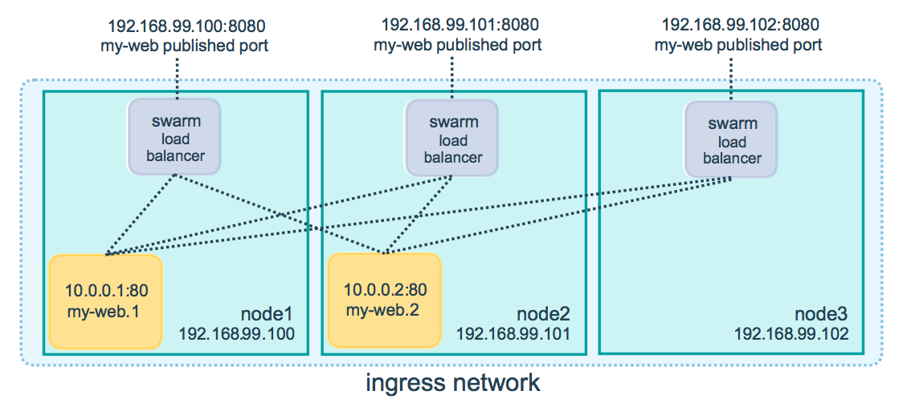

Slide 8
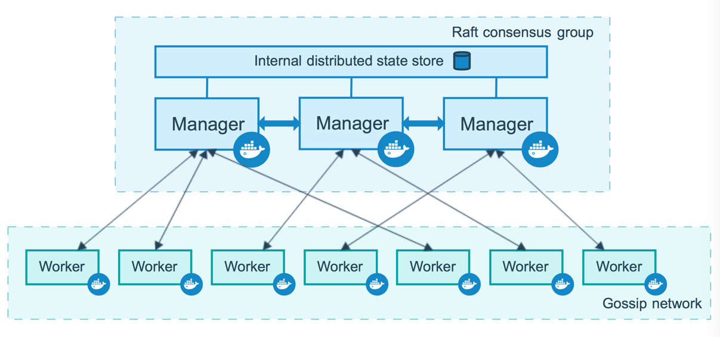

Slide 9


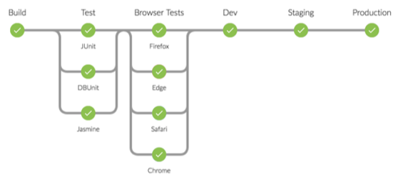











微服务Miro Service
Monitor
Registry
CI
agile需求
Trigger
Build Once
Run anywhere
Commit
CD
需求
Pro Release
Pre Release
canary
User
DDD
AB Test
PRO
PRE
Test
Flow Routing
价值流反馈
AlertManager
Metrics
Events
Policy Center
Center of Analysor
Alert Router
DEVOPS 价值流

Slide 10
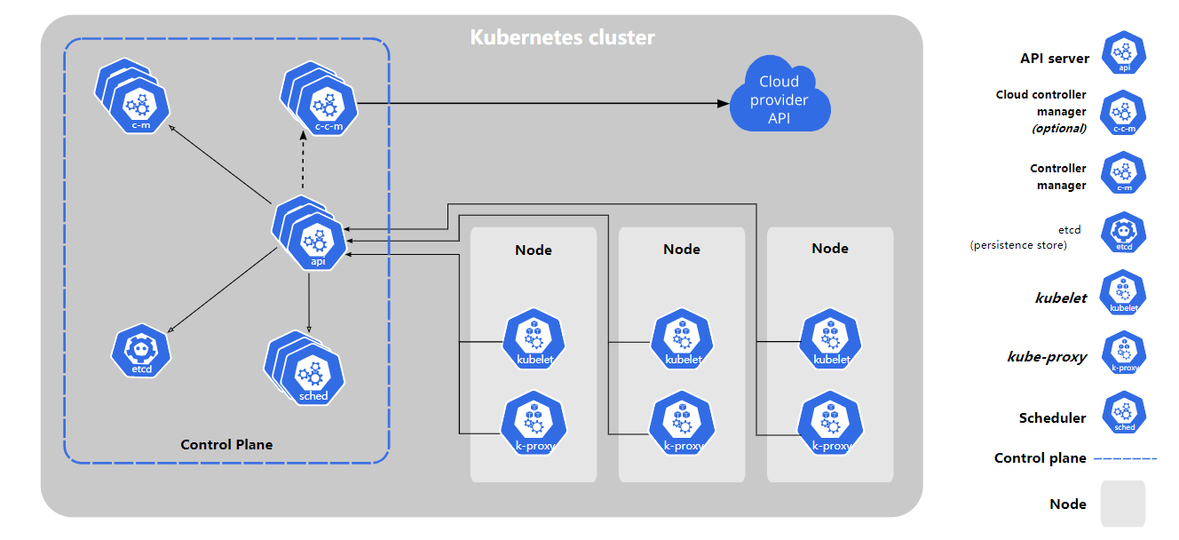

Slide 11
container
container
container1
container2
bridge
bridge
bridge
bridge
container
container
vetp
vetp
route tables
eth0
eth0
eth0
eth0
eth0
eth0
underlay
大二层
三层路由
underlay

Slide 12
container1
container2
container3
container4
calixxxxx
calixxxxx
calixxxxx
routers
calixxxxx
routers
eth0
eth0
三层路由

Slide 13
用户
Authentication
Proxy
ETCD
Rancher
API Server
Rancher CLI
Rancher API
kubectl
k8s API
Cluster
Controller
Cluster
Controller
Cluster
Agent1
Cluster
Agent2
RKE
API
GKE or Other Provider
Nodes
Nodesr
Nodes
Nodesr
Nodes
Nodesr

Slide 104
THANK YOU

