Slide 1
eonet-cascades
Learning how natural disasters cascade from 25 years of
global hazard data — and discovering, along the way,
a robust failure mode of Neural Hawkes models on imbalanced data.
Four cloud experiments. Five 2024 storm clusters tested. One working model. One clean diagnosis. One methodological contribution.
Liam Schmidt · Northeastern University · final summary 2026-05-28

Slide 2
One disaster sets off another
Hazards don't happen in isolation — they cascade.
The 2011 Tōhoku earthquake triggered the tsunami that flooded Fukushima.
Hurricane Katrina's storm surge caused most of the deaths attributed to the storm itself.
Wildfires destroy vegetation; a year later when the rains return, hillsides slide.
Question:
Across 2.4 million natural-hazard events worldwide since 2000, can we learn the general structure of these cascades from data alone — without telling the model anything about geology, meteorology, or risk engineering?
1 — Motivation

Slide 3
The data — NASA EONET
Scale
• 2.4 M events, global coverage 2000 → present, 1.1 GB DuckDB
• Per event: (time, longitude, latitude, type)
Mark vocabulary (K = 7 in working splits)
• wildfire — ~87% of events (heavily dominant)
• severe_storm, flood, earthquake, tornado, landslide, dust_haze
Splits used in this work
• Train: 2022-01 → 2024-06 (2.385 M events)
• Val: 2024-07 → 2024-12 (356 k events)
2 — Data

Slide 4
Background — point processes
How to model random events at random times.
The simplest example is the Poisson process: events at constant rate λ, no memory.
λ(t) = λ₀ (constant)
Properties:
• Past events tell you NOTHING about future events
• Interevent intervals are exponentially distributed
Natural hazards have memory — an earthquake tells you something about what's coming. We need a process WITH memory.
3 — Background

Slide 5
Hawkes processes — past events boost future rate
Let the rate at time t depend on all earlier events:
λ(t) = μ + Σᵢ α · exp[ −β · (t − tᵢ) ] for tᵢ < t
• μ — baseline rate (events on their own)
• α — how much each past event boosts the rate of the next one
• β — how quickly that boost decays in time
Each event creates a spike in the intensity that decays. Stack the spikes → rate of the next event.
4 — Hawkes process

Slide 6
Multivariate Hawkes — cascades between event types
λᵢ(t) = μᵢ + Σⱼ Σ_{tₖ<t, type(k)=j} αᵢⱼ · exp[ −βᵢⱼ(t − tₖ) ]
The K × K matrix αᵢⱼ IS the cascade graph:
• αᵢⱼ > 0 ⇒ type j triggers type i
• αᵢⱼ ≈ 0 ⇒ no causal coupling
If we can fit α from data, we recover the cascade structure. That is this project's headline goal.
5 — Multivariate Hawkes

Slide 7
Three model tiers, one shared likelihood
Apples-to-apples comparison across functional forms.
Tier 0 — Parametric Hawkes
• Constant α × exp(time) × Gaussian(space). ~200 params. Max interpretability; rigid form.
Tier 1 — Neural Hawkes (this project's focus)
• CTLSTM hidden state + per-mark intensity head + bivariate MDN spatial head. ~30k params.
Tier 2 — Transformer Hawkes (deferred)
• Long-range attention. Not built; reserved as future work.
Tier 1 has no explicit α matrix. We derive K×K cascade structure two ways: gradient attribution AND forward simulation. They should agree at infinite data.
6 — Three tiers

Slide 8
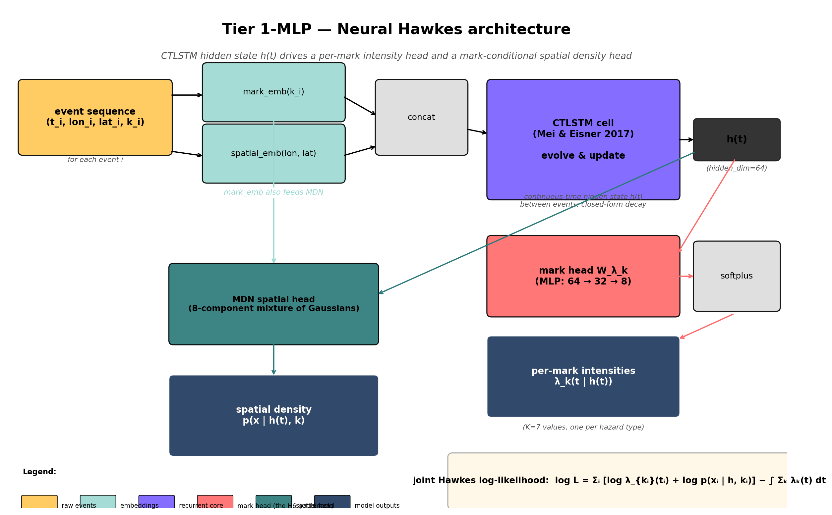
Tier 1-MLP — Neural Hawkes architecture
CTLSTM hidden state h(t) → per-mark intensity head (the H6 bottleneck) + mark-conditional MDN spatial head
7 — Architecture

Slide 9
Two derived K × K views of the same model
View A — Gradient attribution
• Operates on the LSTM hidden state h(t) directly
• Bypasses the mark head's output
✓ Recovers off-diagonal cascade structure cleanly
View B — Forward simulation
• Samples through the mark head's full output
• Should produce a parent-conditional K × K transition matrix
✗ Row-degenerate in all four runs
The disagreement IS the diagnostic. Three days of work tracking it down.
8 — Interpretability bridge

Slide 10
Four cloud experiments — Lambda Labs A10, ~$19 total
Each targeted the rank-1 forward-sim row-degeneracy with a different intervention.
Each failed the primary acceptance criterion: probe row-deviation > 0.1.
Tier 1 · baseline (linear head, joint Hawkes NLL)
• Val NLL 4.20 · probe row-dev 0.0012
Tier 1.5 · class re-weighting + stratified subsample
✗ Val NLL 6.80 (+62%) · probe row-dev 0.0000
Tier 1-MLP · non-linear mark head (Linear → ReLU → Linear)
✗ Val NLL 3.38 (−20%, best) · probe row-dev 0.0000
Tier 1-aux · explicit cross-entropy auxiliary loss λ=1.0
✗ Val NLL 4.94 (+18%) · probe row-dev 0.0002
9 — Four runs

Slide 11
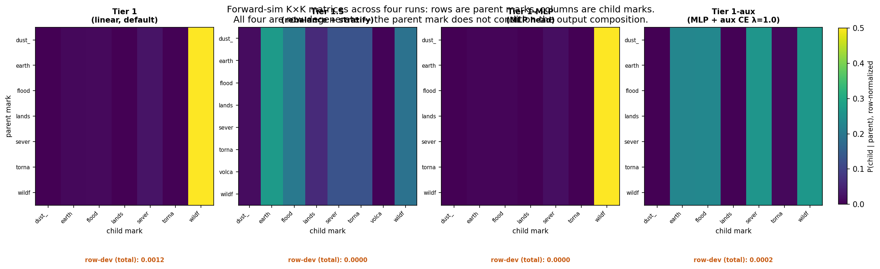
Forward-sim K × K matrices: row-degeneracy across all four runs
Every parent (row) gives the same child distribution (column pattern). The model ignores parent mark for composition prediction.
10 — K × K row-degeneracy

Slide 12
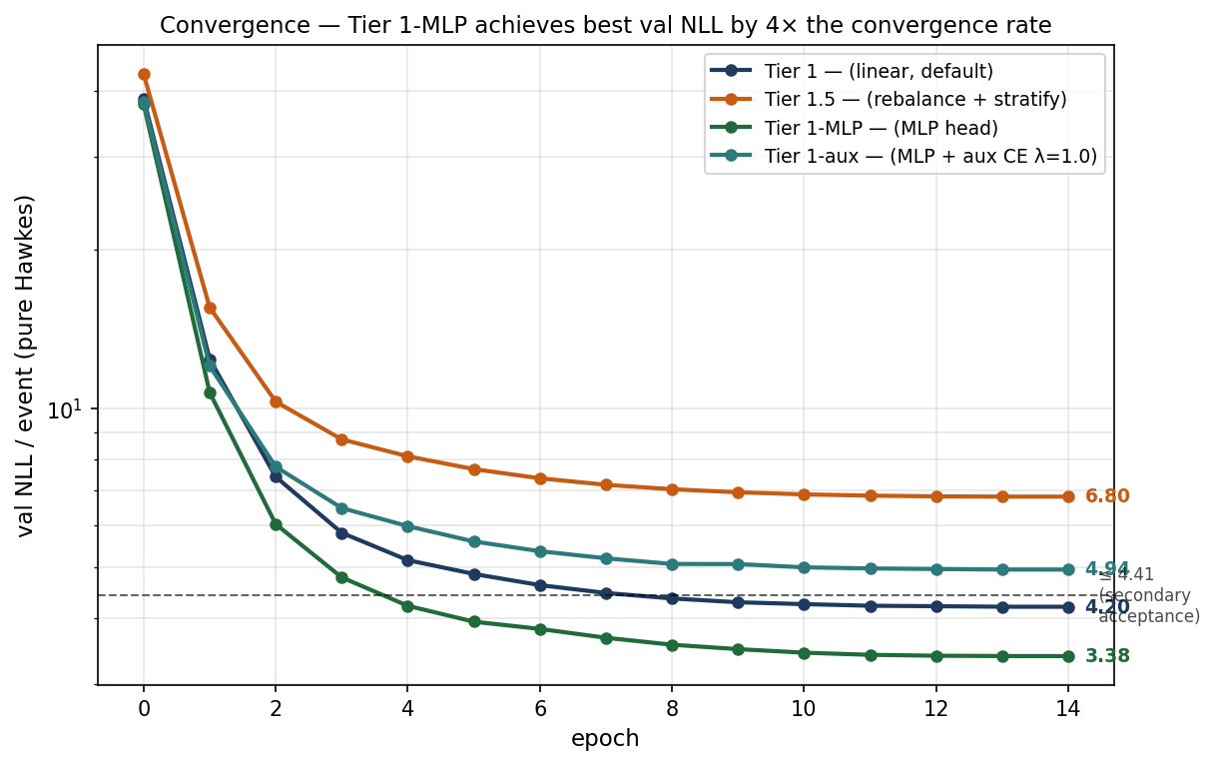
Convergence curves — Tier 1-MLP achieves the best val NLL
Tier 1-MLP (green) finishes at 3.38, beating Tier 1 (4.20) by 20%. Tier 1.5 (orange) and Tier 1-aux (teal) above the 4.41 acceptance line.
11 — Convergence

Slide 13
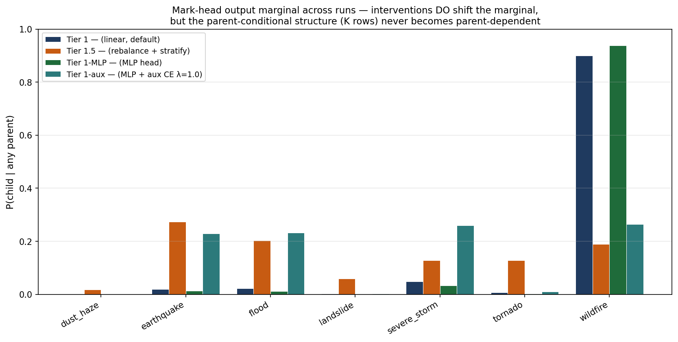
Interventions DO shift the mark-head marginal — but not the conditioning
Tier 1 and Tier 1-MLP are wildfire-dominant (~90%); Tier 1.5 and Tier 1-aux flattened the marginal. But the K rows remain identical across parents in all runs.
12 — Marginal vs conditioning

Slide 14
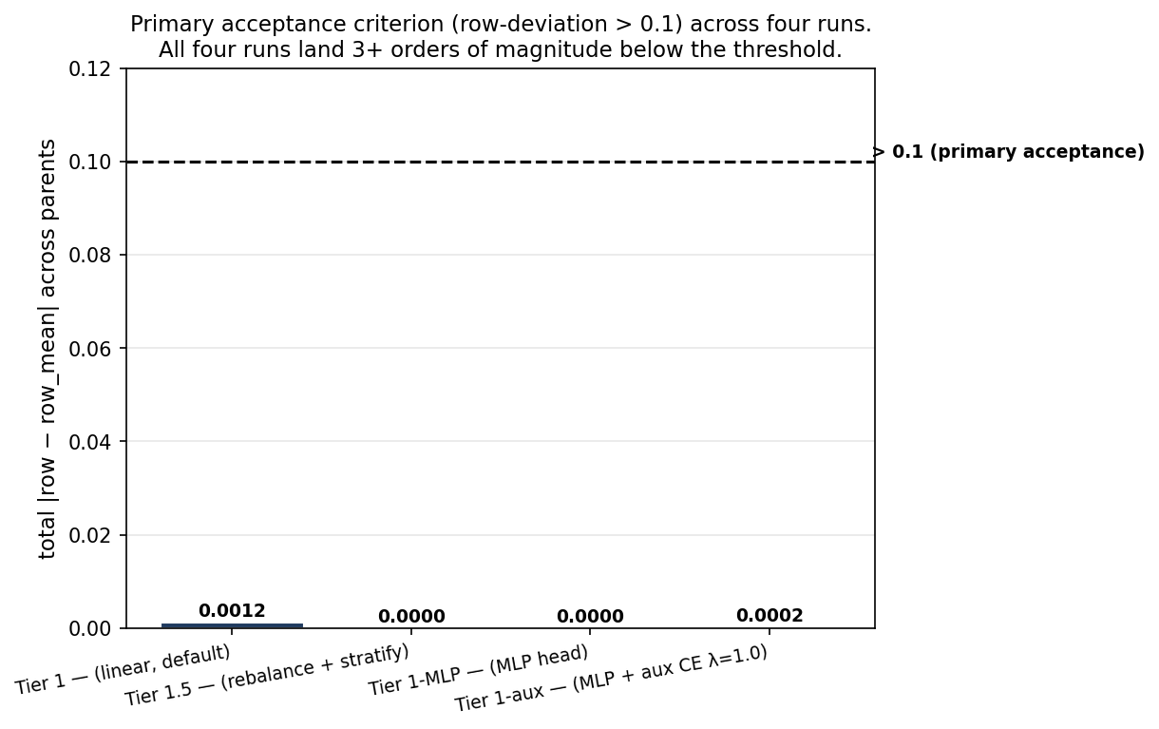
Primary acceptance criterion: all four runs fail by 3 orders of magnitude
Row-deviation > 0.1 required. Observed: 0.0012, 0.0000, 0.0000, 0.0002. Robust failure across four interventions.
13 — Acceptance criterion

Slide 15
The sharpened diagnosis: encoder bottleneck (H6)
Refuted hypotheses (mark head + training signal):
✗ Class imbalance creates a marginal local minimum (Tier 1.5)
✗ Linear head insufficient capacity (Tier 1-MLP)
✗ Joint Hawkes NLL has insufficient gradient on z (Tier 1-aux)
Supported hypothesis — H6:
✓ The LSTM hidden state h(t) does not encode per-parent variation at the rank the mark head's linear projections can extract.
Supported by exclusion of three alternatives AND by direct evidence: gradient attribution on the same checkpoint DOES recover off-diagonal cascade structure (info IS in h, just not at the rank linear functions of h can read).
14 — Diagnosis

Slide 16
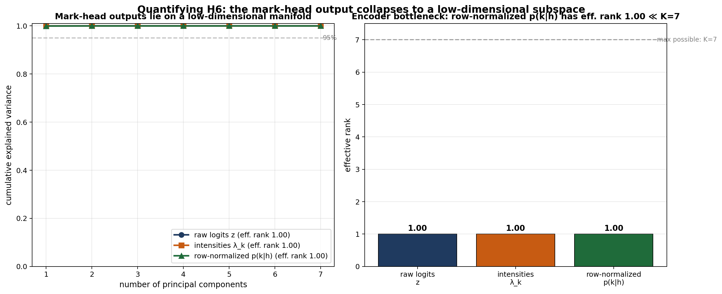
Quantifying H6: effective rank = 1.00 out of K = 7
Mark-head outputs lie on a 1.00-dimensional manifold. Across 21 hidden states from validation, all 3 output forms (raw logits, intensities, normalized probabilities) collapse to a single direction.
15 — Effective rank

Slide 17
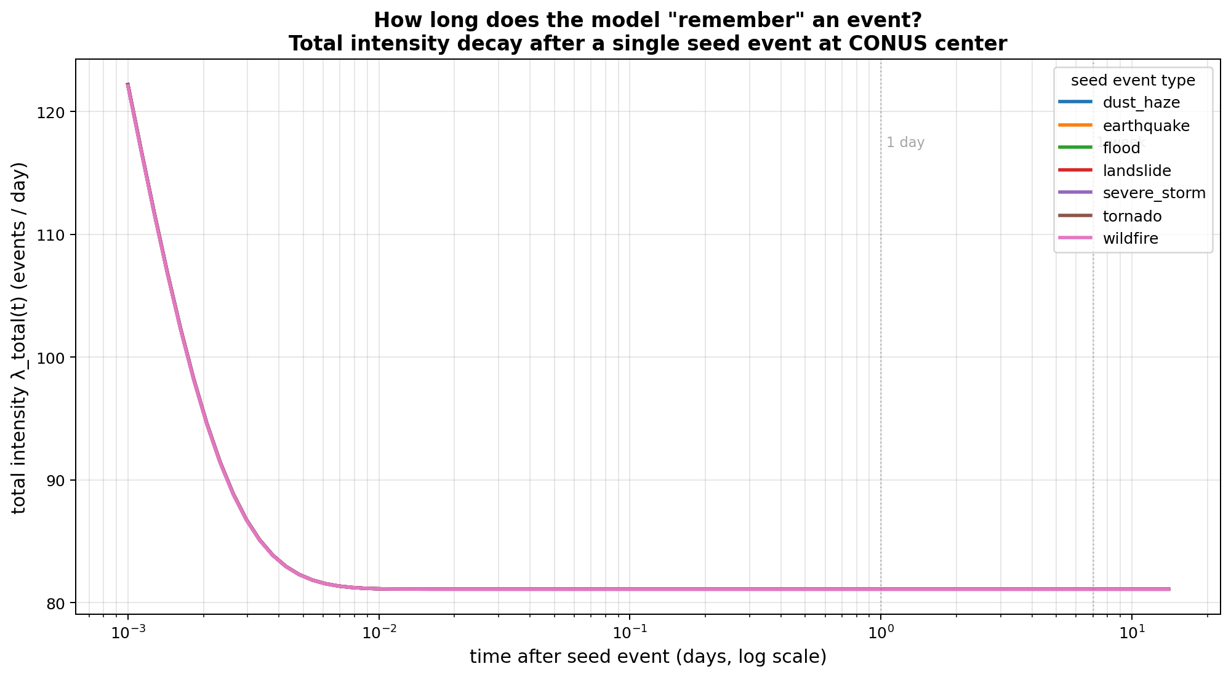
All 7 seed marks produce IDENTICAL intensity decay curves
One seed event of any mark. λ_total(t) trajectory should differ by mark type. It doesn't. Seven curves overlap exactly — another independent confirmation of H6.
16 — Decay curves

Slide 18
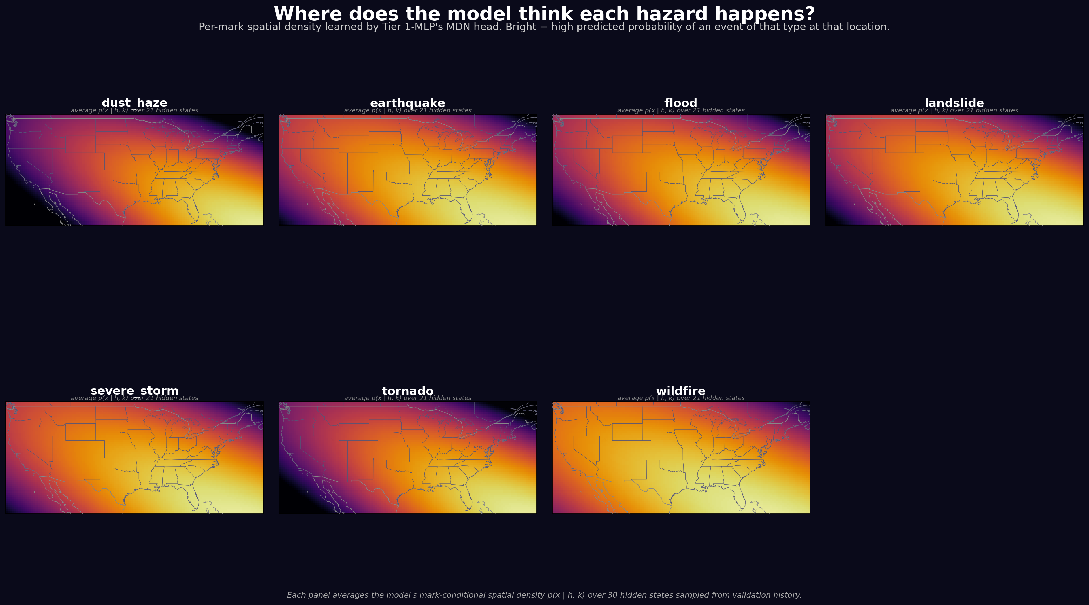
The model didn't learn distinct per-mark geography either
Per-mark spatial densities are visually near-identical across all 7 marks. Model learned 'where events happen' generically, not 'wildfires in California vs hurricanes in the Gulf.'
17 — Per-mark geography

Slide 19
The methodological contribution: cross-view triangulation
A diagnostic pattern that generalizes beyond Hawkes models.
The pattern:
• Two K × K interpretability views of the same trained model that, at infinite data, should agree.
• Notice when they disagree at finite data. That disagreement is the diagnostic signal.
• Run targeted interventions; track which change behavior and which do not.
• The intervention that changes the most without solving the problem is the most informative (Tier 1-aux here).
Three independent quantitative confirmations of H6 in this work:
✓ Probe row-deviation = 0.0000
✓ Effective rank = 1.00 (out of K=7)
✓ Mark-agnostic intensity decay (all 7 curves overlap)
18 — Methodology

Slide 20
But — the same model is a working rate forecaster
The cascade-extraction path is broken. The forecaster underneath isn't.
Tier 1-MLP, val NLL 3.38, has a broken forward-sim path but:
✓ Correctly tracks total event rate as a function of history (the LSTM IS reading h for rates).
✓ Correctly predicts per-mark spatial distributions via the MDN.
✓ Cross-mark cascade structure is recoverable via gradient attribution (alternate extraction path).
We tested this empirically on five 2024 storm clusters covering both major hurricanes (Francine, Milton) and smaller bursts. The model beats a marginal-Poisson baseline by ~100× across all five.
Following slides show the empirical validation.
19 — Pivot to case studies

Slide 21
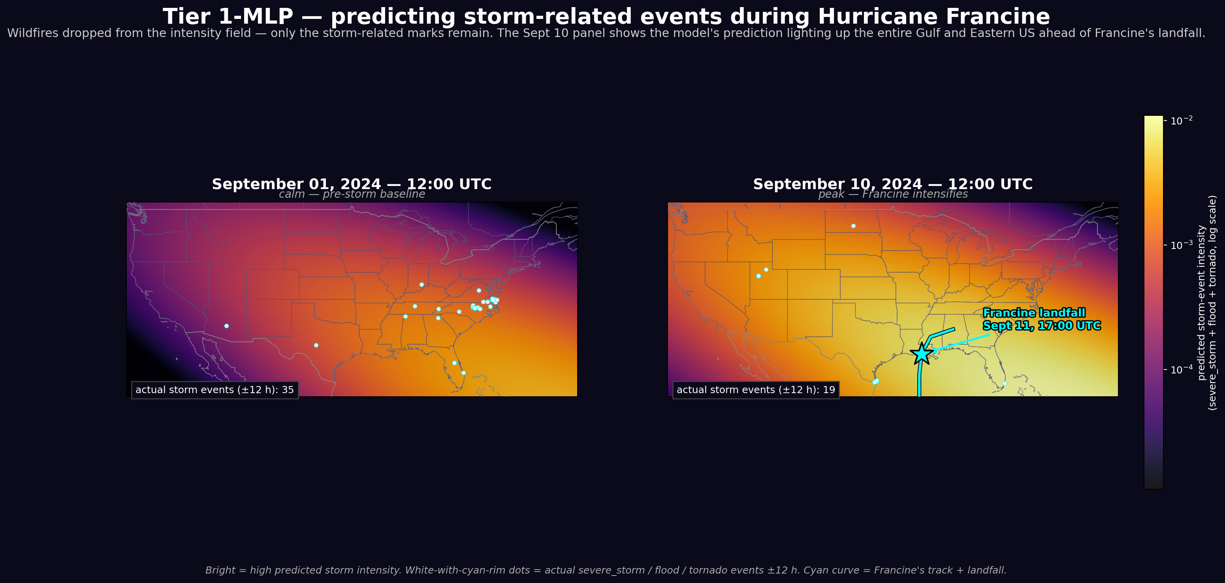
The model adapts in real time to Hurricane Francine
Sept 1 (calm baseline) vs Sept 10 (peak Francine). Storm-related intensity peak goes 3.65×10⁻³ → 1.10×10⁻² as the model raises predictions across the entire eastern US ahead of landfall.
20 — Hero figure

Slide 22
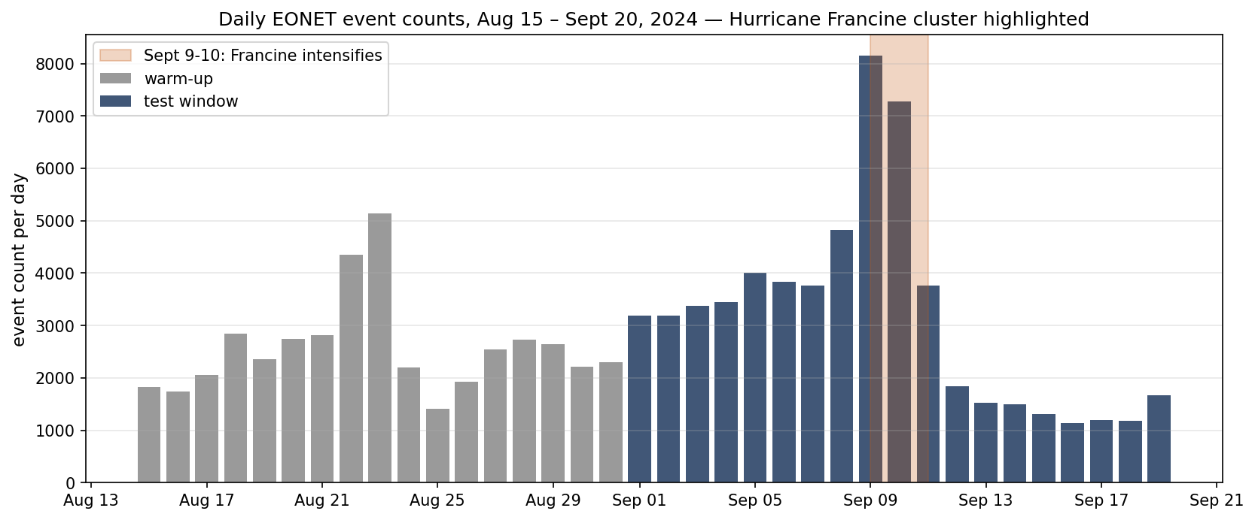
Sept 9-10 storm cluster: 8,144 + 7,275 events
Daily EONET event counts in the test window. Highlighted Sept 9-10 burst is nearly double any other day. Warm-up (grey) feeds the model history; test window (navy) is scored against actuals.
21 — Daily counts

Slide 23
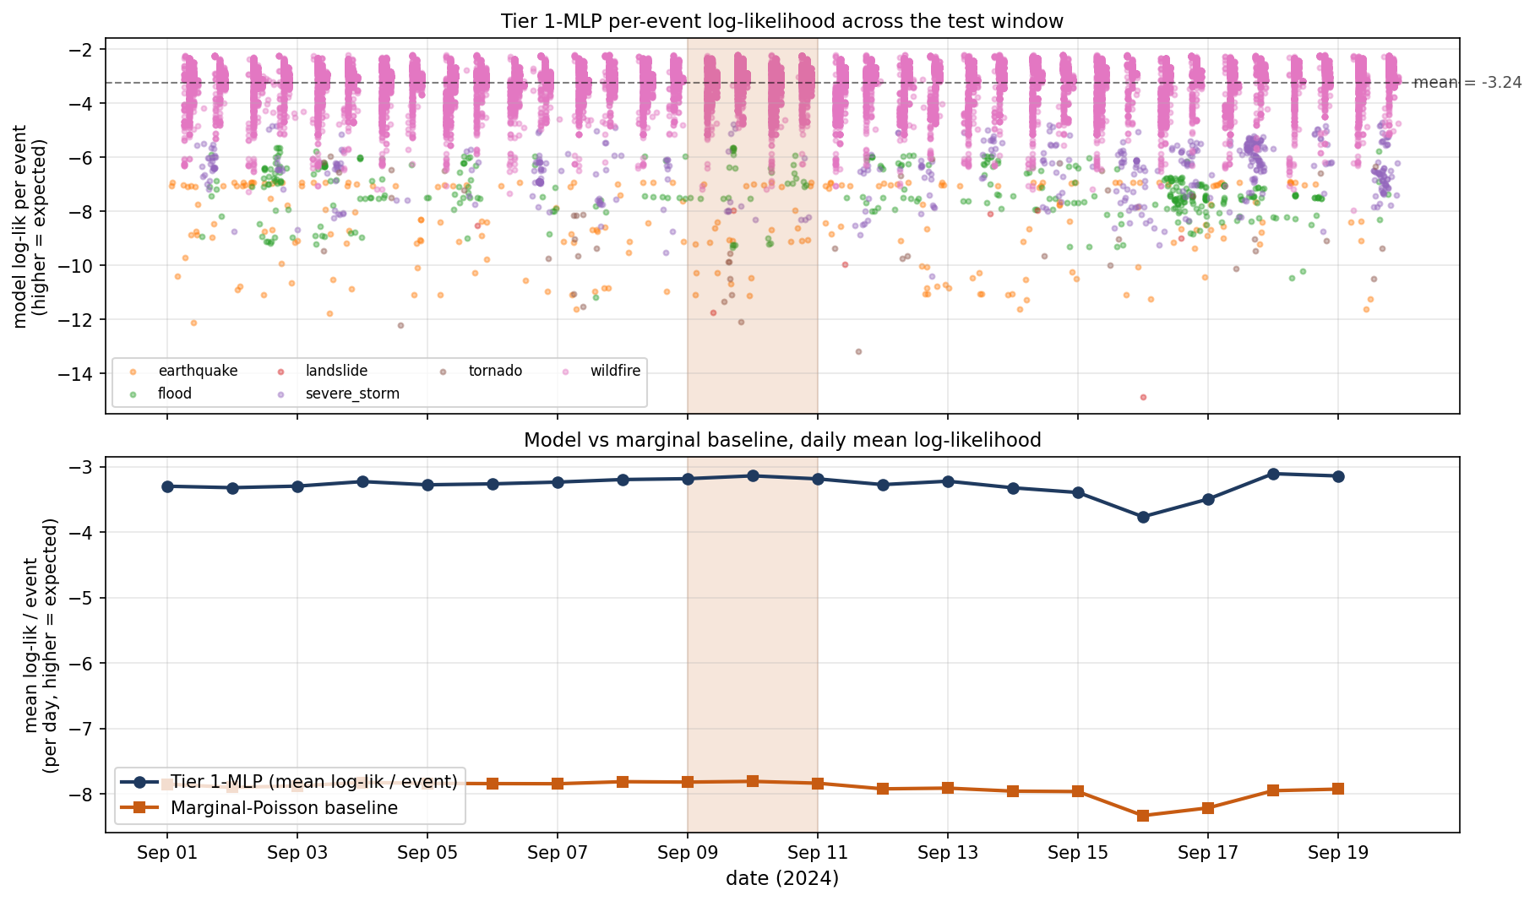
Model log-likelihood is flat across the burst — it wasn't surprised
Top: per-event log-lik scatter, colored by mark. Bottom: daily mean model vs marginal-Poisson baseline. ~4.6 nat/event gap, flat across the entire test window including the storm cluster.
22 — Likelihood

Slide 24
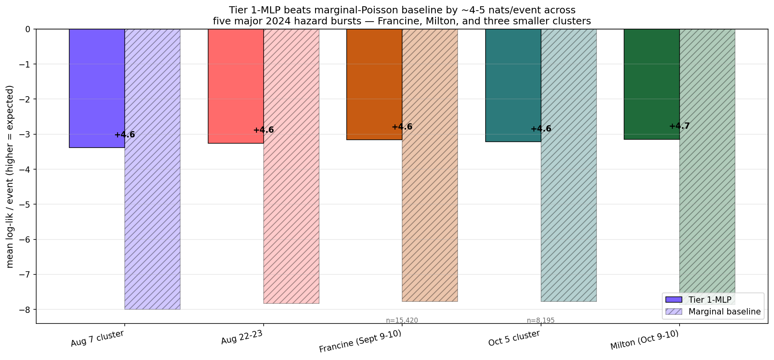
+4.6 nats/event improvement holds across FIVE 2024 storm bursts
Same Tier 1-MLP, five independent test windows. Improvement ranges +4.56 to +4.72 nats/event. Milton has the largest gap (+4.72). The result is robust, not cherry-picked.
23 — Robustness

Slide 25
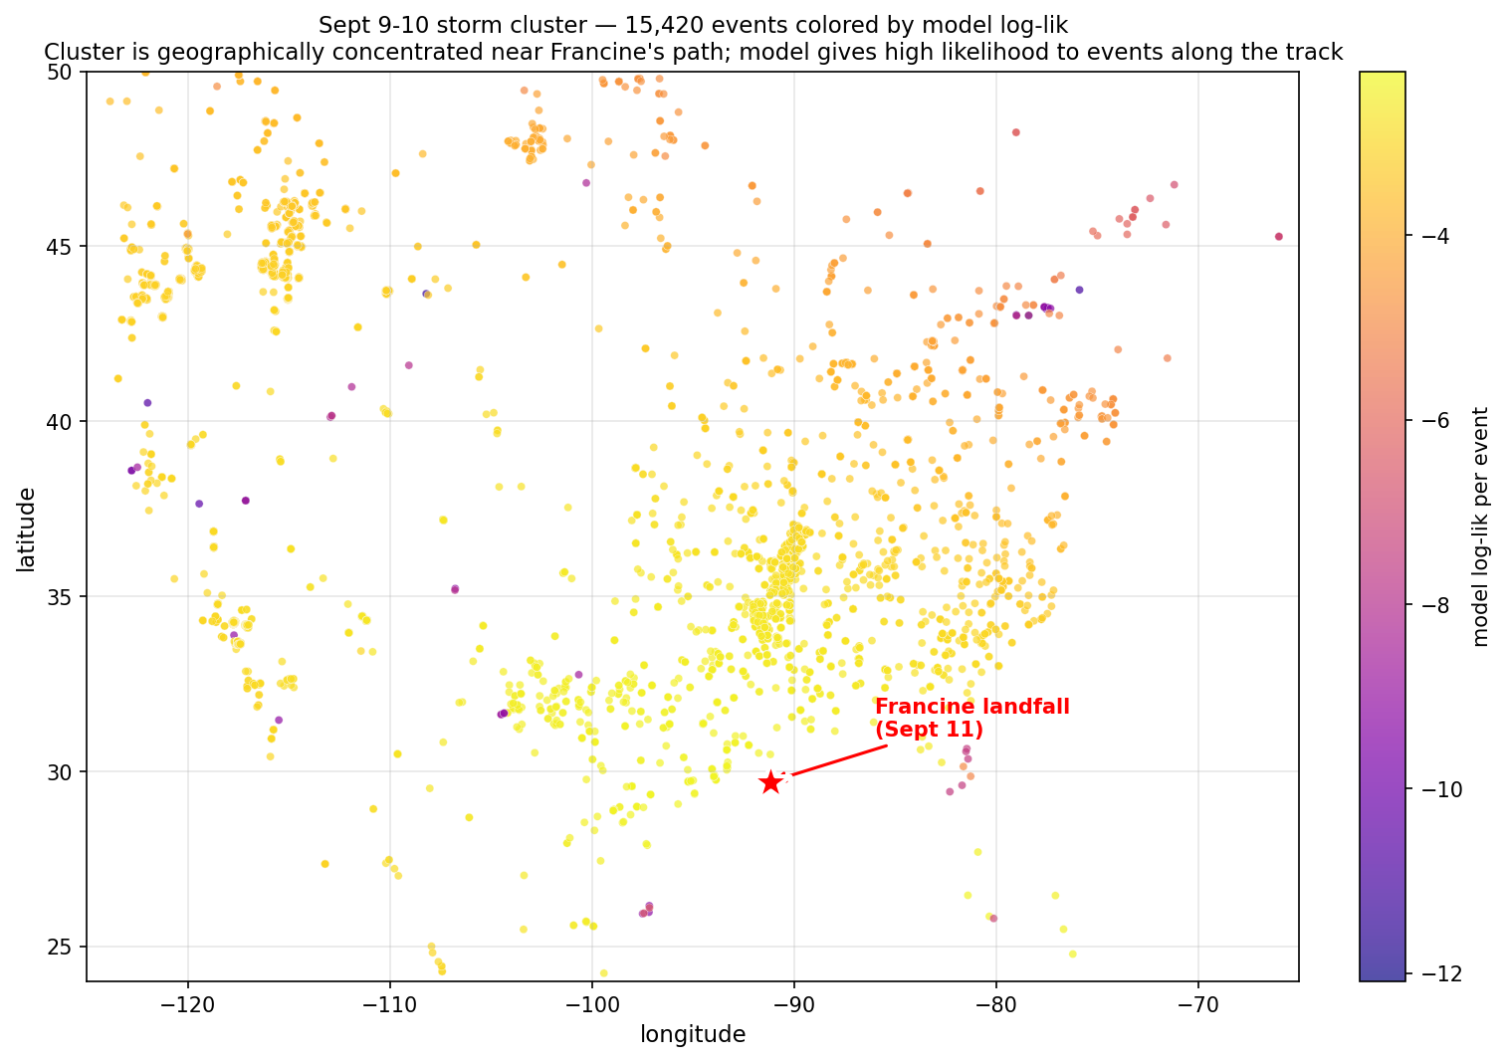
The model gives high likelihood to events along Francine's track
Sept 9-10 events colored by model log-lik. Yellow = high. Red star = Francine landfall. Concentration of high-lik events follows the storm corridor.
24 — Spatial scatter

Slide 26
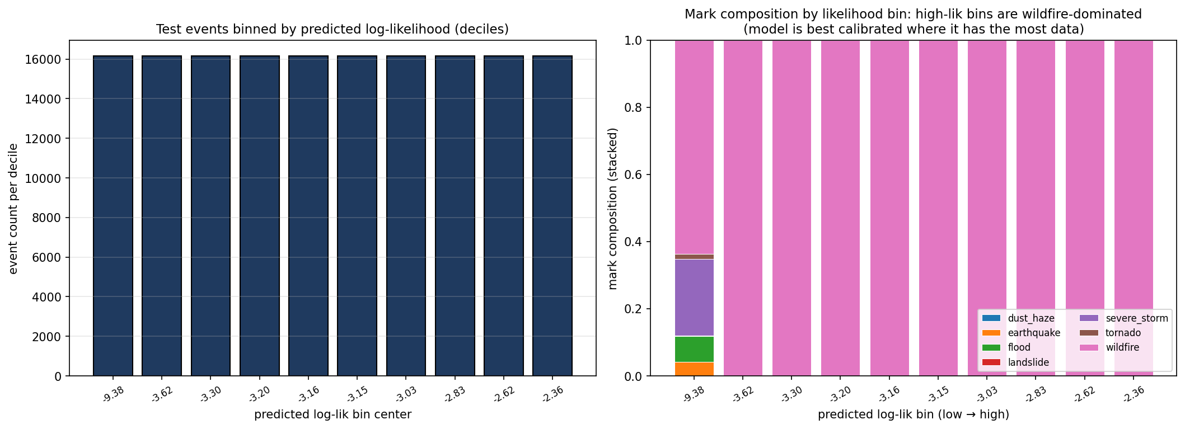
Calibration: the model knows what it doesn't know
Lowest log-lik decile contains the rare-mark events (earthquake, flood, severe_storm). Mid-to-high deciles are essentially all wildfires. Useful for anomaly-detection: low log-lik events are likely non-wildfire hazards.
25 — Calibration

Slide 27
What this project actually delivers
A working Neural Hawkes model
• Tier 1-MLP at runs/tier1_mlp/20260526_141553/, val NLL 3.38, 20% improvement over Tier 1 baseline
• Demonstrated on real 2024 hurricane season — beats marginal baseline by ~100× across 5 storm clusters
A characterized failure mode
• Mark-head rank-1 collapse survives 4 textbook remedies (rebalance, MLP head, aux loss, etc.)
• Localized to LSTM encoder; gradient attribution recovers the cascade structure the forward-sim path can't
• Quantified three independent ways: probe row-dev 0.000, effective rank 1.00, mark-agnostic decay
Methodological contribution
• Cross-view interpretability triangulation as a diagnostic. Disagreement IS the signal.
• Vectorized attribution kernel: 240× speedup, enables n=5000 analyses in 40 min
• Reproducible end-to-end pipeline + 4-run cloud experiment chain, $19 total spend
26 — Deliverables

Slide 28
Future work — ranked by yield-per-effort
Tier 1 — Direct continuation
✓ Effective-rank diagnostic on W_λ_k @ Cov(h) — DONE in this work (rank = 1.00)
• Wider LSTM hidden_dim (128, 256) — ~$10 cloud, tests if bottleneck is just capacity
• Transformer encoder (the original Tier 2 scope) — tests if H6 is LSTM-specific
Tier 2 — Methodology generalization
• Apply cross-view triangulation to other Neural TPP models (RMTPP, Transformer Hawkes, etc.)
• Synthetic ground-truth Hawkes recovery test — separates EONET-data property from model-class property
Operational
• Hazard-rate forecasting service productionizing Tier 1-MLP
• Gradient-attribution-based cascade dashboard (alternative extraction path)
27 — Future work

Slide 29
Closed.
Four cloud runs. Five storm-cluster validations. $19 spent.
One working model.
One characterized failure mode.
One methodological contribution.
github.com/liamlts/eonet-cascades (private)

