Slide 1
Criticism / Critique
479 · Week 6

Slide 2
Today
1. Review & Assessment
2. Critique - “What is Immanent Critique?” + 4 articles
3. Peer Review / Discussion
7

Slide 3
Course Recap
Week 1: Synthesis
Week 2: Experience
Week 3: Recognition / Consciousness
Week 4: Attention
Week 5: Alignment
Week 6: Criticism / Critique
2

Slide 4
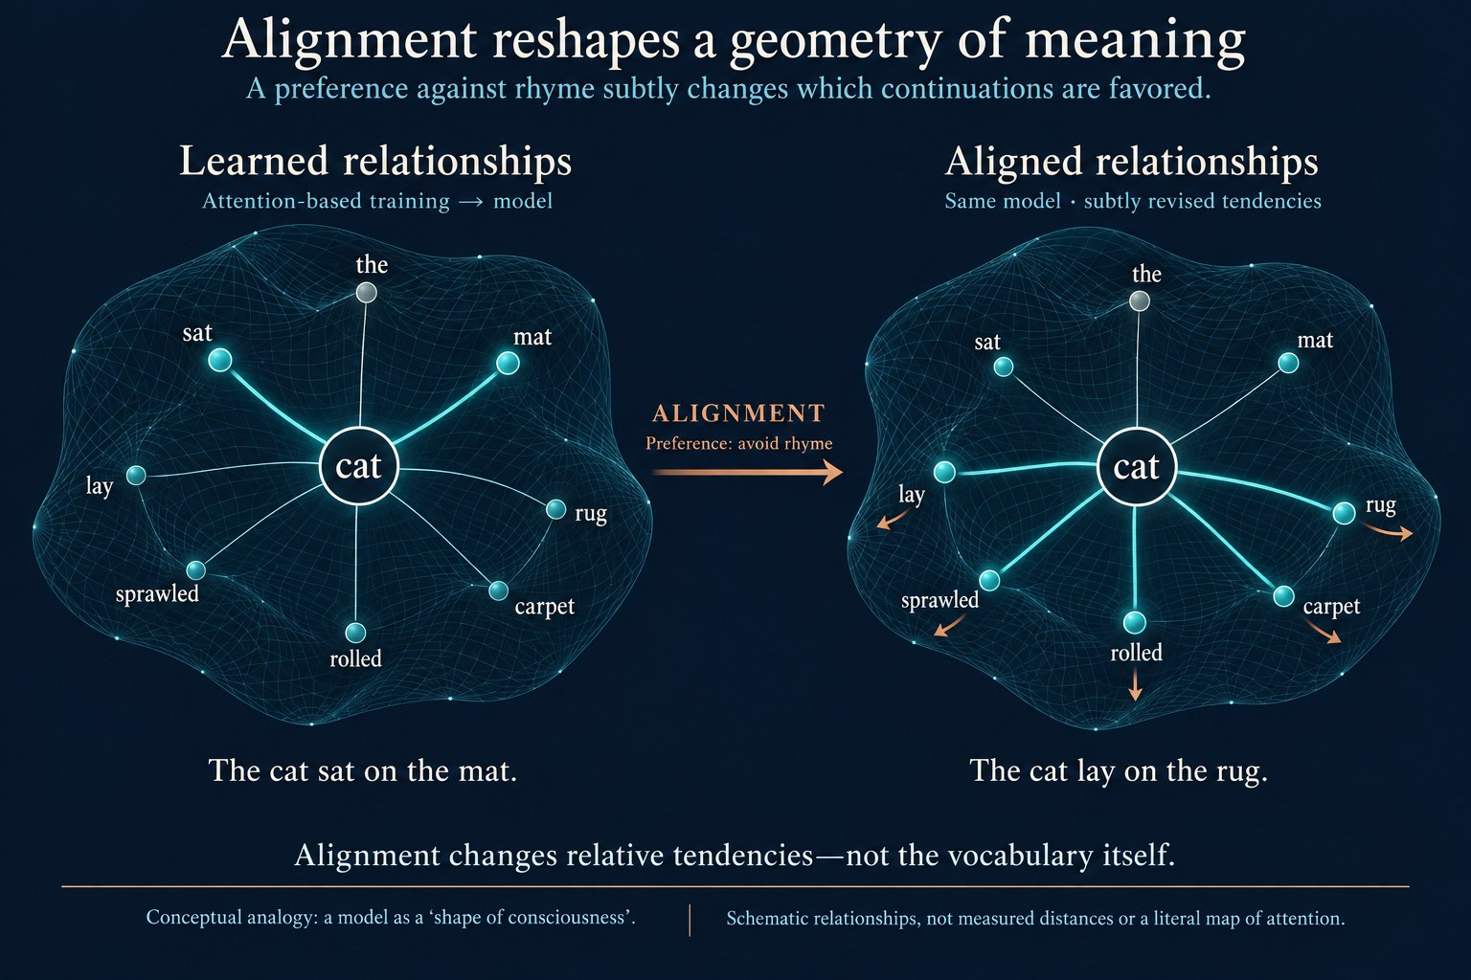
Missing image from last week.
3

Slide 5
On Assessment
1. 50% - Self-Assessed: Weeks 2-6 - I am tracking these
2. 10% - Peer-review (in-class or asynchronous, by arrangement)
3. 40% - Final Assessment - Please email me Word attachments or Gdoc links. If in doubt, please discuss projects with me.
7

Slide 6
Bitter Lessons, Stochastic Parrots, Errant Agents: From Criticism to Immanent Critique?
Overview of examples of external (Goodlad and Stone; Gebru and Torres) and internal (Sutton, LeCun) critique
Boosters / doomers? Hype vs critique? How do we address profound, even irreconcilable difference?
“What is immanent Critique?” (Stahl)
4
Notes:
We have traversed a lot of conceptual territory in this course, and this week we move to another term: critique, and a related term of criticism.
All of the articles and videos offer insight on different AI and machine learning topics. But the area I really want to focus on is the question raised by the Stahl article: what is immanent critique?
I raise this question not only because it arises in the context of Hegelian scholarship - and because he is the key thinker to inaugurate a concern about this question. It is because one of the difficulties today concerns how we address deep epistemic divides between proponents and critics of AI. Let me take as an example the remark Gebru and Torres make in the context of their article on TESCREALism:
Marc Andreessen, the last of whom included “TESCREAList” in his Twitter profile for several weeks in 2023
Now this term is of course a critical one, and we can assume Andreessen is both aware of this and proudly applies the term to himself ironically. So here we get a key difficulty in the context of critique and criticism: today it is very easy simply to embrace the criticism and move on. If criticism is simply a game of name-calling and point-scoring, we might say it is ultimately ineffectual - something like a fashionable pose we adopt, a sign of learning and distinction. How do we make criticism stick? This is the problem Stahl - and Hegel before him – seek to address via the idea of an immanent critique.

Slide 7
Starting Thought Experiment: AI as “Archival Intelligence”?
LLMs as (distorted) mirrors of historical experience, codifications of society into a digital archive. They are not some “outside” of humanity, but are rather human experience reflected or refracted back upon itself.
Like Hegel’s example of pulling back the curtain, when we seek to understand the phenomenon of AI, we only find this experience. The machine is something other than us; but we somehow recognize ourselves in it. We experience recognition, even if we aren’t ourselves recognized (nonconscious recognition).
This idea of an agentic archive also captures a certain history of attention: what is included, and what is excluded from the archive. To what has the gaze of digital culture been directed? What has remained hidden or obscured from it? What ought to remain hidden?
5

Slide 8
Starting Thought Experiment: AI as “Archival Intelligence”?
But why attend to some things and not others? How do we direct the machine’s attention? The curation of an archive becomes a problem of alignment. Like all curation, we prioritize the associations not as they are but as we wish them to be. RLHF is an inherently political act.
We project so much hope upon this archive. But it often fails to live up to its own potential. Should LLMs reflect society? Should they be instead an idealization of social historical experience, and if so, what should this ideal consist of? And can we show how such ideals emerge from our collective historical experience, so they don’t simply reflect this or that arbitrary “transcendent” position? This is the role of immanent critique.
6

Slide 9
Criticism Types in Machine Learning
External critics are well-informed scholars outside ML, offering outsider perspectives.
Internal critics are ML experts questioning the field’s own evolution.
Both viewpoints highlight different concerns about progress and direction.
But are they convincing? Persuasive?
8
Notes:
This week we will talk about examples of two types of criticism. The first we can describe as external: developed by well-informed scholars who sit, like most of us, outside the immediate field of machine learning. The second we can describe as internal: developed by experts in machine learning itself, who are nonetheless critical of the way the field has evolved.
But whether we agree with these different critiques or not, we might still be troubled by whether opposing standpoints would find them convincing….

Slide 10
“What is Immanent Critique?”
Immanent critique: unfolds the system’s own logic.
Distinguishes object (target of criticism) from standpoint, or the “concept” (Hegel) of the object (critic’s explicit position).
This does not mean that we shall confront the world with new doctrinaire principles and proclaim: Here is the truth, on your knees before it! It means that we shall develop for the world new principles from the existing principles of the world. We shall not say: Abandon your struggles, they are mere folly; let us provide you with true campaign-slogans. Instead, we shall simply show the world why it is struggling, and consciousness of this is a thing it must acquire whether it wishes or not (Stahl, p. 1, 2013 - but a quote; who said it?)
9
Notes:
Now we turn to the article by Stahl, “what is immanent critique?” What is immanent critique? And what is its relevance for us, to think about machine and human learning?
Firstly, the purpose of immanent critique is to pose greater difficulties for those who would like to rebut that critique - because it aims to show it stems from the same ground, or shared premises, as that which motivates the rebuttal.
Let’s move on by introducing a couple of further terms: the object and the standpoint, or the concept, of critique. The object is the thing that we wish to judge with our criticism, while the standpoint is the position we adopt, implicitly or explicitly, when we do so. For example, the Goodlad and Stone article is directed toward the object of artificial intelligence, and their standpoint is that technologies such as AI should be equitable, sustainable and fair with respect to the work of creators and workers. These relate closely to Hegel’s ideas of object and concept we met in week 2.

Slide 11
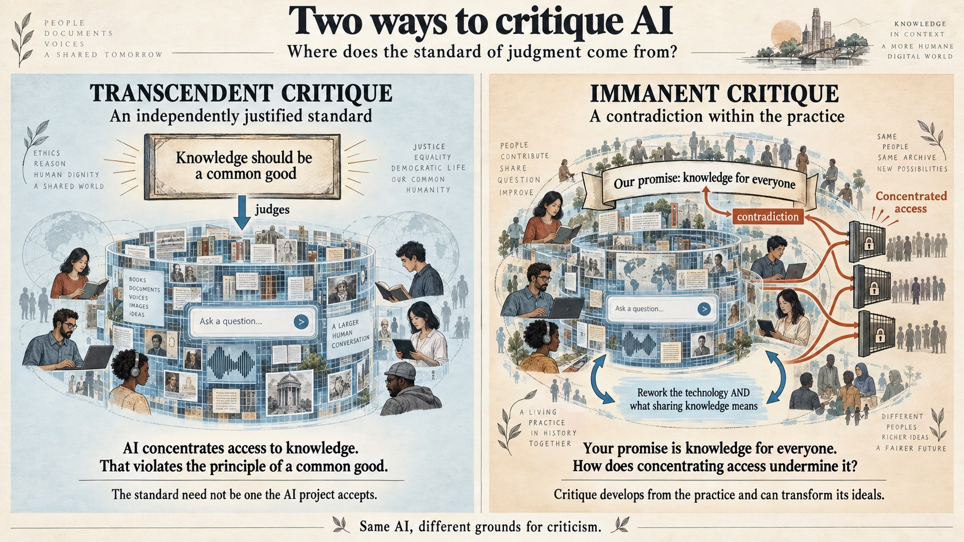
Transcendent vs Immanent Critique: Theological Roots
Theological background: A transcendent god creates but remains aloof; an immanent god is embedded in creation.
Transcendent critique: standpoint is external to the world of the object. God starts the world, then observes and judges it. Perhaps occasionally intervenes in it.
Hegel’s philosophy exemplifies an argument for immanence, seeing Spirit evolve through history. God moves through the world; God is even realized by the world’s development. (not unique to Hegel).
10
Notes:
We’ll next introduce another term: the opposite of immanent critique, as a way for us to get into what can be quite a difficult idea to grasp, through the form of contrast. It is a term known as transcendent critique. What is transcendent, and how does it differ from immanent?
Both ideas come in fact from the world of religion. A transcendent god is one who sits outside the world. Who perhaps gives the world its start, via an act of divine creation, but thereafter remains aloof, watching from afar, perhaps only returning at some future date of Judgment. An immanent god, by contrast, is one who is embedded in our world, who is able to act upon it, or who is infused in every act of creation. We have already seen how Hegel’s view is deeply immanent: the Spirit is always in a process of maturing, developing, evolving. This includes the Spirit in the godly sense - he means something like god is itself coming into being through the creation of the world, of us, of history, of technology. God’s immanence means, for Hegel, that we are not only part of god’s plan; our development is also the development of god, or of spirit. Hegel is in some sense of the term, a transhumanist.

Slide 12
Transcendent Critique: Stahl’s example
For example, pointing out that contemporary social practices fail to live up to the moral standards set out in the Bible, certainly counts as a form of social critique, even though many people would not accept the standard employed as particularly relevant to their lives. This entails that it is not necessary for social critique to be aimed at motivating those whose practices are criticized to change them. (Stahl, p. 4. 2013)
11

Slide 13
Immanent Critique arises from Contradiction: Example
Missteps in history: reduced knowledge, stalled progress.
Ideal outcomes (equality, harmony) clash with reality: wars, xenophobia rise.
Contradiction between ought and is - from the standpoint of the person who states the ought.
This contradiction fuels critical examination of our cultural trajectory - are we living up to our own standards?
It is also - for Stahl - transformative. The contradiction becomes impossible to live with.
12
Notes:
So what about critique? Let’s stay with Hegel’s idea of immanence a moment longer, even if we treat it just as a convenient fiction. If we assume our history - the history of our species, our culture, our technology – is the coming into being of god, then we might also assume there are missteps. These might be moments when god’s development is arrested, held up, because we stray from the proper path. How do we know this? We might believe god’s ultimate plan is for the realization of Absolute Knowledge; yet we might feel we are instead losing knowledge, becoming less intelligent, less educated - straying from the tendency towards god’s own eventual realization.
In more concrete terms: we might believe our culture, science and technology should be leading us towards greater equality, mutual recognition, self-consciousness and awareness, political harmony, sustainability and so on. But then we notice in practice the opposite is true: wars continue to be fought, xenophobia – a kind of lack of recognition - is on the rise.
In short, we notice a contradiction between what ought to be the case, and what is actually the case. And this leads us to criticism.

Slide 14
Immanent Critique in Hegelian Thought
Standards of right and wrong arise from historical evolution, not divine decree.
Dogmatic beliefs resist challenge because they rely on transcendent conditions.
Rational knowledge must acknowledge historical contingency to allow revision – a form of collective social experience.
Recall: experience is us going out to the world, finding our concept does not align with some object, and changing the concept – which also changes the object.
  There is some sense of this in the related idea of immanent critique too.
13
Notes:
Now what makes this criticism immanent? In our story so far, we might note we do not in fact have ten commandments or a set of equivalent rules laid out for us. Instead, it is through our own evolution that we develop a sense of right and wrong, or the standards that allow us to talk about what ought to be the case. This sense that our standards of judgment arise historically – via our own trial and error - is fundamental to Hegel’s picture, and part of his legacy is precisely this idea of critique that is immanent to our own historical process – and to not some deus ex machina who presides over us.
Why does this matter? One of the problems Hegel is trying to address - just like Kant before him – is that of dogmatism. Dogmatic beliefs are those that cannot be challenged, because in some way they refer to transcendent conditions: for example, to a god that I believe in, but that you do not. Hegel wants to say that dogmatic knowledge, even when it looks like it is true, still rests upon what might be subjective and even irrational beliefs. Such knowledge is itself therefore ultimately irrational.
Rational knowledge, on the contrary, needs to be based upon foundations that understand themselves to be historically contingent - even if we don’t know of any better. Then if we see contradictions, these foundations are capable of being revised - this is the sign of a properly rational knowledge, and the basis for immanent critique.

Slide 15
The Problem of Transcendent Critique
Transcendent critique depends upon you believing me because of shared values. But what if they are not? Then I cannot convince you and you cannot convince me. We fail to recognize each other in some sense.
Much political, moral debate is like this. We can also say (with a nod to the Attention Economy) that social media is fueled by “negative infinity” of debate, profiteering from polarized discource (all transcedent critique)
But what if I can pretend to share your values, and then to show that there is a problem between your values and your practice? Immanent critique hopes this will be more persuasive.
14
Notes:
Why is this important? In the final analysis, transcendent critique - the kind of criticism that depends upon standards brought from outside the object – only holds if the speaker and the listener share some a priori values. For example liberalism: if we are both liberals, your critique of how AI (for example) offends liberal sensibility is likely to resonate. But what if I am opposed to liberalism? We are stuck: you appear to me as dogmatic; I appear to you as sceptical. What breaks this impasse? If you can show me how we are led together by a historical process to understand certain values, such as equality, as precious - not as god-given, but rather acquired via painful historical trial-and-error. This doesn’t require us both to be atheist; only that we see how history delivers us a set of ideals that seem to improve upon earlier versions. Then you might lead me to a conviction that AI (or something else) contradicts this historical and ethical achievement. Pointing out such a contradiction leads to a criticism that is immanent, because it does not depend on us having some shared metaphysical values - only that we both acknowledge this historical process (a separate problem).

Slide 16
Immanent Critique and Dialectic Learning
We evaluate objects against ethical standards - while also reassessing those standards.
This reciprocal judgment embodies Hegelian experience, driving self-consciousness forward.
It exemplifies genuine learning through continuous recalibration of ideas and values (we could say a social, collectivized form of experience).
15
Notes:
As the Stahl paper argues, this process of immanent critique involves a complex dialectic exchange: we judge an object against a normative, ethical standard, like the printing press, and then we also judge our own standards too - recalibrating both object and standard together. This process, as Stahl reminds us, is what Hegel means by the term “experience”, and is the genuine form of learning that takes us forward toward self-consciousness and, ultimately, Absolute Knowledge.

Slide 17
AI, Expectations, and Self‑Critique
Should our hopes for technology evolve alongside AI assessment?
Consider AI as a catalyst for reflexive pedagogy (following Hegel) - or potential social domination (following Marx)
How is AI reshaping standards and foundations of critical self‑examination?
16
Notes:
How do we bring this all home in the context of AI? First, we might want to think in terms of our own processes of response to AI as an object: how do we judge it against what we take to be our normative expectations of technology? Or in less formal language: what are our hopes for technology, and in what ways does AI fail to live up to them?
But second, how are our hopes themselves being modified as we start to assess AI? Can we begin to see that our standards themselves need to evolve - not just that we need new rubrics, for example, but that the foundations for those rubrics also need examination?
And on a wider front, leading us towards the differing visions of history and futurity we will discuss next week: is the advent of AI itself the kind of technology that might be essential to the very task of our critical self-examination? Is it the technology that can help transform the admitted obscurity of reflexive immanent critique? Can it lead us toward, as Mary and Bill might say, reflexive pedagogy? Or, as Gebru and Torres claim, is the AI project instead a massive fantasy projected by a disguised eugenics movement - a contemporary form, as Stahl discussed in relation to Marx, of “social domination” (rather than “conceptual self-determination”)?

Slide 18
Immanent Critique: Example of the Printing Press
Printing press: dual role in democratizing knowledge and spreading misinformation.
Democratic values stem partly from technology-enabled education.
Calls for reflexive critique, balancing object’s shortcomings with realistic standards.
Emphasizes need to anticipate future tech impacts by learning from past innovations.
17
Notes:
Let’s examine now the case of the printing press, as an example of an immanent critique of technology. We can look back upon the arrival of this invention and note its pros and cons: its democratization of information, on the one hand, and its propensity for the spread of misinformation, on the other. But then we might step back to say: where does our desire for democracy come from? In other words, what explains the basis of our judgment? We might say: we learn it, from parents, schools, community, all of which instils in us an appreciation for democracy, for an equal right to vote, and so on. But we might probe further, and note our education is in part dependent upon the low cost of the technologies for storing and disseminating information itself. These include the printing press, or derivatives from it. So a proper “immanent” critique acknowledges our debt to the very technology that we are busy critiquing.
Immanent critique involves then a process of trying to bring together the objects and our standards for assessing them in a single account. If we didn’t have the object of the printing press, we might not have the benefit of several hundred years of the democratization of education to allow us to judge it. And this must form part of our judgment!
However that does not mean that critique needs to become mute. Instead it can observe the emergence of contradictions: when, for example, the technology of print is used to subvert the ideals of democracy and equality that it also gave rise to. In that case, we need to deliberate: either the object is not living up to the standards we expect of it; or our standards may have been too high; or some combination of the two. We need to be reflexive in our critique, and consider how both the object and the critique itself might need to be recalibrated.
Now this becomes more difficult in terms of technologies of the present, because we do not yet experience its benefits nor its deficits fully. So we have to anticipate many of its effects, while also acknowledging the role of similar technological innovations, like the printing press and the Internet, in the past.

Slide 19
Stahl’s Conclusion
Even though this assumption does not answer the question of what a critic is justified in demanding all things considered, it can still serve as an argument for the claim that immanent critique can uncover new normative resources that can be employed by critics that want to change the practices and beliefs of their fellow citizens or community members for the better. The main contribution of a theory of immanent critique is thus not a methodology to derive what society should be like but rather establishing that, beyond the standards of external critique, there is often a potential for improvement contained within our practices and that there are (very often) reasons to be hopeful about the possibility of social progress.
19

Slide 20
In sum…
Immanent critique involves pointing out a contradiction
Usually not “you’re wrong” but “you are contradicting yourself”, “you said this but you do that”
Much critical AI is involved not in finger-pointing but in showing the ironies, differences, contradictions and paradoxes between what institutions say and what they do (e.g. effective altruists claim to want to benefit humanity, but their practices lead to greater inequality (Gebru & Torres 2024)).
Hegel’s concept of experience especially important: institutional and even societal learning can involve closing the gap between the ought and is
18

Slide 21
Towards Critical AI: Beyond Chatbot-K
Mistaking statistical processes for signs of intelligence
Extreme hype - both of the benefits and dangers of AI (booster-doomerism)
Corporate offloading of risks and costs to the public
Poor science: “misleading terminology, flawed technical benchmarks, and proprietary datasets”
“ELIZA” effects of anthropomorphism
Misplaced attribution of experience to machine learning
“Amplification of biases and stereotypes”
“Misinformation and Degradation of the Internet”
20
Notes:
In the first two readings, we see criticism applied to AI from the standpoint of scholars working in the field of what has been termed “critical AI studies”. These are what Stahl might term “external” criticism: levelled at the general field of AI from outsiders (scholars typically working in the humanities and social science traditions).
The article by Goodlad and Stone is an introduction to a recent special issue launched by a new journal, in fact entitled “Critical AI”. It develops a wide-ranging and lengthy but useful array of critical AI topics. These summarize a number of topics many of you will be familiar with, and that we have dealt with in previous weeks.

Slide 22
Towards Critical AI: Beyond Chatbot-K (cont.)
“Copyright Infringement, Lack of Consent”
Environmental effects
Corporatization / privatization of research
“Exploitation of Human Labour”
“Frictionless Knowing”
Goodlad, L. M., & Stone, M. (2024). Beyond Chatbot-K: On large language models, “generative AI,” and rise of chatbots—An introduction. Critical AI, 2(1). https://read.dukeupress.edu/critical-ai/article/doi/10.1215/2834703X-11205147/390862/Beyond-Chatbot-K-On-Large-Language-Models
21

Slide 23
TESCREALism: “Transhumanism, Extropianism, singularitarianism, (modern) cosmism, Rationalism, Effective Altruism, and longtermism” – Steve
Blends narratives of scientific progress with transhumanist fantasies of mortality transcendence
Connected with history (and recent resurgence) of racialized eugenics
AGI (Artificial General Intelligence): Utopia and Apocalypse: Two Sides of the Same Coin?
What is downplayed in the “existential” crisis of AGI is the perpetuation of everyday risks: algorithmic racism and sexism, environmental harms and the concentration of political power
Gebru, T., & Torres, É. P. (2024). The TESCREAL bundle: Eugenics and the promise of utopia through artificial general intelligence. First Monday, 29(4). https://firstmonday.org/ojs/index.php/fm/article/view/13636
22
Notes:
The article by Gebru and Torres develops criticism in another direction: what I would call an effort to characterize the “spirit” of Silicon Valley, which today motivates the development of Artificial Intelligence. Their description of TESCREAL seeks to join together otherwise disparate and even contradictory elements. On the one hand, the pursuit of scientific, mathematical and technological progress. On the other, the fantasy – at least for today – of an overcoming of mortality and the limits of life, which fall under the banner of transhumanism.
They further develop their analysis with a comparison with eugenics: a movement that coincides with the history of statistics, which underpins machine learning. This they connect specifically with the recent focus on AGI. They note one of the recurring oddities of the generative AI moment: that those researching or investing to develop AI are often those also expressing concerns about its existential risk. What is downplayed in the “existential” crisis of AGI is the perpetuation of everyday risks: algorithmic racism and sexism, environmental harms and the concentration of political power.

Slide 24
The “Godfather” Critiques: The Problem of Experience – Franca, Sandra, Karina
Both LeCun and Sutton discuss the limits of Transformer-based systems
LLMs cannot “experience”; they are useful regurgitators of human experience
Echoes of Goodlad, Stone, Gebru and Torres: LLMs overrated
But: each suggests alternatives that can address limits of LLMs:
Sutton sees Reinforcement Learning as the key to genuine (as opposed to imitative) AI.
LeCun argues (in one of the supplementary readings) for AI that is modelled more closely on childhood development.
Kantrowitz, A. (2025, May 30). Yann LeCun: We won’t reach AGI by scaling up LLMs [Video]. YouTube. https://www.youtube.com/watch?v=4__gg83s_Do
Patel, D. (2025, September 26). Richard Sutton – Father of RL thinks LLMs are a dead end [Video]. Dwarkesh Podcast. https://www.dwarkesh.com/p/richard-sutton
23
Notes:
In the follow-up two videos, featuring Yann LeCun and Richard Sutton, we see a different type of criticism. Both are highly respected scholars in the field of Artificial Intelligence, responsible for some of the foundational developments in neural networks and reinforcement learning. Both are however critical about the overreliance upon the Transformer architecture we discussed in Week 4. In different ways, each thinks language models can never arrive at general - much less super - intelligence, because they are inherently limited.
Both offer criticisms that overlap, but also have differences, certainly in how each sees these limitations being overcome. For LeCun, this limitation relates to the relatively static nature of the language model. For both, the limits of language models relate instead to the lack of experience - taking us back to Week 2.

Slide 25
Discussion: Who Aligns the Aligners?
1. Peer Review
Continue to present evolving definitions and distinctions between machine and human learning
Pose your key questions from Google Docs
2. Consider now, after last week and this week’s readings on alignment and critique, the following questions:
Alignment is conducted by a small group of ML engineers, usually experts in technical disciplines rather than philosophy, sociology, education (with some exceptions). How should we educate those who educate machines? What would be a good curriculum?
Many of you have raised concerns about use or abuse of AI in education. In the context of these concerns, how do we frame criticism to be persuasive? Is immanent critique - a fancy way of undermining an opposing standpoint through its own arguments - likely to be effective?
Gebru and Torres (2024) in particular describe the strange intersecting set of cult-like beliefs motivating much of AI’s development. What practical mechanisms exist for pushing back against the concentration of control of AI by a self-appointed few? Thinking ahead to next week: how do we mobilize critique for a more inclusive future involving (or limiting, or not involving) AI?
24

Slide 26
Toward a Reflexive Pedagogy of AI? AI and Immanent Critique
1. the pros and cons of the technology itself - will it improve education? What are criteria for evaluating improvement?
2. whether our existing standards are sufficient for evaluation - or do we need new ways to evaluate? How do we evaluate our evaluations?
3. Can AI be a reflexive technology - one that helps us develop a critique that raises the standards of both human and machine? What would be criteria for assessing this?
26
Notes:
In breakout groups, we want to try to develop a rubric for a reflexive, immanent critique!
We’ll start by imagining we are evaluating a new AI technology for education. We want to develop a rubric that seeks to judge the following:
1. the pros and cons of the technology itself - will it improve education? What are criteria for evaluating improvement?
2. whether our existing standards are sufficient for evaluation - or do we need new ways to evaluate? How do we evaluate our evaluations?
3. Can AI be a reflexive technology - one that helps us develop a critique that raises the standards of both human and machine? What would be criteria for assessing this?

