Slide 1

EPOL 590 · LECTURE 1 · MONDAY 19 OCTOBER 2026
AI and Academic Literature
Research questions, and where a literature review begins
Professor Liam Magee · Education Policy, Organization and Leadership · University of Illinois Urbana-Champaign
Notes:
Welcome. EPOL 590, Section AIL, Term B. Seven Monday seminars, 5:00–7:50 PM Central.

Slide 2
WELCOME
Do we need another course on academic literature?
FOUNDATIONAL
FUTURE-ORIENTED
How to develop a literature review
How AI is changing scholarship
What are the impacts of AI on how we learn, study and research? What are the wider epistemic, or knowledge-related, aspects of AI that we ought to consider?
Build, annotate, analyze, map, and turn a body of literature into an argument.
EPOL 590 · Lecture 1 · A mix of theory and practice
Notes:
The course has both a practical and theoretical dimension. I'm hoping, first, that this is a useful course for people wanting to develop a literature review, and a sense of how to use AI ethically and effectively. Second, I also want us to consider what is happening at this point in time with the roll out of AI throughout education and the wider knowledge economy.

Slide 3

THE COURSE IN ONE SENTENCE
How do you build a sense of your field, and its gaps?
Academic literature is at once mundane and mystical. We start with fundamentals — building, annotating, mapping, writing — then ask how AI can make interpretation more critical, analytic and reflexive.
Notes:
From the course overview. All required material — readings, recordings, guides — will be posted on Canvas. No book purchase and no paid AI subscription is required. You are welcome to use your own subscriptions of course, but UIUC also has a number of licenses: https://genai.illinois.edu/ai-apps/

Slide 4
TONIGHT · 5:00–7:50 PM CENTRAL
The plan for this session
5:00
Welcome, the course and how it’s assessed
5:30
Introductions
6:00
Break
6:10
What is academic literature? The response board
6:30
Your research record and the class document
6:40
What makes a good research question?
7:00
Break
7:10
Breakouts: a candidate question, then report back
7:40
Wrap-up: class map, baseline reflection, Task 1
Two ten-minute breaks, on the hour · Times are a guide

Slide 5
SEVEN MONDAYS · 5:00–7:50 PM CENTRAL · ONLINE
What we’ll cover
Session | Seminar | Focus · theme | Task due (Mon)
1 | 19 Oct | Research questions and academic literature What is literature, and what is AI changing? | Task 1 · 26 Oct
2 | 26 Oct | Article anatomy, review design, mapping a field Where’s the gap? Mapping a field | Task 2 · 2 Nov
3 | 2 Nov | AI-assisted close and distant reading Vibe scholarship: does AI mean artificial knowledge? | Task 3 · 9 Nov
4 | 9 Nov | Difficult texts, audiences, scholarly voice Slow reading with AI; finding your scholarly voice | Task 4 · 16 Nov
5 | 16 Nov | Structure, signposting, scholarly communities “What do I know?” Towards a sociology of knowledge | Task 5 · 30 Nov
— | 23 Nov | Fall break: no seminar, nothing due | —
6 | 30 Nov | Reflexivity, positionality and AI in scholarship How do we interpret scholarship, and acknowledge AI? | Task 6 · 7 Dec
7 | 7 Dec | Future of scholarship; final review workshop The automatic academy? The future of scholarship | —
Final | — | Final literature review, Tue 15 Dec, 11:59 PM | Task 7 · 15 Dec
All deadlines 11:59 PM Central, submitted on Canvas · Matches the syllabus and Canvas modules
Notes:
Same sequence as the syllabus and the Canvas modules. Tasks fall on the Monday after each seminar, except Task 5, due the Monday after fall break. The italic lines are each week’s broader theme, carried over from last year’s lectures. Session 7 is mostly a workshop for the final review, which is due the following Tuesday, 15 December.

Slide 6
ASSESSMENT · 50% STAGED · 10% PEER REVIEW
A mock (or real) literature review
1 · Ungraded · Mon 26 Oct
2 · 10% · Mon 2 Nov
3 · 10% · Mon 9 Nov
Research topic and question
Review design, method and scope
Conceptual map of the literature
4 · 10% · Mon 16 Nov
5 · 10% · Mon 30 Nov
6 · 10% · Mon 7 Dec
Literature review writing sample
Structured draft and signposting
AI-use statement and reflexive commentary
Each task builds the same review. Task 1 is ungraded: feedback before any marks. After Tasks 4 and 6 you review classmates’ work, 5% each, complete or incomplete.
Task names match Canvas · 11:59 PM Central · plus an ungraded baseline reflection this week
Notes:
Task 1 is ungraded so students get feedback on their question before marks are at stake. The two peer reviews (Tasks 4 and 6, 5% each) are complete/incomplete, due Friday 20 November and Friday 11 December; Canvas assigns them after each task’s deadline. Submit each task with a short note on what changed and how AI contributed. A real or mock review for a dissertation or article is welcome, as is a syllabus for a course of your own on how to develop a literature review.

Slide 7
TASK 7 · FINAL REVIEW OR COURSE OUTLINE
40%
Tuesday 15 December, 11:59 PM Central
A literature review, or a course outline for teaching how to write one. 1,500–2,000 words, with an AI-use statement and a short revision memo.
Notes:
It’s after the last seminar on purpose, so the Session 7 workshop feeds into revision. Option A is the literature review; Option B is a course outline for teaching how to write a literature review, justified from the literature. Weekly tasks are usually 250–400 words, with sources set by each task. These should accumulate towards the final assessment.

Slide 8
ASSESSMENT CRITERIA
What we’re looking for, every task
01
Significance and feasibility of the question
02
Relevance and traceability of sources
03
Quality of interpretation and synthesis
04
Clear organization, framing and scholarly voice
05
Reflexivity and responsible, transparent AI use
06
Responsiveness to evidence and feedback
From the syllabus · Task-specific rubrics on Canvas
Notes:
One criterion per click. These are the syllabus’s six common criteria. The underlying aim: use all of this to make a persuasive case for a plausible gap, or a different way to frame the problem.

Slide 9
APPROACH
Course Perspective: AI ought to stretch your review
Sketch, then revise
A critical lens on AI
Quick sketches of a literature review, with AI and its caveats
Build intuitions for reviewing and writing up fast
Peer review turns a lonely pursuit into a social one
Knowledge has always been technical: paper, press, media, the internet
Ask how outputs were made and whose knowledge they privilege
Technology should make us work harder, not easier
EPOL 590 · Lecture 1
Notes:
Use AI to widen and deepen what is reviewed; find unusual connections; systematize and organize; assist the reader in reaching your conclusion about the gap in the literature.

Slide 10
FORMAT
How a Monday runs
3 h
2 × 10
~20 h
Used flexibly: mini-lectures, discussion, group work and AI exercises
Minute breaks, on the hour
Per active week in total, including reading, searching and writing
Most of each week’s task starts in the room. Together we’ll build a lightweight notebook of good search, reading and review practices.
EPOL 590 · Lecture 1
Notes:
Twenty hours a week is the syllabus planning figure for a four-credit, eight-week course: about 3 in seminar, 5 reading, 4 searching and mapping, 6 writing, 2 on AI experiments and the process record. Bring material to work on every week.

Slide 11
INTRODUCTIONS · ABOUT 90 SECONDS EACH
Who’s here?
1 Your name, and your program or department
2 Your field, or a research interest
3 A question you might pursue this term
4 One way you’ve used AI in your research
A rough question is fine. We will develop the question progressively each week.
EPOL 590 · Lecture 1
Notes:
With 18 people at about 90 seconds each, this takes close to half an hour. Listen for shared interests: they become the hubs on the class map later tonight, and useful breakout pairings.

Slide 12
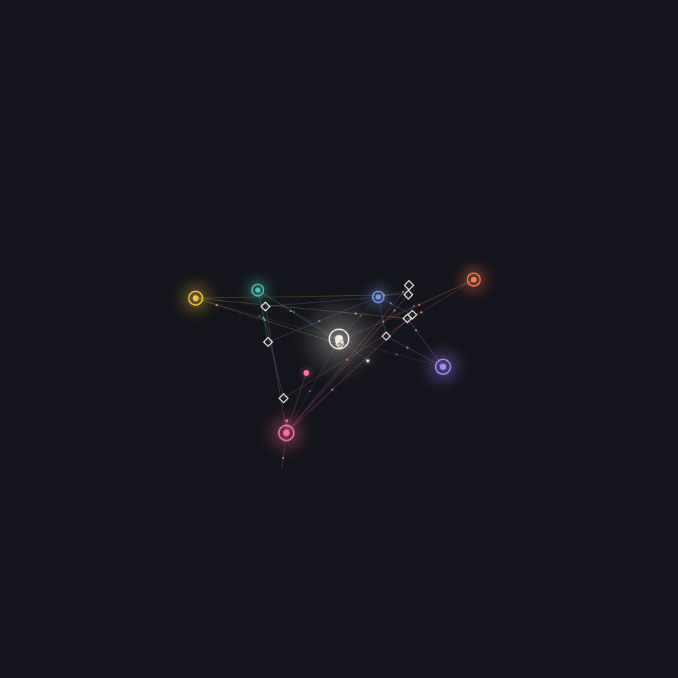
CLASS CONSTELLATION · BEFORE SESSION 2
Put your question on the map
1 Add your name, up to five interests and a one-sentence research topic.
2 Recent papers gather around each interest, coloured to match.
3 Open one, check it against the source, and see who shares your interests.
Open the class constellation →
Notes:
The animation on the right is an illustration, not live data. The real board is a separate page: students add their name, interests and a topic, and recent OpenAlex papers attach to each interest. Zoom chat link: https://machinespirits.org/590-fall-2026/map?k=epol590-pzpmmw . Papers arrive from OpenAlex on the server within seconds of a student joining.

Slide 14

DISCUSSION AND INTRODUCTIONS
What is literature?
What is a literature review?
What is AI changing?
Introduce yourself, your field, and one thing you’ve used AI for in research.
Notes:
One question per click. Round of introductions. The next slide sends everyone to the response board to answer the first question; we come back to “what is a literature review?” in Week 2 when we take a journal article apart.

Slide 15

What is academic literature?
1 Open the response board from the link in the Zoom chat.
2 Answer in a sentence or two. A name is optional.
3 Watch themes form as answers share words, then we read them together.
Open the response board →
Notes:
Post the board link in the Zoom chat before this slide (the Copy link button on the board copies it). The animation on the right is an illustration, not live data: switch to the board itself to read the answers live, then use Fly through or click a theme to discuss it. The same board takes new prompts for later lectures (More, then New prompt), each with its own link. Zoom chat link: https://machinespirits.org/590-fall-2026/respond?k=epol590-pzpmmw#what-is-academic-literature (the class key is in the link, so students skip the key prompt). You manage prompts by opening the board once with your admin key (?admin=…, in ~/.config/epol590/board-keys.txt).

Slide 16
YOUR RESEARCH RECORD
Keep notes you can explain your review from
Note-taking software
A reference manager
A running log
Obsidian or similar; learn Markdown and try a Zettelkasten.
Zotero or any reliable way to keep full citations with your notes.
Question, search decisions, maps, drafts, feedback and AI-use notes.
No particular commercial tool is required
Notes:
The syllabus asks for a research record that lets you explain why the review changed. The tool is up to you.

Slide 17
WORKING TOGETHER
One continuous class document
What we need
What stays in Canvas
A single running document for the term
Sharing and annotation with peers
Institution-supported, shared only with named people
Submissions and grades
Private instructor feedback
Announcements and readings
2026 class workspace: “EPOL 590 Fall 2026” Google Doc · linked on Canvas
Don’t put confidential, identifiable or restricted material into any AI service
Notes:
This term’s class doc, “EPOL 590 Fall 2026”, is the first item in the Course introduction module on Canvas and is linked from the syllabus.

Slide 18

WHAT MAKES A GOOD RESEARCH QUESTION?
Where questions come from
Literature · which key problems are unsolved?
Events · what is happening, and how do we explain it?
Circumstance · it annoys me that no one can answer this
Disposition · I just love working on X
Sociality · all the cool kids work on X. Should I, or shouldn’t I?
Partly a matter of feel: experienced researchers know one when they see it
Notes:
And is “What makes a good research question?” itself a good research question? Ask the room which source their own question came from. Most come from more than one.

Slide 19

QUESTION AND LITERATURE
Each one steers the other
Not a question from thin air, nor one that waits for a systematic review.
1 · Draft a topic or question
2 · Search it: is it answered?
3 · Refine what remains, and repeat
Notes:
Dialectical and iterative process: Draft a question, search on it, and ask whether it’s answered wholly, partly or not at all. What remains becomes the next version of the question. A map can change the question; writing can show the gap was the wrong one. Keep those changes visible in your research record.

Slide 20

PRACTICALITIES
Does it need an answer, and can you give one?
So what?
Is the answer necessary, or does it provoke a shrug?
Doable?
Or would it take 100 years, a billion dollars, a vast team?
Within reach?
Methods you know, data you can actually access.
Notes:
Also ask about consequences: what happens once you know the result? Who uses it?

Slide 21

NOVELTY
Has it been answered before?
Often not obvious: many literatures and disciplines work on related problems
Is it novel for good reasons, or because no one needs it, or research can’t answer it?
Will it stay novel while you work?
“No one has studied the impact of [next year’s model] on student learning” — true until it’s released.
Notes:
The AI example dates fast, which is the point. A gap defined by a product release closes as soon as everyone studies the release. Look for questions that will still be open when you finish.

Slide 22
BREAKOUT GROUPS
Everyone needs a candidate question.
It doesn’t need to be your dissertation
Work on a pseudo-topic together
Test it against sources, practicalities and novelty
Write it down in the class workspace
Notes:
One step per click. About 30–40 minutes in groups, then report back. Ask an AI tool to stress-test the question, then check one claim it makes against a real source.

Slide 23
IF TIME PERMITS · ABOUT 25 MINUTES
How the breakout works
1 Join your breakout room (Rooms 1–4)
2 Open the class doc → Week 1 Collaboration
3 Agree a pseudo-topic and a candidate question
4 Test it: sources, practicalities, novelty, and an AI stress-test
5 Back at 7:35: one question per room
Class doc: first item in Course introduction on Canvas
Notes:
Open Zoom breakout rooms (four rooms, assigned automatically) after this slide. Each room has its own section in the Week 1 Collaboration tab. If time is short, skip the rooms: take two or three volunteers’ questions and test them together as a class against sources, practicalities and novelty.

Slide 24
UNGRADED · THIS WEEK
Baseline reflection
What question do you want to investigate, and why does it matter?
What do you already know about the relevant literature?
What would change your current understanding?
How have you used AI in research, and what are you unsure about?
A short starting point to compare with your final review.
From the syllabus · before or during the first seminar
Notes:
One question per click. Ungraded. It anchors the revision memo that goes with the final review: how did your question, sources and use of AI change over the term?

Slide 25
BEFORE NEXT MONDAY
Readings and Task 1
Weber, M. (1946). Science as a vocation. In H. H. Gerth & C. Wright Mills (Eds.), From Max Weber: Essays in sociology. Oxford University Press, pp. 129–156. Read online
TASK 1 · UNGRADED
Research topic and question
University of Illinois Library. (n.d.). Develop a topic and dissect your research question. library.illinois.edu
Due Monday 26 October, 11:59 PM Central, on Canvas.
A provisional question: its significance, feasibility and first sources, and what you’d need to read to refine it.
Next week · Article anatomy, review design, mapping a field
Notes:
Weber links to the 1946 Oxford edition on the Internet Archive (digitized by the University of California Libraries; not in copyright), opening at “Science as a Vocation”, pp. 129–156. The research-question guide is the University Library’s “Develop a Topic and Dissect Your Research Question”: start from a topic, then narrow it to a question with keywords and limits (population, place, time). Task 1 is 250–400 words with 3–5 initial sources, ungraded.

