Slide 1
Attention
479 · Week 4

Slide 2
Welcome to Week 4: Attention
2

Slide 3
Discussion
Thoughts, impressions?
Some comments later on relationship to Hegel - but is there a relationship between alerting / orienting / executing (Petersen and Posner, 2012) and sense certainty / perception / understanding (Hegel, 1807)?
Terranova (attention economy), Hansen (cognitive lock-in)
3

Slide 4
Assessments
Send me your chats / reflections each week! I do read and respond to them
Peer review: Weeks 5 & 7 - bring your definitions of human and machine learning and key question to class. We’ll use these in the break-out discussions.
4

Slide 5
Attention: Machines, Brains, Society
Vaswani, A., Shazeer, N., Parmar, N., Uszkoreit, J., Jones, L., Gomez, A. N., Kaiser, L. & Polosukhin, I. (2017). Attention is all you need. Advances in Neural Information Processing Systems, 30.
Petersen, S. E., & Posner, M. I. (2012). The attention system of the human brain: 20 years after. Annual Review of Neuroscience, 35(1), 73-89.
Terranova, T. (2012). Attention, economy and the brain. Culture Machine, 13.
Hansen, M. (2024). From attention economy to cognitive lock-ins. Big Data & Society, 11(3), 20539517241275878.
5
Notes:
As we’ve noted in the week’s online guide, this week we are moving both back and forward - back to the earlier moments of consciousness, perception in particular, but also forward to the much more recent developments in both neuro and computer science.
What I propose this week is that we examine four key papers that all treat the concept of attention in a specific way. I won’t be doing too much here to relate this concept to Hegel’s unfolding architecture in Phenomenology of Spirit - we’ll instead turn to that in the weeks ahead. But you may want to think how different meanings of attention might be situated with respect to both concepts of experience and recognition we’ve covered to date.
I’ll start by looking at the Petersen & Posner paper, The Attention System of the Human Brain: 20 Years After, then the Vaswani et al’s Attention is All You Need paper, and then finally Terranova’s critique of the Attention Economy. In each case we’ll provide a short summary, and connect the argument to the wider lecture and course content - then provide time for discussion.
Note that our discussions of these papers will be very high level - just enough to get some intuition of similarities and differences.

Slide 6
Human Attention
Attention Function | Representative Regions / Networks | Application to Reading
Alerting | Locus coeruleus and neuromodulatory influences; thalamic and cortical regions | Become and remain ready to respond to text
Orienting: deliberate selection | Dorsal network: frontal eye fields and intraparietal / superior parietal regions | Direct attention to a word or location
Orienting: reorienting | Ventral network: mainly right temporoparietal junction and ventral frontal cortex | Shift toward a relevant unexpected margin cue
Executive control: maintenance | Cingulo-opercular network, including medial frontal / anterior cingulate and anterior insular regions | Keep the reading purpose in force
Executive control: adjustment | Frontoparietal control network, including lateral prefrontal and parietal regions | Change strategy and reread a difficult phrase
These reading situations are teaching applications of Petersen and Posner’s framework, not neural measurements of reading. Networks cooperate; the rows are not successive stages.
Explore the interactive reading lab: rotate the anatomical cortical model, select a reading moment, and try the same next-token task from the human and machine perspectives.
6
Notes:
The first paper updates Posner and Petersen’s 1990 framework. It distinguishes three broad functions: alerting, orienting, and executive control. These are interacting systems, not a fixed sequence of becoming aware, looking, and deciding. The review also distinguishes sources of attentional influence from the processing systems they affect.
I’ll briefly talk through these three functions.
Alerting concerns readiness to respond. Phasic alerting is a brief increase in readiness, such as after a warning cue; tonic alertness concerns sustained vigilance. The review associates tonic alertness strongly with the right hemisphere, but discusses less settled laterality for phasic effects. It also discusses the locus coeruleus, norepinephrine, thalamic regions, and cortical contributions. Alerting is not simply detecting a stimulus or becoming conscious of it.
Orienting prioritizes a location or sensory input. The dorsal network includes frontal eye fields and intraparietal / superior parietal regions involved in goal-directed selection. The mainly right-sided ventral network includes temporoparietal junction and ventral frontal cortex, associated with interrupting a current focus and reorienting. Attention can shift without an eye movement. During reading, deliberate selection of a word and reorienting to a relevant margin cue illustrate different orienting demands.
For executive control, the authors favor a two-network account. The cingulo-opercular network supports stable task maintenance. The frontoparietal control network supports initiation, switching, and adjustments during performance. Maintaining the instruction to explain a sentence and deciding to reread a confusing phrase illustrate these demands. See the review’s Executive Control section and Figure 2.

Slide 7
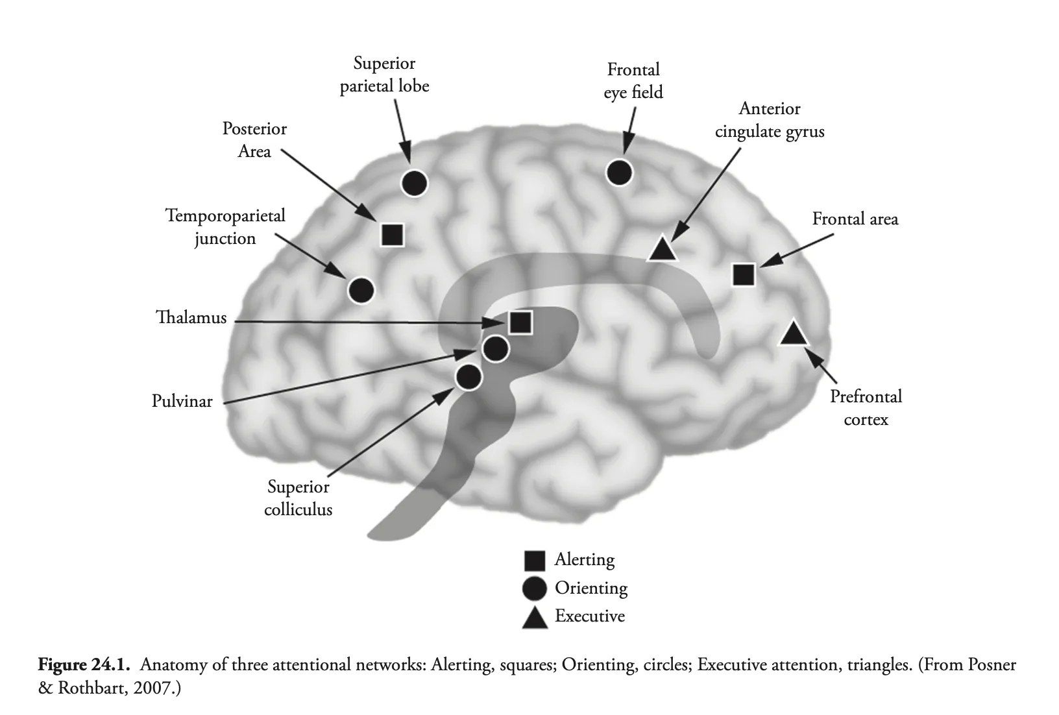
Functions and Networks
Different networks make distinguishable contributions to readiness, selection, and control.
Several regions cooperate within each network, and the networks interact during ordinary activities such as reading.
These distinctions do not imply a fixed alerting → orienting → executive pipeline or a one-region, one-function map.
7
Notes:
The important point is the distinction between functions and networks. Multiple regions contribute to a network; distinguishable networks can work together. Their coordination is not adequately represented by a single moving spotlight, nor by a compulsory order of three stages.
The comparison with transformers is functional: some information receives greater priority in a context. A transformer head is not a brain region. Query, key, and value are three numerical roles inside a weighted-sum calculation; they do not map onto alerting, orienting, and executive control.

Slide 8

Attention and Learning
8
Notes:
Within the context of learning, we can also see how this new attention-oriented work helps to make sense of, in particular, learning difficulties. Impairments on different brain regions can result in complex but still localizable – and potentially addressable – limitations in how attention is alerted, directed, sustained and purposefully redirected, as conditions require.
Now while this is not a course diving into neuroscientific research, we can note in passing that this kind of neurological or neuroscientific research has impacted upon the theory and practice of pedagogy. A quick Google Scholar search shows for example how many results have integrated “executive function” into pedagogy research: 16,900 results since 2022.

Slide 9
Attention and Childhood Development
infants first develop alerting functions (with some orienting and executive ability)
children develop mature orienting and basic executive (concentrating) functions
adolescents and young adults develop higher order executive (both attention-sustaining and -switching) functions
References:
Rueda, M. R., & Posner, M. I. (2013). Development of attention networks. In The Oxford Handbook of Developmental Psychology, Vol. 1: Body and Mind.
Posner, M. I., & Rothbart, M. K. (2007). Research on attention networks as a model for the integration of psychological science. Annual Review of Psychology, 58, 1–23.
Boen, R., Ferschmann, L., Vijayakumar, N., Overbye, K., Fjell, A. M., Espeseth, T., & Tamnes, C. K. (2021). Development of attention networks from childhood to young adulthood: A study of performance, intraindividual variability and cortical thickness. Cortex, 138, 138-151.
9
Notes:
Several of these studies show that the hierarchy of attention mechanisms - alerting to orienting to executing – also correspond to stages of learning and childhood development. Work by Posner and colleagues in particular has sought to demonstrate that:
- infants first develop alerting functions (with some orienting and executive ability)
- children develop mature orienting and basic executive (concentrating) functions
- adolescents and young adults develop higher order executive (both attention-sustaining and -switching) functions

Slide 10
Neuroscience and Hegel?
Without hesitation, the raw instinct of self-conscious reason will reject such a science of phrenology – as well as reject this other observing instinct of self-conscious reason, which, once it has blossomed into a foreshadowing of cognition, has spiritlessly grasped cognition as, “The outer is supposed to be an expression of the inner.” However, the worse the thought is, the less easy it sometimes is to say exactly where its badness lies, and it becomes even more difficult to explicate it. (para 340)
10
Notes:
And to keep concordance with Hegel, we might also note his own strong distrust of the “neuroscience” of his day – a now outdated field called “phrenology”, which involved measuring skulls to determine cognitive aptitude. Much later in the Phenomenology, he savagely criticises the pseudoscience of phrenology for attempting to account for traits like intelligence based on bumps on the skull. Of course for Hegel, as we have seen, the development of Consciousness and Self-consciousness - and eventually Reason, Spirit and Absolute Knowledge – depends upon an infinitely supple and complex negotiation, both within ourselves and with others. This complex process of development cannot be “read” off the shape or dimensions of the skull. In a phrase that pre-empts where we go next week, Hegel states:
Without hesitation, the raw instinct of self-conscious reason will reject such a science of phrenology – as well as reject this other observing instinct of self-conscious reason, which, once it has blossomed into a foreshadowing of cognition, has spiritlessly grasped cognition as, “The outer is supposed to be an expression of the inner.” However, the worse the thought is, the less easy it sometimes is to say exactly where its badness lies, and it becomes even more difficult to explicate it. (para 340)

Slide 11

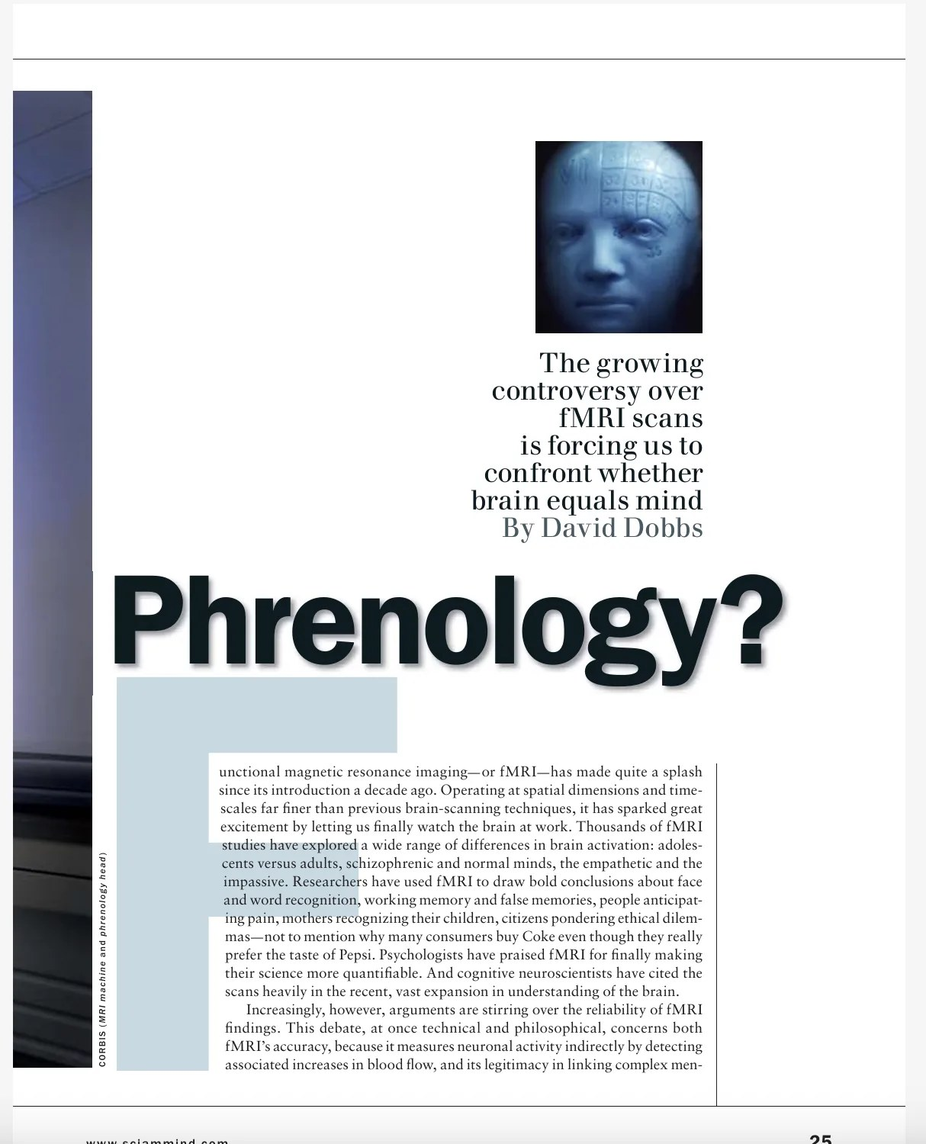
Neuroscience: A Modern Phrenology?
11

Slide 12
The Gap Between Brain and Mind
The idea of mapping psychological functions to brain structures has a venerable history, dating back to Galen’s ventricular doctrine (Green [2003]) and continuing to Gall’s phrenology (Gall and Spurzheim [1810]). Although those theories are now in disrepute, the advent of neuroimaging techniques, such as positron emission tomography (PET), functional magnetic resonance imaging (fMRI), electro-encephalography (EEG), and magnetoencephalography (MEG), gives the prospect of finding one-to-one correlations between psychological functions and brain structures new vigour, and the project is the main goal of the young field of cognitive neuroscience (Posner and DiGirolamo [2000]). Yet many doubt that cognitive neuroscience can give us such a psychological atlas, whereby the building blocks of mind get assigned to specific neural structures (Uttal [2001], [2011]). (De Brigard and Gessell, 2024)
12

Slide 13
References:
Dobbs, D. (2005). Fact or Phrenology?. Scientific American Mind, 16(1), 24-31.
De Brigard, F. and Gessell, B. (2024). The Mirage of Big-data Phrenology. The British Journal for the Philosophy of Science.
Stea, J. N., Black, T. R., & Di Domenico, S. I. (2022). Phrenology and neuroscience. In Investigating Pop Psychology (pp. 9-19). Routledge.
Uttal, W. R. (2011). Mind and brain: A critical appraisal of cognitive neuroscience. The MIT Press.
13
Notes:
While neuroscience involves far more rigorous and detailed methods of investigation into the operations of the brain than phrenology, we can note in passing that it has attracted criticisms quite similar to those levelled by Hegel towards the “neuroscience” of his day. See for example the following quote from a recent article by De Brigard and Gessell.
Despite the advances in science, for many today there remains a distinct gap between brain and mind, or the biological processing of signals and the rich descriptions of consciousness we get from philosophy, literature, art and religion.
How we understand this gap also affects our interpretation of the potential for machines to develop consciousness - our topic for next week. But for now, we need to look at how the concept of attention also applies to machine learning.

Slide 14
Machine Attention
Pre-2017: Recurrent, convolutional networks (RNNs, CNNs)
Problems: Recurrent networks degrade as the length of text grows
Attention already used in combination with architectures
But is Attention All You Need? The Vaswani et al. (2017) Transformers paper
Implementation by OpenAI: Improving Language Understanding by Generative Pre-Training (Radford et al. 2018): GPT-1.
14
Notes:
Vaswani et al.’s 2017 paper is a landmark in machine learning. Perhaps the most cited paper this century, this work by Google scholars was first actually implemented in a large generative language model, not by Google, but by a young start-up company, OpenAI.
There is an entire story of intrigue about how OpenAI was founded – with seed funding from Elon Musk – and eventually caught sight of this 2017 paper, understood its potential, and developed something called a “Generative Pre-Training” model (Improving Language Understanding by Generative Pre-Training).
Now we don’t have time or opportunity to fully talk through this paper and its technical details. We would need to venture too far into the history of neural networks and their application to language modelling. But we can say that prior to this paper, the state-of-the-art models were using recurrent or convolutional networks, sometimes with attention mechanisms built in.

Slide 15
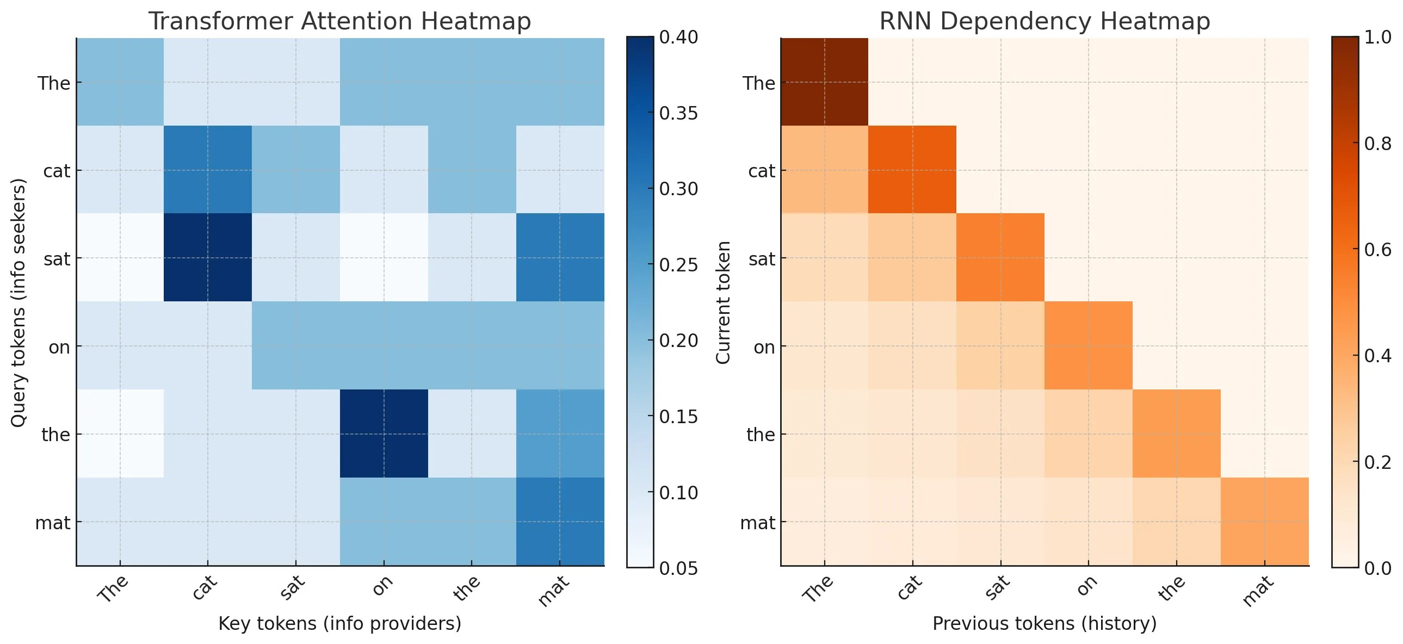
From linear to grid representations
15
Notes:
In short the problem with these systems was the need to maintain an ever-growing set of connections between the next token we would like to predict and the tokens or words that preceded it.
I’ve used two heatmaps generated by GPT-5 to convey the general idea: RNNs process tokens in a linear way, from left to right, just as we read. But we quickly develop a long set of connections between tokens.
Instead transformers require every token in a sentence or sequence to be related to every other - no matter how far apart they are in the sequence. This reduces the time involved both in training and inferencing or predicting, because a number of tokens can be processed in parallel. In recurrent neural networks, by comparison, each token depends upon the state of the preceding one, so the same kind of parallelism isn’t possible. This comes at the cost of the need for much greater computation and memory - effects of which we can see in today’s shortage in computer memory and graphics chips.
Shortly we’ll do a thought experiment that will hopefully make this more clear.

Slide 16
Some general terminology…
16

Slide 17
Tokens vs Words
Tokens are word-like pieces of data that are the foundational primitives of language models. Why not words? There are many words in natural language, but often they involve commonly recurring terms (e.g. morphemes, prefixes, suffixes: ‘un-’, ‘-ing’). Roughly 4 tokens per 3 words.
17

Slide 18
Training vs Inference:
Training involves building a large language model by processing large amounts of textual (or other) data, to develop up relationships between tokens.
Inference applies the trained model to a particular sequence, e.g. when you ask a question of ChatGPT.
18

Slide 19
Terminology continued…
19

Slide 20
Neural Network, Layers, Weights and Biases
Describes the structure of a language model: has interconnected nodes organized in layers. Each layer contains (typically) a weight matrix and bias vector.
Much of the difference between models involves details about the architecture of a network and its layers; how much the weights and biases are trained; and what data is used in training.
20

Slide 21
Feed forward / Backpropagation
1. First we estimate weights and biases, and generate a loss, measuring their accuracy.
2. Second we use calculus to update all the weights
3. Rinse and repeat, until loss is minimized.
21

Slide 22
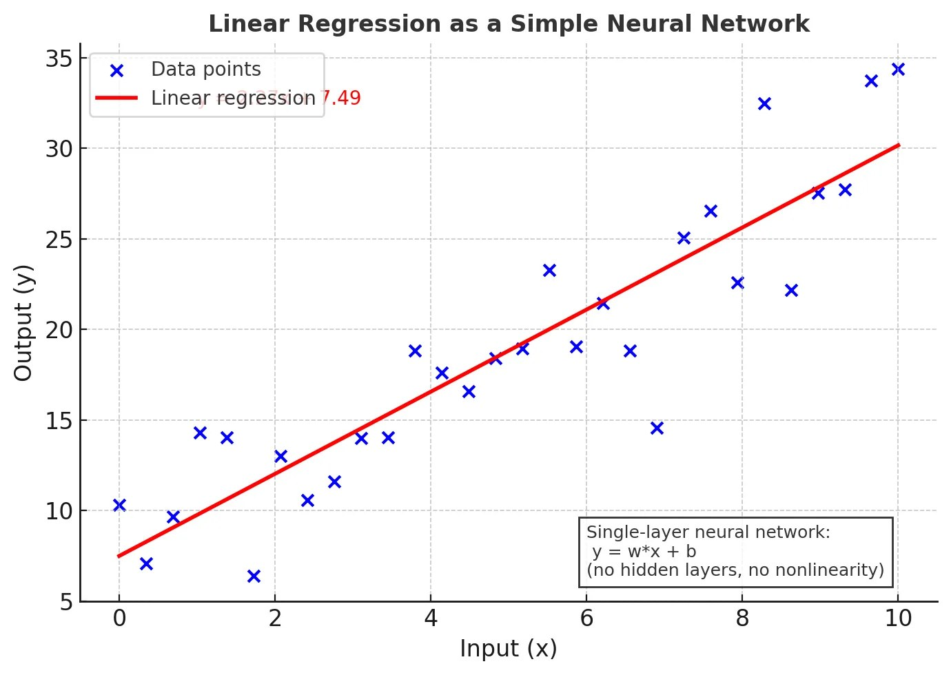
Is AI just fancy statistics?
Core Intuition: A language model approximates a function (with many parameters).
Typical multiple regression - a simplified 1-layer neural network:
y_{i} = β₀ + β₁x_{i1} + β₂x_{i2} + … + β_{p}x_{ip} + ε_{i}, i = 1, …, n
So training is the attempt to produce an (ever more) accurate approximation of this function, by adjusting its parameters against the data.
22

Slide 23
Attention is Three Matrices: Queries, Keys, Values
Queries: what each token is asking for from other tokens (in training or inference)
Keys: what each token offers to be matched against. The comparison of the key and query gives a score of the relative match of each other token to this token
Value: what the token represents (e.g. in syntax or semantic terms)
This process is what is meant by attention.
23

Slide 24
Thought Experiment
The cat sat on the…
24
Notes:
Let’s work through the following thought experiment. We will imagine we have the following unfinished sentence, and we’ll focus on the last word, the:

Slide 25
Sympathy for the Machine…
Query | Key | Weight
the | The | 0.05**
the | cat | 0.15
the | sat | 0.25
the | on | 0.50
the | the | 0.05**
** Because the rarely attends to other instances of the!
What does this set of probabilities refer to? The relevance or how much the word the attends to the other tokens in the sentence.
25
Notes:
Now let’s think about this from the machine’s point of view, during inference rather than training. We saw from preceding discussion that this word the maintains a place in three lists of words or tokens:
- Query
- Key
- Value
We are considering the second the as our query word, and we want to know what word should follow. We first compare it with every other word in the sentence, checking against their key values. This generates an initial set of probabilities, for which I’ll just use some example values:
Query Key Weight
------- ----- --------
the The 0.05**
the cat 0.15
the sat 0.25
the on 0.50
the the 0.05**
** Because the rarely attends to other instances of the!
What does this set of probabilities refer to? The relevance or how much the word the attends to the other tokens in the sentence. We are primed, in other words, more strongly in favour of ‘on the’ than anything else.

Slide 26
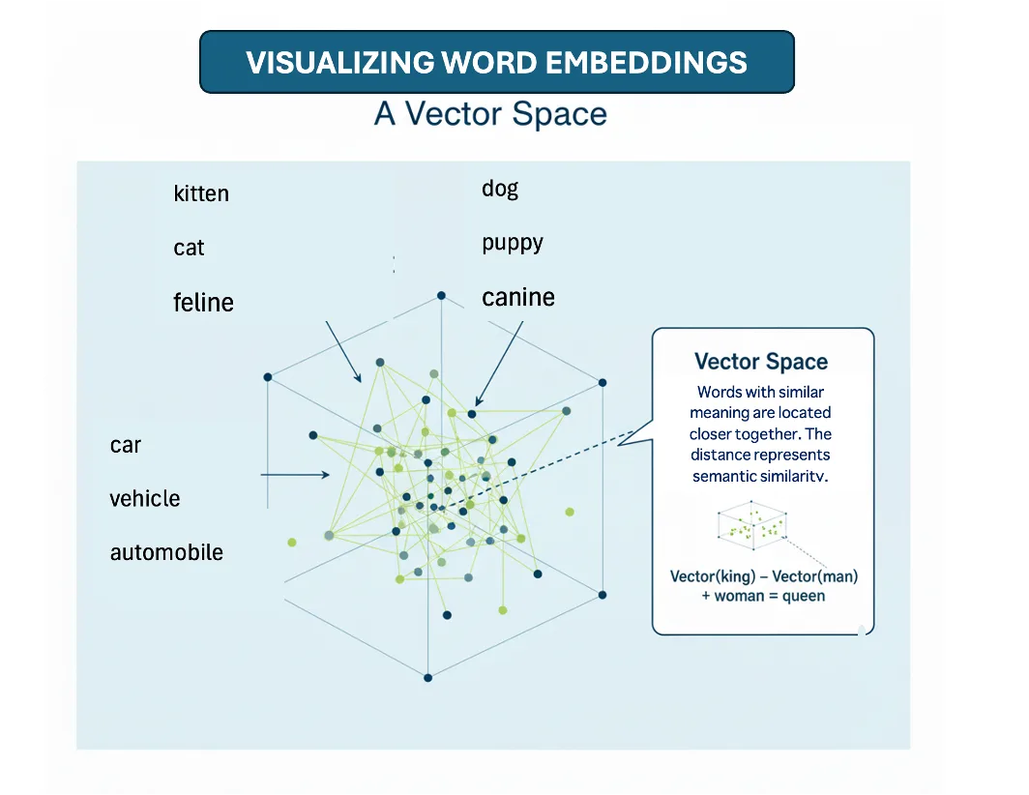
From Attention to Context
26
Notes:
Now each of these tokens – the, cat etc – also contains a set of numbers relating to their values. The values are – if you like – the semantic space of the word: the cattiness of the ‘cat’ (noun, animal, furry, etc); the sittingness of the ‘sat’ (verb, temporal, positional, etc); the on-ness of the ‘on’ (preposition, relational term); the the-ness of the ‘the’ (definite article, applies to nouns, connected to preposition). But also tied to the context of the current sentence.
So once we have a sense of relative attention – how the ‘the’ relates to other words in the sentence – we combine the values, which we can think of as a hybrid syntactico-semantic representation, with these attention weights.
This produces a context that governs prediction.

Slide 27
Iterated Context: From tokens to quasi-phrases / sentences
‘the’ is no longer just a word or token
its ‘the’-ness becomes a kind of 0.55 * ‘on’ + 0.25 * ‘sat’ etc.
All of these influences, derived from repeated attention, make ‘mat’ a more likely continuation.
27
Notes:
This process is repeated over several or many layers of a network. At each layer we develop a richer representation of this context for each token. The mathematical representation of the ‘the’ we are looking at accumulates the influence of the other tokens it attends to - and so do these other tokens themselves. These ultimately help to narrow the scope – or increase the bias - toward particular tokens such as ‘mat’.
The ‘the’-ness becomes a highly specific and contextualized ‘the’-ness that is paired strongly with a prepositional phrase; is associated with a spatio-temporal situation - one of sitting; and is (less strongly) influenced by an agent. None of these roles are hard-coded; they are learned by the network. But at the same time they resemble the rules of grammar and meaning we are used to.
All of these influences, derived from repeated attention, make ‘mat’ a likely continuation (from within the wider set of the model’s vocabulary).

Slide 28
From Context to Prediction
Token | Probability
the | 0.01
cat | 0.01
sat | 0.01
on | 0.01
mat | 0.80
dog | 0.08
house | 0.08
28
Notes:
This learned context is applied to every item in our initial vocabulary. That would include all the words we have used, plus (in a toy example), other nouns like ‘mat’, ‘dog’, ‘house’. This produces a final set of probabilities:
And finally: we roll a virtual die, and produce a set of predictions. In this toy example, 80 per cent of the time the predicted completion of the sentence will be ‘mat’.
Note that this 80% of the time - not 100% - is what makes LLMs often ‘probabilistic’, ‘stochastic’ and ‘non-deterministic’.
As a further note: You might also imagine all of this computation gets expensive for (a) large vocabularies (like multiple human languages) and (b) long contexts (like novels). That is true! And why companies like Nvidia and TSMC have such extreme valuations today - to train and do inference on attention-based mechanisms involves hardware investments in the order of tens or hundreds of billions of dollars today.

Slide 29
What about human attention?
Let’s continue now with a further rough experiment.
Start by attending to the following words I say:
The cat sat on the...
29

Slide 30
Now when I said:
Start by attending to the following words I say:
You are alerted. You have to shift from an everyday state to an alerted one, maybe by the fact that I’ve issued an imperative: ‘Start’.
What follows is your orientation to what actually does follow from the words ‘the following words I say’. You are oriented towards the completion:
The cat sat on the...
30

Slide 31
Executive Functions and Metacognition
Do you:
1. Complete the sentence?
2. Keep listening to what I say?
31
Notes:
But then you are also possibly primed to the visual and audible incompleteness. The sentence doesn’t end, instead your lecturer continues on with his exposition. The executive functions need to decide. What do you do? Do you:
1. Complete the sentence?
2. Keep listening to what I say?
Or both? Because this is a trivial case, you can complete the sentence very fast, and I’m not speaking too fast. Or do you resist the completion – ignoring my command altogether, or completing the sentence with another word?

Slide 32
Questions on human attention
Think for a moment about this final activity. Is your completion different to the LLM? How much of this - pointing ahead to next week’s topic – is conscious or unconscious? Do you – like the Transformer model – draft a list of candidates, and pick the most likely? Is there a kind of metacognitive aspect that enables you to determine to sustain or switch your attention? Can you refuse to complete what you ought to - what your training suggests?
32

Slide 33
Similarities and differences
Curious that two very different mechanisms use the same term “attention”
Really it is metaphorical - substantial differences in what these systems do, and at what scale:
Computational attention: word-to-word (or pixel), over and over
Human attention: layered through quite distinct processes (alert > orient > execute)
But in some sense can we also see some important similarities - especially when we compare textual interpretation (reading) / next token prediction (writing)?
33

Slide 34
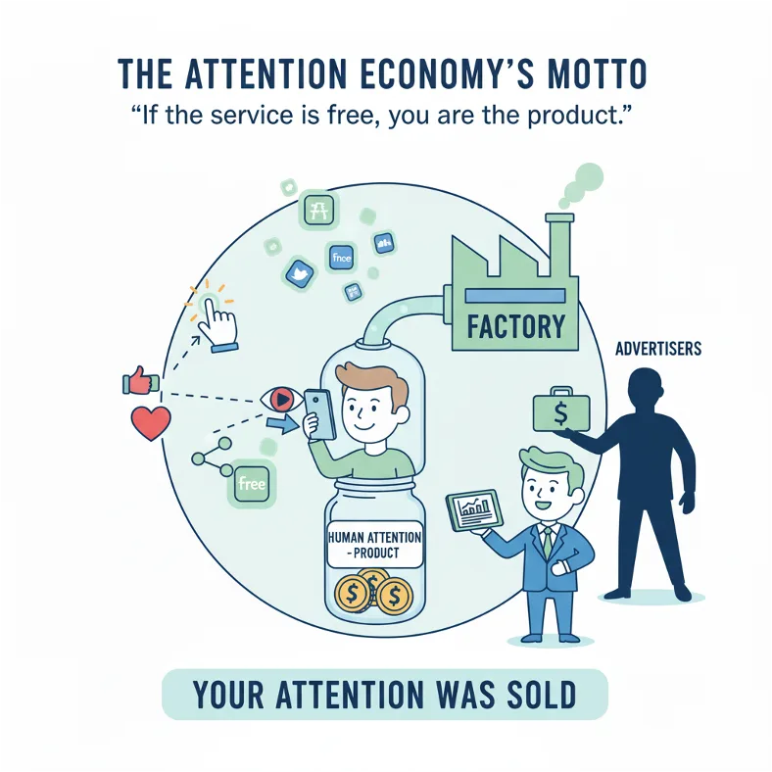
Make Content, Get Attention… Profit?
34
Notes:
Turning now to Terranova’s article, we come to the idea that attention is a kind of commodity and even capital, marked - like all commodities – by scarcity. It is an object that in itself warrants the attention of capital, of investors and advertisers, in the context of digital media. This is of course not new - the nephew of Sigmund Freud, Edward Bernays, pioneered many uses of what was then, in the early/mid twentieth century, new media, such as radio, magazines, film and television. But with the maturation of computers, the Internet, smartphones, social media and, today, AI, we come to a point at which we see attention as corroded or “degraded” by information. There is so much information, in other words, that human attentive processes become saturated, barely able to keep up.
Terranova argues, citing Nicholas Carr, Catherine Malabou, Jonathan Crary and others, that precisely the kind of neuroscientific research we discussed earlier makes possible a new corresponding industrialization of attention. By developing sophisticated techniques for securing attention (at alerting and orienting levels), it also seems as though the higher order “executive functions” are disrupted. In particular, the ability to “switch” is impaired - we find ourselves staring at the screen long past the point at which we intended to, when we initially and intentionally sought distraction.

Slide 35
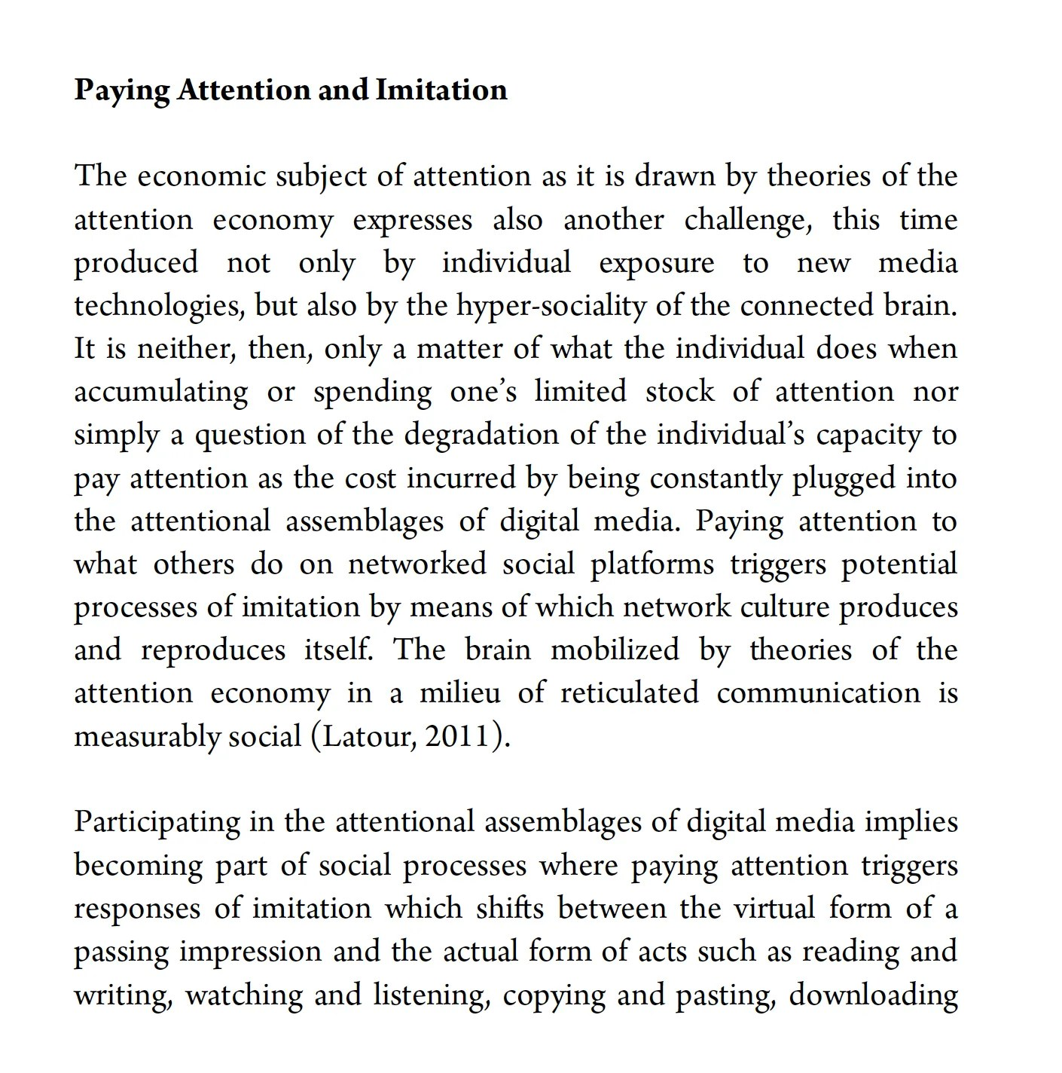
Attention and Imitation
35
Notes:
In a turn that also reminds us of our discussion of Hegel and the social process of learning, Terranova then discusses how attention to digital media in turn leads to another kind of by-passing of the deeper attention marked by executive function, due to social imitation.
But this need not be entirely negative. Here Terranova turns to another Italian theorist, Lazzarato, and his treatment of attention as the condition of social labour – and therefore a positive and productive force.
But Terranova’s discussion takes a negative turn again, through the work of Bernard Stiegler. Stiegler – a French philosopher writing on technology since the 1990s – famously argued that contemporary technologies short-circuit important cognitive processes of memory and social processes of communication, resulting in, as Stiegler put it, a grave risk of “proletarianization”. Primal psychic and libidinal energy gets put to service, in this analysis, in the creation of value for companies that can direct our collective attention via “social technologies” and “new forms of social relations”.

Slide 36
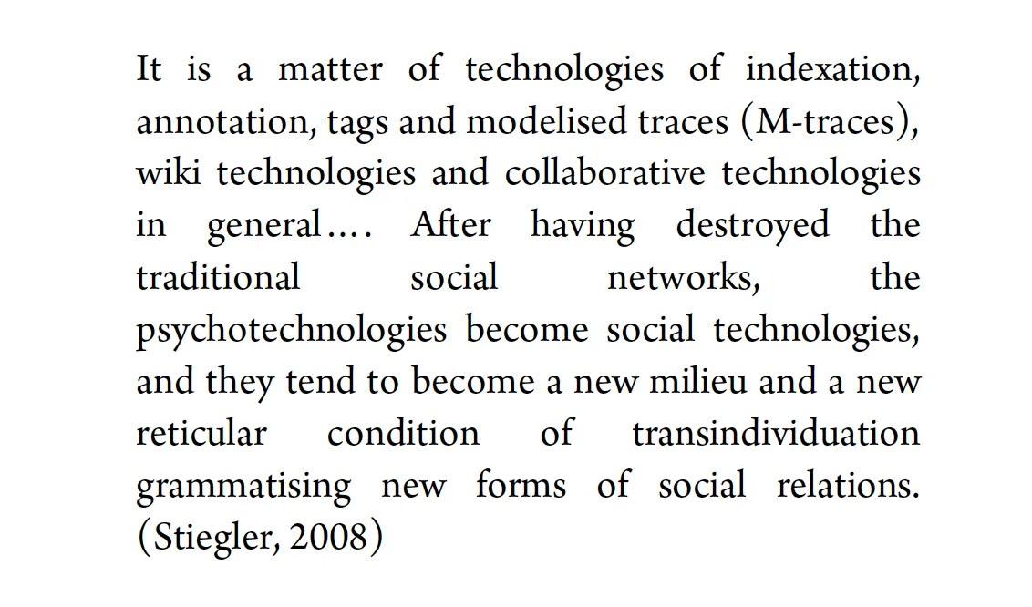
Cooperation or Proletariatanization?
36
Notes:
Collecting up both Lazzarato and Stiegler’s arguments, Terranova claims that – despite the very different valences or attitudes each brings to their analysis – both authors see attention as not simply a store of human attention that is only degraded by technologies. Rather, those technologies redirect attention, which in turn makes possible new kinds of subjects and social relations. For Lazzarato, technology actually makes humans cooperate in ways that can resemble the internal structure of an individual brain. For Stiegler, technology is similarly integral to all human cognitive and social activity – but in its current form (the Internet, social media, and the general capitalization of attention and associated “libidinal” energies), it is tending toward the production of a simplified, proletarianized and even stupefied society.

Slide 37
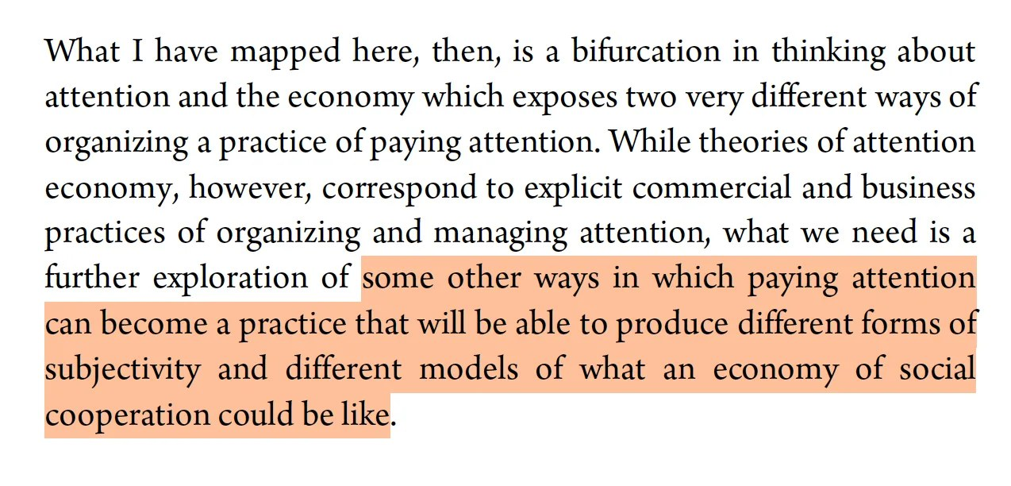
Is Attention a Design Problem?
37
Notes:
The reason for including Terranova’s analysis – aside from its wide-ranging survey of recent debates – is that in a certain sense it elaborates upon Hegel’s insistence that self-consciousness and learning is essentially social in nature. Indeed both Lazzarato and Stiegler’s positions, which Terranova surveys, can be seen as extensions to Hegel’s insight, though adjusted for the dramatic effects wrought by informatic technologies.
The individual human subject is affected by what others say and do, and digital technologies act like a concentrating device of those social habits. Let’s exaggerate: every tweet, post or Tiktok we read or watch acts like a small encounter between two self-consciousnesses, which must resolve itself into a micro-master / servant dialectic enounter. Do we like the content, do we stay engaged to it - are we in other words, a servant to it? Or do we criticize, disengage and ultimately walk away? Is our self-regulation of our own attention a method also of self-mastery that resists servitude to others? Or are these attention-grabbing technologies too powerful for self-regulation, and do we need to treat attention management as a collective design problem?
And where does this then bring us with respect to a technology that arguably exceeds what Terranova, Lazzarato and Stiegler could ever have anticipated in terms of its potential capture of human attention - precisely via application of its own “attention” mechanisms?
In the reading on cognitive lock-in, Mark Hansen argues that as we enter the era of machine learning, platforms will increasingly predict, and thereby control, even more fundamental processes than our attention: our conscious thinking itself. ‘Lock-in’ refers to a situation where leaving a vendor is difficult because of the legacy investment in that vendor. Hansen’s point is that our commitment to a given AI system will create, at a personal and psychological level, a similar inability to leave that system - it will have made us dependent upon it cognitively (and perhaps also affectively).

Slide 38
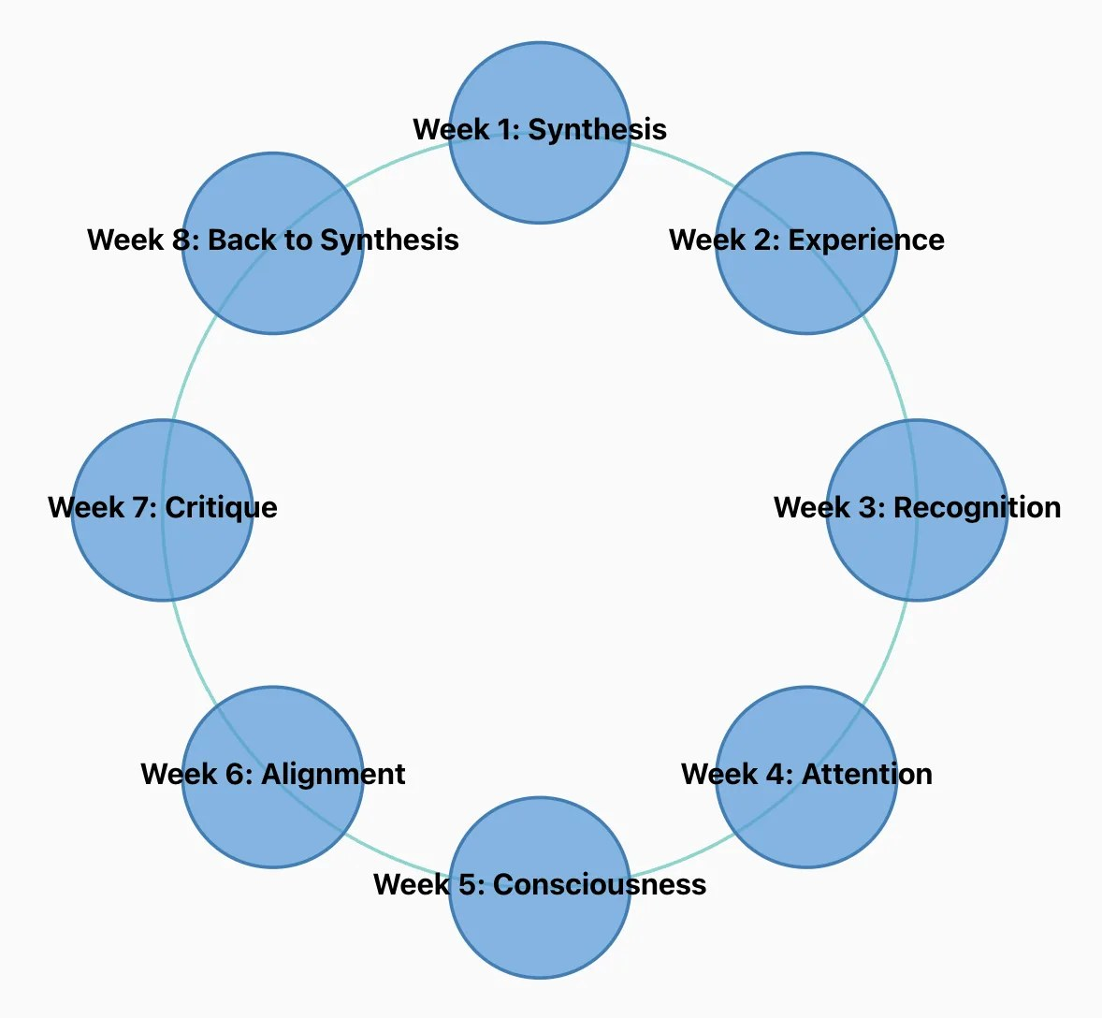
Synthesizing Human and Machine Attention?
Posner on the role of attention in development and learning:
Michael Posner: Implications of Cognitive Neuroscience for Education (gocognitive)
Michael Posner on the anatomy of attentional networks: a historical perspective (gocognitive)
38
Notes:
According to many neuroscientists, attention is seen as critical to the operations of consciousness. In recent discussions, neuroscientists like Posner have also emphasized the experimental and social nature of attention formation, even in infants as they shape their alerting, orienting and executive facilities. Surprisingly, neuroscience may not be so far removed from Hegel’s speculations on the nature of consciousness.
Next week we focus on this concept, bringing closer together Hegel’s ideas on consciousness and self-consciousness with other theories. We’ll see how some scholars, like N. Katherine Hayles, have sought to combine research into both human cognition and machine learning with more traditional philosophical concerns about the nature of consciousness. We will revisit attention, but also consider ideas of the “unconscious” – developed originally by Freud, but surprisingly relevant in the world of machine learning too – as well as Katherine Hayles’ work on what she terms “nonconscious cognition”, operating in the world of machines.

Slide 39
From Absolute Spirit to the General Intellect and Social Mind (Terranova, Hansen)
One view of machine learning: it is a social product that helps us realize a collective intellectual potential
Return to this in Week 7.
39

Slide 40
Break-out Rooms
How useful is the concept of attention in understanding similarities and differences between machine and human learning?
How might the machinic concept of attention limit its ability to learn? What about human attention - is this mechanism a limitation to learning, especially in the digital age?
Terranova and Hansen present critical views on how attention is monetized and controlled. But are there positive sides to this?
40

