Slide 1
ERAM 590 - AI and Academic Literature

Slide 2
Lecture 1

Slide 3
Welcome to AI and Academic Literature
What is this course about? Do we need another course on academic literature?
Foundational: How to Develop a Literature Review
Future-Oriented: How AI is Impacting Academic Literature / Scholarship
Mix of Theory and Practice

Slide 4
Overview
How do you build a sense of your field and its gaps? This course aims to make sense of a term – academic literature – at once mundane and mystical. It starts with fundamentals: how to build, annotate, analyze, map and translate a literature database into a literature review. It progresses to think about how AI and other technology can help foster more critical, analytic and reflexive modes of interpretation and understandings of the field.
All required material (video lectures, readings etc.) will be provided to students.

Slide 5
What we’ll cover…
Week 1 - Course Overview / What’s a Good Research Question? / AI tools for literature
Week 2 - Where’s the Gap? Mapping a Field / Anatomy of a Journal Article
Week 3 - Does Artificial Intelligence mean Artificial Knowledge? How AI is Impacting Academia / Vibe Scholarship (Is It as Bad as It Sounds?)
Week 4 - Academic Audiences and Techniques of Persuasion / Finding Your Scholarly Voice: Peers / Audience / Venue / Field
Week 5 - “What Do I Know?” Towards A Sociology of Knowledge / Designing a Literature Review
Week 6 - The Reflexive Researcher
Week 7 - The Automatic Academy? The Future of Scholarship

Slide 6
Assessments: Building a ‘Mock’ (or Real) Literature Review
The aim of the course is to build a cumulative literature review. It is a course in which to experiment with different approaches to engage with literature. Accordingly assessment will focus less on the “correctness” of the final output and more on week-to-week engagement with course materials and activities.
That all said, the purpose of the course is to support a dissertation / journal article / other academic writing – to that extent, if the final output does serve other purposes, well and good!

Slide 7
Assessments: Building a ‘Mock’ (or Real) Literature Review
Week 1: First Draft of Research Topic / Research Question (10%)
Week 2: Design, Method and Structure of the Literature Review (10%)
Week 3: Concept Map of the Literature (10%)
Week 4: Literature Review Sample: In the Scientific Mode / In the Humanities Mode (10%)
Week 5: Literature Review: Signposting (10%)
Week 6: Statement about the use of AI in your Literature Review / Reflection about the role of AI in academia (10%)
Week 7: Final Literature Review (40%) - Due Friday Dec 12

Slide 8
Week | Theory | Practice | Assessment
1 | Course Overview / Anatomy of a Journal Article / What Makes a Good Research Question? | AI Tools for Literature | First Draft of Research Topic / Research Question
2 | Academic Audiences and Techniques of Persuasion | Where’s the Gap? Mapping a Field | Design, Method and Structure of the Literature Review
3 | Does Artificial Intelligence Mean Artificial Knowledge? How AI is Impacting Academia | Vibe Scholarship (Is It as Bad as It Sounds?) | Concept Map of the Literature
4 | Finding Your Scholarly Voice: Peers / Audience / Venue / Field | Drafting a section of your review in a scientific and humanities mode | Literature Review Sample: In the Scientific Mode
5 | “What Do I Know?” Towards A Sociology of Knowledge | Framing Language: “Carry” Your Reader | Frame up your Literature Review
6 | The Reflexive Researcher and Interpreting Scholarship | Reflecting on your positionality vis-a-vis interpretation; drafting a statement about AI’s epistemic role | Statement on the Use of AI in Your Literature Review / Reflection on the Role of AI in Academia
7 | The Automatic Academy? The Future of Scholarship | Compiling a complete literature review | Final Literature Review

Slide 9
Rubric / Criteria
Develop novel, significant and feasible research question
Compile relevant map of the field relating to the research question
Choose and apply appropriate citation practices (science / humanities / mix) for question & field
Use framing / signposting / metadiscursive language
Show reflexivity as a scholar
Acknowledge and demonstrate appropriate use of AI
Use all of the above to highlight a plausible gap in the literature

Slide 10
Approach
“Industry” orientation: move fast and break things!
Quick sketches of a literature review - with AI (and caveats)
Why? The idea is to build intuitions about (a) how to review literature and (b) how to write-up those reviews quickly
Peer review: really more like turning an individual pursuit into something social.
AI Orientation:
Understanding that knowledge has always had a technical orientation (paper, printing press, media, computers, Internet)
But we need a critical lens; looking ahead to how technology should make us work harder intellectually (not easier)

Slide 11
Format
We’ll use the 3 hours flexibly
2 x 10 minute breaks on the hour
The 3 hours will encompass (most of) the assessment
Mix of mini-lectures / discussion / group-work
With discussion - we’ll aim to build a lightweight notebook on good literature search / reading / review practices
AI exercises
Mix of theory / practice

Slide 12
Discussion and Introductions
What is Literature? What is a Literature Review?
What is Changing? How is AI Impacting Scholarship?

Slide 13
Notes on Software Note-taking…
Encourage everyone to use some software (Obsidian etc)
Try to learn Markdown / Zettenkettel…
My own NightOwl - Why?

Slide 14
Mechanisms for Collaborative Document Editing
What we need:
A “continuous document”
Ability to share with peers & annotate
Box / Microsoft Office? HIPAA-compliant but cumbersome
Canvas options?
Google Docs? Not HIPAA-compliant
ERAM 590 - Google Docs

Slide 15
What Makes a Good Research Question? (and is that a “Good Research Question”?)
Partly a question of feel - experienced researchers know a good question when they see it
Sources:
Informed by literature: what key problems are unsolved?
Informed by events: what is happening and how do we explain it?
Informed by circumstance: it annoys me no-one can answer this question - perhaps I can?
Informed by disposition: I just love working on – or want to know more about – X.
Informed by sociality (FOMO): All the cool kids work on X - should I be working on it too? Or should I not be working on it?

Slide 16
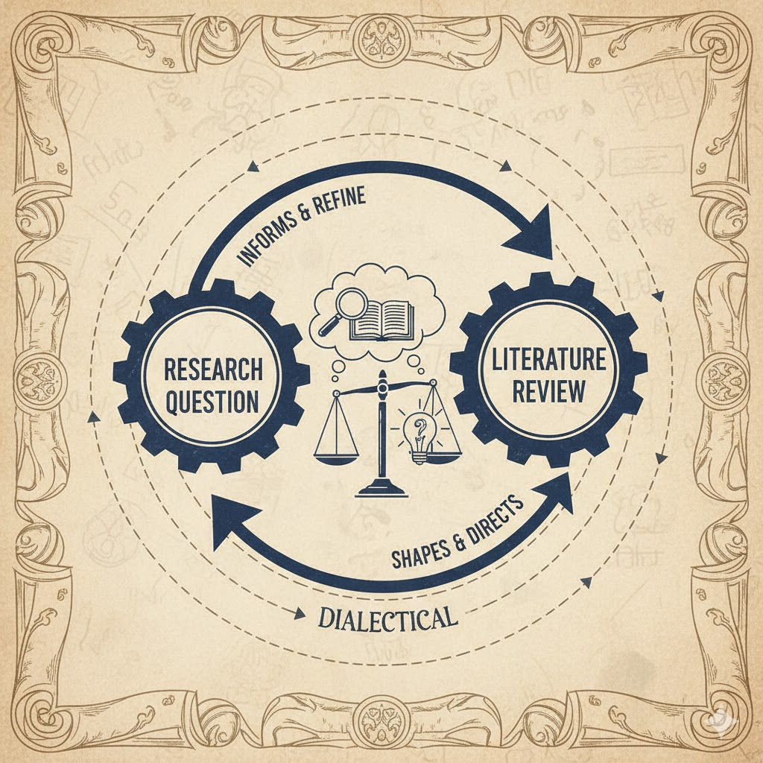
What Makes a Good Research Question? Relationship to literature
Should I dream up a research question from thin air? Should I wait until I’ve done a systematic literature review?
Think of the relationship between research question and literature review as dialectical (each directing the other):
Think of a draft topic / question
Search on the topic / question. Is it answered? Wholly or partly? Which parts remain?
Image

Slide 17
What Makes a Good Research Question? Practicalities
Does the research question need an answer? Is it necessary? Or does it provoke a “so what?” response?
Is it doable and feasible? Or would I need 100 years / 1 billion dollars / a vast research team to do it?
Will I be able to answer this question with methods that I know and data that I can access?

Slide 18
What Makes a Good Research Question? Novelty
Has this question been answered before?
Not always obvious… Many different literatures, disciplines, traditions work on related problems.
Is it novel for good reasons? No one needs an answer to it, or it is unanswerable through research (does God exist?)
Is it likely to remain novel throughout my research? Think of AI: “No one has studied the impact of Gemini 3 / ChatGPT 6 on student learning” (because these systems aren’t released yet - but once they are, the studies will follow).

Slide 19
What Makes a Good Research Question? Consequences
What happens when I know the results
Is it doable and feasible? Or would I need 100 years / 1 billion dollars / a vast research team to do it?
Will I be able to answer this question with methods that I know and data that I can access?

Slide 20
Class discussion
We’ll all need a candidate research question / topic
Doesn’t need to be your dissertation!
Breakout groups: work on a pseudo-topic
Document the topic!

Slide 21
Readings
Weber, M. (1946). Science as a Vocation. In Science and the Quest for Reality (pp. 382-394). London: Palgrave Macmillan UK.
libguides.umn.edu. n.d. “Characteristics of a Good Research Question - Literature Searching - Research Guides at University of Minnesota Minneapolis.” Libguides.umn.edu. [https://libguides.umn.edu/c.php?g=1337354&p=9854773].

