Slide 1

590 Lecture 2
Week 2 - Anatomy of a Journal Article / Where’s the Gap? Mapping a Field
Overview:
What is a Journal Article? What is a Literature Review? (hours 1)
Mapping a Field (and Minding the Gap) (hour 2)
Design, Method and Structure of the Literature Review (hour 3)

Slide 2
Recap on Week 1
What is this course about? Do we need another course on academic literature?
Foundational: How to Develop a Literature Review
Future-Oriented: How AI is Impacting Academic Literature / Scholarship
Mix of Theory and Practice
How do you build a sense of your field and its gaps? This course aims to make sense of a term – academic literature – at once mundane and mystical. It starts with fundamentals: how to build, annotate, analyze, map and translate a literature database into a literature review. It progresses to think about how AI and other technology can help foster more critical, analytic and reflexive modes of interpretation and understandings of the field.
All required material (video lectures, readings etc.) will be provided to students.

Slide 3
Recap on Week 1
Week | Theory | Practice | Assessment
1 | Course Overview / Anatomy of a Journal Article / What Makes a Good Research Question? | AI Tools for Literature | First Draft of Research Topic / Research Question
2 | Academic Audiences and Techniques of Persuasion | Where’s the Gap? Mapping a Field | Design, Method and Structure of the Literature Review
3 | Does Artificial Intelligence Mean Artificial Knowledge? How AI is Impacting Academia | Vibe Scholarship (Is It as Bad as It Sounds?) | Concept Map of the Literature
4 | Finding Your Scholarly Voice: Peers / Audience / Venue / Field | Drafting a section of your review in a scientific and humanities mode | Literature Review Sample: In the Scientific Mode
5 | “What Do I Know?” Towards A Sociology of Knowledge | Framing Language: “Carry” Your Reader | Frame up your Literature Review
6 | The Reflexive Researcher and Interpreting Scholarship | Reflecting on your positionality vis-a-vis interpretation; drafting a statement about AI’s epistemic role | Statement on the Use of AI in Your Literature Review / Reflection on the Role of AI in Academia
7 | The Automatic Academy? The Future of Scholarship | Compiling a complete literature review | Final Literature Review

Slide 4
Anatomy of a Journal Article
Think back to Weber: the “Journal Article” is the vehicle of choice for transmitting science (German: Wissenschaft, or what we would call knowledge)
We read dozens, hundreds, thousands…
Our life is conditioned by the results of journal articles
For example, “AI” is today completely dominated by a single paper, “Attention is All You Need” (GS cites: > 200K)
But what is a journal article? How do you analyze one? How do you write one?

Slide 5
Quick history:
The “journal” is a recent invention
Convenient communication of science (17-19th centuries)
Involves the following “ontology”:
A collection of articles
bold textAuthors of the article
An editor (who reviews and assembles articles)
Peer reviewers (other scholars who the editor invites to review articles)
A publisher (who recruits the editor, typesets, sells and distributes the journal to readers)
A readership (who subscribes to the journal - very often university libraries)

Slide 6
Aside: Perversity of Publishing
University libraries pay subscriptions to the publisher for articles that its own employees have authored (and edited and reviewed)
Why?
Are there alternatives?
Open access publishing (but questions of sustainability of volunteer labour / reputation / distribution reach)
Rise of “predatory publishing” (& dreaded “Article Processing Charge” - upto $8K USD)

Slide 7
What is the purpose of an article?
An article makes an argument
As such, it is a form of persuasive writing
It aims to change the mind of a reader
But to do so, it must use evidence (and other things)
All the parts of an article should contribute to this aim: persuasion

Slide 8
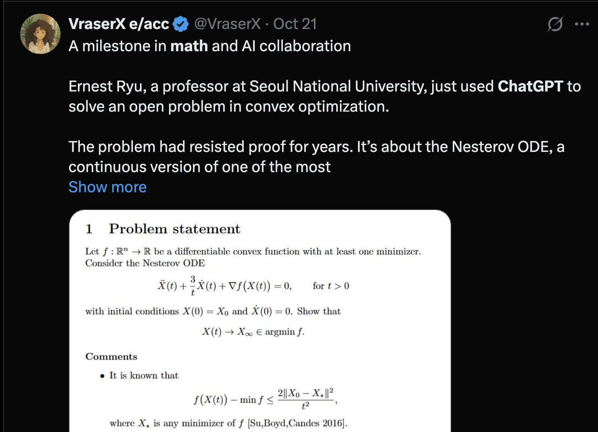
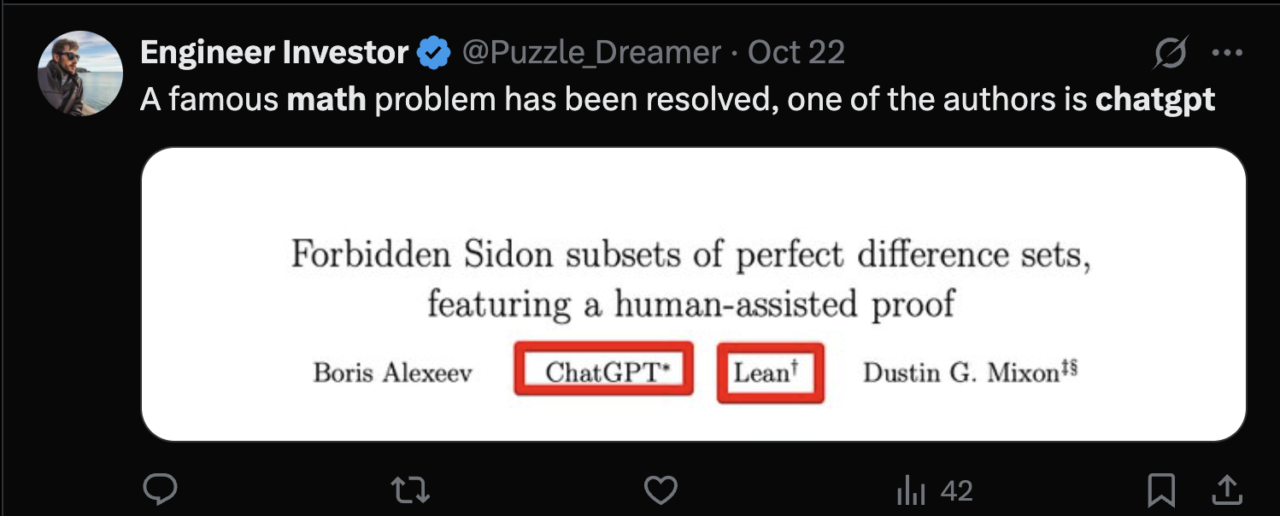
Another aside: AI Authorship of Journals
Would you read an article by a bot? Under what circumstances?
What about a math paper?
Image
Image

Slide 9
Typical structure of an Article
Introduction
Literature Review
Methodology
Findings
Results
Conclusion
But why? Why these parts?
Let’s answer this collaboratively:
ERAM 590 - Google Docs

Slide 10
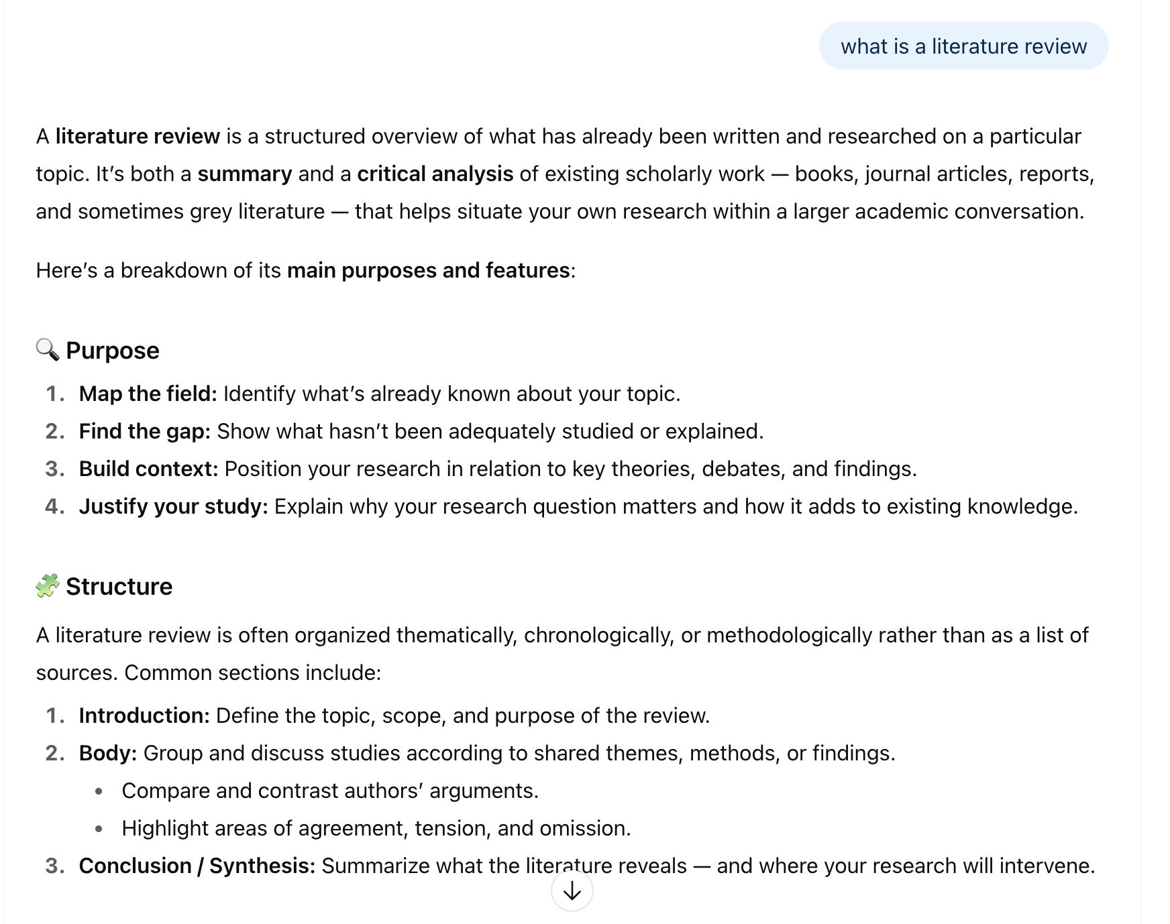
What is a literature review?
Lots of answers, lots of guidance…
Literature Review Guidelines – Learning Design and Leadership (LDL) Program
Writing a Literature Review - Purdue OWL® - Purdue University
Literature Reviews – The Writing Center • University of North Carolina at Chapel Hill
Image

Slide 11
Designing a Literature Review
We have a Research Question / Topic
What’s next? Just blast out a search on Google Scholar / University Website? Build a list of references, annotate, summarize, organize? Find the gap?
But can come across as arbitrary
Or: think of the Literature Review as a mini-research project within the project ( / article / dissertation)

Slide 12
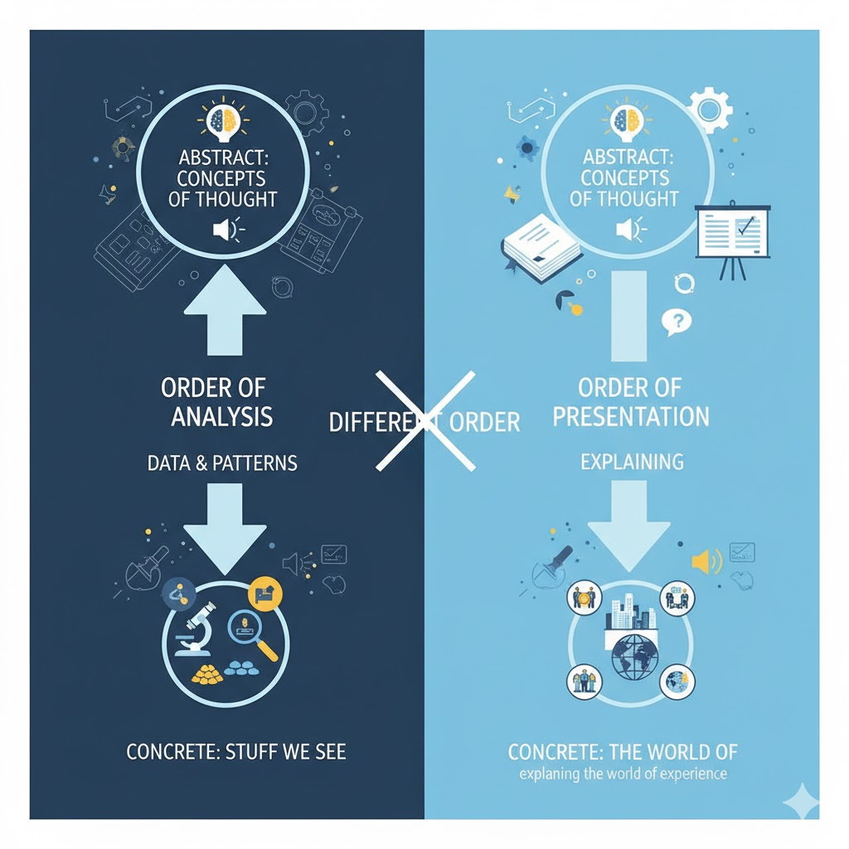
Learn from Marx?
Order of analysis is different from order of presentation
In analysis we go from concrete (stuff we see) to abstract (concepts of thought)
In presentation, we go from abstract (concepts) to concrete (the world of experience) - explaining the world of experience
Image

Slide 13
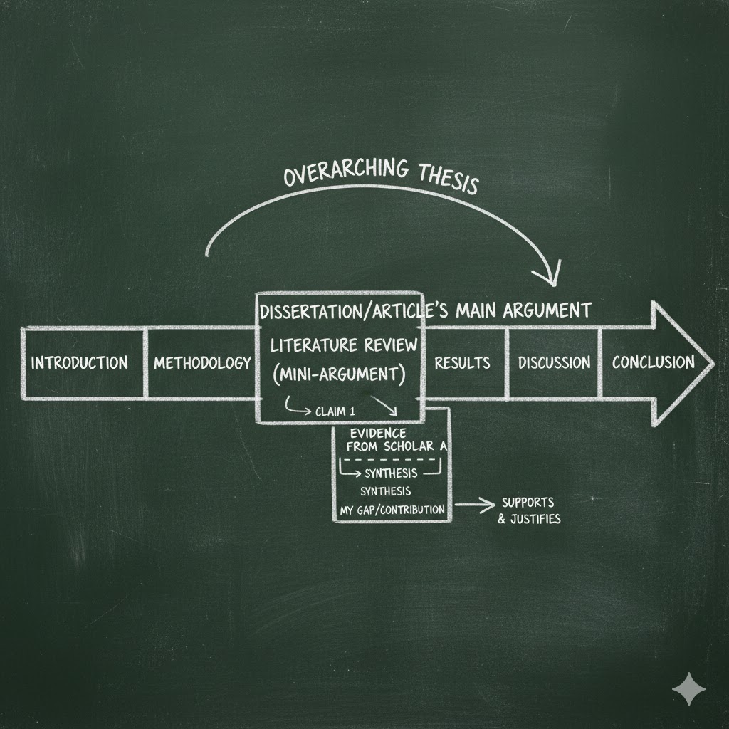
Google Gemini’s view
“create an image showing how a literature review is a mini-argument embedded within the larger argument of an article or dissertation”
Image

Slide 14
Hour 2 (might get here early)…
Mapping Fields and Minding Gaps

Slide 15
What’s the “research question” of the Literature Review
What’s the gap in the literature? (should eventually coincide with the research question)
What are you arguing? That this gap exists… (perhaps other things too)
Develop a Methodology:
Choose relevant search terms (think about AI’s ability to translate the terms you think of to the ones you don’t)
Pick a couple of relevant articles and read the references
Choose an organization principles:
Organize by theme? What are the themes?
Organize by time? How have debates on topic X evolved?
Construct an Introduction and Conclusion

Slide 16
Metaphors of Knowledge: Navigating fields and finding gaps
What is the field? Talk your reader through it…
What is the gap? Tell your reader how you get there…
work backwards - find the gap, then organize the steps…
Use the language of argument / metadiscourse:
If we are on a “path” through the “field”, join the dots:
Move up / down: general - specific
“More generally…”, “At an abstract level”, “Theoretically…”, “Globally / Nationally…”
“More specifically…”, “At an concrete level”, “Pratically”, “Locally
Move side to side: similar - different
“Similarly…”, “Along the same lines…”,
“However…”, “Conversely…”, “On the other hand…”, “In contrast…”
“Control” your navigation:
“This review will cover…”, “The literature describes several facets of…”
Add some drama: “Meanwhile…”, “Despite…”, “X has dispute Y’s findings…”
“This review has covered…”

Slide 17
Work it like a Puzzle
Look at the whole picture - does it make sense?
Fill it in piece by piece
Iterate - whole to part, part to whole
More vocabularly: the Hermeneutic Circle
Understand the Whole (in order to Interpret the Path)
Interpret the Path (in order to Understanding the Whole)

Slide 18
Common Pitfalls
The Annotated Bibliography and the Literature Review
Tone: Navigating The Two Cultures (see Snow 1959)
Lack of Signposting / metadiscourse / discourse markers / rhetorical statements
Lack of persuasive purpose
Laundry list of gaps -> Narrow down on the one / two that you are likely to follow

Slide 19
More on tone…
Tone: Navigating The Two Cultures (see Snow 1959)
Scientist / Quantitative / Positivist
Lots of 3rd person / passive voice (“It was observed that…”) - But note, this is changing
Humanist / Qualitative / Post-positivist or Interpretivist or Constuctivist
More 1st person / active voice (“We noticed that”)
In the field of education, both “cultures” co-exist (sometimes even peacefully)
How do you decide on your tone?

Slide 20
Two (or Three) (Pseudo-)Random Articles
Keerthiraj, & Misra, A. (2025). Who owns the future? AI, digital sovereignty, and the politics of knowledge. AI & SOCIETY, 1-13. https://link.springer.com/article/10.1007/s00146-025-02641-y
Liu, J., Zhang, Y., Li, W., Wang, Q., Niu, P., & Zhang, X. (2025). Adaptive vs. Planned Metacognitive Scaffolding for Computational Thinking: Evidence from Generative AI-Supported Programming in Elementary Education. Computers & Education, 105473. https://www.sciencedirect.com/science/article/pii/S0360131525002416?casa_token=cBNpQ0r7f4oAAAAA:THnluE0eVY1uTJ3bnp1V6j-fsLEXobOB6QqoszFx_hsNacpAVPMmIe61gO70IXtFPiT2vIRcGPk
Spivak, G. C. (2023). Can the subaltern speak?. In Imperialism (pp. 171-219). Routledge. http://users.uoa.gr/~cdokou/TheoryCriticismTexts/Spivak-Subaltern.pdf
Why these two (three) examples? Contrasting methods, yes - but more than this, these articles reflect different orientations towards scholarly techniques of persuasion

Slide 21
First: What do we do when we open an article?
What are the different ways of reading?
2 Common Strategies:
Top to bottom
Abstract, Introduction, Conclusion - then the rest
Sometimes:
Literature Review first
Methodology first (what did the researchers do?)
References first (what “space” of academia does this belong in?)
Other ideas?
ERAM 590 - Google Docs

Slide 22
Who owns the future? AI, digital sovereignty, and the politics of knowledge Keerthiraj, & Misra, A. (2025)
Keerthiraj, & Misra, A. (2025). Who owns the future? AI, digital sovereignty, and the politics of knowledge. AI & SOCIETY, 1-13. https://link.springer.com/article/10.1007/s00146-025-02641-y

Slide 23
Adaptive vs. Planned Metacognitive Scaffolding for Computational Thinking
Liu, J., Zhang, Y., Li, W., Wang, Q., Niu, P., & Zhang, X. (2025). Adaptive vs. Planned Metacognitive Scaffolding for Computational Thinking: Evidence from Generative AI-Supported Programming in Elementary Education. Computers & Education, 105473. https://www.sciencedirect.com/science/article/pii/S0360131525002416?casa_token=cBNpQ0r7f4oAAAAA:THnluE0eVY1uTJ3bnp1V6j-fsLEXobOB6QqoszFx_hsNacpAVPMmIe61gO70IXtFPiT2vIRcGPk

Slide 24
Can the subaltern speak?
Spivak, G. C. (2023). Can the subaltern speak?. In Imperialism (pp. 171-219). Routledge. http://users.uoa.gr/~cdokou/TheoryCriticismTexts/Spivak-Subaltern.pdf

Slide 25
Hour 3
Designing a Literature Review

Slide 26
Checklist:
What are the key terms of the (draft) research question? List them…
What are the norms of your field? And what is your field?
What is a reasonable method or recipe for your literature review?
What are related terms (can AI find reasonable synonyms)?
What do you get when you search Google Scholar / library databases for these terms?
Do you have existing articles / authors to draw from?
What citation system are you using? Can you code / organize literature in the way you’d like?
What is the best organization of the literature? Thematic, field (for multi-/interdisciplinary work), chronological, spatial, general / special?
Are there classics you are expected to cite? References with very large number of citations (e.g. Braun & Clarke 2006; Vaswani et al. 2017; Bender et al. 2021)?

Slide 27
Do some sketches: “fast” review
Time, followed by theme, followed by space
Just be approximate
“Criticism of AI dates back to the inception of the field itself. For example, Dreyfus (1966 - or thereabouts) discussed the brittleness of (etc)… By the early 1980s, scepticism voiced by philosophers such as Searle (1981) in his famous”Chinese room” experiment, contributed to the emergence of an AI winter. More recently, as generative AI has largely revived the field, criticism has been directed toward both issues of social justice and bias (e.g. Bender et al. 2021) and potential existential risk (e.g. lesswrong blog). In some cases, critical AI scholars have also argued the existential case is a convenient disguise that obscures more immediate negative social effects (Gebru and Torres 2024). Moreover scholars from outside the US - particularly in the Global South – have begun to argue AI constitutes a form of neocolonialism, impacting digital sovereignty (Keerthiraj, & Misra 2025)”
Can work with or without AI - useful just to test how this or that understanding helps make your case (about gaps)
Don’t commit to this structure just yet!

Slide 28
Then develop a plan…
Tentative gap - what do you think it is?
Scaffold your review - how many sections? do you need subsections? Add preliminary citations
Develop a sense of key transitions - what’s the drama in the review? “also argued”, “moreover” etc
Be light, noncommital - prepared to cut/paste
As your literature grows, you might need to qualify the statement of the gap. Maybe there are studies of the general topic X - but you can add adjectives to the gap (research question) to narrow it down… Go back to Step 1, rinse and repeat…

Slide 29
Also consider
Different perspectives - outside the ordinary frame of discipline, time
e.g. “heteroscopia” (“many visions”) - concept by Jaireth (2001) to describe Indian cinema
But also a useful term for thinking about machinic vision, generative AI
Less-known authors (especially not widely cited) - this can enrich a review, demonstrating greater awareness beyond the same few authors / studies…
e.g. History of AI - typically focussed on US developments. But Schmidhuber (1922) argues the importance of developments in Ukraine (USSR), Japan, Finland in the 1960s/70s. Who knew?
In short: surprise us!

Slide 30
Growing your database
Different techniques for expanding your database:
Search (Google Scholar / library databases)
With existing articles:
Go back: Scan references of this article
Go forward: Search for citations of this article
Go sideways: What else was published in the same journal / issue
Check common “authorities”: Wikipedia, syllabi, AI
e.g. “Critical AI” - people will be citing Bender et al. (2021) stochastic parrots paper

Slide 31
This Week’s Activity
Write down the gap (should be close to your research question)
Write down your assumed audience / field. What do you know about them? Do they prefer lots of recent citations (science)? Or fewer, with more emphasis on the classics (philosophy, theory, some qual studies)?
Create a short plan / recipe method:
“Search for these terms / filters”
“Create a database of 10 articles”
“Scan the articles for relevance - discard those that are not relevant”
“With remaining articles: review references, search for more recent citations”
“Once I have 50 articles: code / annototate for relevance”
“Map out review structure; add citations, continue to search under subheadings”
“Supply list of refs to AI and ask if I’m missing anything crucial” <!–
Develop a rough structure of headings / subheadings
Lay in some initial citations (if you know them), with indicative transitional language (“also”, “however” etc) –>

Slide 32
Next Week’s Readings
sciencepolicy.colorado.edu
Aarseth, E. J. (1997). Cybertext: Perspectives on ergodic literature. JHU Press. williamwolff.org

