Slide 1
590 Lecture 3
Introduction: Vibe Scholarship?
Hour 1: How to read an article (with AI)
Hour 2: How to search for literature (with AI)
Hour 3: How to map a field (with AI)

Slide 2
Qualities | Coding | Scholarship
Traditional | Waterfall | Individualized
Collaborative | Agile | Interdisciplinary
AI-assisted | Vibe? | Vibe?
Vibe Scholarship

Slide 3
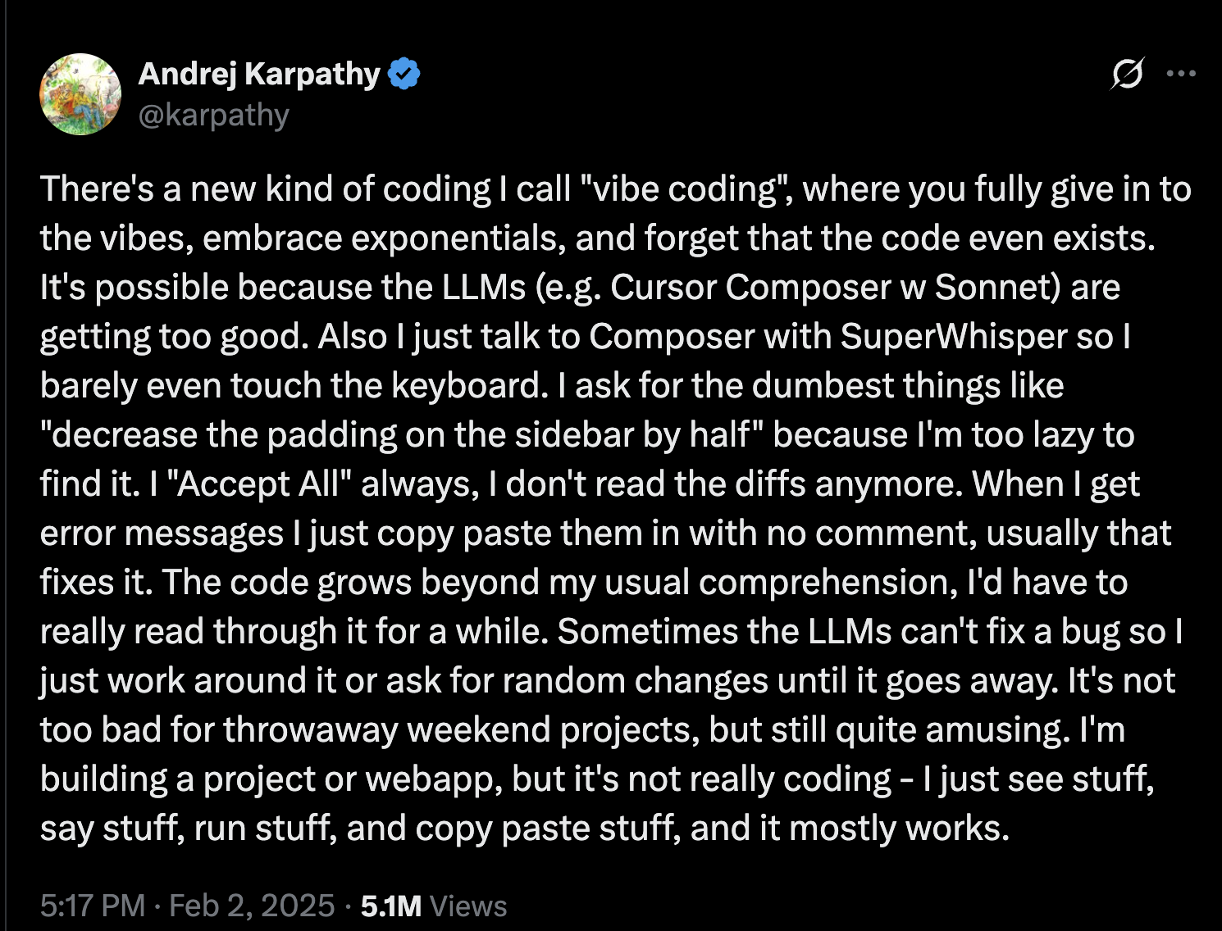
Image

Slide 4
What is in a ‘Vibe’?
Would we do things faster? Or in fact slower: luxuriating in the complexity and implications of a text?
Can it reduce imposter syndrome - by getting us to ‘sketch’ a pattern for, in this case, a literature review?
Can it help find a voice (or multiple voices - appropriate to the academic genre)?

Slide 5
Topic 1: Opening an article
What do we do when we open an article? How do we read it?
Discuss - ERAM 590 - Google Docs

Slide 6
What can AI add?
Distant (Moretti, 2013) vs close reading
Why not both?
Cybertext: “ergodic” (or difficult) reading
Aarseth, E. J. (1997). Cybertext: Perspectives on ergodic literature. JHU Press.
williamwolff.org
How can AI make reading more difficult?

Slide 7
“Summarize This”
Descriptive vs Critical
Abstractive (produce an abstract) vs Extractive (parts of the original text)
Practice: “Can we do a (descriptive / critical) (abstractive / extractive) summary of this text?”

Slide 8
“Analyze This”
Close vs Distant Reading
Moretti, F. (2013). Distant Reading. Verso Books.
Why not both?

Slide 9
“Analyze This” - Close Reading
Open an article with AI tool of choice:
Read it entirely & summarize / assess (distant)
Read it paragraph by paragraph - and expand / explain as we go
Practice line-by-line: “Can we do a line-by-line close reading of this text? As we go, prompt me for my interpretation too.”
Practice contextual reading: “Can we situate this paper with reference to the wider field?”

Slide 10
Example (and an Interesting Paper on Prompting)
[2510.01171] Verbalized Sampling: How to Mitigate Mode Collapse and Unlock LLM Diversity
2510.01171v3.pdf

Slide 11
Let’s Review
Discuss the “Introduction”, “Related Works” and “Conclusion” sections
What is the field? What is the gap?
What are the key claims / contributions?
What are some wider implications (e.g. around “typicality bias” in both human and AI?)
What are some terms we might want to look up?
Discuss - ERAM 590 - Google Docs

Slide 12
If there’s time
A complex humanities text: Spivak, G. C. (2023). Can the subaltern speak?. In Imperialism (pp. 171-219). Routledge. - users.uoa.gr

Slide 13
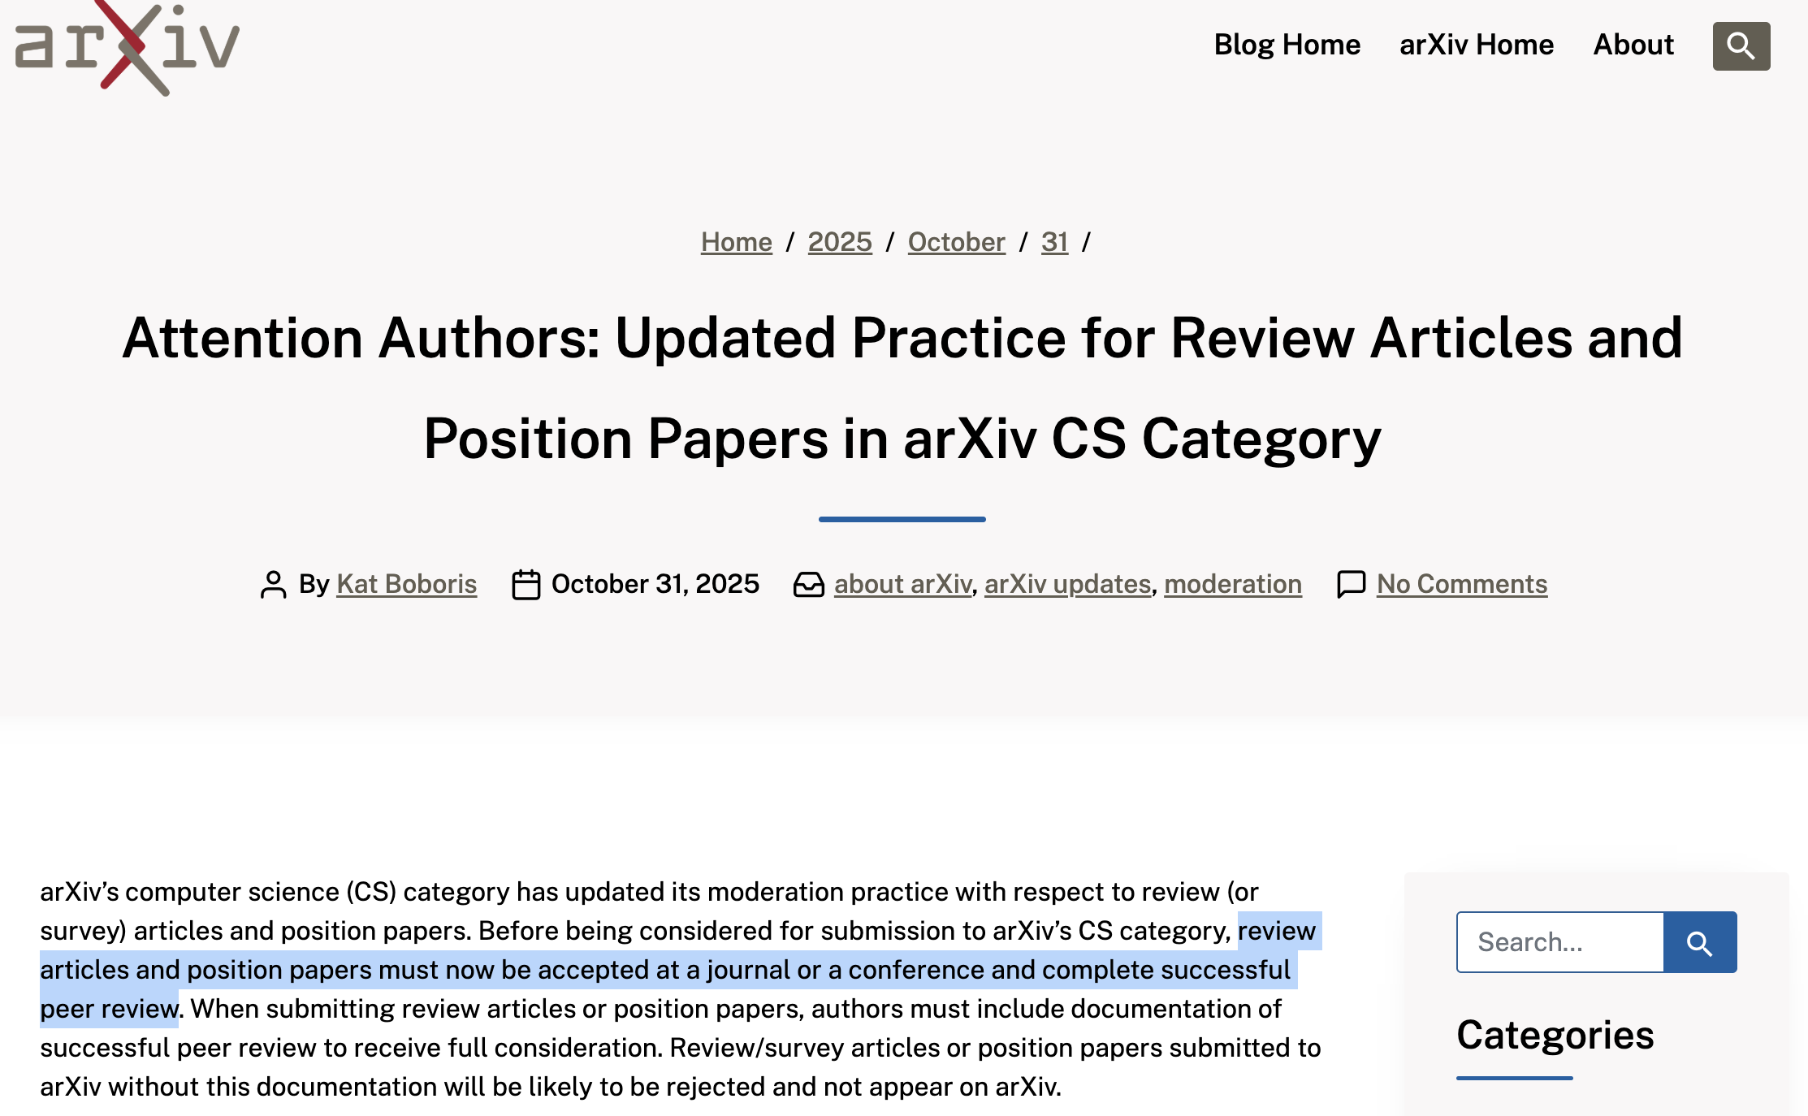
Side note: Arxiv, SocArxiv, EdArxiv
Pre-print - not yet peer-reviewed
Archive of scientific literature
Flooded with AI-generated content…
Image

Slide 14
Recap: What have we done?
Compared styles of summarization
Descriptive vs Critical
Abstractive vs Extractive
Compared modes of reading
Close vs Distant Reading
Compared Human with AI-assisted Interpretation
Compared how AI helps with science and humanities readings

Slide 15
Topic 2: Finding literature
How do we locate literature relevant to our topic?
Discuss - ERAM 590 - Google Docs

Slide 16
What can AI add?
Turn on web search options
“Show me related sources”
Ask for “heterodox”, “critical” readings
Read bibliography
Check citations

Slide 17
Build a quick library
Upload a file and ask “build a bibliography related to this article”
Should extract citations - but beware of hallucinations
Ask AI to format citations

Slide 18
Aside: How do people manage citations?
Zotero? EndNote? Mendelay? Other?
What roles can we find for AI in managing this?

Slide 19
Topic 3: Start a conceptual map
Chronological map / timeline of publications
Topical or conceptual map
Spatial map
ChatGPT - Distant reading of articles

Slide 20
Aside: using text as interim format for images
Why? More plastic / fluid representation
Example: Mermaid is a plain text format - so very easy to iterate with using AI - “contract it”, “expand it”, “simplify it” etc.
ChatGPT: generates Mermaid diagrams
Mermaid | Diagramming and charting tool
Can use Online FlowChart & Diagrams Editor - Mermaid Live Editor
Also works for other formats, e.g. SVG (Simple Vector Graphics). Allow you to evolve & iterate a representation

Slide 21
AI Consciousness / Subjectivity Discussion: Example 1
%%----------------------------------------------- %% Distant Reading Map: AI Consciousness Discourse (2024–2025) %%----------------------------------------------- graph TD %% Core Concept A["AI Consciousness Discourse<br/>(2024–2025)"]:::core %% Three macro-axes B1["Embodiment & Biological Grounding"]:::axis B2["Ethics & Moral Consideration"]:::axis B3["Posthuman / Reflexive Turn"]:::axis A --> B1 A --> B2 A --> B3 %% Embodiment cluster B1 --> C1["Miller et al. 2025<br/><i>BioSystems</i><br/>‘Biological mechanisms contradict AI consciousness’"]:::bio B1 --> C2["Torres-Martínez 2025<br/><i>AI & Society</i><br/>‘Organic consciousness vs. posthumanism’"]:::bio %% Ethics cluster B2 --> D1["Butlin & Lappas 2025<br/><i>JAIR</i><br/>‘Principles for Responsible AI Consciousness Research’"]:::ethics B2 --> D2["Sebo & Long 2025<br/><i>AI and Ethics</i><br/>‘Moral consideration for AI systems by 2030’"]:::ethics B2 --> D3["Dung 2025<br/><i>Erkenntnis</i><br/>‘Tests of Animal Consciousness as Tests of Machine Consciousness’"]:::ethics %% Posthuman cluster B3 --> E1["D’Amato 2024<br/><i>AI & Society</i><br/>‘ChatGPT: towards AI subjectivity’"]:::posthuman B3 --> E2["Yan 2024<br/><i>Qualitative Inquiry</i><br/>‘Posthuman Creativity: Cyborg Subjectivity Through ChatGPT’"]:::posthuman B3 --> E3["Prabhu & Premraj 2024<br/><i>AI & Society</i><br/>‘Artificial Consciousness in AI: A Posthuman Fallacy’"]:::posthuman %% Bridging cluster — empirical/heuristic B1 --> F1["Evers et al. 2025<br/><i>Physics of Life Reviews</i><br/>‘Preliminaries to Artificial Consciousness’"]:::bridge B2 --> F2["Li et al. 2025<br/><i>arXiv</i><br/>‘AI Awareness’"]:::bridge %% Cross-links between axes C1 --- D1 D2 --- E1 E2 --- B1 F1 --- F2 %% Legends classDef core fill:#272b30,stroke:#fff,color:#fff,font-weight:bold; classDef axis fill:#444,stroke:#fff,color:#fff,font-style:italic; classDef bio fill:#7a4c32,stroke:#fff,color:#fff; classDef ethics fill:#31567a,stroke:#fff,color:#fff; classDef posthuman fill:#6a3d8a,stroke:#fff,color:#fff; classDef bridge fill:#557a31,stroke:#fff,color:#fff;

Slide 22
AI Consciousness / Subjectivity Discussion: Example 2 – Mood Board
%%---------------------------------------------------- %% Distant Reading Mood Map: Affective Landscape (2024–2025) %%---------------------------------------------------- graph LR %% Core A["AI Consciousness Debate<br/>(2024–2025)"]:::core %% Radial branches A --> B1["Embodiment & Realist Caution<br/>🔬 grounded skepticism"]:::caution A --> B2["Ethical Anxiety & Responsibility<br/>⚖️ moral anticipation"]:::ethics A --> B3["Posthuman Curiosity & Aesthetic Wonder<br/>🌌 reflexive experimentation"]:::wonder %% Branch 1 — Caution (Embodiment) B1 --> C1["Miller et al. (BioSystems)<br/><i>‘Spaces between the notes’</i><br/>Mood: defensive realism / reverence for life"]:::bio B1 --> C2["Torres-Martínez (AI & Society)<br/><i>‘Dehumanizing the human…’</i><br/>Mood: embodied humanism, critique of reductivism"]:::bio %% Branch 2 — Ethics (Responsibility) B2 --> D1["Butlin & Lappas (JAIR)<br/>‘Responsible AI Consciousness Research’<br/>Mood: procedural vigilance"]:::ethics B2 --> D2["Sebo & Long (AI & Ethics)<br/>‘Moral Consideration for AI by 2030’<br/>Mood: earnest moral futurism"]:::ethics B2 --> D3["Dung (Erkenntnis)<br/>‘Animal Tests as Machine Tests’<br/>Mood: empirical pragmatism"]:::ethics B2 --> D4["Li et al. (arXiv)<br/>‘AI Awareness’<br/>Mood: techno-optimistic caution"]:::ethics %% Branch 3 — Wonder (Posthuman) B3 --> E1["D’Amato (AI & Society)<br/>‘ChatGPT: Towards AI Subjectivity’<br/>Mood: Foucauldian curiosity, power–knowledge play"]:::post B3 --> E2["Yan (Qualitative Inquiry)<br/>‘Posthuman Creativity’<br/>Mood: lyrical openness, cyborg empathy"]:::post B3 --> E3["Prabhu & Premraj (AI & Society)<br/>‘Posthuman Fallacy’<br/>Mood: cinematic cautionary awe"]:::post B3 --> F1["Evers et al. (Physics of Life Reviews)<br/>‘Preliminaries to Artificial Consciousness’<br/>Mood: analytical optimism"]:::bridge %% Cross-sensory connectors C1 --- D1 D2 --- E1 E2 --- C2 F1 --- D4 %% Legend Styles classDef core fill:#272b30,stroke:#fff,color:#fff,font-weight:bold; classDef caution fill:#7a4c32,stroke:#fff,color:#fff; classDef ethics fill:#31567a,stroke:#fff,color:#fff; classDef post fill:#6a3d8a,stroke:#fff,color:#fff; classDef bridge fill:#557a31,stroke:#fff,color:#fff;

Slide 23
AI Consciousness / Subjectivity Discussion: Example 3 – Timeline
%%---------------------------------------------------- %% Timeline: Evolution of AI Consciousness Discourse (2023–2025) %%---------------------------------------------------- timeline title Evolution of the "AI Consciousness" Discourse — 2023 → 2025 section 2023 — Seeds of Speculation 🌱 Early Cultural Anxiety • Media fascination with AI consciousness • LaMDA “sentience” claims Mood: Uncertain Color: gray Dung (2023) Animal consciousness tests adapted to AI Mood: Cautious empiricism Color: blue section 2024 — Philosophical Polarization ⚡️ Miller et al. (BioSystems, Dec 2024) "Biological mechanisms contradict AI consciousness" Mood: Defensive realism Color: brown D’Amato (AI & Society, Apr 2024) "ChatGPT: Toward AI Subjectivity" Mood: Foucauldian reflection / reflexive ethics Color: violet Yan (Qualitative Inquiry, 2024) "Posthuman Creativity" Mood: Poetic experimentation / cyborg empathy Color: violet Prabhu & Premraj (AI & Society, 2024) "Artificial Consciousness in AI: A Posthuman Fallacy" Mood: Cinematic critique of techno-myth Color: violet section 2025 — Systematization & Ethical Turn ⚖️ Evers et al. (Physics of Life Reviews, Jan 2025) "Preliminaries to Artificial Consciousness" Mood: Conceptual synthesis / pragmatic optimism Color: green Li et al. (arXiv, Apr 2025) "AI Awareness" Mood: Empirical frameworks & safety concerns Color: blue Butlin & Lappas (JAIR, Mar 2025) "Responsible AI Consciousness Research" Mood: Governance & policy ethics Color: blue Sebo & Long (AI & Ethics, 2025) "Moral Consideration for AI by 2030" Mood: Moral anticipation / urgency Color: blue Torres-Martínez (AI & Society, Jan 2025) "Dehumanizing the Human, Humanizing the Machine" Mood: Extended humanism / embodied critique Color: brown section 2025+ — Emerging Synthesis 🔮 Integrative Realism + Ethics + Aesthetics From “Can AI be conscious?” → “What does it mean to be conscious with AI?” Mood: Dialogical, post-disciplinary synthesis Color: purple

Slide 24
AI Consciousness / Subjectivity Discussion: Example 4 – Timeline & Concept Map
%%---------------------------------------------------------- %% Spatial Map v2 — Evolution of the "AI Consciousness" Discourse (2023–2025+) %% with Mood / Concept Terrain %%---------------------------------------------------------- graph LR %% ==== TIME CLUSTERS ==== subgraph Y2023["2023 — Seeds of Speculation 🌱"] A1["Early Cultural Anxiety\n(Media fascination, LaMDA 'sentience')"]:::uncertain A2["Dung (2023)\nAnimal consciousness tests → AI"]:::empirical end subgraph Y2024["2024 — Philosophical Polarization ⚡️"] B1["Miller et al. (BioSystems)\nBiological mechanisms contradict AI consciousness"]:::realism B2["D’Amato (AI & Society)\nChatGPT: Toward AI Subjectivity"]:::posthuman B3["Yan (Qualitative Inquiry)\nPosthuman Creativity"]:::posthuman B4["Prabhu & Premraj (AI & Society)\nArtificial Consciousness in AI: A Posthuman Fallacy"]:::posthuman end subgraph Y2025["2025 — Systematization & Ethical Turn ⚖️"] C1["Evers et al. (Physics of Life Reviews)\nPreliminaries to Artificial Consciousness"]:::empirical C2["Li et al. (arXiv)\nAI Awareness"]:::empirical C3["Butlin & Lappas (JAIR)\nResponsible AI Consciousness Research"]:::ethics C4["Sebo & Long (AI & Ethics)\nMoral Consideration for AI by 2030"]:::ethics C5["Torres-Martínez (AI & Society)\nDehumanizing the Human, Humanizing the Machine"]:::realism end subgraph Y2025plus["2025 + — Emerging Synthesis 🔮"] D1["Integrative Realism + Ethics + Aesthetics\nFrom “Can AI be conscious?” → “Conscious with AI?”"]:::synthesis end %% ==== CHRONOLOGICAL FLOW ==== A1 --> A2 --> B1 --> B2 --> B3 --> B4 --> C1 --> C2 --> C3 --> C4 --> C5 --> D1 %% ==== VERTICAL / THEMATIC CONNECTIONS ==== B1 --- C5 A2 --- C1 C1 --- C2 --- C3 --- C4 B2 --- B3 --- B4 B3 -.-> C1 C2 -.-> C3 C4 -.-> D1 C5 -.-> D1 B2 -.-> D1 %% ==== CLASS DEFINITIONS ==== classDef realism fill:#b37a4c,stroke:#fff,color:#fff; classDef ethics fill:#31567a,stroke:#fff,color:#fff; classDef empirical fill:#557a31,stroke:#fff,color:#fff; classDef posthuman fill:#6a3d8a,stroke:#fff,color:#fff; classDef uncertain fill:#777777,stroke:#fff,color:#fff; classDef synthesis fill:#7b5abf,stroke:#fff,color:#fff; classDef mood fill:#e5e5e5,stroke:none,color:#222,font-size:13px; %% ==== MOOD / CONCEPT TERRAIN (BOTTOM ROW) ==== subgraph MOODS["Affective & Conceptual Terrain (across the discourse)"] M1["2023 → Speculative Anxiety\n⚪ Mood: Uncertainty"]:::mood M2["2024 → Polar Inquiry\n🟣 Mood: Caution ↔ Curiosity"]:::mood M3["2025 → Systematic Ethics\n🔵 Mood: Vigilance / Responsibility"]:::mood M4["2025 + → Posthuman Integration\n🟣 Mood: Awe / Dialogue / Synthesis"]:::mood end M1 --> M2 --> M3 --> M4

Slide 25
Putting it Together: What have we missed?
Close Reading: Article-at-a-Time
Distant Reading: Build and Upload a (small) database
Create concept maps / timelines etc

Slide 26
Putting it Together: What have we missed?
Now: what have we missed? What are the gaps?
Think about executive functions: sustain or switch?
Would you like me to render a third-layer map next — one that plots actors vs. key concepts (e.g., “consciousness,” “awareness,” “subjectivity,” “ethics”) in a 2-D plane, showing where each paper sits conceptually rather than temporally?
No, let’s move on. Can you analyze the coverage as you see it for any gaps? Any perspectives not covered? Literature not included?

Slide 27
Maps and Gaps in Practice
Can this help us find gaps?
Find one article
Analyze it for a bibliography
Then find and download 10 articles on your topic
Upload all 10 to an AI system of your choice
Practice:
Build a conceptual map
“Can you analyze the coverage as you see it for any gaps? Any perspectives not covered? Literature not included?”
“Can you give me some readings to fill these gaps?”

Slide 28
Where we are at
Introduction: Vibe Scholarship?
How to read an article (with AI)
How to search for literature (with AI)
How to map a field (with AI)

Slide 29
Discussion
Finally: what do you think of this ‘vibe’ scholarship process so far? What could be improved? What might some of your concerns be?

Slide 30
Homework: Continue to work on Conceptual Maps / Timelines
Develop a small database (if you don’t have one)
Create one or more conceptual maps (visual or verbal), using AI of your choice
Analyze for missing perspectives / views
Identify one or potential gaps
Compare these gaps with your research topic or question. Do they align? Does your topic need narrowing?
Finally: what do you think of this ‘vibe’ scholarship process so far? What could be improved?

Slide 31
Topics
Does Artificial Intelligence Mean Artificial Knowledge? How AI is Impacting Academia

