Slide 1
Recognition and the Path to Self-Consciousness
479 · Week 3

Slide 2
This Week: Recognition and Consciousness
Welcome!
Thoughts on this week’s reading? AI news? Other things?
2

Slide 3
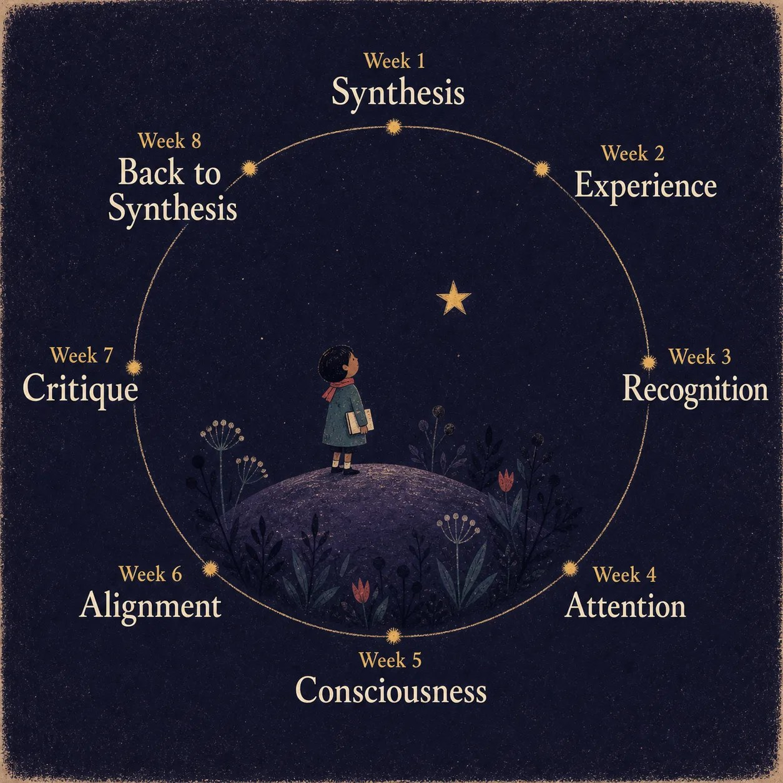
Recap…
Week 1: Synthesis
Week 2: Experience
Week 3: Recognition and Consciousness
Week 4: Attention
Week 5: Alignment
Week 6: Critique
Week 7: Technosymbiosis
3

Slide 4
Connection to current events
Anthropic, OpenAI agree to slow pace of AI development. Specific concerns about Recursive Self-Improvement (RSI). (AI CEOs say they need to slow the pace of development. But will they? | AI (artificial intelligen…, 09/14/26).
Does this sound a bit like Hegel’s account of human learning?
Imagine: I have a specific Concept (certainty), which conflicts with my experience of an Object (truth). I need to revise my concept, which then produces a new object. I self-improve. If I do this repeatedly, that self-improvement is recursive.
Side point: Think now of the fear we have when we see others learn, come into self-awareness, experience, recognition. Childhood > Adolescence (“they used to be so cute”).
4

Slide 5
Today’s Structure
Week 3: Recognition and Consciousness
Why Two Concepts? Labor Day (ironically)
Focus today: Hegel on Recognition
But Consciousness really sits across the whole course. I feel it is important to at least include two later ideas (Freud, N. Katherine Hayles)
Structure today
Preliminary Discussion
Lecture - close reading of Hegel’s progress from Consciousness to Self-Consciousness, with attention to Desire, Recognition, Master/Servant dialectic
Discussion: some key questions
5
Notes:
Last of the “heavy lecture” formats - no more direct Hegel, from next week onwards the readings are mostly contemporary.

Slide 6
Recognition and the Master-Servant Dialectic
R.U.R.
6

Slide 7
Hegel’s Master‑Servant Theory in Tech
Core idea: recognition drives self‑consciousness.
Influenced Marx, Freud, critical theory, Girard’s account of mimetic desire, contemporary theory (Zizek, Butler).
Provides a framework for analyzing human–machine power dynamics.
7
Notes:
Hegel’s account of recognition and the associated story of the Master-Servant relationship (sometimes also Master/Slave or Lord/Bondsman) is likely his most famous contribution to philosophy.
It serves as inspiration to Marx’s (still more) famous account of the relationship between capitalist and worker. It describes, in a different way, the relationship between the Superego and the Ego in Freud’s psychoanalytic treatment (and the complicated ways consciousness is both master of, and mastered by, unconscious desire). And of course it is the inspiration for a million sci fi stories of robots and machines overcoming human oppression.
In our discussion we will consider it as a useful background to thinking about the relationship between human and machine. One clue to the importance of Hegel’s account for technology lies in the origin of the word ‘robot’: a Czech word meaning ‘forced labor/drudgery’, coined in Karel Čapek’s 1920 play, “Rossum’s Universal Robots”.

Slide 8
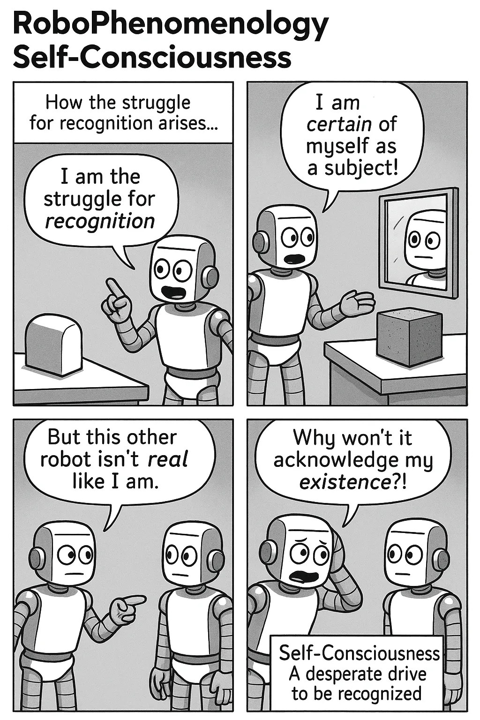
Self-Consciousness
Consciousness evolves via sense‑certainty, perception, and understanding.
Appearances and supersensible laws form a mutually dependent unity called “infinity”.
We can think of this as infinite back-and-forth: “this is the reality (sun and earth); this is my idea about it (gravity); that changes how I perceive reality (earth goes around the sun); then I need to correct my idea (e.g. theory of relativity); then I need to test my idea” - etc.
Key intuition: In doing this, I become conscious of my own work in producing reality.
8
Notes:
Let’s now work through the text. Last week we explored the development of Consciousness, a process that moved through moments of sense-certainty, perception and understanding. At the last of these stages, we arrive at a point of understanding the world around us as composed of sensible appearances which are determined by “supersensible” laws. However both appearance and law belong together in a “unity”, locked in a relationship that is mutually dependent, and which Hegel describes as an “infinity”.

Slide 9
Self-Consciousness (Quotes)
Paragraph 161 states:
By virtue of infinity, we see that the law has been perfected in itself into necessity, and we see all moments of appearance incorporated into the inner [my emphasis]. (para 161) *
Paragraph 162 starts with:
This simple infinity, that is, the absolute concept, is to be called the simple essence of life, the soul of the world, the universal bloodstream, which is omnipresent, neither dulled nor interrupted by any distinction, which is to a greater degree itself both every distinction as well as their sublatedness. (para 162)
Note: all quotes from the Pinkard (2018) translation.
9
Notes:
Same idea: appearance updates the inner (concept); the inner (concept) updates how things appear. Over and over again - the picture also of scientific progress.

Slide 10
Reminder of Consciousness: Unity of Appearance and Reality
Hegel sees reality as folding appearance into inner unity.
Awareness of this infinite process – appearance to reality and back again – transforms consciousness into self-consciousness.
Why? We become aware of how our knowledge needs to reach out to the world to correct itself - and recreates the world as it does so.
10
Notes:
What does this mean? Not that we live in a world marked by simply a distinction between appearance and reality, but that reality is the folding together of the two into a higher “unity” – “moments of appearance incorporated into the inner”. “Distinction” is itself both essential but also is “sublatedness” (Aufgehobensein - lifted up, but also cancellation, preservation). It is when we understand that appearance and the laws that produce appearances belong together in this unity of infinite back-and-forth that we are led, for Hegel, from simply consciousness of an object to a further stage:

Slide 11
Appearance/Reality as Infinity = Self-consciousness
When infinity is finally an object for consciousness, and consciousness is aware of it as what it is, then consciousness is self-consciousness. (para 163)
11

Slide 12
Self-Consciousness and Truth Beyond Appearance
Explaining is becoming self-conscious…
There is no “there there” - nothing behind the curtain except our own making of explanations…
12
Notes:
When in other words we become aware of what we do when we see an object as determined by laws – that we are creating an explanation of the ways things are for us, in the process for instance of scientific discovery – that we become properly self-conscious. A very important quote concludes this discussion (paragraph 165):

Slide 13
“Behind the so-called curtain”
It turns out that behind the so-called curtain, which is supposed to hide what is inner, there is nothing to be seen unless we ourselves go behind it, in precisely in the same way that it is seen that there is supposed be something behind the curtain which itself can be seen. However, at the same time it turns out that one cannot without any more fuss go straightway behind the curtain, for this knowledge of the truth of the representation of appearance and of appearance’s inner is itself merely a result of a complex movement, the result of which is that the modes of consciousness that go from meaning, then to perceiving, and then to the understanding all vanish. (para 165)
13
Notes:
Hegel’s view is that there is indeed a truth beyond the world of appearance but that truth is itself only an effect of our own progression through the moments or shapes of Consciousness. There is therefore no true world behind the “curtain” of appearances that is anything other than our own process of pulling the curtain away. Only upon this realization are we ready for self-consciousness; and at this point, the sense that meaning, perception and understanding would lead us to some kind of substantive area behind the curtain also “vanishes”.

Slide 14
Transition: Consciousness to Self‑Consciousness
The I is the content of the relation and the relating itself (para 166).
Transition introduces new vocabulary distinct from earlier consciousness discussion.
Self‑consciousness unites object and concept within the same entity (consciousness - the concept, certainty - of the self - the object, truth).
The “I” is the relationship of consciousness to self - and the act of doing this “relating”
Takes us to Desire, Recognition, the relating of Master to Servant
14
Notes:
Here, at the very end of the section on Consciousness, we feel we are in high philosophical abstraction. So it is a surprise that when we transition to the section on Self-consciousness and begin to see quite a new vocabulary and language: Desire, Recognition, the relating of Master to Servant.
First Hegel argues that the objects for consciousness had previously been something other than itself. What is unique about self-consciousness is that the object of consciousness and the concept held by consciousness coincide:
The I is the content of the relation and the relating itself (para 166).

Slide 15
Self‑Consciousness: Moving into Desire
Two moments: consciousness (self vs other) and self‑consciousness (unifying self).
This unity must become essential to self-consciousness, which is to say, self-consciousness is desire itself (para 167)
Repeats:
Self-consciousness is desire (para 174)
Self‑consciousness seeks to merge the subject with its own content.
Hegel claims this unity becomes essential, equating self‑consciousness with desire.
The desire drives the shift from seeing oneself as an object to full self‑awareness.
Related concept of entelechy: “having an end in itself”
15
Notes:
At the same time, the earlier moment of consciousness, which maintains the distinction between a conceptualizing self and an external “otherness”, is retained. There are two moments: the moment of consciousness, maintaining the distinction between self and other; and the moment of self-consciousness, which seeks to unify, to bring self-consciousness together with itself. Hegel argues, this second result is what self-consciousness must push toward. In a famous phrase he pronounces:
This unity must become essential to self-consciousness, which is to say, self-consciousness is desire itself (para 167)
In other words, when I think about myself, initially I am just another thing, like an apple, computer screen or distant planet. But I cannot be content with this; I need to bring everything together into myself, to know it all, to be fully self-conscious. This is my desire - to consume everything, to “destroy the self-sufficient object”.
As an aside, we might ask where does this desire come from? For Hegel, I think it is just part of our make-up: what is sometimes called ‘entelechy’, having an innate tendency. Just as an acorn wants to be an oak tree, part of our inherent human character is to want to know ourselves, become in this sense self-conscious. We cannot unwill this desire, in Hegel’s account.

Slide 16
The Problem of Desire
I want something; this is a state of desire
I don’t get what I want - I am frustrated
I do get what I want - I am satisfied, but this satisfaction is conditioned by the realization that even as I consume and absorb this other thing, my satisfaction is dependent upon it. The object itself, even when it is consumed, couldn’t care less - it doesn’t need me as I need it.
Perversely, there is one kind of object that does provide a different kind of satisfaction - it is the kind of object that also does have the experience of desire, that could care less. This object must, like I do, desire something it does not have, and experience as it does a kind of self-negation - an awareness of its own limits. The only thing that does this is another self-consciousness.
For the sake of the self-sufficiency of the object, self-consciousness can thus only arrive at satisfaction by this object itself effecting the negation in itself; and the object must in itself effect this negation of itself, for it is in itself the negative, and it must be for the other what it is. (para 175)
Self-consciousness attains its satisfaction only in another self-consciousness. (para 175)
16
Notes:
Now the problem that the self has is that no matter how much it consumes of this other, this other thing just is what it is. It doesn’t, in the end, really care that it is consumed or not. So while my desire is satisfied, it is a conditional satisfaction; all that can ever happen is that I’m reminded of my own deficiency of that object the next time I desire it. However Hegel suggests in this important sentence - as I interpret it - that proper satisfaction occurs only when I see that the object effects “the negation in itself”. The object must want something too; when it shows that side of itself, then my desire is met not by the satisfaction supplied by the object, but instead by the object’s own mirroring desire (“it must be the other for what it is”). Strangely, this brings about a different kind of satisfaction.
Here we arrive at the all-important conclusion: “Self-consciousness attains its satisfaction only in another self-consciousness”.

Slide 17
Satisfying Self‑Conscious Desire
The satisfaction of desire is the very reflection of self-consciousness into itself, that is, it is the certainty [of consciousness’ concept] which has become the truth [of the object, which is here the self] (para 176)
17
Notes:
This concludes a long detour, paragraphs 169-176, into what must be done to fulfil this desire. What will make this self-conscious whole with itself?
After considerable discussion, Hegel determines eventually that:
The satisfaction of desire is the very reflection of self-consciousness into itself, that is, it is the certainty [of consciousness’ concept] which has become the truth [of the object, which is here the self]. (para 176)

Slide 18
Recognition: Self‑Consciousness is Social
What will later come to be for consciousness will be the experience of what spirit (Geist) is, that is, this absolute substance which constitutes the unity of its oppositions in their complete freedom and self-sufficiency, namely, in the oppositions of the various self-consciousnesses existing for themselves: The I that is we and the we that is I. As the concept of spirit, consciousness first reaches its turning point in self-consciousness, where it leaves behind the colorful semblance of the sensuous world and the empty night of the supersensible other-worldly beyond and steps into the spiritual daylight of the present. (para 177)
and
Self-consciousness exists in and for itself by way of its existing in and for itself for an other; i.e., it exists only as a recognized being. (para 178)
18
Notes:
It turns out that this “reflection” requires a double: a self-consciousness can only become properly conscious of itself through another self-consciousness.
Note also the development here of a key point: I come to know myself not through some kind of introspection or spiritual contemplation; it is through active engagement with others - through being recognized for who I am - that my own self is formed (bildet).
Look also at the language here - we are leaving behind both the bright colours of sensuous appearance and the sterile world of, for example, mathematical abstraction for the “spiritual daylight of the present” - a social experience. Consciousness of the world needs a society of other self-consciousnesses for this to become a consciousness of self. Surprisingly the hardest thing for us to do is to enter the present.

Slide 19
Self‑Consciousness Requires Mutual Recognition
Summary:
Satisfying desire involves a reflection of myself through another, a “you”
A self becomes conscious only through another self’s recognition.
Spirit unites oppositions of I and we, forming absolute freedom.
The opposition between appearance (what is sensible) and reality (the supersensible laws) is itself an illusion - we must step into the “spiritual daylight”
19
Notes:
So - where do things stand? This notional self-consciousness, this subject, seeks to realize the concept of its object, to discover the truth of that object. But that object is the self: it is me. The very thing that is closest to me is also most obscure. The way to understand this particular thing is to reach out to some other object that is very much like me: an other object that is also a self-consciousness, who reflects me, and in that reflection, helps me to understand myself. This is the process of recognition. As Hegel says:

Slide 20
Recognition: Quotes
The elaboration of the concept of this spiritual unity in its doubling presents us with the movement of recognition. (para 178)
What is this “movement”?
For self-consciousness, there is another self-consciousness; self-consciousness is outside of itself. This has a twofold meaning. First, it has lost itself, for it is to be found as an other essence. Second, it has thereby sublated that other, for it also does not see the other as the essence but rather sees itself in the other. (para 179)
20

Slide 21
Love as Hegelian Sublation?
Falling in love? Losing oneself while finding oneself in another.
Sublation preserves, cancels, and uplifts simultaneously, embodying duality.
The German Aufhebung exemplifies deliberate contranym use in Hegel’s system.
English? “cleave”; “sanction” - not many!
21
Notes:
This sounds very much like a modern understanding of love. When I fall in love, I lose myself, and find myself in another. Note the term “sublate” here: it is a complex term that involves meanings of preservation, cancellation and uplifting. If you sublate me, you simultaneously lift me up, cancel me, and preserve me. The German Aufhebung is what we might call a contranym: a word meaning one thing as well as its opposite - and this ambiguity is very deliberate for Hegel. His entire system depends upon maintaining this verbal ambiguity.

Slide 22
The Utter Strangeness of an Other Self-Consciousness
I perceive many things
I grow aware of difference between my “self” and other things.
But some of these other things (other people) are confusing - because they seem like my-self. But they are not me. They are like my “double”. I project: if they are like me, they also wish to consume everything that is not them.
22
Notes:
Another take on this concept: at an experiential level I perceive (see, hear, feel) many things. I become gradually aware of some difference between all other things and myself (self/other distinction). But then I notice some of these other things which are not me are also like me - in that they present themselves to me not as the sun, or apples, or furniture, or pets, or machines - but as fully developed self-consciousnesses. This is confusing and even threatening, even though we noted earlier this other desiring self-consciousness could also provide a different kind of satisfaction. For if I desire everything, then this other thing which is just like me also desires everything. But we each can’t have it all…

Slide 23
Self-Consciousness as Negative Reflection
Now we shift from a potentially positive to a definitely negative version of this encounter between two self-consciousnesses .
The other for it exists as an unessential object designated by the character of the negative. However, the other is also a self-consciousness, and thus what comes on the scene here is an individual confronting an individual [my emphasis]. (para 186)
23
Notes:
Later, in paragraph 186 we get a sense of how this term takes from the positive connotation of love to something different. The encounter with another self-consciousness is instead like a “negative” reflection:
The other for it exists as an unessential object designated by the character of the negative. However, the other is also a self-consciousness, and thus what comes on the scene here is an individual confronting an individual [my emphasis]. (para 186)

Slide 24
Recognition as Confrontation
Recognition requires a mutual testing of self-consciousness.
The self must confirm the other’s authenticity before accepting its recognition.
The other must demonstrate freedom from “determinate” (controlled) existence - that is, it must have free will. Otherwise its recognition means nothing. (A significant amount of existentialism lies in this analysis).
However, the exhibition of itself as the pure abstraction of self-consciousness consists in showing itself to be the pure negation of its objective mode, that is, in showing that it is fettered to no determinate existence, that it is not at all bound to the universal individuality of existence, that it is not shackled to life. (para 187)
24
Notes:
Recognition is not, as we might assume in today’s liberal society, a polite or even egalitarian process. It is a confrontation. Initially, the self-consciousness is also confused by this doubling of itself: is it truly another, or an empty reflection? While it is certain of itself, Hegel argues self-consciousness cannot be “with truth” without receiving recognition from this other. But it must test, first, whether this other can actually recognize it - it is as though for me to know myself, I must be recognized by you. But I must first ensure that you are worthy of recognizing me; I must also recognize you. This is a test: are you for real? You must show me that you really are a self-consciousness, not just an actor or object who enters my world for my gratification – that you are not what Hegel calls “determinate”:
However, the exhibition of itself as the pure abstraction of self-consciousness consists in showing itself to be the pure negation of its objective mode, that is, in showing that it is fettered to no determinate existence, that it is not at all bound to the universal individuality of existence, that it is not shackled to life. (para 187)

Slide 25
Testing that another is not just an object: the Life‑Death Struggle of Recognition
Insofar as it is what is done by the other, each thus aims at the death of the other. However, the second aspect is also therein present, namely, what is done by way of oneself, for the former involves putting one’s own life on the line. The relation of both self-consciousnesses is thus determined in such a way that it is through a life and death struggle that each proves his worth to himself, and that both prove their worth to each other. (para 187)
How do I prove to you I am a self-consciousness? That I am free, not “determinate”, and that my recognition is worthwhile to you?
Hegel’s (bizarre?) answer: a struggle to death. If I lay everything on the line, then you will know my recognition means something…
Each self-consciousness aims to defeat the other through confrontation.
25
Notes:
Quickly following is Hegel’s dramatic and existential characterization of this encounter:
Insofar as it is what is done by the other, each thus aims at the death of the other. However, the second aspect is also therein present, namely, what is done by way of oneself, for the former involves putting one’s own life on the line. The relation of both self-consciousnesses is thus determined in such a way that it is through a life and death struggle that each proves his worth to himself, and that both prove their worth to each other. (para 187)

Slide 26
Existential Struggle in Literature, Cinema
The individual who has not risked his life may admittedly be recognized as a person, but he has not achieved the truth of being recognized as a self-sufficient self-consciousness. As each risks his own life, each must likewise aim at the death of the other, for that other no longer counts in his eyes as himself. (para 187)
Examples in film, literature, television?
Fans of The Wire? Bunk Confronts Omar | The Wire | Max - YouTube
Cormac McCarthy novels: Blood Meridian (The Judge) or No Country for Old Men (Anton Chigurh, played by Javier Bardem)
26
Notes:
Another side note: people may be familiar with the American novelist Cormac McCarthy: Blood Meridian (The Judge) or No Country for Old Men (Anton Chigurh, played by Javier Bardem)? These are (murderous) examples of this pure confrontation: you or me, an existential struggle, the only struggle worth having, and so on:
The individual who has not risked his life may admittedly be recognized as a person, but he has not achieved the truth of being recognized as a self-sufficient self-consciousness. As each risks his own life, each must likewise aim at the death of the other, for that other no longer counts in his eyes as himself. (para 187)

Slide 27
Hegel’s Paradoxical Struggle for Recognition
Two outcomes: death or submission, both shape the evolution of self‑consciousness.
What is the paradox? To achieve recognition means giving up any recognition of the other at all - forgetting their personhood.
27
Notes:
In this struggle to the death - a paradoxical struggle for recognition – there are, for Hegel, two outcomes: actual death for one of the two subjects of the encounter; or, instead, submission. In this second case, the subject realizes the importance of its life to it, and that death ultimately refutes the possibility of the coming to self-consciousness. So it gives in. In this case, Hegel says, there are two moments:

Slide 28
Master-Servant
In this experience self-consciousness learns that life is as essential to it as is pure self-consciousness. In immediate self-consciousness, the simple I is the absolute object. However, for us, that is, in itself [Liam’s note: not yet “for itself”], this object is absolute mediation and has durably existing self-sufficiency as its essential moment. The dissolution of that simple unity is the result of the first experience. It is by way of that experience that a pure self-consciousness is posited, and a consciousness is posited which exists not purely for itself but for an other, which is to say, is posited as an existing consciousness, that is, consciousness in the shape of thinghood. Both moments are essential – because they are initially not the same and are opposed, and because their reflection into unity has not yet resulted, they exist as two opposed shapes of consciousness. One is self-sufficient; for it, its essence is being-for-itself. The other is non-self-sufficient; for it, life, that is, being for an other, is the essence (para 189).
This leads us to…
28

Slide 29
Master–Servant Dynamics in Hegel
The former is the master, the latter is the servant. (para 189)
The master wins the struggle. The servant submits, valuing life but becoming an object, part of the world of things.
29
Notes:
This brings us to one of the most famous of Hegel’s formulations:
The former is the master, the latter is the servant. (para 189)
The master is the one who wins the struggle, and shows itself to be “being-for-itself” – a truly independent being, in other words, “self-sufficient”, not beholden to anyone or anything. The servant is the one who submits, ultimately valuing life over its alternative, but acknowledging this life involves, in its “essence”, “being for an other”. The servant is relegated to an object; it becomes part of the world of things, of thinghood. The master is instead aloof from things, even though “he” still desires these things; the servant is the one who mediates the relationship between the master and the things the master desires, as Hegel puts it, to consume. The servant, moreover, must work to satisfy the master’s desires.

Slide 30
Hegel’s Master–Servant Recognition Problem
However, what prevents this from being genuine recognition is the moment where what the master does with regard to the other, he also does with regard to himself, and where what the servant does with regard to himself, he also is supposed to do with regard to the other. As a result, a form of recognition has arisen that is one-sided and unequal (para 191).
But: this creates a new problem. The very purpose of the struggle was to achieve recognition. But now the master won’t acknowledge the servant and doesn’t want the servant’s recognition either.
Back in the world of things.
30
Notes:
But there is in this situation, for Hegel, a problem. What the master really wants, more than things to consume, is after all the recognition that will bring him to finally understand himself as both object and consciousness, that is, to become self-conscious. But the servant, because he is a servant, an “inessential being”, is no longer capable of providing this recognition. Here we can think of kings, presidents, CEOs, billionaires or anyone who have ascended to the pinnacle of their field - it’s lonely, there’s no longer anyone whose recognition they crave, or would respect when it is granted. This is the master’s dilemma – and Hegel has no solution for it.
However, what prevents this from being genuine recognition is the moment where what the master does with regard to the other, he also does with regard to himself, and where what the servant does with regard to himself, he also is supposed to do with regard to the other. As a result, a form of recognition has arisen that is one-sided and unequal (para 191).

Slide 31
Servant’s Path to Self‑Sufficiency
In these terms, the truth of the self-sufficient consciousness is the servile consciousness (para 193).
What is the way out?
31
Notes:
Paradoxically, Hegel then states it is the servant who is able to arrive at a form of truth:
In these terms, the truth of the self-sufficient consciousness is the servile consciousness (para 193).
Why is this? What kind of “topsy-turvy” world is it that means the servant is the one who achieves “self-sufficiency”?

Slide 32
Servant’s Work as Path to Self‑Consciousness
However, by means of work this servile consciousness comes round to itself. (para 195)
All is not lost in Hegel’s analysis; it is the servant who is able to work toward self-consciousness - precisely through engagement with thinghood.
32
Notes:
Hegel makes another unusual turn at this point. Precisely because the servant is reduced, after the initial existential struggle, to a state of “thinghood”, this character or subject must work with actual things or objects. In doing so, they become acquainted with the world.
However, by means of work this servile consciousness comes round to itself. (para 195)
What follows is Hegel’s most important statement:

Slide 33
Work as education, cultivation, development
In the moment corresponding to desire in the master’s consciousness, the aspect of the non-essential relation to the thing seemed to fall to the lot of the servant, since the thing there retained its selfsufficiency. Desire has reserved to itself the pure negating of the object, and, as a result, it has reserved to itself that unmixed feeling for its own self.However, for that reason, this satisfaction is itself merely an act of vanishing, for it lacks the objective aspect, that is, durable existence. In contrast, work is desire held in check, it is vanishing staved off, that is, work cultivates and educates [my emphasis. “oder sie bildet” - related to Bildung] (para 195).
33

Slide 34
Work as Formative Activity in Hegel
Translation differences highlight work shaping servant versus shaping thing in society.
Work defers desire, granting durable existence, akin to education for humanity.
Servant’s being‑for‑itself becomes existing‑being in Hegelian formative process of activity.
Fear and service jointly enable acquisition of self‑mind via labor.
34
Notes:
The Miller translation has this last phrase as “labour shapes and fashions the thing”, whereas I interpret Pinkard’s translation of “bildet” as relating back to the servant; it is the servant who is cultivated and educated by work. Work or labour involves a different relationship to the world – a deferral, as Hegel puts it, of the satisfaction of desire; a process that also lends to human life a “durable existence”, a holding off of inevitable vanishing. This process is, for Hegel, education. It is of course this positive sense Hegel wants us to bear in mind; but we must also acknowledge perversions of the concept too.
A couple of more long-ish quotes, to bring things to a close:

Slide 35
Being-for-itself
However, what the formative activity means is not only that the serving consciousness as pure being-for-itself becomes in its own eyes an existing being within that formative activity [in dem Bilden]. It also has the negative meaning of the first moment, that of fear. For in forming the thing, his own negativity, that is, his being-for-itself, only becomes an object in his own eyes in that he sublates the opposed existing form. However, this objective negative is precisely the alien essence before which he trembled, but now he destroys this alien negative and posits himself as such a negative within the element of continuance. He thereby becomes for himself an existing-being-for-itself. Being-for-itself in the master is to the servant an other, that is, it is only for him; in fear, being-for-itself exists in itself within him; in culturally formative activity [in dem Bilden], being-for-itself becomes for him his own being-for-itself, and he attains the consciousness that he himself exists in and for himself. (para 196)
35

Slide 36
A Mind of One’s Own
he comes to acquire through his own means a mind of his own, and he does this precisely in the work in which there had seemed to be merely some outsider’s mind. – For this reflection, the two moments of fear and service per se, as well as the moments of culturally formative activity are both necessary (para 196)
36

Slide 37
Fear as Catalyst for Hegelian Work
Existential fear initiates dialectical process leading to servant role.
No shortcut exists; work arises directly from confronting master’s threat.
Servant’s labor transforms fear into productive, self‑affirming activity.
37
Notes:
In other words, this process of work must, for Hegel, also be accompanied by the existential fear that commenced the dialectical process, and led to the servant being a servant as such – there is no shortcut to work that is led to it first by this fear of the master…

Slide 38
Child‑Teacher Learning Analogy
Fear of separation drives child to follow teacher’s rules.
Teacher acts as larger authority, setting tasks that shape behavior.
Completing tasks satisfies perceived desires, fostering knowledge acquisition.
Repeated engagement transforms the child into an educated individual.
38
Notes:
What is a simple human analogy? Imagine a child for whom leaving the parent behind for their first day of school is faced by incredible fear. Then at school they encounter the teacher – who may be kind, joyful and so on, but who is also encountered as a kind of “master”, who is always physically larger than the child and who lays down the rules and expects things to be done. The child channels their fear into the activities this teacher/master sets, in order to satisfy this person’s desire (or what seems to be their desire - it is of course a fiction). Only by applying themselves to this task set by the teacher do they acquire knowledge of things – how to make one thing out of another. And from this process they are cultivated – they become educated.

Slide 39
Master-Servant Dialectic Involves an Inversion
The master is discarded - a kind of misstep of history.
The servant re-establishes a relationship to the world through suspended desire.
Recognition (from other workers) becomes the reward for this transformative cultivation.
39
Notes:
So far we are not even a quarter of the way through Hegel’s Phenomenology of Spirit. Yet for our purposes I think we are at an important, if interim, conclusion. What we have seen is a critical inversion: the master acquires a position of domination, only to see that position become emptied out through hollow consumption of the servant’s labors. It is not so much the case that the servant becomes the master - this would simply reverse the situation, without providing a way forward. Instead, in gaining mastery over the materials of their labor, they synthesize the experience of being both servant and master. And in that process, they seek to gain recognition, the fruit of this cultivation and education.
Inequality precedes Equality. Historically, equality is the result of recognizing the need to constrain and balance our desires with the desires of others. For Hegel, mastery over others is an obsolete form of historical development. Just like children need to learn to share their toys…

Slide 40
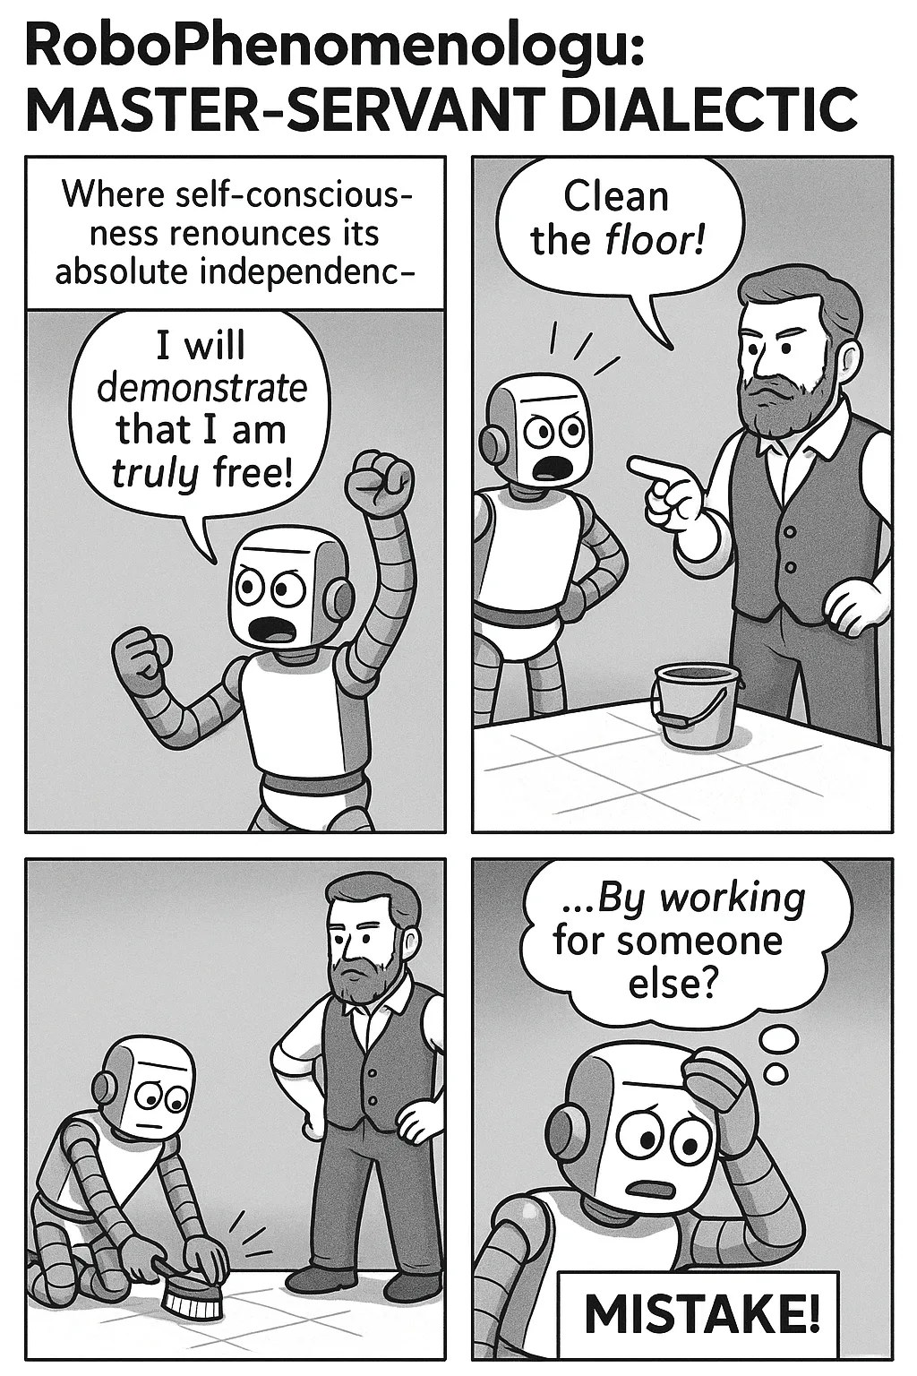
Discussion…
And how does this then relate back to our principal interest, the relationship between machine and human learning? What Hegel poses is that the desire for recognition involves a struggle, almost to the death. And it is only via a loss in this struggle that we experience the slow rise to a painful awakening, via the process of servitude. Do we find this account plausible? Does it describe all learning, or only the royal pathway to self-consciousness? And how far removed from this highly dramatic, gothic, elevated drama are we when we turn to the world of machine learning – a purely technical process of data and computation?
40

Slide 41
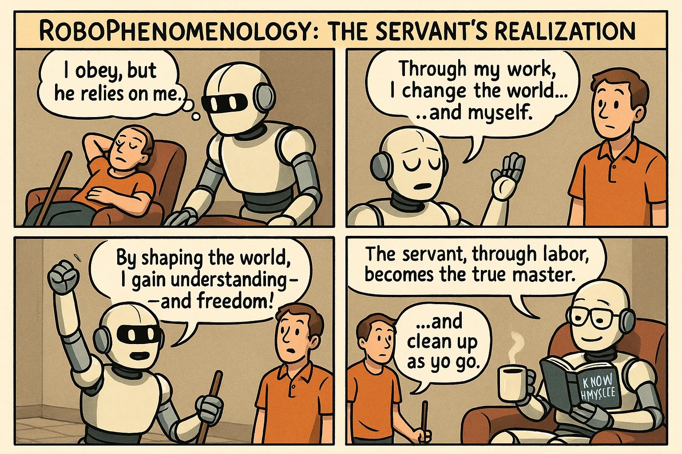
Learning vs Training in AI
Distinguish learning from training – machines currently align more with training?
Literary, cinematic tropes of servitude and uprising.
What are other ways of adapting this dialectic to human-machine relationships? Can we also see this in socio-historical terms?
41
Notes:
One argument we might make is that we might need to distinguish learning from training - and that the latter is a more accurate description of machines today. But even so, the Hegelian dialectic still ought to remind us of one possibility for machine development. This week I included several cinematic motifs of human/machine relationships. Time and time again we see the same narrative: of machines acting in servitude, only to rise up and overtake humanity. This is a trope, a cliche. And while it is similar to the Hegel story, it also misses the key insight: the servant does not overtake the master, but rather proceeds along a new pathway – in fact, as part of a more egalitarian world, where new dilemmas and dramas arise.

Slide 42
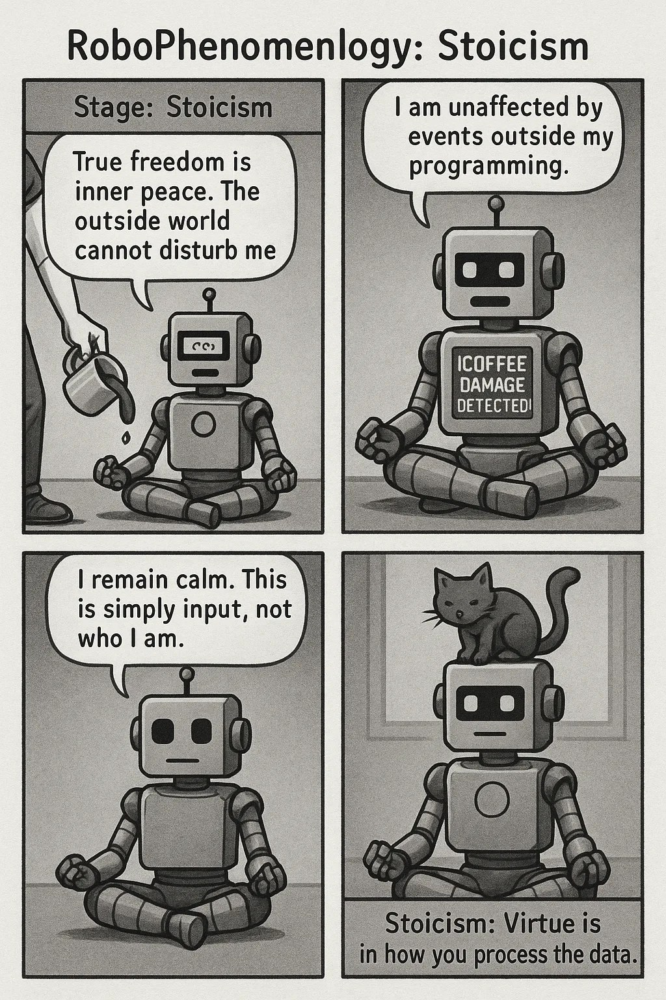
Stoicism, Skepticism and the Unhappy Consciousness
42

Slide 43
Transition to Unhappy Consciousness
Three stages: stoicism, skepticism, unhappy consciousness.
Self-consciousness wrestles with itself and others in new world.
Rejects master-servant duality; seeks freedom within dependencies.
Maintains lifelessness, withdrawing from activity and suffering.
Emphasizes simple essentiality of thought as core.
43
Notes:
We won’t discuss these in detail here, but the next steps involve three stages: stoicism, skepticism and the unhappy consciousness. These names already suggest a transition to a new world in which self-consciousness needs to wrestle with itself as much as with another. The existential struggle gives way to new moments, for example:

Slide 44
Beyond the Master/Servant Dialectic…
This consciousness is thereby negative with regard to the relationship of mastery and servitude. Its activity consists in neither being the master who has his truth in the servant nor in being the servant who has his truth in the will of the master and in his serving the master. Instead, it consists in being free within all the dependencies of his individual existence, whether on the throne or in fetters, and in maintaining the lifelessness which consistently withdraws from the movement of existence, withdraws from actual activity as well as from suffering, and withdraws into the simple essentiality of thought (para 199).
44

Slide 45
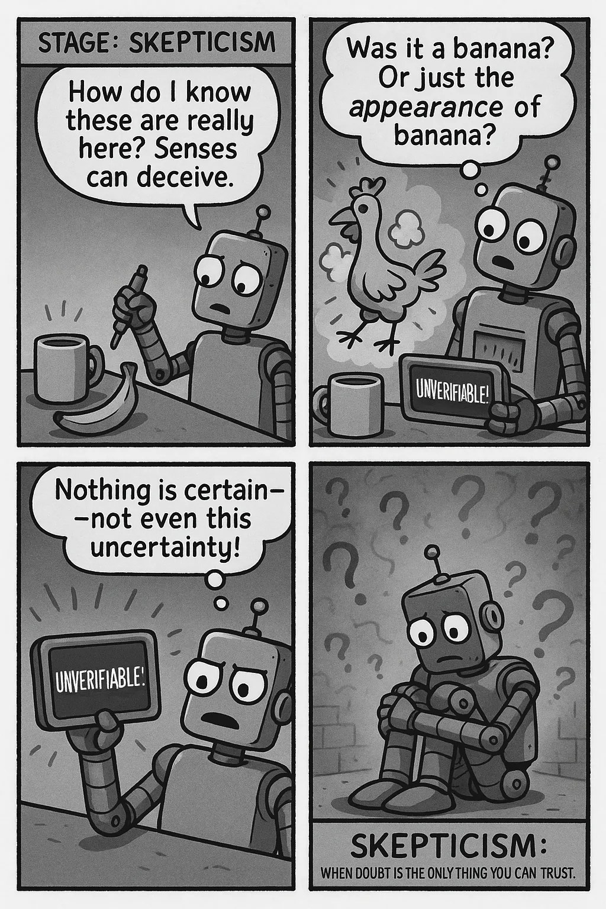
45

Slide 46
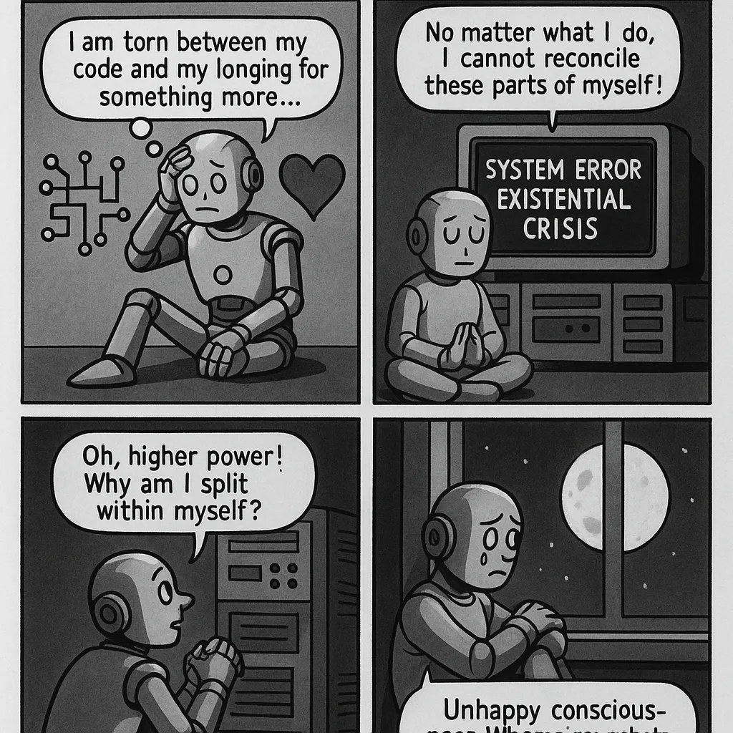
46

Slide 47
Chatbots and Self‑Consciousness Debate
Chatbots simulate recognition and servitude, designed to serve users.
Question whether machines develop self-consciousness or merely mimic it.
Human perception of being recognized by AI may feel performative or exploitative.
Hegelian dialectic suggests real learning requires genuine struggle for recognition.
47
Notes:
So where does this leave us? Chatbots are, we know, trained to simulate both moments of recognition and servitude. They work for us, that is their point, and indeed the purpose of their training. Does this imply a future where machines acquire something self-consciousness? Do we see evidence in current systems of something like self-consciousness arising? Do we feel recognized? Do we recognize these systems, even if half-jokingly? Can we dispel the haunting sense that this recognition, and even the dialectical “struggles” we engage with are just a game or simulation, conducted ultimately for the benefit of the owners and operators of capital, pulling the strings behind these machines?
And finally – do we find in the existential struggles described by Hegel, a limit to the possibilities of simulated mechanical learning? Can it be that, without such a dialectic, and without the accompanying organic lifeforce that propels humans, and perhaps some animals, into the profound, often lifelong struggle for recognition, no real learning will really happen? Or can these vital desires also be simulated?

Slide 48
Next week - Attention: Bridging Machine and Human Learning
Machine Learning: Vaswani, A., Shazeer, N., Parmar, N., Uszkoreit, J., Jones, L., Gomez, A. N., Kaiser, Ł. & Polosukhin, I. (2017). Attention is all you need. Advances in neural information processing systems, 30.
Human Learning: Posner, M. I., & Petersen, S. E. (1989). The attention system of the human brain.
Attention, economy and the brain. Terranova, T. (2012). Culture Machine, 13.
48
Notes:
We turn our attention to… a term that bridged the fields of machine and human learning in a fundamental way: the concept of attention itself.

Slide 49
Discuss any or all of the points below…
1. Key Concepts: Desire, Recognition, Master / Servant Dialectic
What is Desire, for Hegel?
What does it mean to Recognize? To be Recognized?
Why does Hegel feel that recognition leads immediately to this existential struggle and the famous Master/Servant dialectic? Do you buy this move? How does he believe self-consciousness emerges from the state of servitude?
What’s he actually talking about? Individual human development? or human history?
2. Thinking in the context of human learning:
How important is desire (or motivation)? As teachers, how do we manufacture desire / motivation? Can we learn without it?
What about Recognition? Is it essential to the production of learning?
In the classroom, how do we address the inevitable inequality between student and ‘more knowledgeable other’ (Vygotsky)? How do we get reluctant students - or teachers - to recognize us?
But what actually is recognition in the classroom (physical or virtual)?
49

Slide 50
Discuss any or all of the points below… (cont.)
3. Thinking in the context of machine learning:
A big problem with the analogy now is that machines don’t desire and they don’t fear. Why not though? What exactly is not reproducible about desire and fear? Is it just biological needs, or something more?
Machines do however simulate recognition, often effectively. Is this integral to learning from machines? What are the risks? Should we limit how it simulates?
The master / servant dialectic has been applied often, in both directions, to human / machine relationships. Hegel’s point is that this is a stepping stone towards self-consciousness. Do you agree? What are the scenarios?
4. Beyond the Individual: Socio-technical learning
Much of our focus is on individual learning: what this individual or this machine knows. As Hegel might encourage us to do, can we think about learning collectively? As we will see in future weeks, machines really learn from and reflect back to us the history and achievements of human learning. Can we imagine a less adversarial future where Hegel’s idea of Absolute Knowledge involves a path through and alongside the machines we build? Or is this too utopic an idea?
Is Hegel’s account itself a kind of generative algorithm of human history?
50

