Slide 1
Emotive Therapy
Strategic Therapy with RL-enabled emotive syncing

Slide 2
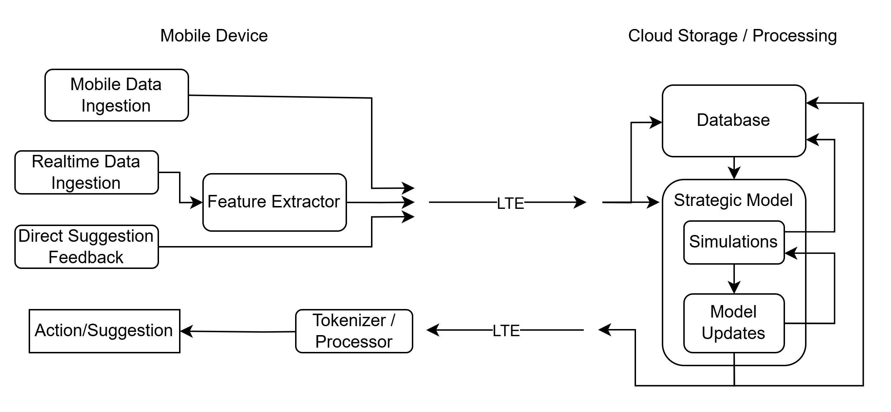
Mobile Architecture

