Slide 1
CROSS-PLATFORM
mobile
DEVELOPMENT

Slide 2

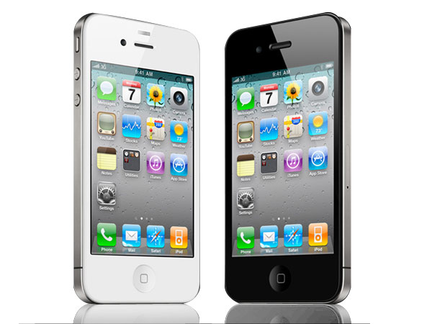


MOBILE DEVELOPMENT
Notes:
Define 'mobile development'
More children own mobile phones than own books.
550,000 new android devices are activated every day.
More than 100,000,000 smartphones are sold every quarter (more than PCs)
Android has most market share
Iphone has most valuable market place
Because android owners are tight bastards

Slide 3

Notes:
That's a yellow wood.
And two roads diverging.

Slide 4
Sorry,
you cannot travel both,
and be one traveller
Notes:
Discuss choices

Slide 5

Notes:
If you're rich you can pay to build your app two or more times.
- The same team will not have both skill sets
- Rea did this for realestate.com.au
- Repeat as other platforms become significant
- What does this do to our agility?

Slide 6

“cross compile”
Notes:
Application source is abstracted from the platform and the framework translates that into platform specific apps.
Explain scare quotes
Show picture
Debugging problems.
Tool/framework lock-in
Things like appcelerator titanium and rhomobile

Slide 7
CROSS-PLATFORM
“cross compile”
=
|| web
Notes:
Cross platform option
Compile to native solutions
Or
Web

Slide 8
Mobile Web Sites
Notes:
Regular web sites work for mobile (tell story of first iphone experience)
Optimized mobile websites are similar
- less content
- different perf considerations

Slide 9

PhoneGap
aka Apache Callback
Notes:
Differences between phonegap app and website
- local resources
- only data has latency
- forced into client-side UI
- different strategy for disconnected scenario
Web app in a native wrapper
Discuss PG starting point
Discuss the reality of client-side programming
- ie one page asynchronous Uis have arrived
- need a framework (spine, sammy, knockout, backbone)

Slide 10
demo
Notes:
0.8 bare html
0.85 add content
0.9 add phonegap.js
0.95 add custom css
1.0 add custom js

Slide 11
PhoneGap APIs

