Slide 1
EDES 301 PCB Project
Liam McConnico-Blanchet
Due 12/17/2024 @ 11:59pm

Slide 2

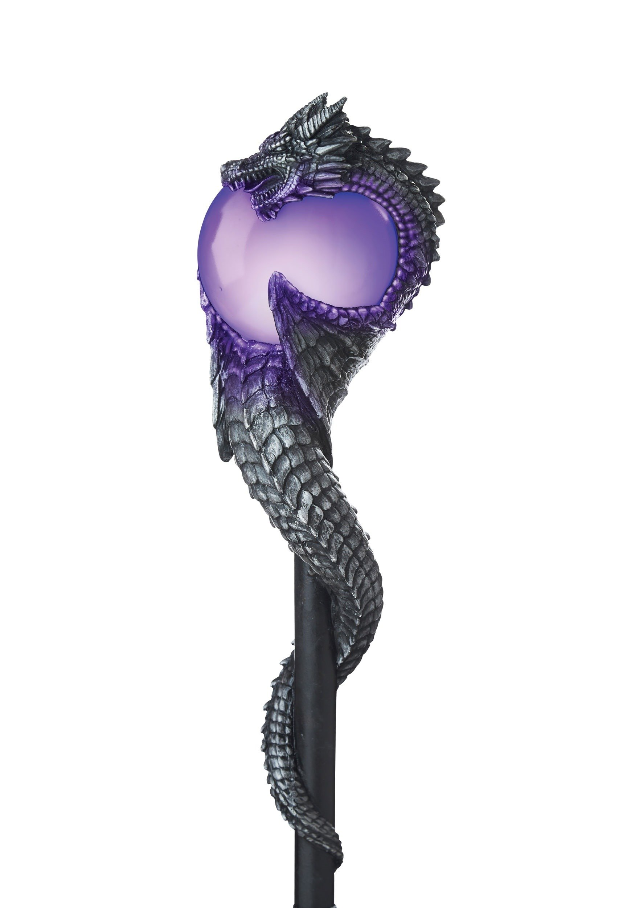
Background Information
I’ve wanted to have my own replica lightsaber for a long time, but they’re too expensive
Being able to make our own lightsaber means it will be both cheaper and more personal
Since I don’t want an exact lightsaber replica, I will be able to add a lot more features than a regular replica lightsaber.
Similar projects
NeoPixel Lightsaber: https://www.hackster.io/Modustrial_Maker/neopixel-lightsabers-w-party-modes-arduino-controlled-3e5a0d
ENGI 301 Elemental Cosplay Sword: https://www.hackster.io/Eunice011/elemental-cosplay-sword-1821f4
Wizard’s Walking Staff: https://www.hackster.io/Lucas_Ainsworth/wizard-s-walking-staff-ed7e08
Incorporate aspects of different designs (movement of the wizard staff, lightsaber-ness of the NeoPixel Lightsaber, light ups of ENGI 301 cosplay sword) to get a fuller lightsaber experience.
X =
ENGI 301
Lightsaber
Staff

Slide 3
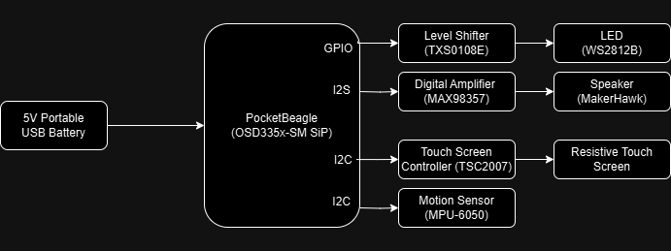
System Block Diagram

Slide 4
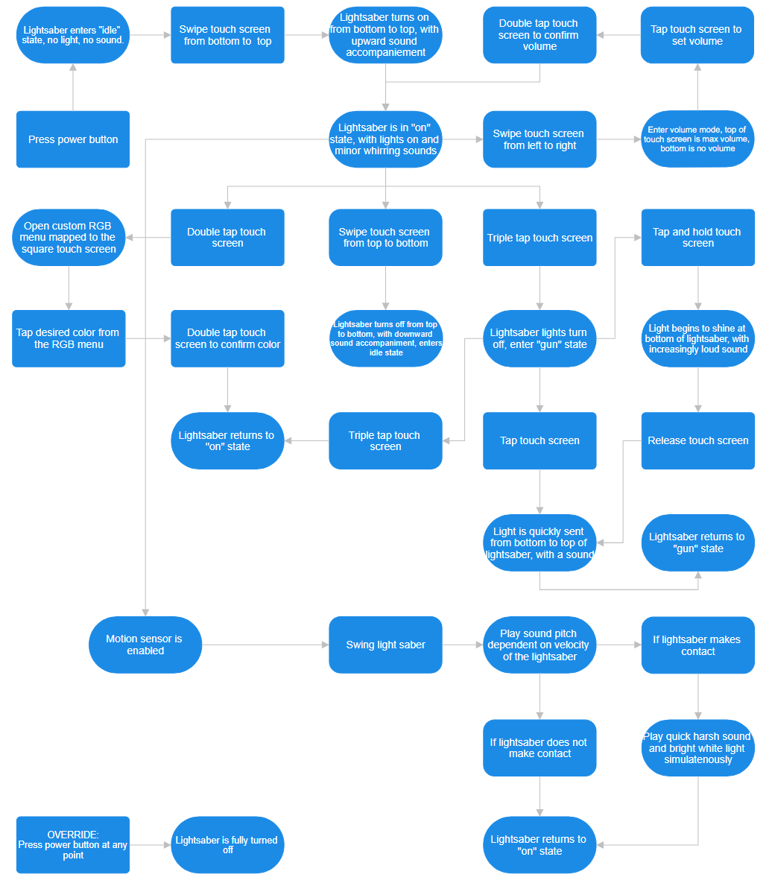
Software Block Diagram

Slide 5
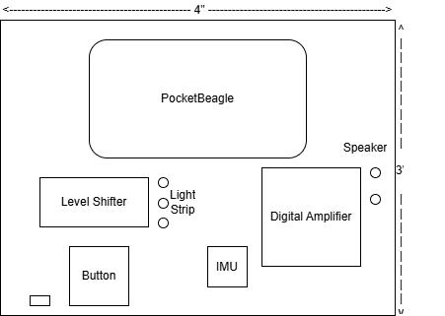
Mechanical Block Diagram
Complete For Project 2
See next slide for an example
FRONT
BACK
FRONT

Slide 6
Bill of Materials
Component | Cost
LED Reel (16.4ft) | $27.99
IMU 5pc | $12.99
Speakers 2pc | $11.99
Digital Amplifier | $5.95
5V Portable USB Battery 2pc | $17.99
Resistive Touch Screen | $5.95
Resistive Touch Screen Controller | $4.95
Total | $87.81

