Slide 1
Brain Undither
A neural network approach to undithering images.

Slide 2
What is Dithering?
- Dithering is best described as the intentional use of noise to approximate a higher bit-depth image.
- The first dithering algorithms were invented in the early days of binary displays, when simple thresholding of an image produced unsatisfactory renderings.
- It was found that by strategically “dotting” the image, finer shades of gray could be approximated.

Slide 3
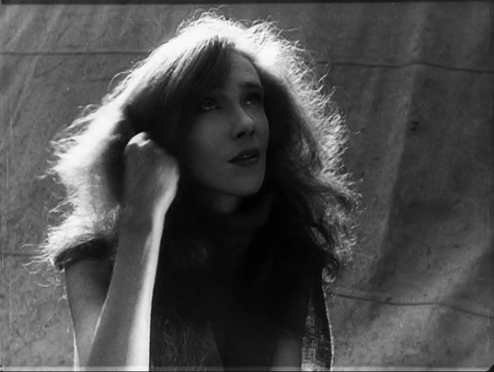
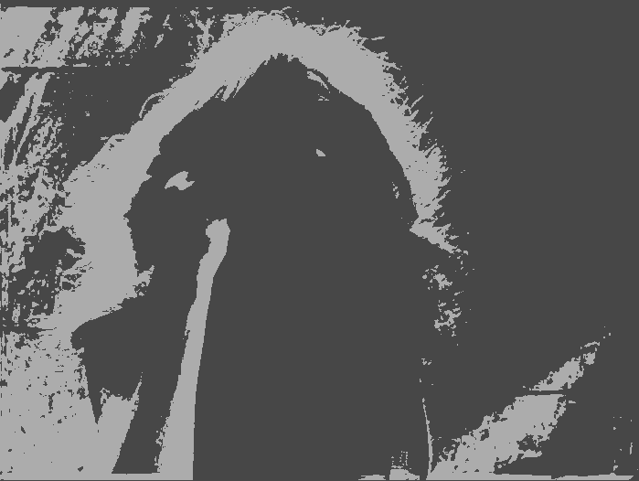
An Example...
Left: Full 8-bit greyscale image Right: 1-bit thresholded image.
[ Picture from the film Po Zakonu (1926) ]

Slide 4
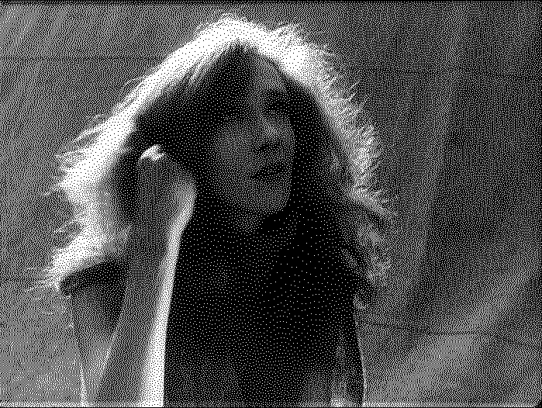
An Example...
Floyd-Steinberg dithered 1-bit image.
[ Picture from the film Po Zakonu (1926) ]

Slide 5
How does dithering work?
- In order to produce the dots seen in dithered images, it is necessary to add/remove from the total value of pixels before they are thresholded, so they have a chance of being assigned a different color.
- Floyd Steinberg dithering is a form of “Error diffusion” dithering: When a pixel is thresholded, the difference between the approximated and actual pixel is sent to the pixel neighbors, eventually causing some pixels to be thresholded to a completely different color (creating dots).

Slide 7
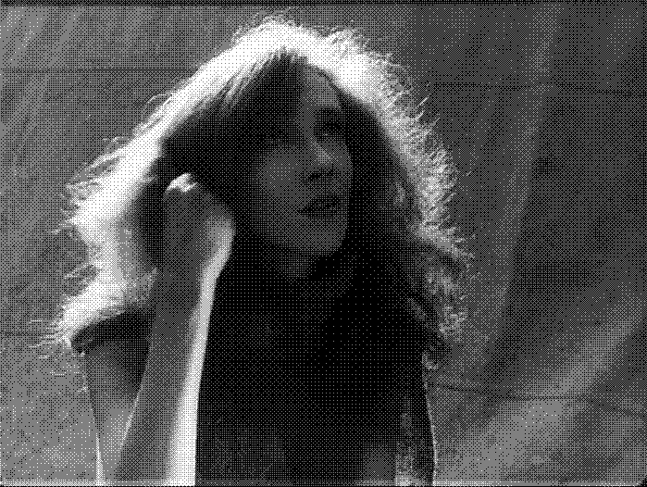
Ordered Dithering
- In Ordered Dithering, the dithering effect produces a structured pattern instead of “random” dots.
- This image uses 3 colors instead of 2.

Slide 8
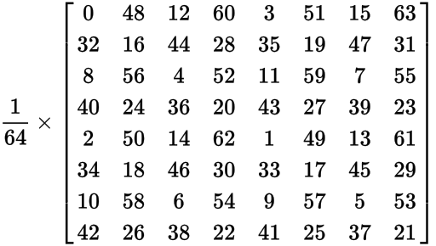
Ordered Dithering
- Instead of diffusing the error outwards, we add values to the pixels by tiling a Bayer Matrix over the image (this is an 8x8 variant).
- We use this matrix because its elements can be found using only bit operations (fast):
M(i, j) = bit_reverse(bit_interleave(bitwise_xor(x, y), x)) / n ^ 2

Slide 10
Ordered Dithering
- Consecutive values in the matrix are fairly far apart from each other, which gives a “checkerboard” effect.
- Because the dithering is structured, it is highly compressible and also suitable for animations.

Slide 11
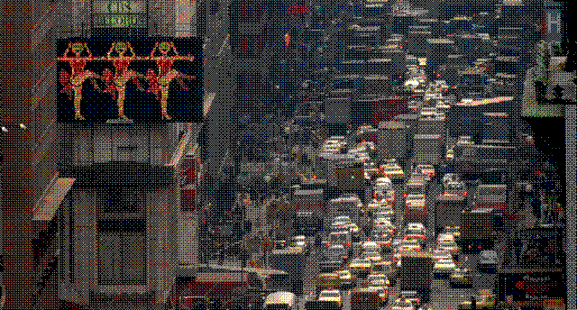
An Example
A 3 second clip from Koyaanisqatsi (1982). Only 8 colors (3-bits) are being used.

Slide 12
Undithering
- So I want to try and undo this process – go from a dithered image back to the original (or as near as possible). - Clearly some information is unrecoverable.
- What methods are generally used?

Slide 13
Gaussian Blur
- We can pretend that the dithering pattern is Gaussian noise, and use a Gaussian blur to smooth the image. - It’s fast, and it’ll work for any dithering method – but the result is obviously blurred.

Slide 14
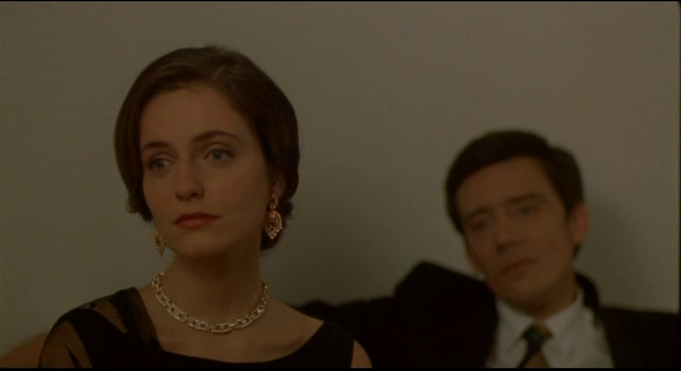
An Example...
[ Picture from the film Abraham’s Valley (1993) ]

Slide 15
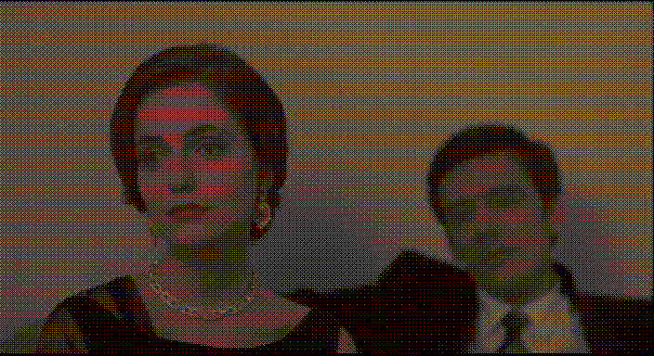
An Example...
[ Picture from the film Abraham’s Valley (1993) ]

Slide 16

An Example...
[ Picture from the film Abraham’s Valley (1993) ]

Slide 17
My Method
- Instead of applying a simple blue to the image, why not pass each window to a ANN?
- Notice first that a convolution is equivalent to a perceptron regressor applied independently to each channel:
1 | 1 | 1
1 | 1 | 1
1 | 1 | 1
A “Box Blur” filter

Slide 18
My Method
- I want to try and take a 7x7 window (147 features; 49 x 3 color channels) and predict a single color (3 outputs, 1 for each color channel)
- We take all colors at once, since we hope that there is some spectral correlation between colors that we can use.
- But our feature vector is huge!

Slide 19
PCA
- To reduce the size of the input into the ANN, we first apply Principal Components Analysis to our data. - I found that 95% of the variation in each window can be described by just 49 dimensions (a third of the original 147).

Slide 20
Limiting Focus
- Because I wanted to maximize the potential for the ANN to work, and because I wanted to see if a specific dithering method encoded extra information in its structure, I trained my network solely on ordered dithered images (specifically using an 8x8 Bayer Matrix and 3-bits of color).
- This allows us to do some useful pre-processing as well...

Slide 21
Removing the structuring elment
- Why not try remove the Bayer Batrix from the image, to normalize the colors a bit and to restore some color variation?

Slide 22
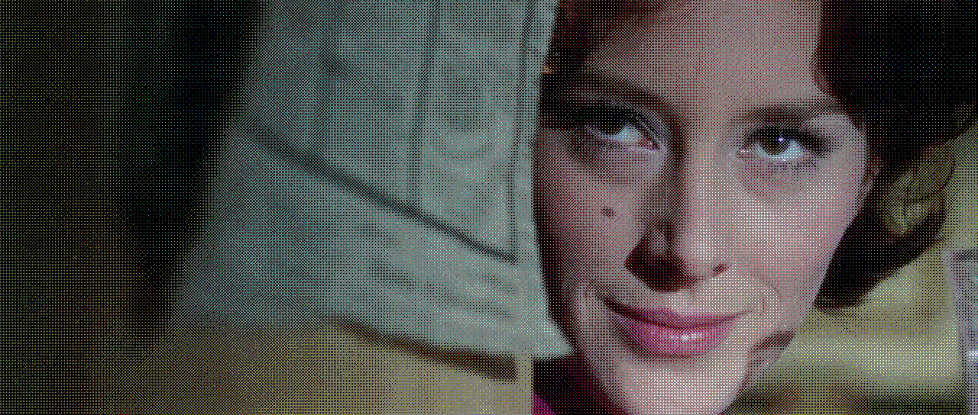
An Example...
The original 8x8, 3 bit ordered dithered image.
[ Picture from the film The Ipcress File (1965) ]

Slide 23
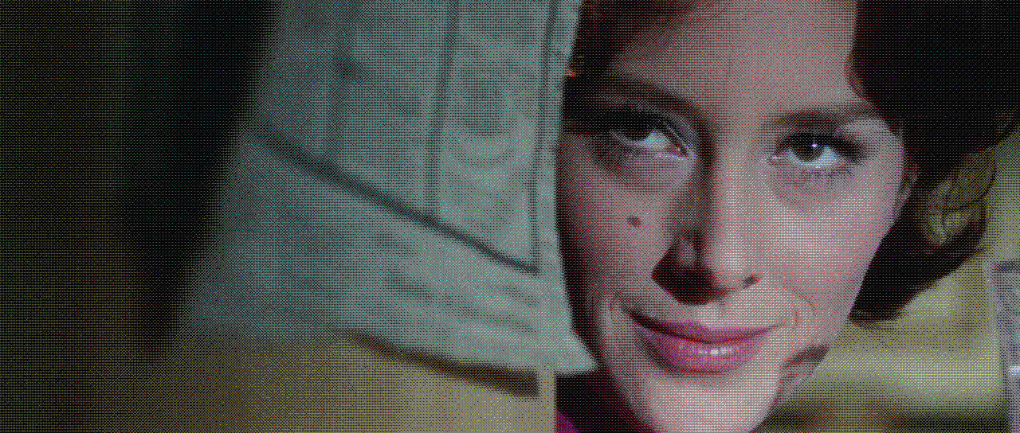
An Example...
The “unmasked” version.
[ Picture from the film The Ipcress File (1965) ]

Slide 24
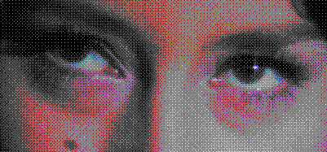
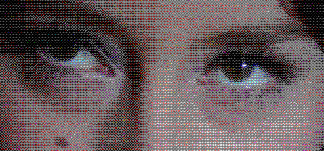
An Example
Top Image: Original Bottom Image: Unmasked version.
[ Picture from the film The Ipcress File (1965) ]

Slide 25
Unmasking Evaluation
- It turns out that this has minimal effect on the resulting image, But since it’s almost “free” we’ll keep it. :)

Slide 26
Training data
- The training data was a selection of stills from a variety of videos.
- The stills are of varying brightness, color, and spatial frequency (standard vs. high definition, small image vs large image, sharp vs blurred, etc.).
- Each sample contains a window from the dithered image, with the corresponding center pixel from the original image.
- I took approximately 10,000 random samples from each of 110 random images to give a total of 1,100,000 data points.

Slide 27
ANN structure
- My ANN has 2 hidden layers, of size 50 (7x7 + 1 bias node) and size 25. - Initial tests comparing the use of 1 hidden layer over 2 showed that the use of 1 layer left the image too blurred. - More layers = Better approximation - More layers = Slower training; prediction
- 2 hidden layers is a good compromise.

Slide 28
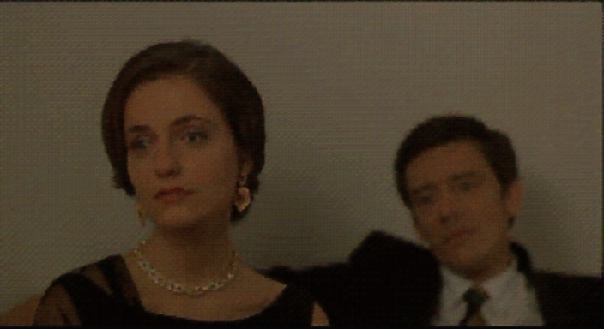
Result...
- Here is an image from the trained ANN:
Original My Method Gaussian Blur 5x5
[ Picture from the film Abraham’s Valley (1993) ]

Slide 29
Conclusions...
- In the process of going from 24-bits of color to 3-bits of color, it is inevitable that some color information will be unrecoverable.
- My method gives (arguably) better results than a standard Gaussian Blur but it is considerably slower and more intensive. (Holding the neccesary data in memory for an image of 1920x816 requires 3 GB!) - Optimizing the code and implementing the method in a lower level language will likely help correct this. - And now...

