Slide 2
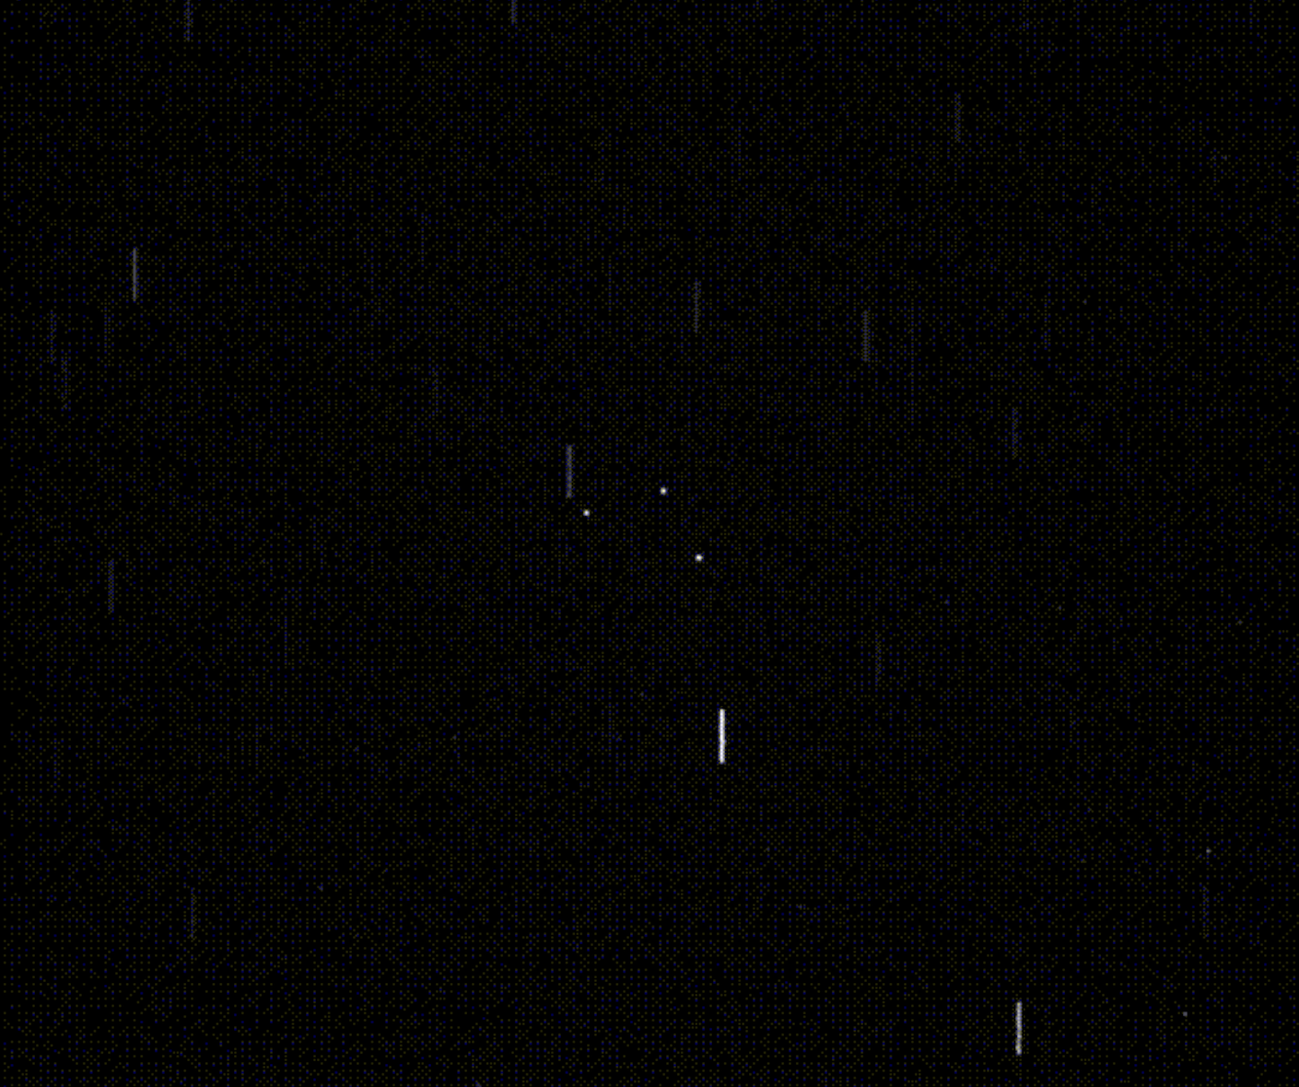
Selected stars
Objects

