Slide 1
POT (平安通) Health Monitoring Application
Leveraging REST APIs and WebSockets for Real-Time Elderly Care
CST8916 – Group 10
XuHui Liang
Cong Zhao

Slide 2


Introduction
"POT" (平安通) is a health monitoring system that's a joint project between the Macau government and CTM (Companhia de Telecomunicações de Macau), my previous employer.
We use wearable tech to keep an eye on their health in real-time.
(Social Welfare Bureau, n.d.)
(CTM, n.d.)

Slide 3
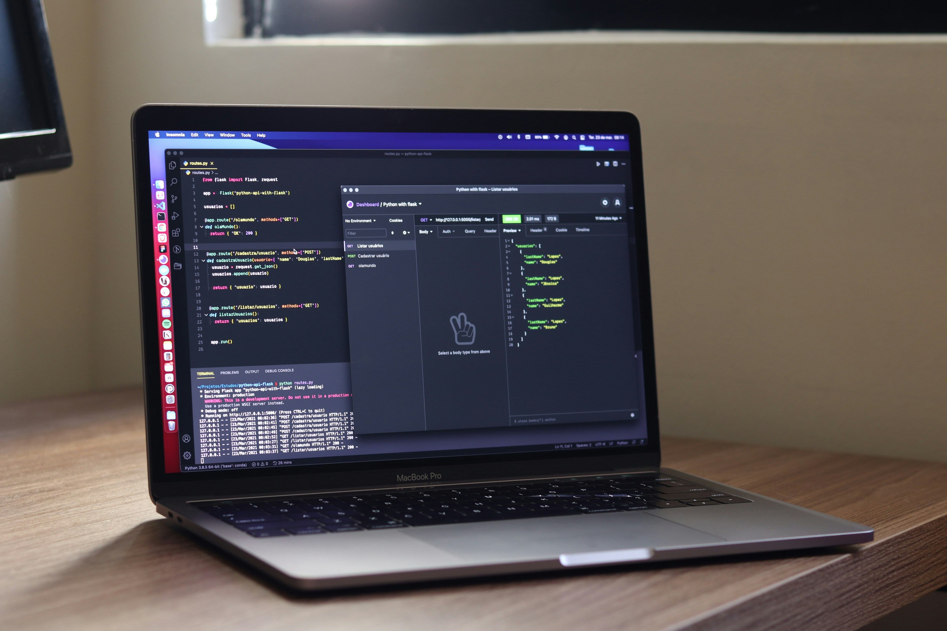
System Structure
For the POT (平安通) health monitoring system, we've built a hybrid architecture: using REST APIs for data management
and WebSockets for real-time communication.
REST APIs
WebSockets
Microservices
Wearable Devices
Monitoring Center
(Lopes, 2021)

Slide 4
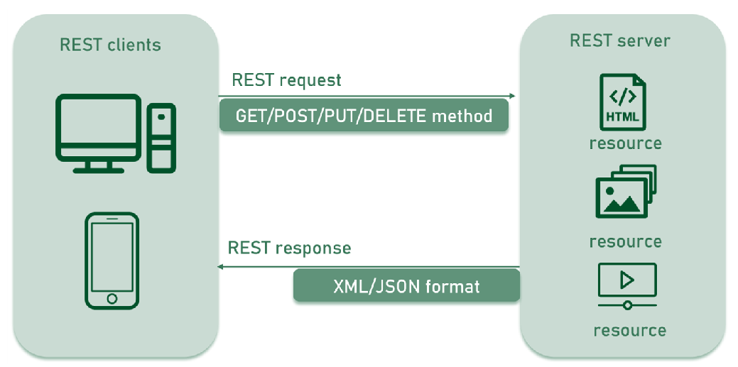
REST APIs for Management Platform
In the POT, we use a REST API to handle data requests and updates between the management front-end and our microservices.

Slide 5
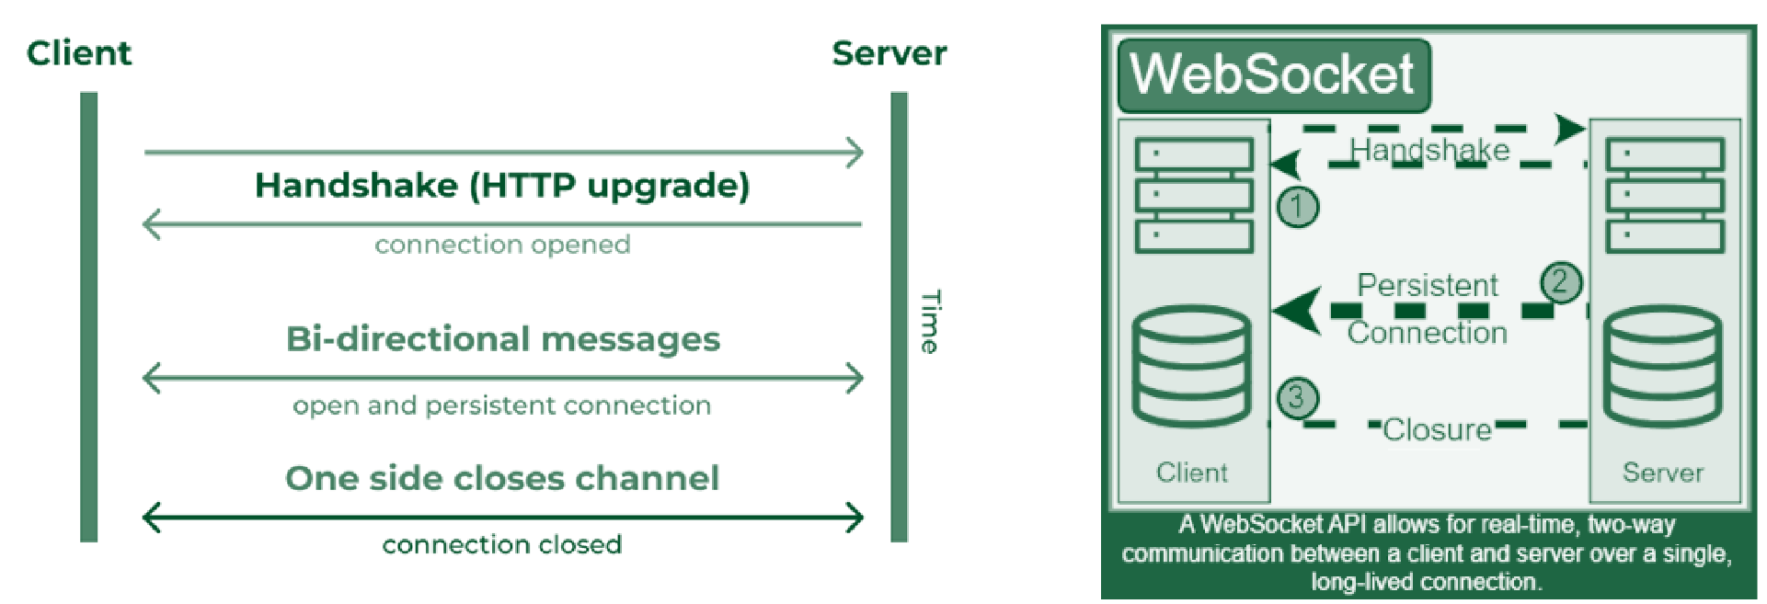
WebSockets for Wearable Devices
In our POT (平安通) app, we use WebSockets
to handle real-time data
between wearable devices and our system.

Slide 6
Benefits of Our Hybrid Approach
Our hybrid approach leverages the strengths of both REST APIs and WebSockets to optimize our system.
REST APIs are used for the management front-end to communicate with microservices, handling everyday data tasks easily with lots of community support.
Meanwhile, WebSockets manage communication with wearable devices, allowing us to monitor health data in real time and send instant alerts.
This mix boosts performance, scales smoothly as we grow, and makes it easier for our team to develop and maintain the system.

Slide 7
Conclusion
By combining REST APIs with WebSockets, the POT system effectively manages both reliable data handling and real-time communication.
This hybrid approach ensures high performance, scalability, and the ability to respond instantly to critical health events, perfectly aligning with our goal of providing a safe and responsive health monitoring solution.

Slide 8
Reference
CTM. (n.d.). Companhia de Telecomunicações de Macau https://www.ctm.net/en-US/person/index.html
Lopes, D. (2021, June 9). a laptop computer sitting on top of a wooden desk. [Photograph]Unsplash. https://unsplash.com/photos/a-laptop-computer-sitting-on-top-of-a-wooden-desk-ehyV_XOZ4iA
Social Welfare Bureau. (n.d.). Social Welfare Bureau. https://www.ias.gov.mo/en

Slide 9
Thank You All

