Slide 1
Letting Go
It 's not enough deciding to open.

Slide 2
Letting Go
You must plunge your fingers
into your navel, with your two hands
split open,
spill out the lizards and horned toads
the orchids and the sunflowers,
turn the maze inside out.
Shake it.
split open

Slide 3
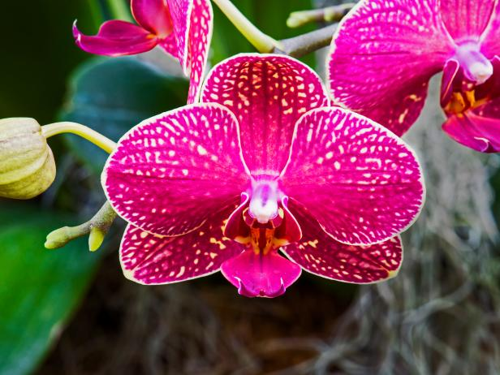
Letting Go
You must plunge your fingers
into your navel, with your two hands
split open,
spill out the lizards and horned toads
the orchids and the sunflowers,
turn the maze inside out.
Shake it.

Slide 4
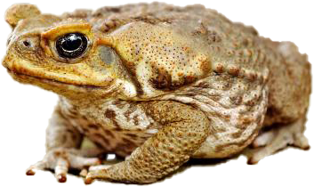
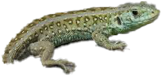
Letting Go
You must plunge your fingers
into your navel, with your two hands
split open,
spill out the lizards and horned toads
the orchids and the sunflowers,
turn the maze inside out.
Shake it.

Slide 5
Letting Go
Monstrosity inside
You must plunge your fingers
into your navel, with your two hands
split open,
spill out the lizards and horned toads
the orchids and the sunflowers,
turn the maze inside out.
Shake it.

Slide 6
Yet, you don't quite empty.
Maybe a green phlegm hides in your cough.
You may not even know that it's there until a knot grows in your throat and turns into a frog.
It tickles a secret smile on your palate full of tiny orgasms.
But sooner or later it reveals itself.
The green frog indiscreetly croaks.
Everyone looks up.
Letting Go
Small green phlegm
Grows
Everyone looks up
You may not know
secret smile
full of tiny orgasms

Slide 7
Letting Go
Again
Spring rain
young ears of corn
It's not enough
opening once.
Again you must plunge your fingers
into your navel, with your two hands
rip open,
drop out dead rats and cockroaches
spring rain, young ears of corn.
Turn the maze inside out.
Shake it.

Slide 8
Letting Go
Again
Orchids
sunflowers
Spring rain
young ears of corn
Spring rain
young ears of corn
It's not enough
opening once.
Again you must plunge your fingers
into your navel, with your two hands
rip open,
drop out dead rats and cockroaches
spring rain, young ears of corn.
Turn the maze inside out.
Shake it.

Slide 9
Letting Go
Again
Orchids
sunflowers
Spring rain
young ears of corn
Spring rain
young ears of corn
It's not enough
opening once.
Again you must plunge your fingers
into your navel, with your two hands
rip open,
drop out dead rats and cockroaches
spring rain, young ears of corn.
Turn the maze inside out.
Shake it.
Grow up

Slide 10
This time you must let go
Meet the dragon's open face and let the terror swallow you
-You dissolve in its saliva
-no one recognizes you as a puddle
-no one misses you
-you aren't even remembered and the maze isn't even of your own making.
Letting Go
you aren't even remembered
maze isn't your own making

Slide 11
This time you must let go
Meet the dragon's open face and let the terror swallow you
-You dissolve in its saliva
-no one recognizes you as a puddle
-no one misses you
-you aren't even remembered and the maze isn't even of your own making.
Letting Go
you aren't even remembered
maze isn't your own making

Slide 12
You've crossed over.
And all around you space.
Alone With nothingness.
Nobody's going to save you.
No one 's going to cut you down, cut the thorns thick around you .
No one's going to storm the castle walls nor kiss awake your birth, climb down your hair, nor mount you on the white steed.
Letting Go
Cross over

Slide 13
You've crossed over.
And all around you space.
Alone With nothingness.
Nobody's going to save you.
No one 's going to cut you down, cut the thorns thick around you .
No one's going to storm the castle walls nor kiss awake your birth, climb down your hair, nor mount you on the white steed.
Letting Go
Cross over
Empty
Free
Relax
out of the convention
No one 's going to cut you down,
cut the thorns thick around you .

Slide 14
Interests no longer back to boring life change inside
Letting Go
There is no one who
will feed the yearning
Face it. You will have
to do , do it yourself
And all around you a vast terrain.
Alone. With night.
Darkness you must befriend if
you want to sleep nights.
It's not enough
letting go twice, three times,
a hundred Soon everything is
dull, unsatisfactory
Night's open face
interests no longer
And soon, again you return
to your element and
like a fish to the air
you come to the open
only between breathings
But already gills
grow on your breasts.

