Slide 1

What factors affect movie's budget covering?
Students: Arman Aghamyan, Liana Minasyan, Hakob Hakobyan
Instructor: Hrant Davtyan
Course: ECON 317 Data Scraping
August 16, 2019

Slide 2

Methods for Getting Data
Wptools API
Selenium
Scrapy
RegEx

Slide 3
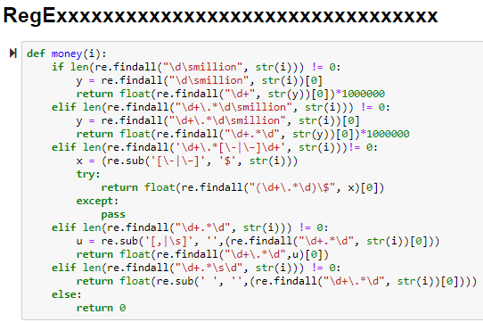
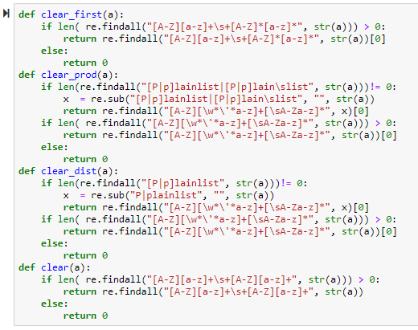
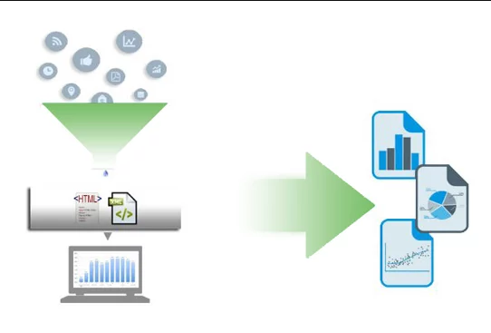

Slide 4
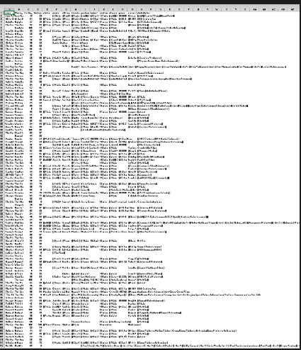
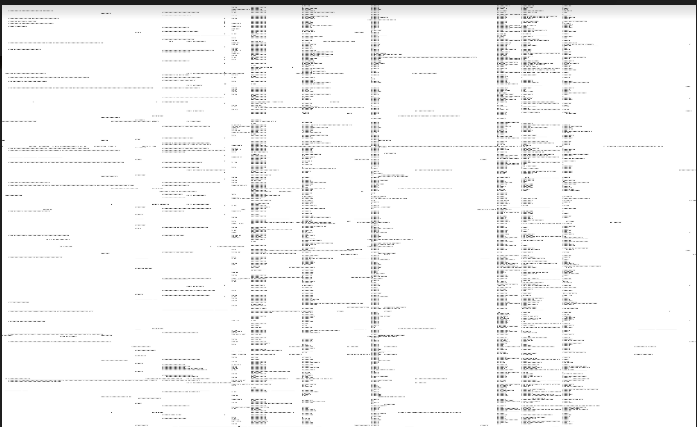
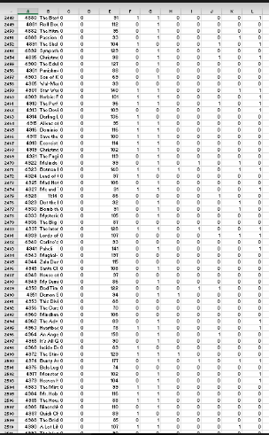
Raw data

Slide 5
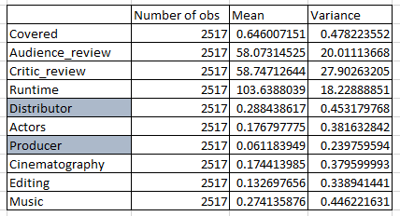
Variables

Slide 6
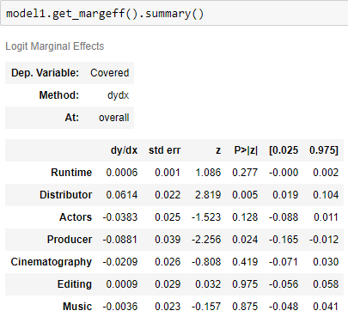
Logit Summary

Slide 7
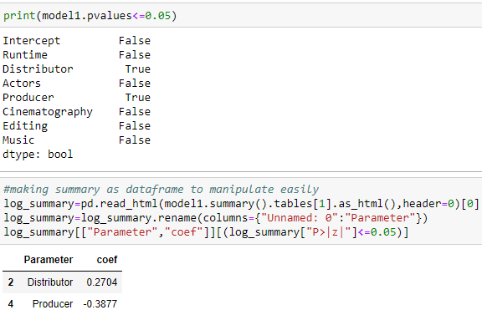
SIGNIFICANT VARIABLES

Slide 8
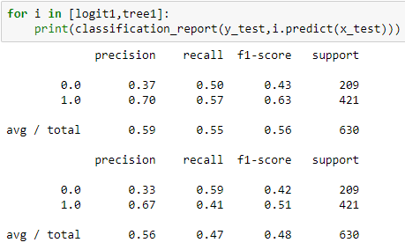
Classification report

Slide 9
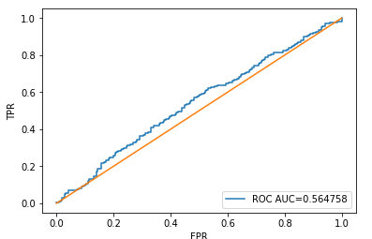
ROC curve

Slide 10
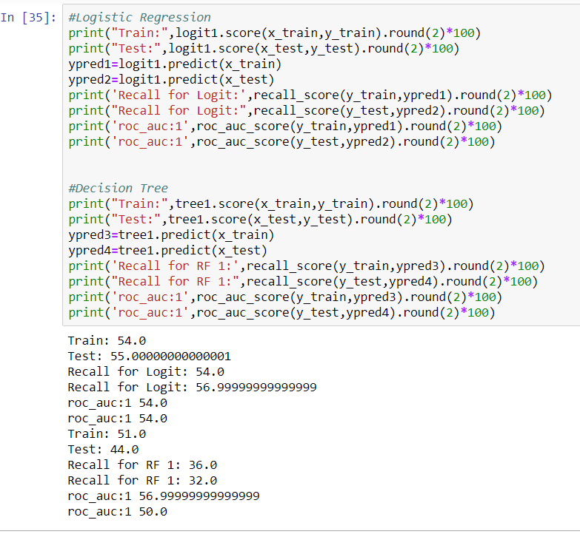

Slide 11


Word Clouds BY Drama and Documentary GENRES

Slide 12

Genre prediction

Slide 13
Thank you for attention!!!

