Slide 1
JQuery
Why does RBM care?

Slide 2
Wtf is JQuery?
a library that makes it quicker and easier to write JavaScript
written in JavaScript
a single .js file that you link to from your webpage
open source under the MIT and GPL licenses
Notes:
Often with jQuery you can write a single line of code to achieve what would have taken 10-20 lines of regular JavaScript code.
The jQuery library actually comes in 2 forms:
The uncompressed .js file is easy to read and modify, but it's around 160kb in size
The minified .js file has all comments, whitespace, and other unnecessary characters removed from the file, squeezing the whole library into a mere 23kb. Although you can't easily read the code, this is the version you'll want to place on your site, as it's much quicker for visitors to download.

Slide 3
What do I do with it?
Adding animated effects to elements. jQuery lets you easily add effects such as fading in/out, sliding in/out, and expanding/contracting.
Making XML (Ajax) requests. These use JavaScript to request additional data from the Web server without having to reload the page.
Manipulating the DOM. You can easily add, remove, and reorder content in the Web page using just a couple of lines of code.
Creating image slideshows. You can use jQuery effects to build nice animated slideshows and lightboxes.
Making drop-down menus. jQuery makes it easy to create multi-level dropdowns with animations.
Creating drag-and-drop interfaces. Use jQuery to build a page with elements that can be repositioned or reordered simply by dragging and dropping.
Adding power to forms. With jQuery you can easily add complex client-side form validation, create auto-complete Ajax text fields that pull data from a server-side database, and so on.

Slide 4
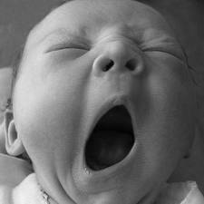
So what?
Notes:
We already have…
Prototype
Low Pro
Scriptaculous
Javascript itself

Slide 5
Why is JQuery better?
easy to write JavaScript that works on many different browsers
hundreds of jQuery plugins are available to add even more power and functionality to your scripts
embraced by the ruby on rails community
active project with many contributing developers
Notes:
Incompatibilities between popular browsers such as IE, Firefox and Safari mean that you often need to write different chunks of JavaScript code for each browser. With jQuery, however, you just call the appropriate jQuery function and let jQuery deal with making the code run on different browsers. Nice!

Slide 6
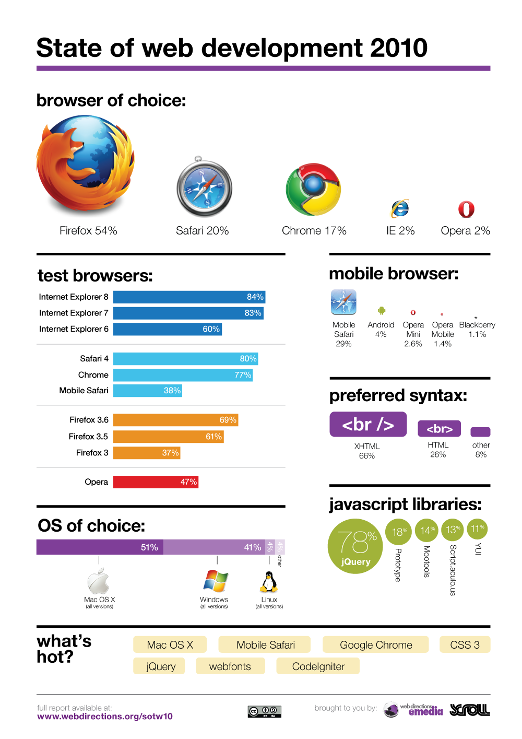
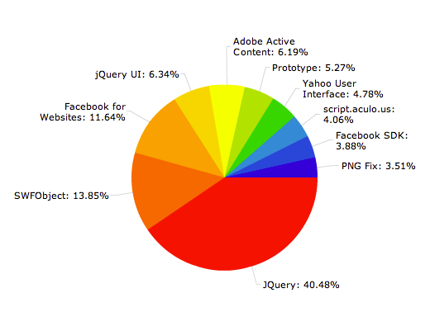
JQuery is the most detected JavaScript library in use on the web
Notes:
http://www.webdirections.org/sotw10/results/
THE STATE OF WEB DEVELOPMENT REPORT
Our detailed report of the technologies and techniques used by web professionals around the world in early 2010.
http://trends.builtwith.com/javascript
BuiltWith Trends provides trending information for over 1500 individual web technologies since 2008, providing the most accurate picture of internet technology usage statistics available anywhere on the web today - and all for free.

Slide 7
Who’s using it?
Google
Amazon
IBM
Microsoft – Visual Studio, ASP.NET MVC.
Twitter
Dell, Inc.
Best Buy
NBC
Match.com
ESPN
CBS News
Bank of America
New Jersey Defensive Driving
Notes:
http://docs.jquery.com/Sites_Using_jQuery

Slide 8
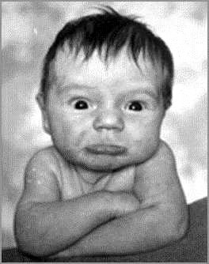
I still don’t see why we should care.

Slide 9
JQuery Mobile
"write once, deploy anywhere."

Slide 10
What’s JQuery Mobile?
a user interface framework for mobile devices built on top of jQuery
developers can write one application for a number of mobile devices, including smartphones and tablets
supports iOS (iPhone, iPad, iPod Touch), Android, Blackberry OS6, HP's webOS, Mozilla's Fennec and Opera Mobile
future platforms include Windows Mobile, Symbian, MeeGo and more

Slide 11
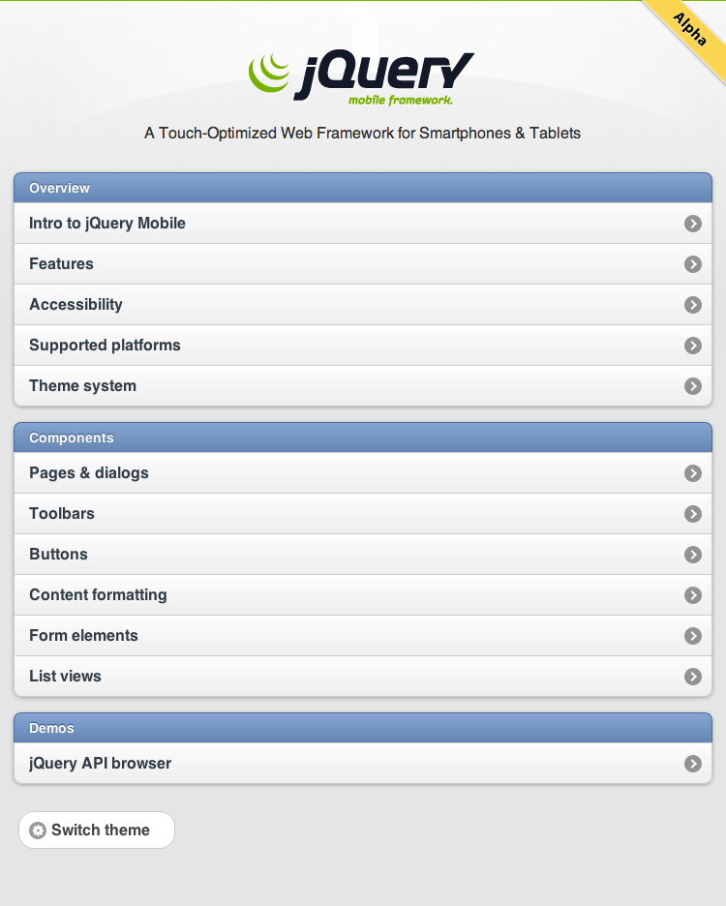
A demo
http://jquerymobile.com/demos/1.0a1/
Notes:
http://jquerymobile.com/demos/1.0a1/
Form Elements: Form Element Gallery
Pages: Page Transitions
Toolbars: Fixed positioning

Slide 12
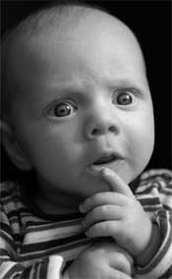
I’m still not convinced.

Slide 13
What do I get?
Progressive Enhancement: A jQuery Mobile app will work in more browsers, guaranteed, even those that don't support JavaScript.
Graceful Degradation: Less capable browsers will still receive the best possible experience that their platform can handle.
Accessibility: All jQuery Mobile components are ARIA accessible.
Simplicity: jQuery Mobile is completely markup-driven requiring no JavaScript configuration, making it easy to get started.
Small File Size: The JavaScript is only 12KB and the CSS is a mere 6KB.
Theming: jQuery Mobile has a comprehensive theming structure built from the ground up and includes a "Themeroller" tool.

Slide 14
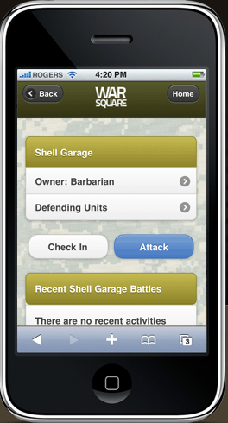
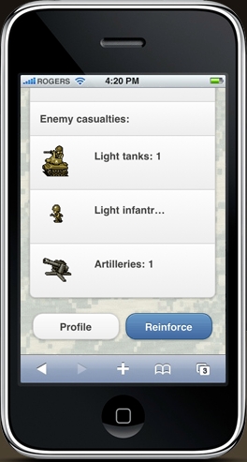
WarSquare
Notes:
Within 36 hours of the Jquery Mobile release, an app was already built using the technology.
The new app is called WarSquare and it's a geo-aware mobile Web game built on top of Foursquare.
It looks just as polished as many native iOS apps.
http://warsquare.r10.railsrumble.com/#

Slide 15

That’s kinda cool.

Slide 16


Better and Easier
QUnit: framework for unit testing your JavaScript
JQueryUI: animation, advanced effects and high-level, themeable widgets

Slide 17

PhonoSDK
PhonoSDK is a simple jQuery Javascript plug-in that turns any Web browser into a multi-channel communications platform capable of placing and receiving VoIP telephone calls from the browser as well as handling real-time chat communications and more.
Notes:
http://labs.voxeo.com/
PhonoSDK allows jQuery developers to easily add and style a softphone in any web browser application and in minutes call any SIP address and receive calls to the SIP address dynamically create onReady.

Slide 18

FuncUnit
Functional Testing
for JavaScript Applications
FuncUnit is a free, open source, web application testing tool. It is the first complete functional testing tool built for JavaScript developers by JavaScript developers. If you know jQuery, you already know the API.

Slide 19

JQuery UI Widgets
Wijmo is a complete kit of over 30 jQuery UI Widgets. It is an extremely dangerous mixture of jQuery, CSS3, SVG, and HTML5 that when combined become an unstoppable force on the web.
Notes:
http://wijmo.com/posts/
Sneak Peak – scroll down

Slide 20

I <3 JQuery

Slide 21
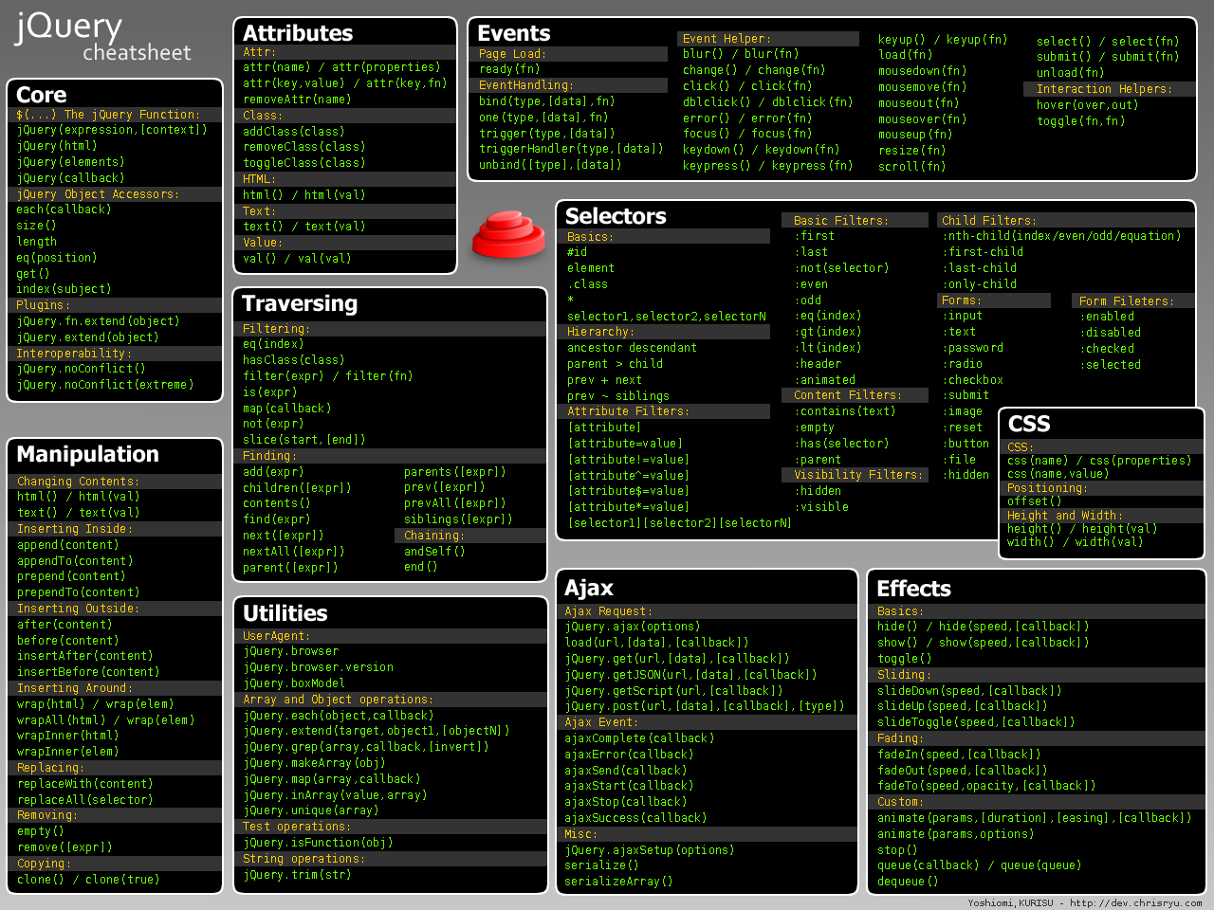
Questions?

