Slide 1
There are noticeable disproportions between consumption levels and CO2 emissions across different food categories.
Ideally, one might expect these values to align, but in reality, some foods contribute significantly more to emissions than their consumption share suggests.
For instance:
Beef accounts for 3.92% of total consumption, yet it generates 45.72% of total CO2 emissions.
Lamb & Goat makes up just 0.84% of consumption, but is responsible for 11.13% of CO2 emissions.
This highlights the substantial environmental impact of certain food categories relative to their consumption levels.

Slide 2
The R² value (0.3151) indicates a weak correlation—only 31.5% of the variance in CO₂ emissions is explained by food consumption.
Beef, Milk, Wheat seem to be outliers
While there is a general trend where more food consumption leads to higher CO₂ emissions, certain food categories (like beef) deviate significantly from this trend.
This suggests that emissions are highly dependent on food type, not just quantity.

Slide 3
We observe similar trends in Armenia, with some distinct characteristics:
Soybeans have zero consumption.
Beef is responsible for ~55% of total CO2 emissions, making it the dominant contributor to environmental impact.
Nuts and peanut butter consumption is low, indicating a preference for other food sources.

Slide 4
Meat-Based - Beef, Poultry, Fish, Lamb & Goat, Pork
Animal Byproducts - Eggs, Milk & Dairy
Plant-Based - Rice, Wheat, Nuts, Soybeans
Meat-based foods have the highest environmental impact per unit consumed.
Animal byproducts (eggs & dairy) are more sustainable than meat but still have a notable CO₂ footprint.
Plant-based foods offer the best balance of high consumption and low CO₂ emissions.

Slide 5
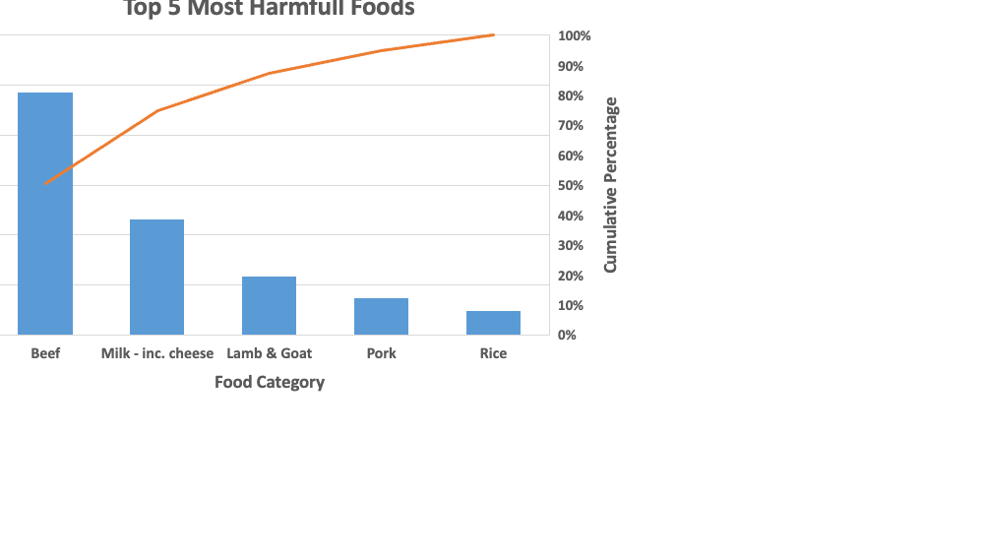
Beef is the most significant contributor to CO₂ emissions.
Milk - including cheese also has a substantial environmental impact.
The cumulative percentage line (blue) shows that the top 3 categories contribute to the majority of emissions (80%+).
Rice and Pork have relatively lower emissions but still contribute to the total.

