Slide 1

Contoso Promotions Analysis

Slide 2
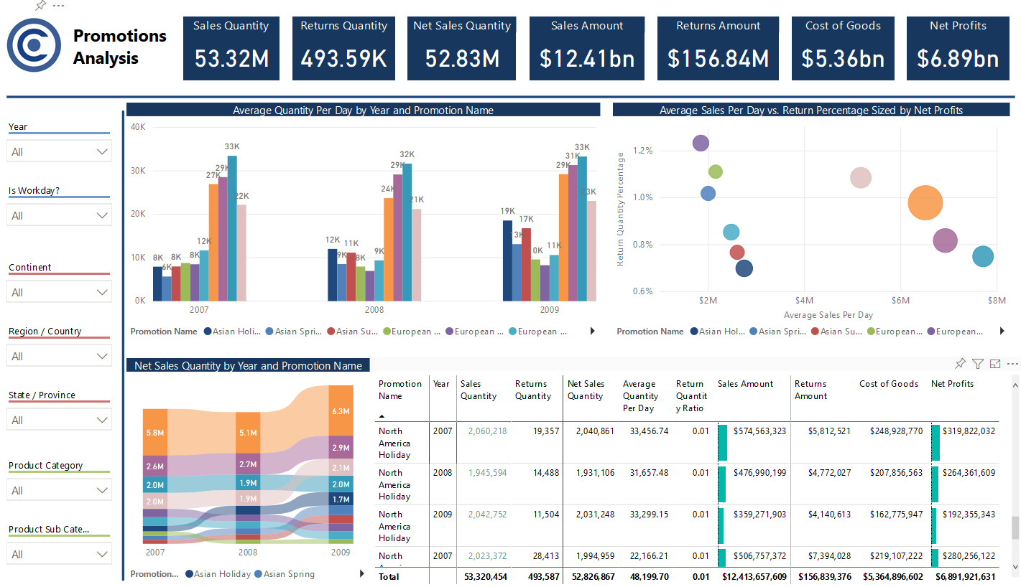
Highest Average Sales Comparatively to Lowest Returns:
North America Holiday
Notes:
The sales promotion with the highest average relative to the lowest returns ratio was North America Holiday. Average sales during the North America Holiday promotion exceeded average sales with no discount while it’s returns ratio was second to lowest at roughly 0.75%.

Slide 3
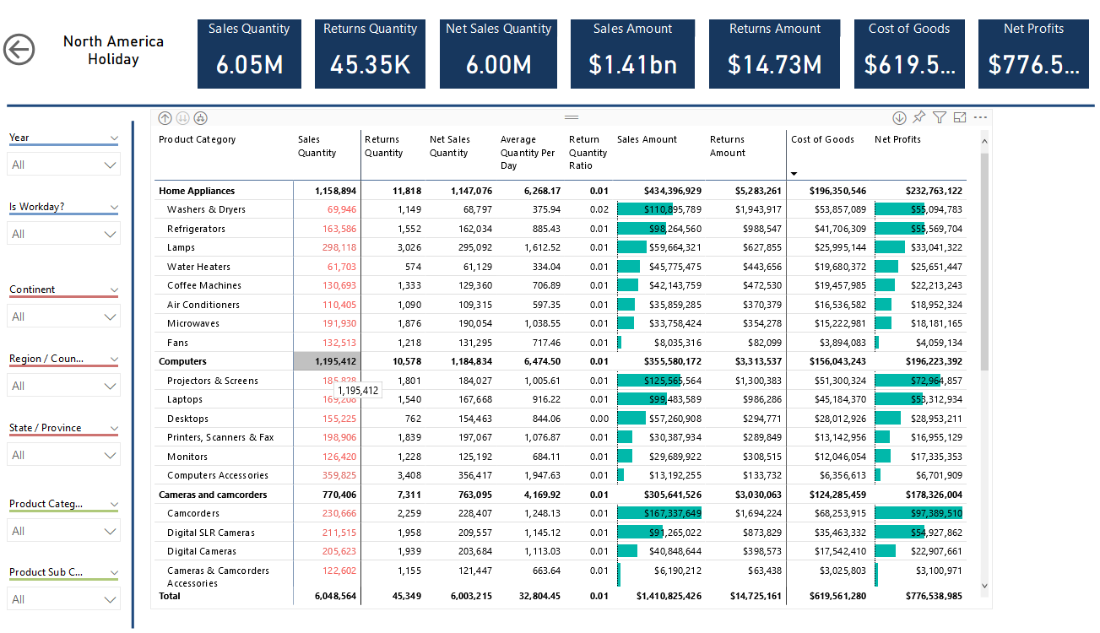
Notes:
Here we see the breakdown of the promotion. Profits during the promotion totaled $776.5 million, where home appliances have the largest total sales at around $434.4 million.

Slide 4
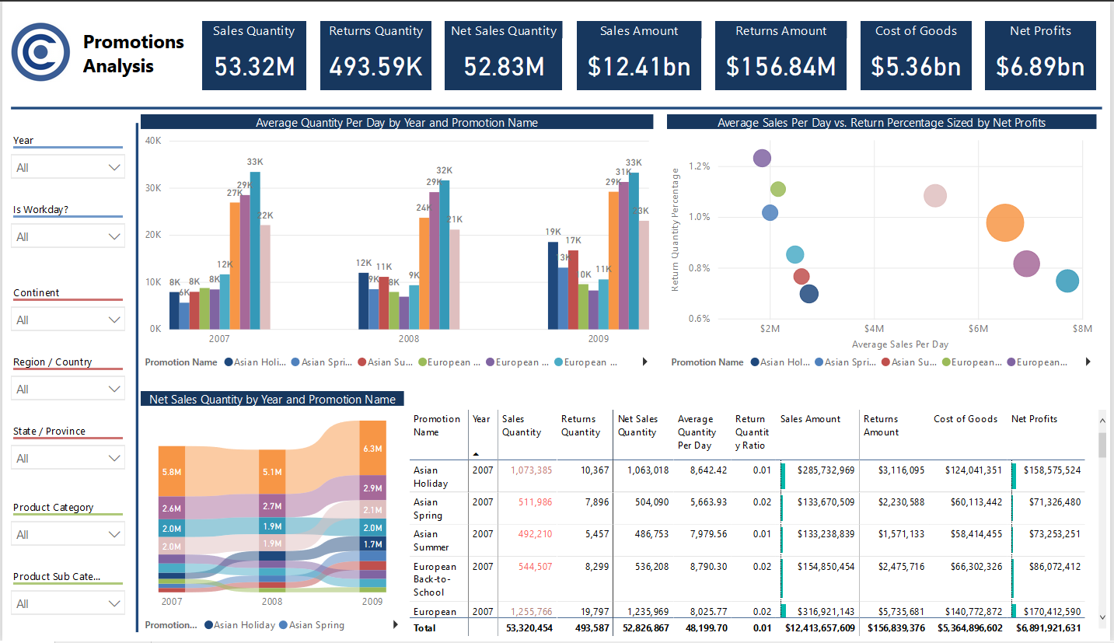
Promotion with Lowest Return Ratio:
Asian Holiday
Notes:
The sales promotion with the lowest return ratio overall was Asian Holiday, with a ratio right around 0.7%.

Slide 5
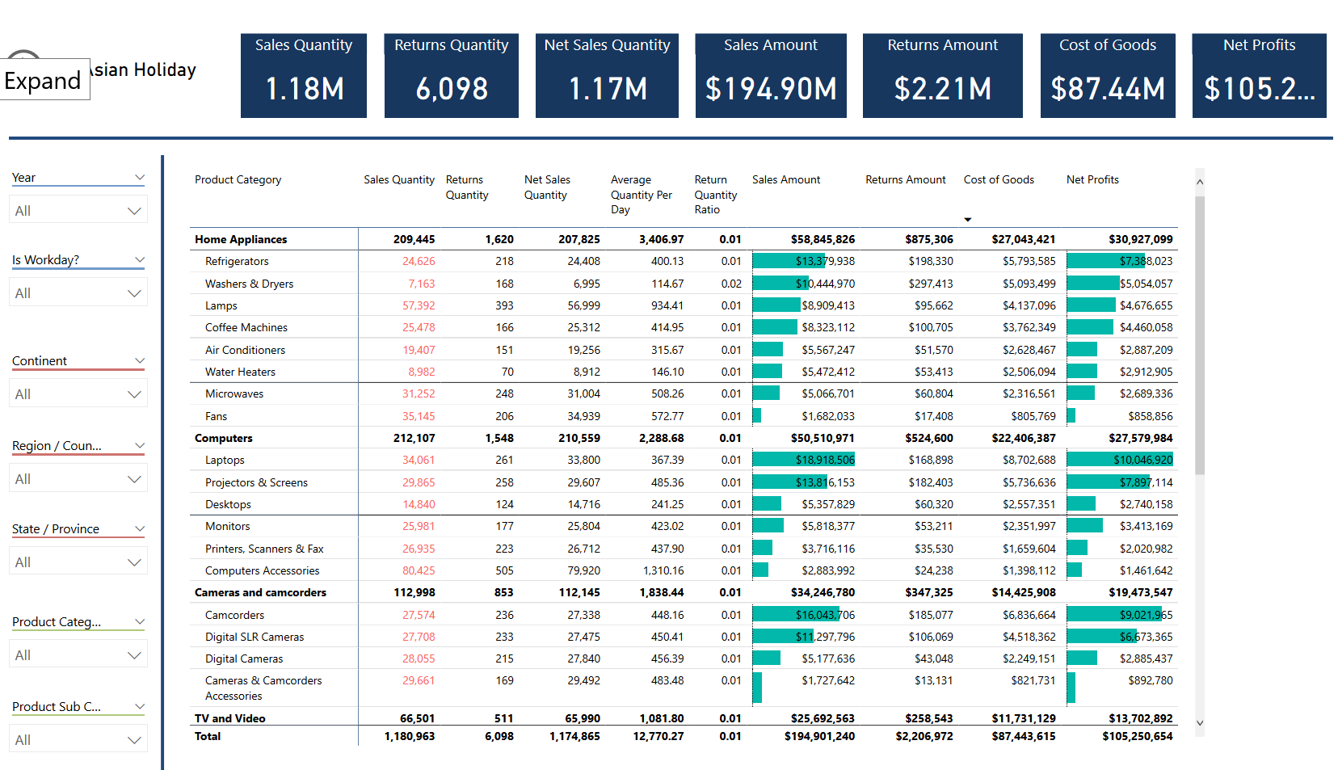
Notes:
The total number of returns for the Asian Holiday promotion was 6,098 amounting to roughly $2.2 million.

Slide 6
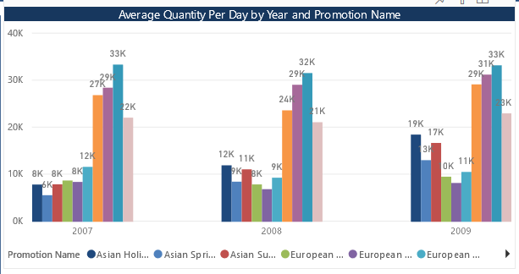
Promotions With Lower Average Sales Quantity Per Day than No Discount:
Asian Holiday, Asian Spring, Asian Summer, European Back-to-School, European Holiday, European Spring, and North American Spring
No Discount
Notes:
Asian Holiday, Asian Spring, Asian Summer, European Back-to-School, European Holiday, European Spring, and North American Spring all had average sales quantities that fell below a normal day with no discount. We should consider eliminating a few of these, however we must first consider the effects these promotions have on advertising and bringing in more year-round customers.

Slide 7
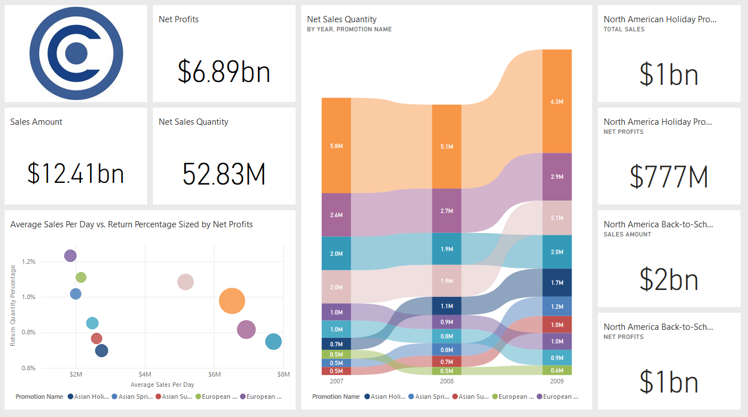
Notes:
The bottom line we need to consider is the profits we make on each promotion. North America Back-to-School has produced the highest total net profits of around $1 billion, with North America Holiday as a clse second around $777 million.

Slide 8
Conclusions & Recommendations
Promotions are not only about making more profit in the short-term, but also about long-term customer loyalty and company recognition.
Find what sales tactics are effective for high selling promotions: North America Holiday and Back-to-School.
Investigate weak spots in low-selling promotions: Asian Holiday, Asian Spring, Asian Summer, European Back-to-School, European Holiday, European Spring, and North American Spring
Eliminate lowest selling discounts for each region: Asian and North America Spring, and European Holiday.
Notes:
We should eliminate lowest selling discounts for each region, since they are selling lower than if we have no discount. However, promotions are not only about short-term profits, but are also about long-term customer loyalty and company recognition. Therefore it is important to continue to have promotions in each region and focus our efforts in increasing sales during those promotions.

