Slide 1
Who Pays for Oil Shocks? Fuel Price Pass-Through to the Inflation of Poor Households across Philippine Regions
Capstone Paper Presentation (SA3)
Graduate School of Applied Economics, University of Southeastern Philippines
Prepared by: Lian Cataytay
November 2026

Slide 2
1. Why this question matters now
The 2026 oil shock pushed inflation above target, and the poor's inflation even higher.
The shock
Pump prices: the fuel index was 76% above a year earlier in April 2026
Headline inflation: 2.4% in February → 7.2% in April → 6.2% in August
Bottom 30% of households: 8.5% in April and 8.2% in August
BSP target: 2–4%
The policy response
RA 12316: lets the President suspend fuel excise taxes when Dubai crude ≥ USD 80/barrel
Excise suspended on LPG and kerosene, not on gasoline and diesel
Fuel subsidies for public utility vehicle drivers
BSP raised its policy rate three times, to 5.00%
Sources: PSA CPI (2018 = 100); RA 12316; BSP. Inflation is year on year.
Who Pays for Oil Shocks? · SA3 Capstone
2

Slide 3
2. Research gap and questions
Cross-country evidence says fuel shocks hurt the rich more; is that true in the Philippines?
The gap
Kpodar and Liu (2022), 122 countries: fuel price shocks are progressive: prices rise more for richer households
But Filipino poor households spend over half their budget on food and ride public transport
PSA publishes a bottom-30% CPI by region, so we can test this directly
Three objectives
Objective 1 (descriptive): trends in fuel prices and both inflation rates, 2001–2026
Objective 2 (estimation): pass-through (RQ1), the inflation gap (RQ2), categories (RQ3), regions (RQ4)
Objective 3 (policy): the 2026 shock, its peso cost and the policy response
Research question: When fuel prices rise, do poor Filipino households face larger price increases than the average household, and does it depend on where they live?
Who Pays for Oil Shocks? · SA3 Capstone
3

Slide 4
3. Key terms and notation
Each term keeps the same meaning on every slide.
Term | Meaning and formula
Fuel price shock | Monthly change in PSA's retail fuel index 07.2.2: f_{t} = 100·Δln F_{t}
Inflation (group g) | π^{g}_{t} = 100·Δln P^{g}_{t}; A = all income households, B = bottom 30%
Pass-through | β_{h}: change in inflation h months later per 1% fuel rise; cumulative B_{h} = β₀ + … + β_{h}
Inflation gap | D_{t} = 100·ln(P^{A}_{t} / P^{B}_{t}); a fall means prices rose more for the poor (regressive)
Basket weight | w^{g}_{k}: share of group g's 2018 budget spent on category k
Region groups | Our own dummies G_{r}: high poverty, high food share, Mindanao, island regions
Both CPIs are official PSA indices; the gap and the region groups are our constructions.
Who Pays for Oil Shocks? · SA3 Capstone
4

Slide 5
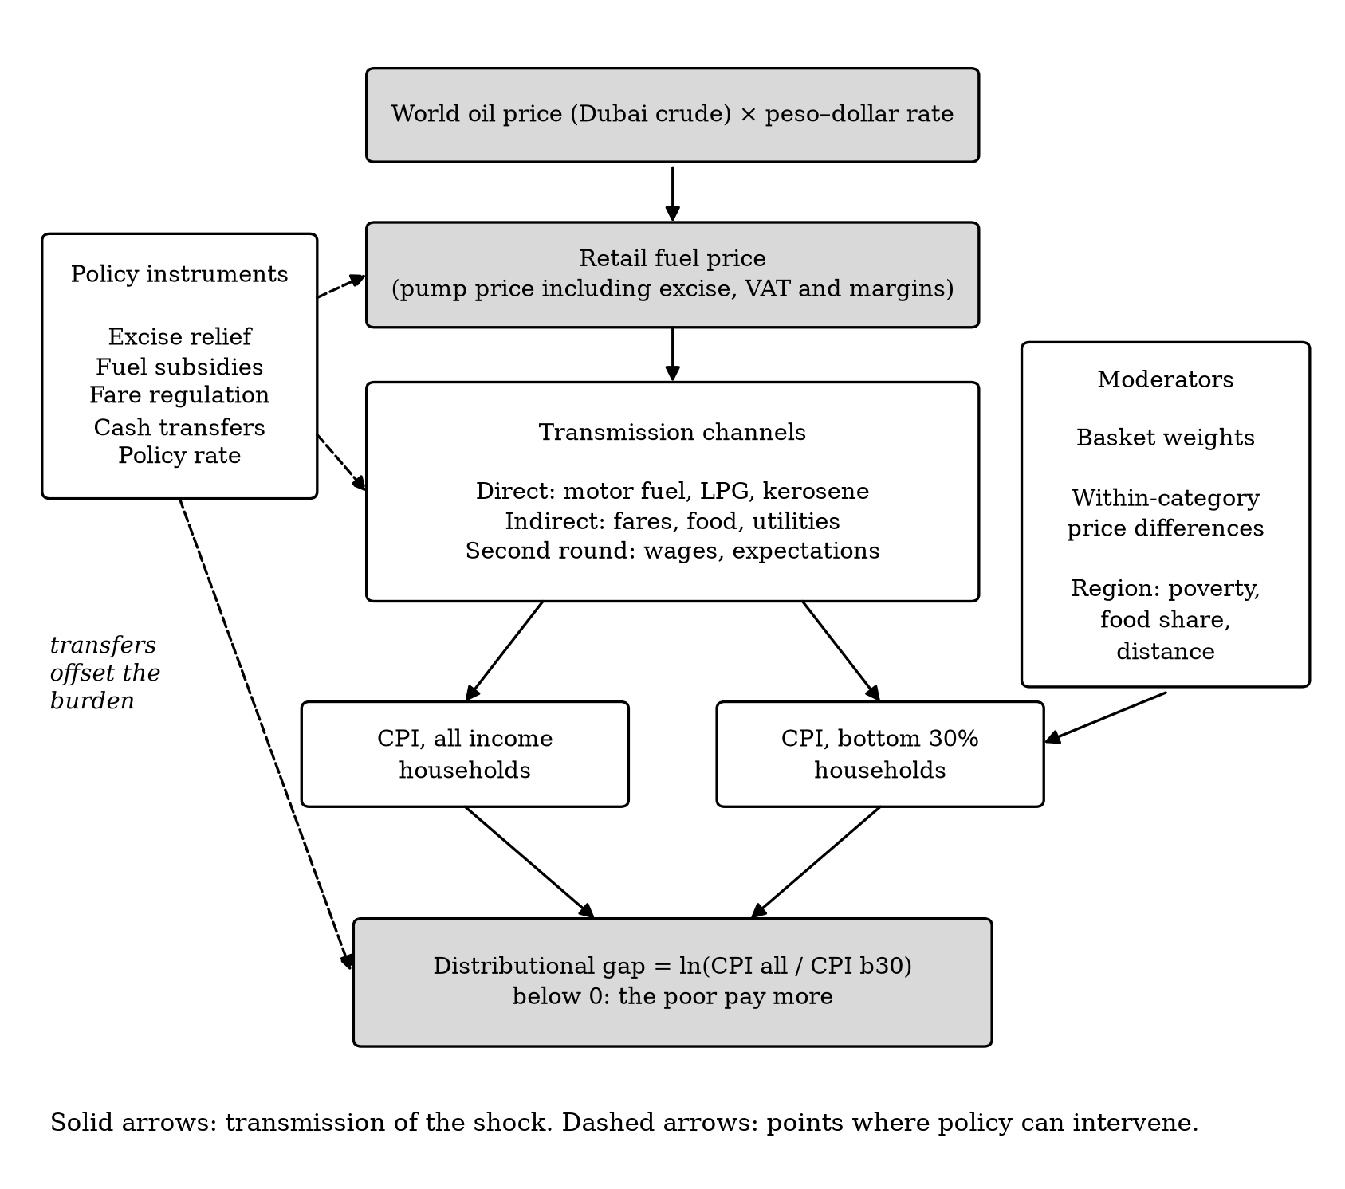
4. Theoretical framework
A group's pass-through equals the fuel content of what it buys.
Cost-push pricing (Leontief input–output): each good's price rises with its fuel cost share, π_{k} ≈ φ_{k} f
Cost-of-living index: π^{g} ≈ Σ_{k} w^{g}_{k} φ_{k} f, so pass-through = fuel intensity of the basket
Gap = weights effect + within-category effect (the poor buy different items in each category)
Oil-specific channels: direct, indirect and second-round (Kilian 2008; Blanchard and Galí 2010)
Welfare cost ≈ budget-share-weighted price rise (Deaton 1989)
Solid: transmission; dashed: where policy acts.
Who Pays for Oil Shocks? · SA3 Capstone
5

Slide 6
5. Data and empirical strategy
Local projections on monthly PSA data, 2001–August 2026, national and 17 regions.
Variable | Source | Coverage
All-income CPI and 13 categories | PSA OpenSTAT | 1994–Aug 2026, national and 17 regions
Bottom-30% CPI | PSA OpenSTAT | 2000–Aug 2026, national and 17 regions
Retail fuel index 07.2.2 (shock) | PSA OpenSTAT | 1994–Aug 2026, national and 17 regions
Crude oil, pump price, FX, policy rate, food | World Bank, BSP, BIS, FAO | Robustness and controls
Model (Jordà 2005; Kpodar and Liu 2022), for each h = 0…12: π_{t+h} = α_{h} + β_{h} f_{t} + 12 lags + leads + trend + ε
Errors: Newey–West (national), region fixed effects and Driscoll–Kraay (panel); 90% bands
Who Pays for Oil Shocks? · SA3 Capstone
6

Slide 7
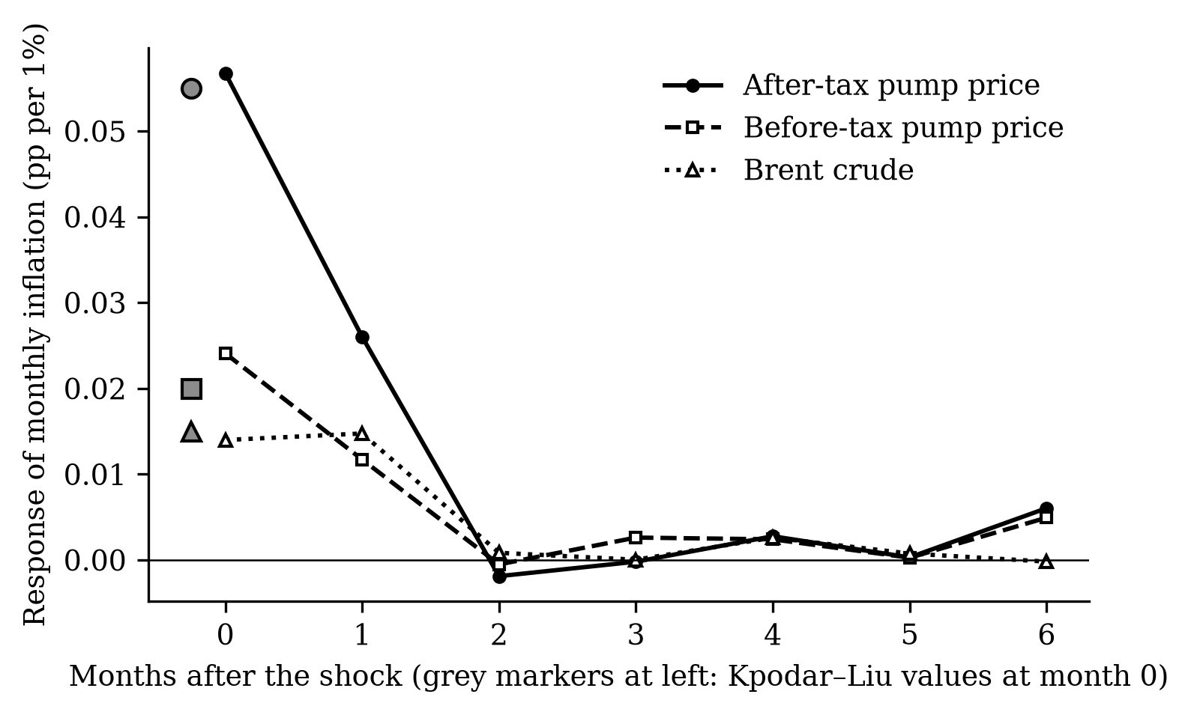
6. Validation before any Philippine estimate
Our code reproduces the reference study's European results under rules set in advance.
Shock (EU, impact) | Ours | Paper
Pump price after tax | 0.057 | 0.055
Pump price before tax | 0.024 | 0.020
Brent crude in euro | 0.014 | 0.015
Response of monthly HICP inflation to a 1% fuel price rise, 2005–Jun 2019. A simulation test also passed.
Who Pays for Oil Shocks? · SA3 Capstone
7

Slide 8
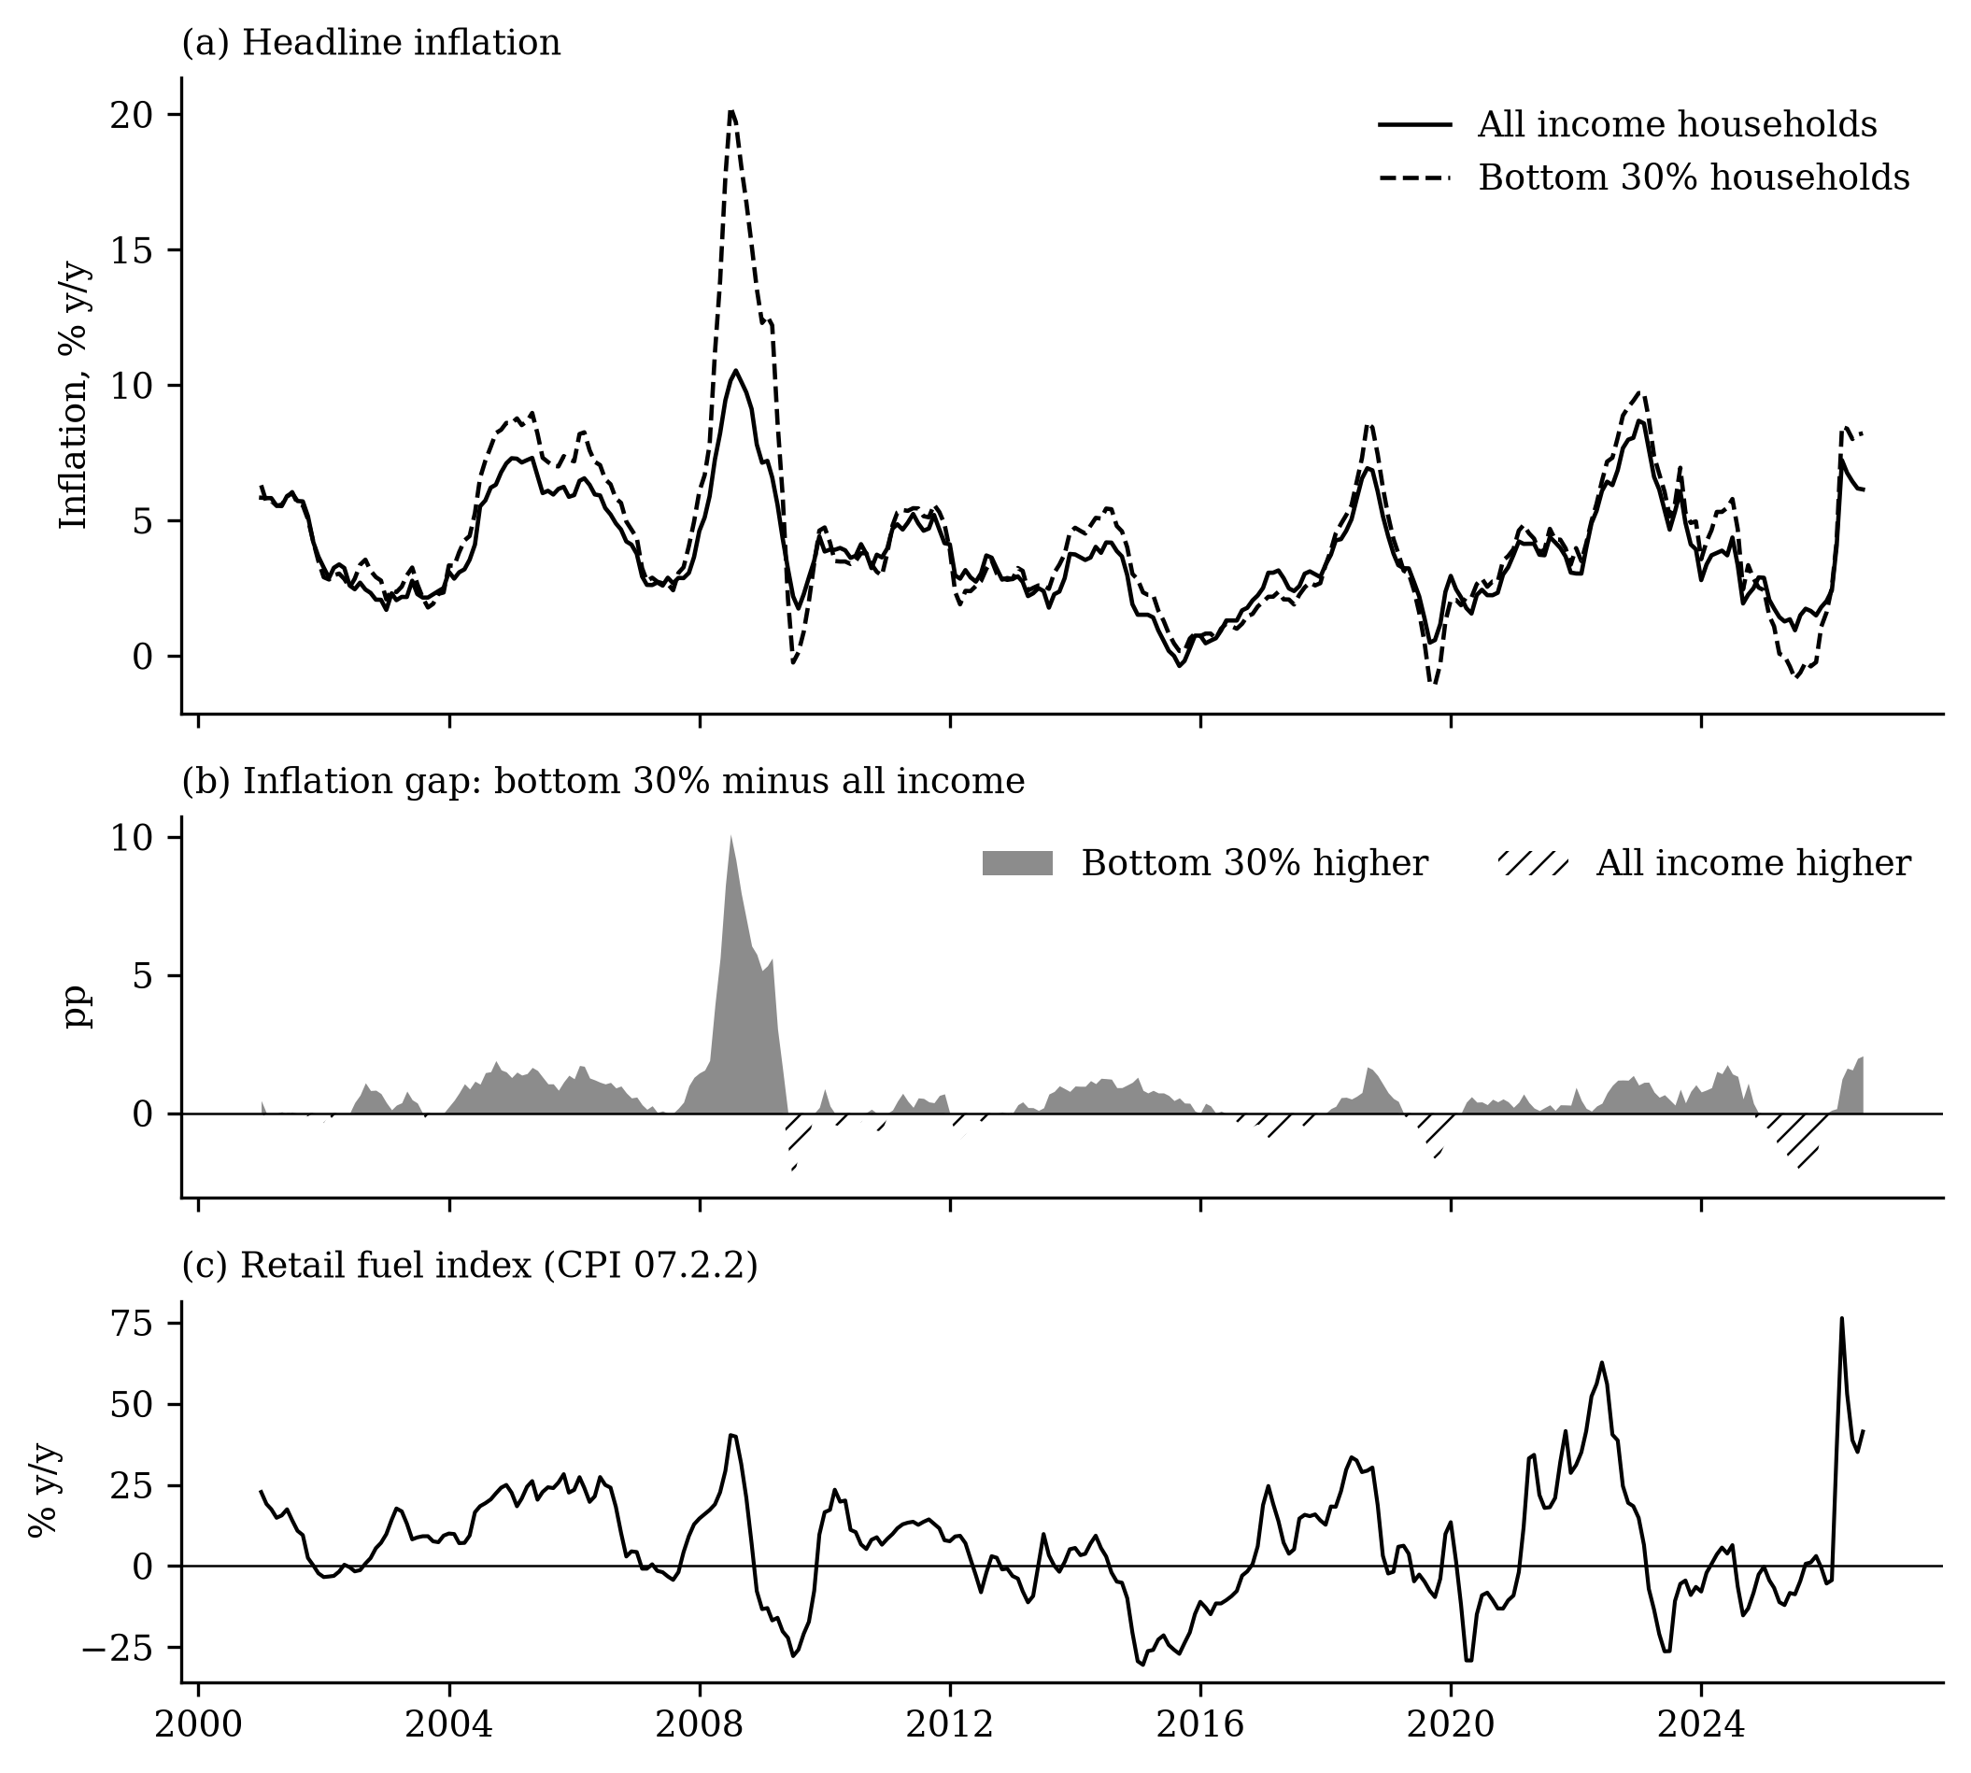
7. Objective 1: the poor's inflation has been higher
Bottom-30% prices rose 13.3 log points more than all-income prices since 2001.
Average inflation, 2001–2026: 4.33% (bottom 30%) vs 3.77% (all)
Higher for the poor in 18 of 25 years
Fuel-shock episodes: poor's inflation higher in 6 of 9
Peak gap in 2008 (rice crisis): 13.9% vs 8.2%
Source: PSA CPI; authors' calculations. Year-on-year rates.
Who Pays for Oil Shocks? · SA3 Capstone
8

Slide 9
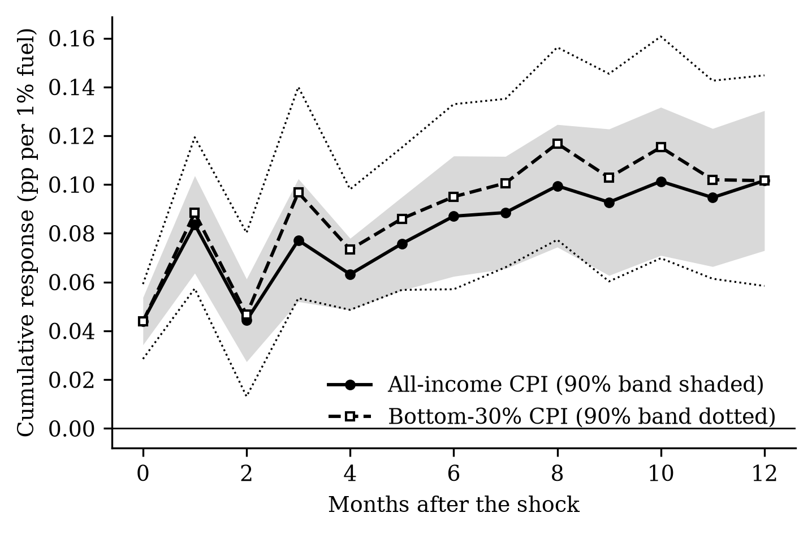
8. RQ1: fuel prices pass through quickly and keep building
A 10% fuel price rise raises the price level by about 1.0% after a year.
Impact: 0.044 pp per 1% fuel rise (s.e. 0.006)
After 12 months: 0.102 (all) and 0.102 (bottom 30%)
Larger than the cross-country developing-economy impact (0.018)
Crude oil understates it: only about 40% of the retail estimate
Cumulative responses, 90% bands. National, Newey–West standard errors.
Who Pays for Oil Shocks? · SA3 Capstone
9

Slide 10
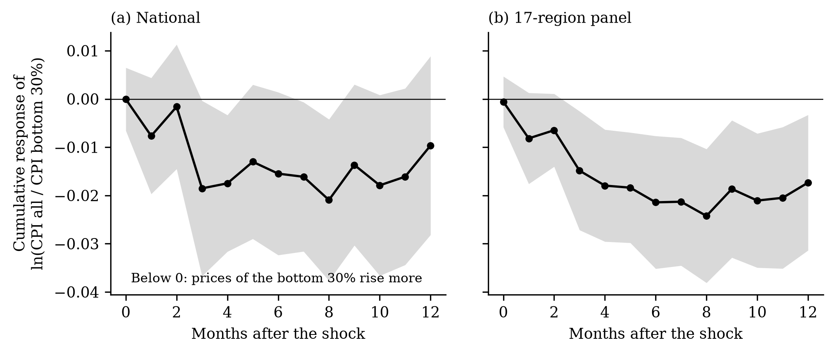
9. RQ2: the poor pay more, not less
The gap falls after a fuel shock: the effect is regressive, the opposite of the cross-country finding.
National: −0.0155 after 6 months (s.e. 0.0103), significant at h = 3, 4, 7, 8 · 17-region panel: −0.0214 (s.e. 0.0084), significant
Meaning: a 10% fuel rise leaves the poor's price level about 0.2% higher than the average household's
Who Pays for Oil Shocks? · SA3 Capstone
10

Slide 11
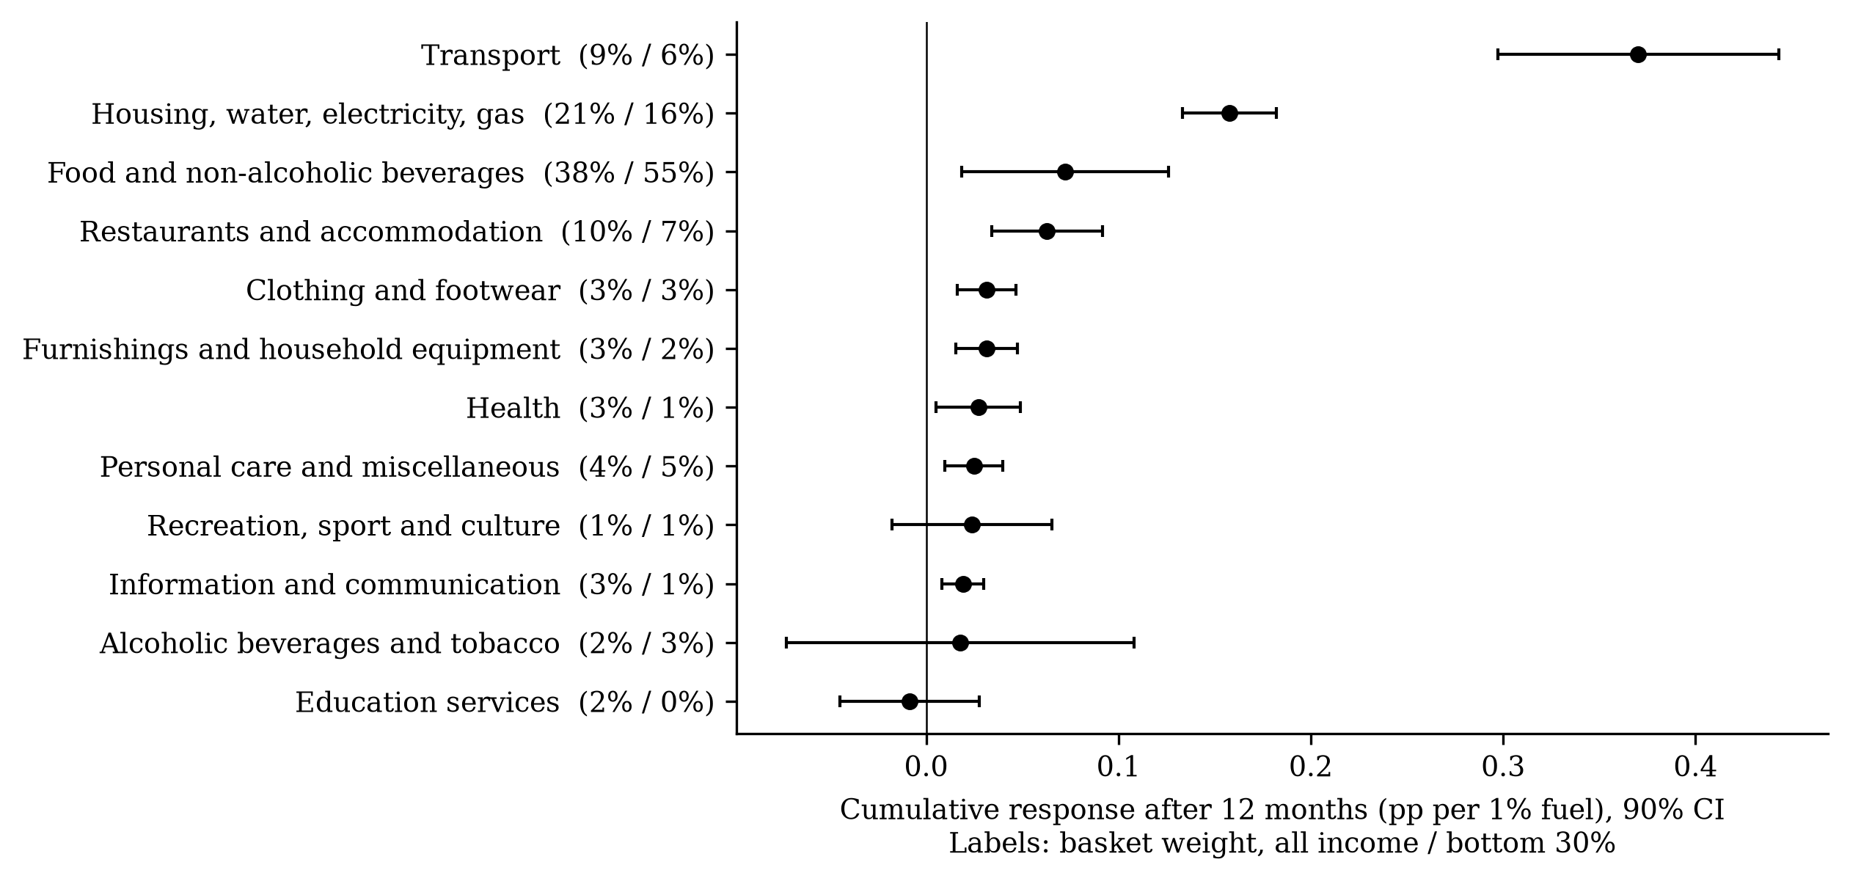
10. RQ3: which prices carry the shock?
Transport, utilities and food carry the shock; budget shares alone would predict the opposite gap.
Largest responses: transport 0.370, housing and utilities 0.158, food 0.072
10 of 13 categories respond significantly
Weights alone predict a progressive gap (+0.0101)
Within categories, responses differ: utilities 0.182 (poor) vs 0.142; transport 0.196 vs 0.300
Cumulative response after 12 months, all-income CPI divisions, 90% CI. Within-category comparison is exploratory (2013–2026).
Who Pays for Oil Shocks? · SA3 Capstone
11

Slide 12
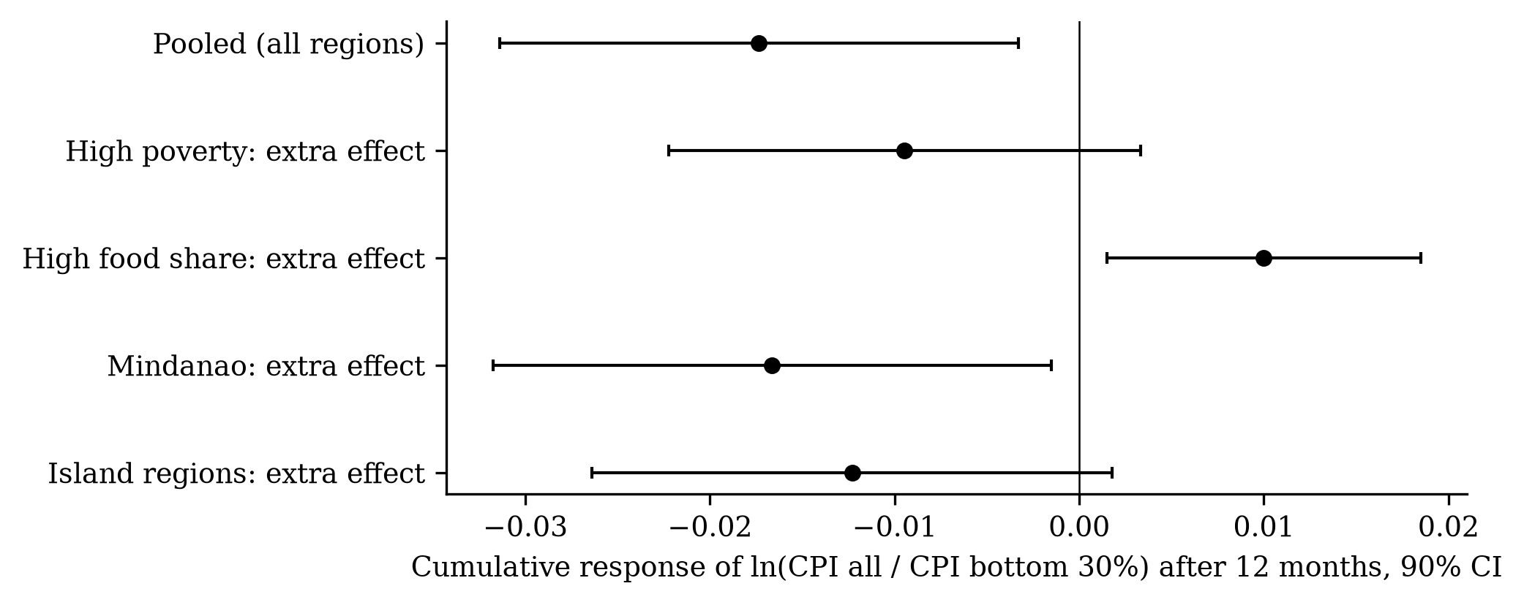
11. RQ4: do regions differ?
The gap tends to be wider in Mindanao and island regions, but the evidence is weak.
Mindanao: −0.0166 extra (s.e. 0.0092)
Island regions: −0.0123 (s.e. 0.0086)
High poverty: −0.0095 (s.e. 0.0078)
High food share: 0.0100 (s.e. 0.0052)
None survives a correction for testing four groups
Additional cumulative effect on the gap after 12 months; 17-region panel, Driscoll–Kraay errors.
Who Pays for Oil Shocks? · SA3 Capstone
12

Slide 13
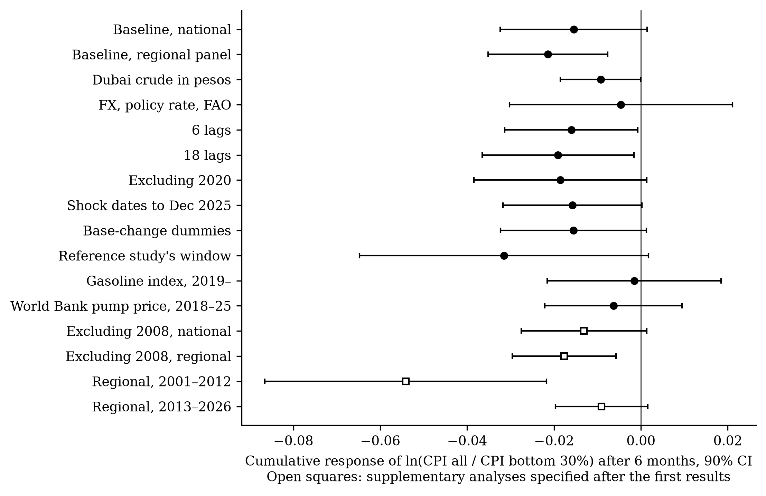
12. How robust is the regressive result?
The sign holds in almost every check, but the effect is concentrated in 2001–2012.
Leave one region out: −0.0227 to −0.0203
2001–2012: −0.0541; 2013–2026: −0.0091
Near zero with macro controls (−0.0046), the gasoline index and the World Bank pump price
Read with care: regressive in sign, strongest in the 2000s
Cumulative gap response after 6 months, 90% CI. Open squares: supplementary analyses.
Who Pays for Oil Shocks? · SA3 Capstone
13

Slide 14
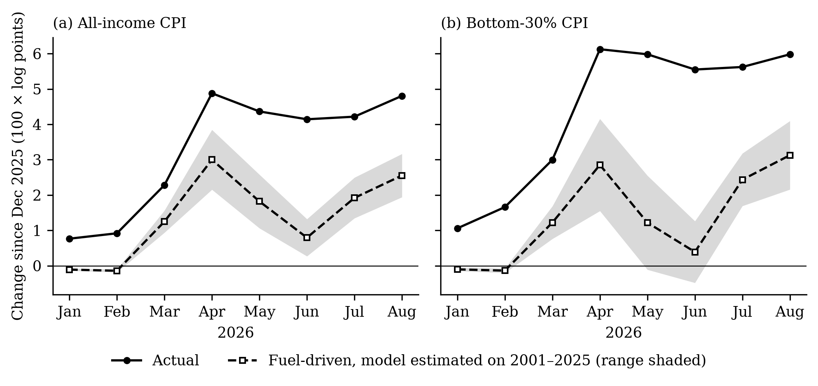
13. Objective 3: what explains the 2026 surge?
A model estimated only on data to 2025 explains about half of the 2026 price rise.
Dec 2025–Aug 2026: fuel-driven 2.55 of 4.81 log points (all), 3.13 of 5.98 (bottom 30%) · Prices did not fall when fuel eased in May–June
Who Pays for Oil Shocks? · SA3 Capstone
14

Slide 15
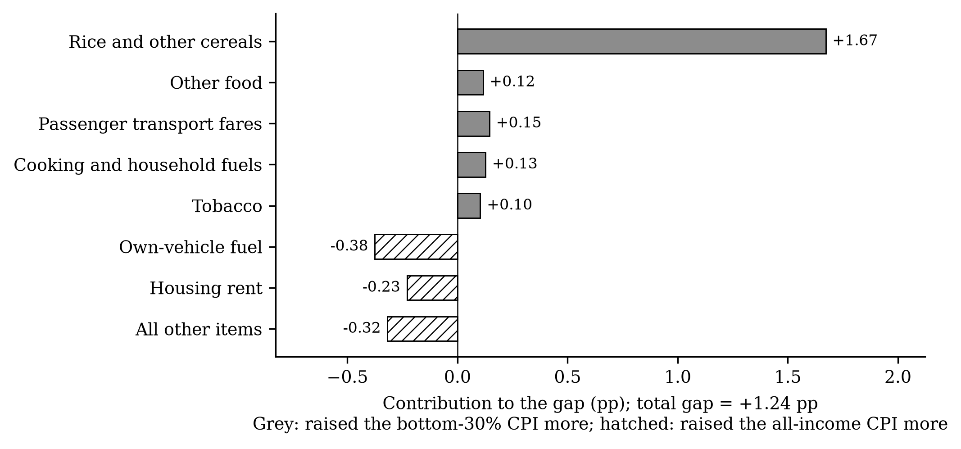
14. The cost to poor families, and why it was higher
Fuel added about PHP 467 a month to a poverty-line family's costs; rice drove the extra gap.
Peso cost by August 2026
National: PHP 467 a month for a family of five at the poverty line
By region: PHP 390 (XII SOCCSKSARGEN) to 633 (National Capital Region)
All price increases: about PHP 907 a month
Highest actual rise: XI Davao, BARMM, VI Western Visayas, XIII Caraga and IX Zamboanga Peninsula
Contributions to the +1.24 pp gap: cereals +1.67.
Who Pays for Oil Shocks? · SA3 Capstone
15

Slide 16
15. Policy implications
Transfers sized to the poor's own price index are better targeted than fuel tax cuts.
Instrument (2026) | What the evidence says
Excise relief, gasoline and diesel | Mainly helps the better-off: motor fuel is 2.39% of the average basket, 1.59% of the poor's
Excise relief, LPG and kerosene | Distribution-neutral for LPG (same weight and response); kerosene matters more for the poor but is small
Fuel subsidies for drivers | Protect poor commuters only if tied to fare restraint
Policy rate increases | Appropriate: pass-through builds for at least a year
Targeted cash transfers | Best targeted; size with the bottom-30% CPI (PHP 467–907 a month)
Rice price and supply measures | Needed: cereals explain +1.67 pp of the 2026 gap
Who Pays for Oil Shocks? · SA3 Capstone
16

Slide 17
16. Limitations and reproducibility
The results are descriptive of transmission, not a clean causal test, and every number can be rebuilt.
Limitations
Retail prices may respond to local conditions; an identified oil supply shock is the next step
Bottom 30% vs all, not poorest vs richest
2026 analysis covers eight months; rice and trade policy cannot be separated from fuel
Data and reproducibility
All data public: PSA OpenSTAT, World Bank, BSP, BIS, FAO, Eurostat
Data appendix in the paper links every figure and table to its source and script
One command (./run_all.sh) rebuilds every number
Pre-registered estimation plan and replication test
Who Pays for Oil Shocks? · SA3 Capstone
17

Slide 18
TAKEAWAY
In the Philippines, the poor pay more when fuel prices rise.
Pass-through is fast and lasting: a 10% fuel rise lifts prices about 1.0% within a year
Regressive, not progressive: the poor's prices rise more, through food, utilities and fares
2026: fuel explains about half of the surge; rice drove the poor's extra inflation
Policy: protect the poor with transfers sized to their price index, not broad fuel tax cuts
Who Pays for Oil Shocks? · SA3 Capstone
18

Slide 19
Thank you
Questions and discussion

