Slide 1


Critical Review of Agbola and Acupan (2010): An Empirical Analysis of International Labor Migration in the Philippines
Agbola, F. W., & Acupan, A. B. (2010) · Economic Systems, 34(4), 386–396
Lian Cataytay · University of Southeastern Philippines
We build dreams without limits! | www.usep.edu.ph
Notes:
Good day. I am presenting my critical review of Agbola and Acupan (2010). The slides follow my two-page review in the same order, and every point is backed by a highlighted excerpt from the article itself.

Slide 2

The review at a glance
Domestic conditions shape emigration, but a short sample and missing pull factors limit the ECM.
Item | The study
Question | How do economic, demographic and political factors affect emigration from the Philippines?
Data | Annual national aggregates, 1975–2005 (T = 31)
Method | Error correction model (ECM), estimated by OLS
Result | Unemployment ↑ emigration; adult literacy, political instability, population density ↓
Main criticisms
Relatively short sample (T = 31)
Missing pull factors that may have also shaped emigration
How to read the slides
Highlighted evidence from the article
Strength
Roadmap
1 Research Problem / Gap → 2 Theoretical Framework → 3 Data → 4 Methodology → 5 Key Findings → 6 Areas for Further Research
Critical note
Reviewer suggestion
© 2026 University of Southeastern Philippines | All Rights Reserved. This presentation contains confidential and proprietary information. Photography, video, and audio recording of these materials are prohibited without prior authorization.
Notes:
In one slide: Agbola and Acupan estimate how domestic conditions shape emigration from the Philippines, using annual data for 1975 to 2005 and an error correction model, or ECM. My two main criticisms are the relatively short sample and the missing pull factors that may also have shaped emigration. Throughout the slides, yellow highlights are the authors' own words, green marks a strength, red a critical note, and blue my suggestions.

Slide 3

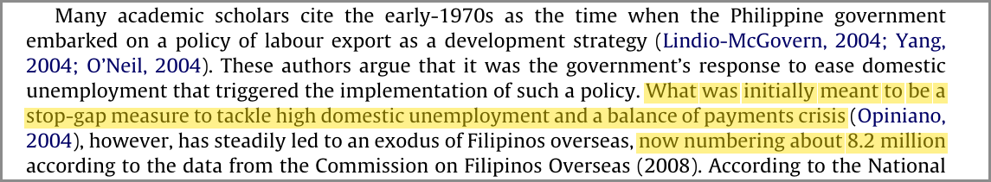
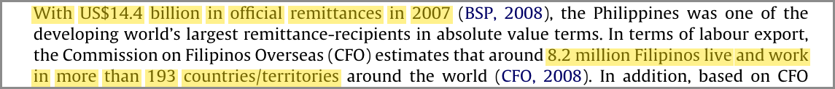
1. Research Problem / Gap: the context
Labor export began as a stop-gap, but this became structural.
Labor export began in the 1970s as a stop-gap for unemployment and a balance-of-payments crisis
It then became structural
About 8.2 million Filipinos lived or worked abroad
They sent home US$14.4 billion in 2007
Evidence from the article (highlighted)
Stop-gap that became an exodus (Agbola & Acupan, 2010, p. 388)
Scale of emigration and remittances (Agbola & Acupan, 2010, p. 387)
© 2026 University of Southeastern Philippines | All Rights Reserved. This presentation contains confidential and proprietary information. Photography, video, and audio recording of these materials are prohibited without prior authorization.
Notes:
Part 1, the research problem. Labor export began in the 1970s as a stop-gap for unemployment and a balance-of-payments crisis, but it became structural. As the highlighted passages show, about 8.2 million Filipinos lived or worked abroad and sent home 14.4 billion US dollars in 2007.

Slide 4
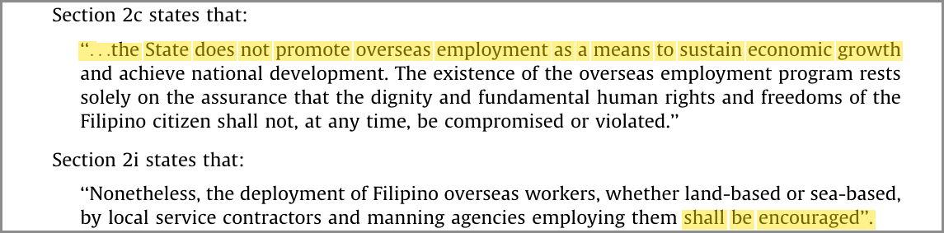
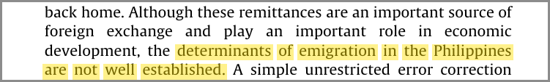

1. Research Problem / Gap: policy and gap
The policy is ambiguous, and the determinants of emigration “are not well established.”
RA 8042 §2c: the State “does not promote overseas employment”
RA 8042 §2i: yet deployment “shall be encouraged” → ambiguous policy
Gap: the determinants of emigration “are not well established” (p. 386)
Evidence from the article (highlighted)
RA 8042, Sections 2c and 2i (Agbola & Acupan, 2010, p. 388)
Aim: study how economic, demographic and political factors affect the size of emigration.
Abstract: the gap (Agbola & Acupan, 2010, p. 386)
Abstract: the aim (Agbola & Acupan, 2010, p. 386)
© 2026 University of Southeastern Philippines | All Rights Reserved. This presentation contains confidential and proprietary information. Photography, video, and audio recording of these materials are prohibited without prior authorization.
Notes:
The policy behind labor export is Republic Act 8042. Section 2c says the State does not promote overseas employment, yet Section 2i says deployment shall be encouraged, so the policy is ambiguous. The gap the authors identify is that the determinants of emigration are not well established. They address it by studying how economic, demographic and political factors affect the size of emigration.

Slide 5
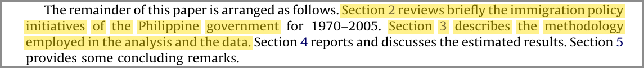
1. Research Problem / Gap: assessment
Clear and policy-relevant, but the gap is asserted rather than demonstrated.
Strength
The question is clear and policy-relevant.
Evidence from the article (highlighted)
The paper’s structure: no literature review section (Agbola & Acupan, 2010, p. 387)
Critical note
The gap is asserted rather than demonstrated: earlier Philippine studies are not reviewed in the paper.
The paper moves from policy (Section 2) straight to the model (Section 3).
The gap is stated in one sentence (Agbola & Acupan, 2010, p. 386)
© 2026 University of Southeastern Philippines | All Rights Reserved. This presentation contains confidential and proprietary information. Photography, video, and audio recording of these materials are prohibited without prior authorization.
Notes:
My assessment of Part 1. The question is clear and policy-relevant. But the gap is asserted rather than demonstrated: as the highlighted outline shows, the paper goes from policy in Section 2 straight to the model in Section 3, without reviewing earlier Philippine studies.

Slide 6
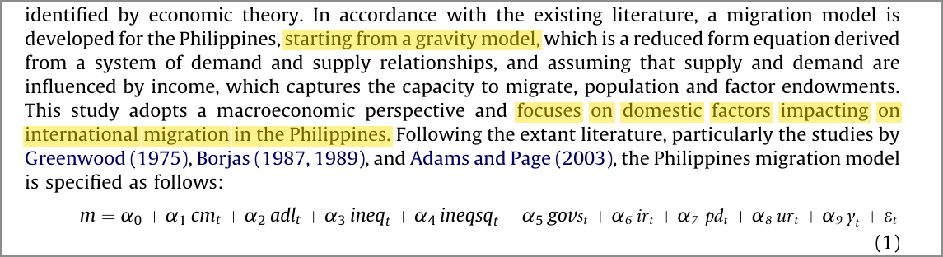
2. Theoretical Framework
Four theories yield one macro push-factor equation with nine domestic explanatory variables.
(i) Expected-utility models (Ravenstein, 1885; Todaro, 1969)
People move to “better” themselves
(ii) Human capital theory (Hicks, 1939; Sjaastad, 1962)
Predicts that education raises emigration
(iii) Roy effect (Borjas, 1987)
Inequality determines which skill groups leave
(iv) Gravity model (Greenwood, 1975; Adams & Page, 2003)
Links migration to income, population and cost
Evidence from the article (highlighted)
(i) Ravenstein and Todaro (Agbola & Acupan, 2010, p. 389)
(ii) Human capital theory (Agbola & Acupan, 2010, p. 389)
(iii) Roy effect (Agbola & Acupan, 2010, p. 392)
(iv) Gravity model → equation (1) (Agbola & Acupan, 2010, p. 390)
© 2026 University of Southeastern Philippines | All Rights Reserved. This presentation contains confidential and proprietary information. Photography, video, and audio recording of these materials are prohibited without prior authorization.
Notes:
Part 2, the theoretical framework. The authors use four theories: expected-utility models from Ravenstein and Todaro; human capital theory, which predicts that education raises emigration; the Roy effect, where inequality decides which skill groups leave; and the gravity model, which links migration to income, population and cost. Together they give one macro push-factor equation, equation 1 at the bottom right, with nine domestic explanatory variables.

Slide 7
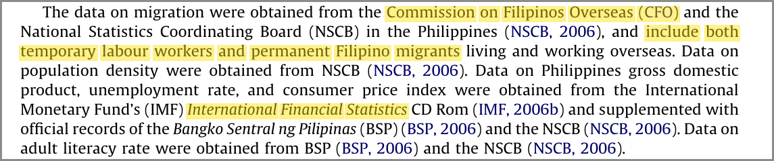
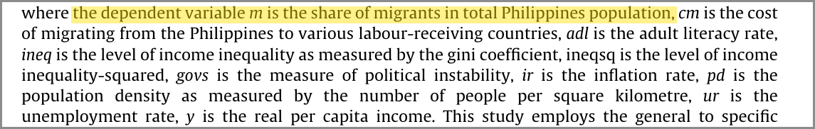
3. Data: sample, dependent variable and sources
Secondary annual national aggregates for 1975–2005 (T = 31).
Sample: secondary annual national aggregates, 1975–2005 (T = 31)
Dependent variable – migration share (m): temporary plus permanent Filipino migrants as a share of the population (CFO; NSCB)
Income, unemployment, inflation: IMF International Financial Statistics, BSP, NSCB
Adult literacy: BSP; NSCB · Population density: NSCB
Evidence from the article (highlighted)
Data sources (Agbola & Acupan, 2010, p. 390)
Definition of the dependent variable m (Agbola & Acupan, 2010, p. 390)
Sample period (Agbola & Acupan, 2010, p. 391)
© 2026 University of Southeastern Philippines | All Rights Reserved. This presentation contains confidential and proprietary information. Photography, video, and audio recording of these materials are prohibited without prior authorization.
Notes:
Part 3, the data. The study uses secondary annual national aggregates for 1975 to 2005, so T equals 31. The dependent variable is the migration share, m: temporary plus permanent Filipino migrants as a share of the population, from the Commission on Filipinos Overseas and the NSCB. Income, unemployment and inflation come from the IMF, the BSP and the NSCB; literacy from the BSP and NSCB; and population density from the NSCB.

Slide 8
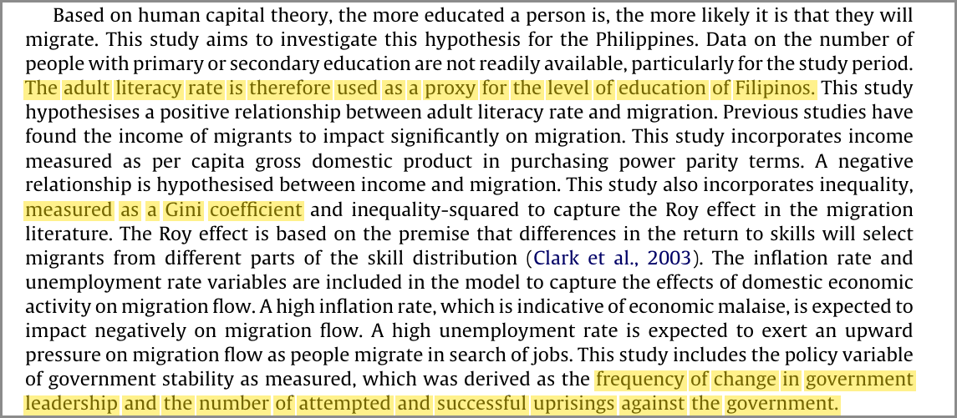
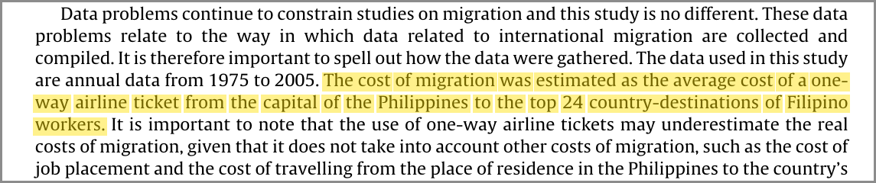
3. Data: the explanatory variables
Nine explanatory variables, grouped into economic, demographic and political factors.
Factor | Variable | Measure / proxy
Economic | Cost of migration (cm) | Avg. one-way airfare, Manila → top 24 destinations
Economic | Real GDP per capita (y) | Real per capita income
Economic | Unemployment rate (ur) | Unemployment rate
Economic | Inflation rate (ir) | From the consumer price index
Economic | Inequality (ineq), ineq² | Gini coefficient and its square
Demographic | Adult literacy (adl) | Proxy for education
Demographic | Population density (pd) | People per km²
Political | Political instability (govs) | Leadership changes; attempted and successful uprisings
Evidence from the article (highlighted)
Proxies: literacy, Gini, instability (Agbola & Acupan, 2010, p. 392)
Cost of migration (Agbola & Acupan, 2010, p. 391)
© 2026 University of Southeastern Philippines | All Rights Reserved. This presentation contains confidential and proprietary information. Photography, video, and audio recording of these materials are prohibited without prior authorization.
Notes:
These are the explanatory variables, grouped by factor. The economic variables are the cost of migration, proxied by the average one-way airfare from Manila to the top 24 destinations; real GDP per capita; the unemployment rate; the inflation rate; and income inequality with its square, measured by the Gini coefficient. The demographic variables are adult literacy, a proxy for education, and population density. The single political variable is political instability: the frequency of leadership changes and of attempted and successful uprisings.

Slide 9
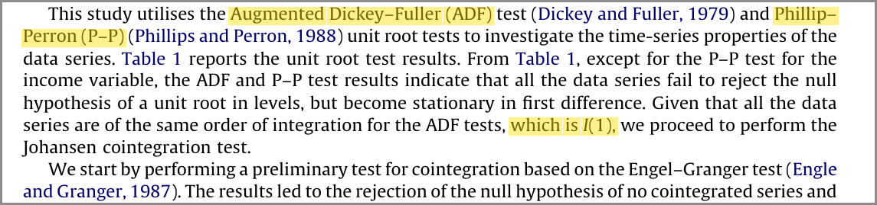
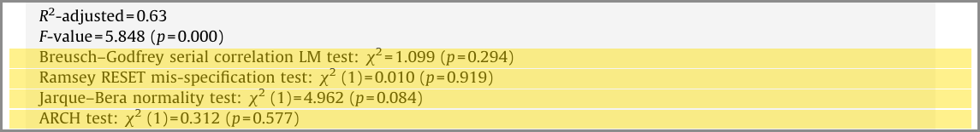
4. Methodology: the procedure
A five-step time-series procedure that follows the textbook sequence.
(i) Unit roots: ADF and Phillips–Perron tests treat the series as I(1)
(ii) Cointegration: Engle–Granger, Johansen and Pesaran bounds tests confirm a long-run relationship
(iii) Specification: general-to-specific reduction to a parsimonious model
(iv) Estimation: unrestricted ECM by OLS
(v) Diagnostics: Breusch–Godfrey, RESET, Jarque–Bera, ARCH and CUSUM/CUSUMSQ, all passed
Evidence from the article (highlighted)
(i)–(ii) Unit root and Engle–Granger tests (Agbola & Acupan, 2010, p. 390)
(v) Diagnostic tests (Agbola & Acupan, 2010, p. 392)
(v) CUSUM and CUSUMSQ (Agbola & Acupan, 2010, p. 393)
© 2026 University of Southeastern Philippines | All Rights Reserved. This presentation contains confidential and proprietary information. Photography, video, and audio recording of these materials are prohibited without prior authorization.
Notes:
Part 4, the methodology. It is a five-step time-series procedure: unit root tests that treat the series as I(1); three cointegration tests that confirm a long-run relationship; a general-to-specific reduction; an unrestricted ECM estimated by OLS; and diagnostic tests, which are all passed. The highlighted excerpts show the unit root tests and the diagnostics.

Slide 10
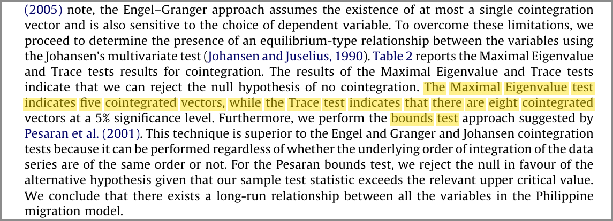
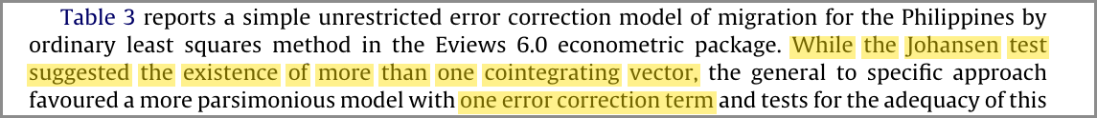
4. Methodology: assessment
The textbook sequence, but one ECT for five to eight cointegrating vectors, and little power.
Strength
The methodology follows the textbook sequence.
Evidence from the article (highlighted)
Critical note
The Johansen test finds five to eight cointegrating vectors, yet only one error correction term (ECT) is kept
31 observations for 10 estimated terms leave little power
Johansen: five (λmax) to eight (trace) vectors (Agbola & Acupan, 2010, p. 391)
Only one ECT is kept (Agbola & Acupan, 2010, p. 392)
Annual data, 1975–2005 → T = 31 (Agbola & Acupan, 2010, p. 391)
© 2026 University of Southeastern Philippines | All Rights Reserved. This presentation contains confidential and proprietary information. Photography, video, and audio recording of these materials are prohibited without prior authorization.
Notes:
My assessment. The methodology follows the textbook sequence. However, the highlighted Johansen results show five to eight cointegrating vectors, yet the authors keep only one error correction term. And 31 yearly observations for 10 estimated terms leave little statistical power.

Slide 11
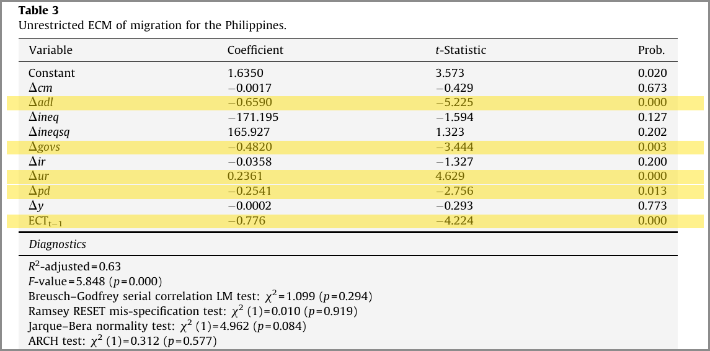
5. Key Findings: the results
Four push factors are significant; about 78% of any deviation is corrected within a year.
Explanatory variable | Coefficient | t-statistic | Result (5%)
Unemployment | +0.236 | 4.629 | Significant (+)
Adult literacy | −0.659 | −5.225 | Significant (−)
Political instability | −0.482 | −3.444 | Significant (−)
Population density | −0.254 | −2.756 | Significant (−)
Inequality, inflation, cost, income | — | |t| < 1.6 | Not significant
Evidence from the article (highlighted)
Notes: adjusted R² = 0.63; F = 5.848 (p = 0.000). Adapted from Agbola and Acupan (2010, p. 392).
Table 3: significant rows highlighted (Agbola & Acupan, 2010, p. 392)
ECT = −0.776 (t = −4.224): about 78% of any deviation from equilibrium is corrected within a year.
Speed of adjustment (Agbola & Acupan, 2010, p. 392)
© 2026 University of Southeastern Philippines | All Rights Reserved. This presentation contains confidential and proprietary information. Photography, video, and audio recording of these materials are prohibited without prior authorization.
Notes:
Part 5, key findings. My Table 1 summarises the authors' Table 3, shown on the right with the significant rows highlighted. Unemployment, adult literacy, political instability and population density are significant at 5 percent; inequality, inflation, the cost of migration and income are not. The error correction term is minus 0.776, so about 78 percent of any deviation from equilibrium is corrected within a year.

Slide 12
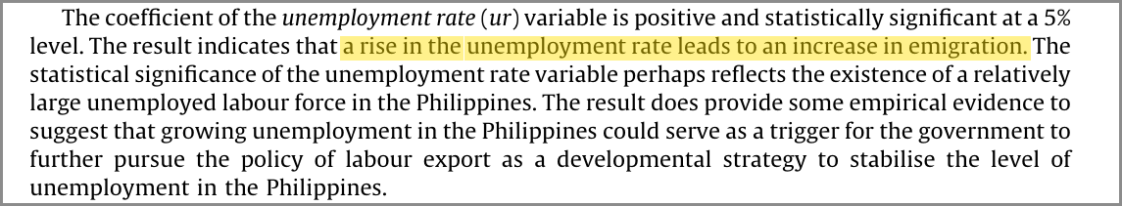
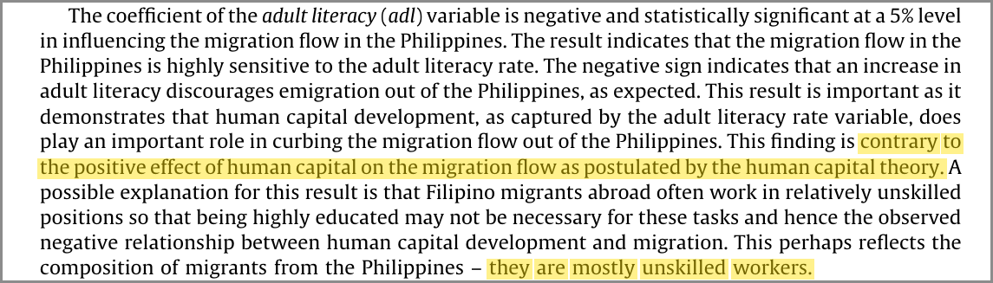
5. Key Findings: interpretation
Unemployment raises emigration; adult literacy, instability and density lower it.
Unemployment ↑ → emigration ↑: consistent with emigration as a safety valve for surplus labor
Adult literacy ↑ → emigration ↓: contradicts human capital theory; the authors attribute this to the low-skilled profile of migrants
Political instability and population density also lower emigration
The other variables are not significant → Roy effect rejected
Evidence from the article (highlighted)
Unemployment: safety valve (Agbola & Acupan, 2010, p. 394)
Adult literacy: against human capital theory (Agbola & Acupan, 2010, p. 393)
Roy effect does not hold (Agbola & Acupan, 2010, p. 395)
© 2026 University of Southeastern Philippines | All Rights Reserved. This presentation contains confidential and proprietary information. Photography, video, and audio recording of these materials are prohibited without prior authorization.
Notes:
Interpreting the results. Unemployment raises emigration, consistent with emigration as a safety valve for surplus labor. Adult literacy lowers emigration, which contradicts human capital theory; the authors attribute this to the low-skilled profile of migrants, as highlighted. Political instability and population density also lower emigration. The other variables are not significant, so the Roy effect is rejected.

Slide 13
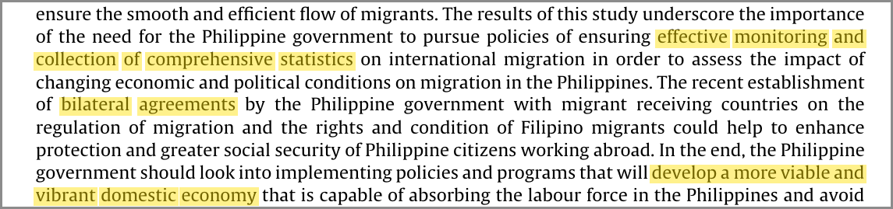
5. Key Findings: the authors’ recommendations
Better statistics, bilateral protection, and a domestic economy able to absorb labor.
1. Better migration statistics: effective monitoring and collection of comprehensive statistics
2. Bilateral protection agreements with migrant-receiving countries
3. A domestic economy able to absorb labor, reducing reliance on unpredictable foreign demand
Evidence from the article (highlighted)
Policy recommendations in the conclusion (Agbola & Acupan, 2010, p. 395)
© 2026 University of Southeastern Philippines | All Rights Reserved. This presentation contains confidential and proprietary information. Photography, video, and audio recording of these materials are prohibited without prior authorization.
Notes:
The authors close with three recommendations, highlighted in their conclusion: better migration statistics through effective monitoring, bilateral agreements to protect overseas workers, and a domestic economy that can absorb labor.

Slide 14
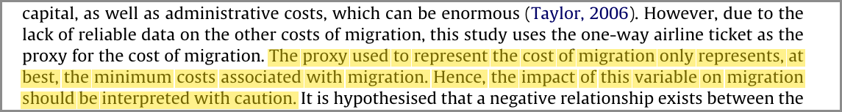
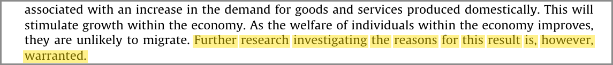
6. Areas for Further Research: the authors
The authors acknowledge four limitations and call for two lines of work.
Migration statistics are hard to compile
Airfare is only the minimum cost of migration
The density result needs further research
Their data do not “permit us to move beyond speculation” on political instability (p. 394)
Evidence from the article (highlighted)
Statistics are hard to compile (Agbola & Acupan, 2010, p. 391)
Airfare = minimum cost (Agbola & Acupan, 2010, p. 392)
Density: further research warranted (Agbola & Acupan, 2010, p. 393)
The authors call for
Call for: explaining the density effect and better monitoring of migration statistics.
Instability: beyond speculation (Agbola & Acupan, 2010, p. 394)
© 2026 University of Southeastern Philippines | All Rights Reserved. This presentation contains confidential and proprietary information. Photography, video, and audio recording of these materials are prohibited without prior authorization.
Notes:
Part 6. The authors acknowledge four limitations, each highlighted on the right: migration statistics are hard to compile, airfare is only the minimum cost of migration, the density result needs further research, and their data do not permit them to move beyond speculation on political instability. They call for explaining the density effect and for better monitoring of migration statistics.

Slide 15
6. Areas for Further Research: my suggestions
Four further directions, each rooted in a feature of the study.
(i) Disaggregate the migration share by type
Why: temporary vs. permanent are pooled
(ii) Add pull factors
Why: destination wages and labor demand; the model uses domestic factors only
(iii) Extend the sample past 2005
Why: the data stop in 2005 (T = 31)
(iv) Test structural breaks
Why: stability is checked with CUSUM only
© 2026 University of Southeastern Philippines | All Rights Reserved. This presentation contains confidential and proprietary information. Photography, video, and audio recording of these materials are prohibited without prior authorization.
Notes:
Beyond the authors' own agenda, I suggest four other areas. First, disaggregate the migration share by type, because temporary and permanent migrants are pooled, as highlighted in the data description. Second, add pull factors such as destination wages and labor demand, since the model focuses on domestic factors only. Third, extend the sample past 2005. And fourth, test for structural breaks, since stability is checked with CUSUM only.

Slide 16

Conclusion
Domestic push factors such as unemployment, adult literacy, political instability and population density shape Filipino emigration.
Agbola and Acupan (2010) offer useful early evidence.
Given T = 31, weak proxies and no pull factors, these results are a starting point.
© 2026 University of Southeastern Philippines | All Rights Reserved. This presentation contains confidential and proprietary information. Photography, video, and audio recording of these materials are prohibited without prior authorization.
Notes:
To conclude: Agbola and Acupan offer useful early evidence that domestic push factors, namely unemployment, adult literacy, political instability and population density, shape Filipino emigration. But given only 31 observations, weak proxies and no pull factors, these results are a starting point.

Slide 17


Thank you
Questions and discussion
We build dreams without limits! | www.usep.edu.ph
Notes:
Thank you. I am happy to take questions.

