Slide 1
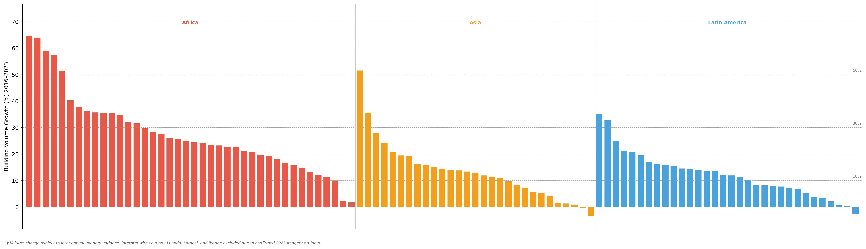
Ouagadougou (59%)
Africa
South & Southeast Asia
Latin America
Phnom Penh (52%)
50%
Addis Ababa (35%)
La Paz (35%)
Nairobi (25%)
Hanoi (24%)
30%
Guatemala City (20%)
Jakarta (8.3%)
Buenos Aries (8%)
10%
Cairo (2%)
Bangkok (1%)
Mexico City (0.3%)

Slide 2
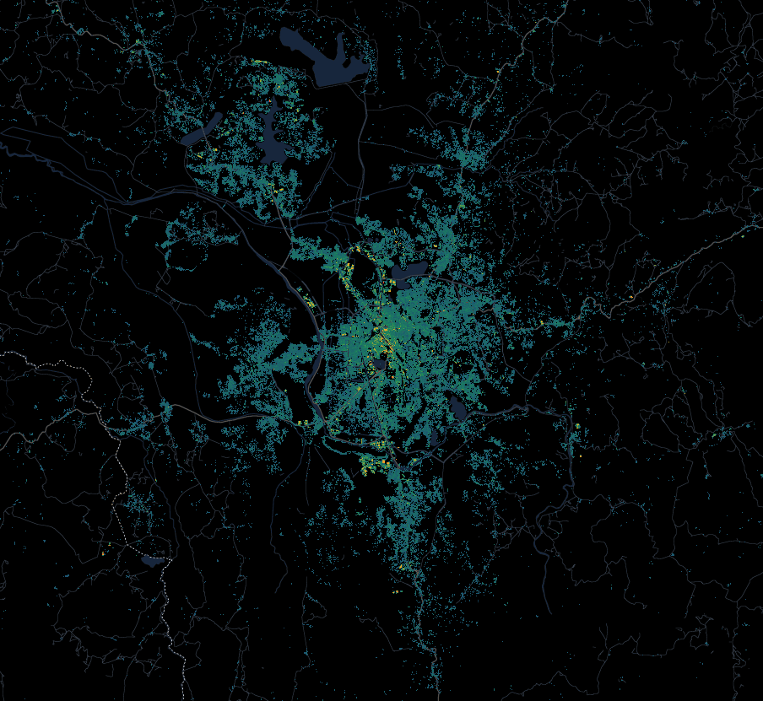
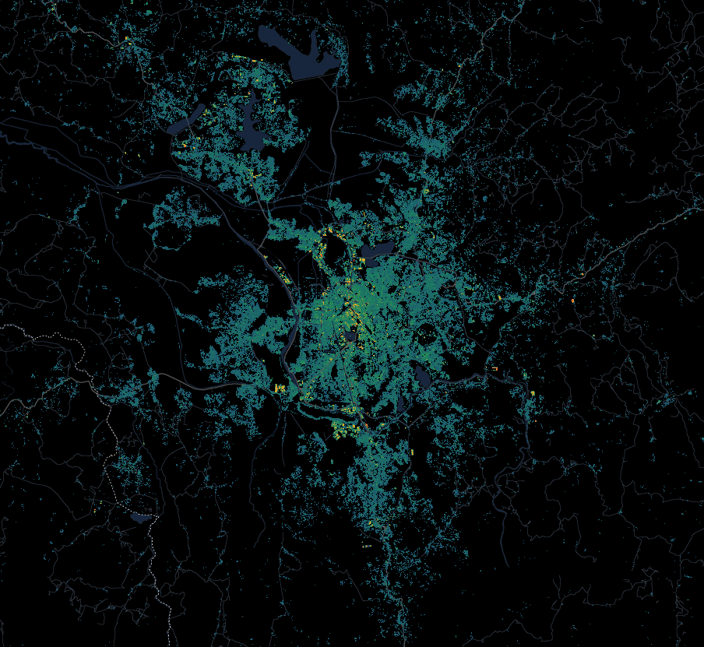
Sample Data: Antananarivo, Madagascar
2016
2023
No Building
Building Height (pixel)
10 km
0
100m

