Slide 1
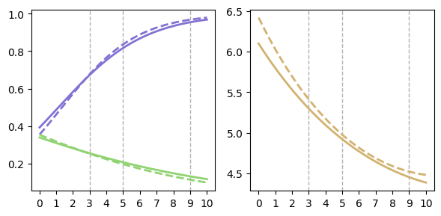

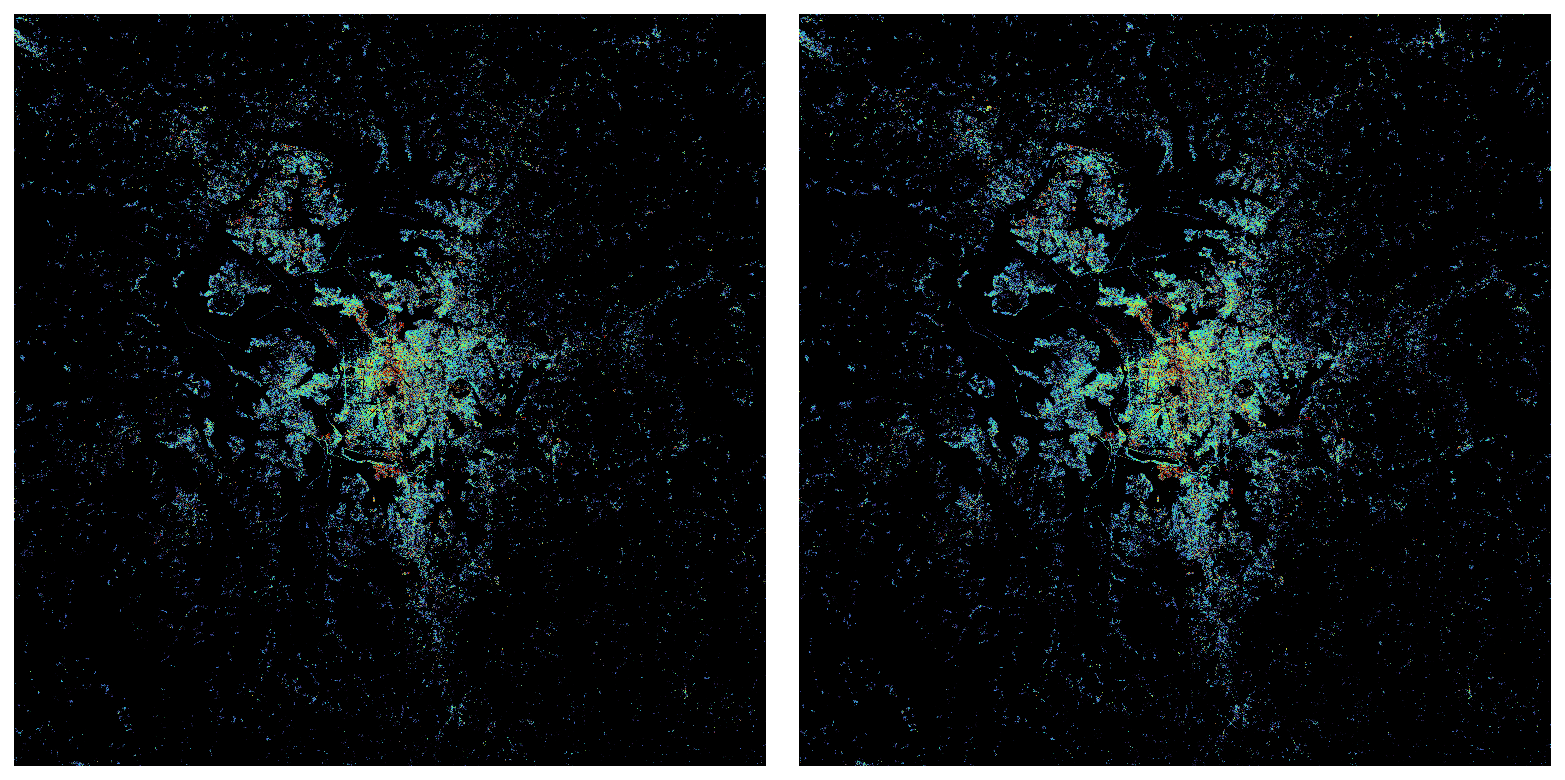
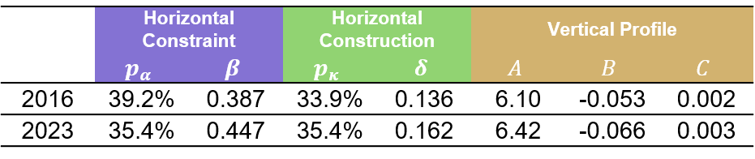
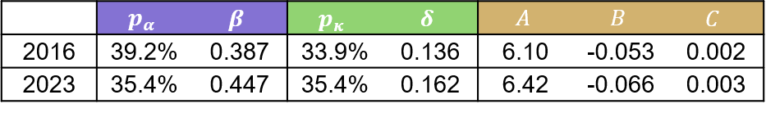
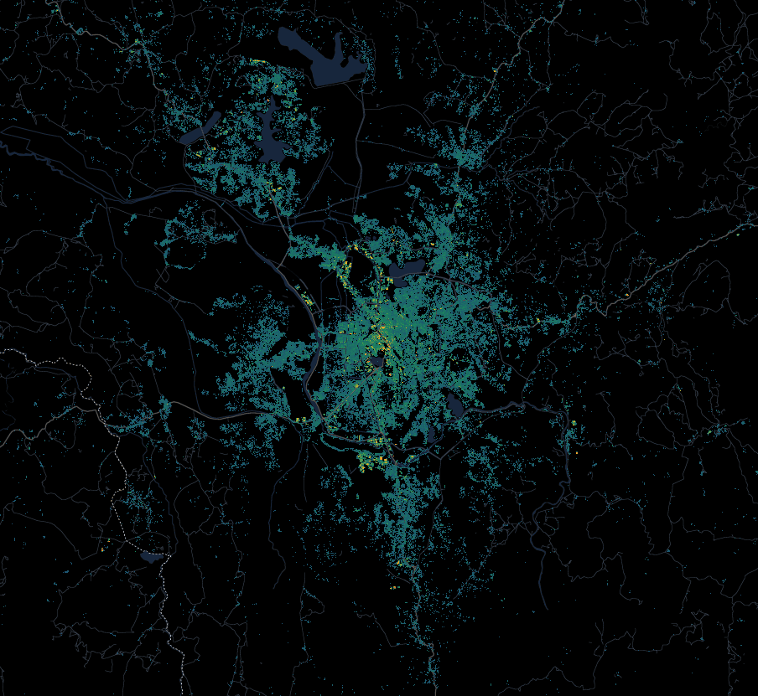
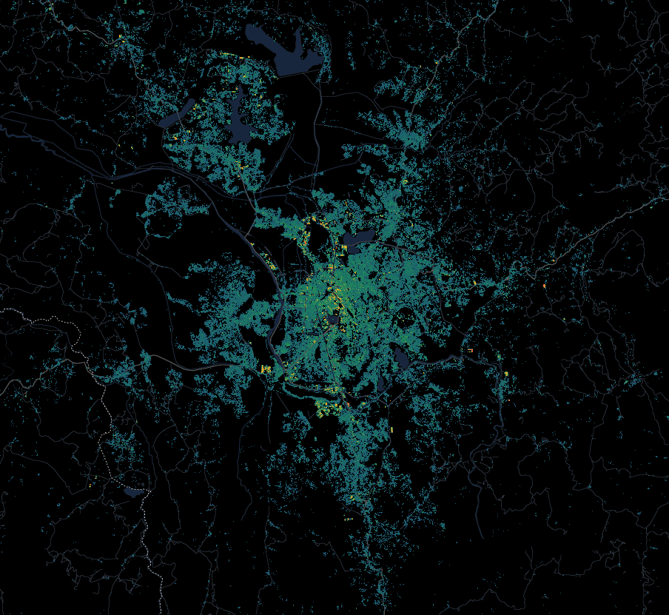




(b) Horizontal Constraint and Construction Curves
(c) Vertical Profile Curves
(a) Building Existence and Height Map (Antananarivo, Madagascar)
2023
$$ψ\left(r\right)=logistic\left(α+ βr\right)$$
2016
$$H\left(r\right)=A \exp\left(Br+Cr^{2}\right)$$
r = 9
2016
2016
r = 9
2023
r = 5
2023
r = 5
r = 3
Probability
Height (m)
r = 3
$$π\left(r\right)=logistic\left(κ –δr\right)$$
Remoteness (r)
Remoteness (r)
No Building
Building Height (pixel)
10 km
0
10m
 | Horizontal Constraint |  | Horizontal Construction |  | Vertical Profile
 | $$p_{α}$$ | $$β$$ | $$p_{κ}$$ | $$δ$$ | $$A$$ | $$B$$ | $$C$$
2016 | 39.2% | 0.387 | 33.9% | 0.136 | 6.10 | -0.053 | 0.002
2023 | 35.4% | 0.447 | 35.4% | 0.162 | 6.42 | -0.066 | 0.003
r = 9
r = 9
r = 5
r = 3
r = 5
r = 3

