Slide 1





















Africa
South & Southeast Asia
Latin America
$$p_{κ}$$
$$p_{α}$$
$$p_{κ}$$
$$p_{α}$$
$$p_{κ}$$
$$p_{α}$$
2023
2023
2023
40.3%
2016
43.7%
51.8%
2016
34.7%
47.1%
2016
33.1%
39.0%
44.9%
50.7%
35.7%
46.7%
32.9%
$$δ$$
$$β$$
$$δ$$
$$β$$
$$δ$$
$$β$$
0.092
0.264
0.090
0.330
0.075
0.317
0.088
0.269
0.090
0.330
0.079
0.321
0.0016
6.58
0.0044
8.67
0.0061
8.20
0.0022
6.64
0.0043
8.31
0.0065
8.02
$$C$$
0.048
$$A$$
$$C$$
0.086
$$A$$
$$C$$
0.099
$$A$$
0.057
0.089
0.098
$$|B|$$
$$|B|$$
$$|B|$$
2016
2023

Slide 2
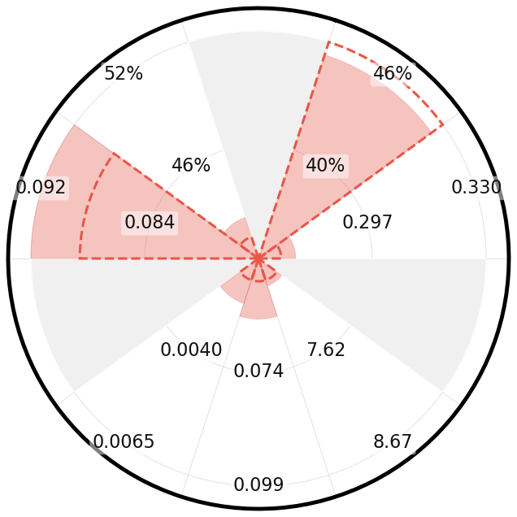
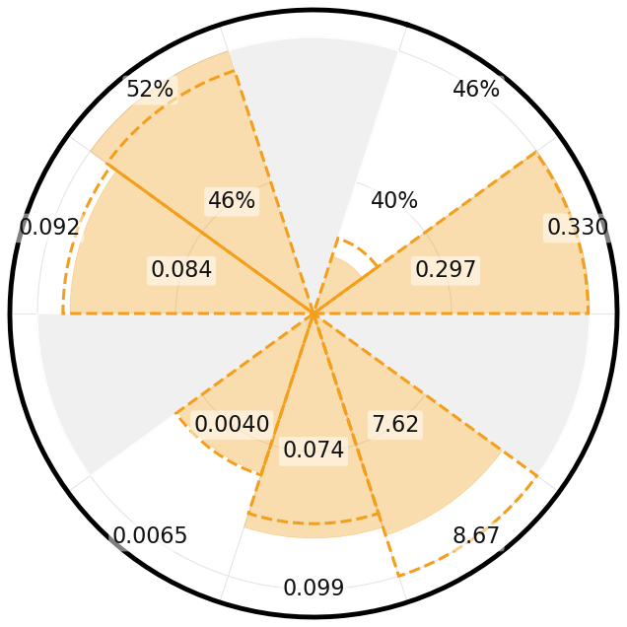
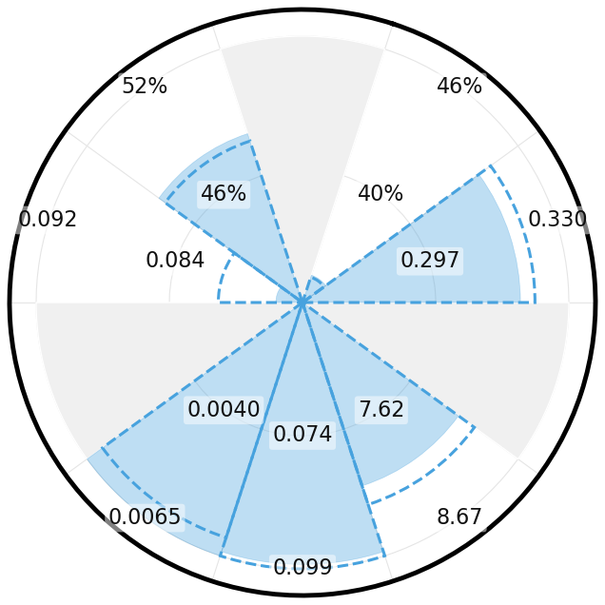
Africa
South & Southeast Asia
Latin America
$$p_{κ}$$
$$p_{α}$$
$$p_{κ}$$
$$p_{α}$$
$$p_{κ}$$
$$p_{α}$$
2023
2023
2023
40.3%
2016
43.7%
51.8%
2016
34.7%
47.1%
2016
33.1%
39.0%
44.9%
50.7%
35.7%
46.7%
32.9%
$$δ$$
$$β$$
$$δ$$
$$β$$
$$δ$$
$$β$$
0.092
0.264
0.090
0.330
0.075
0.317
0.088
0.269
0.090
0.330
0.079
0.321
0.0016
6.58
0.0044
8.67
0.0061
8.20
0.0022
6.64
0.0043
8.31
0.0065
8.02
$$C$$
0.048
$$A$$
$$C$$
0.086
$$A$$
$$C$$
0.099
$$A$$
0.057
0.089
0.098
$$|B|$$
$$|B|$$
$$|B|$$
2016
2023

