Slide 1
City | Country | Continent | Population2016 | Population2023 | Volume2016 | Volume2023
Lagos | Nigeria | Africa | 12634381 | 15945912 | 1.218e+09 | 1.375e+09
Kinshasa | Congo (Kinshasa) | Africa | 12100142 | 16315534 | 4.712e+08 | 4.908e+08
Bangalore | India | Asia | 10556789 | 13607800 | 1.388e+09 | 1.375e+09
Jakarta | Indonesia | Asia | 10286636 | 11248839 | 3.027e+09 | 3.482e+09
Lima | Peru | Latin America | 10002049 | 11204382 | 1.401e+09 | 1.248e+09
Bogota | Colombia | Latin America | 9988963 | 11507960 | 1.127e+09 | 1.155e+09
Chennai | India | Asia | 9929919 | 11776147 | 9.925e+08 | 9.716e+08
Bangkok | Thailand | Asia | 9647526 | 11069982 | 3.160e+09 | 3.243e+09

Slide 2
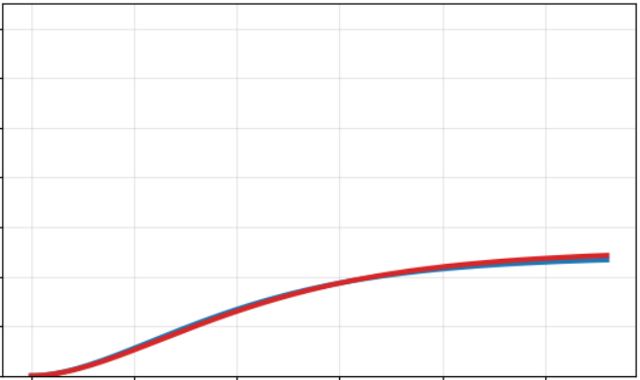
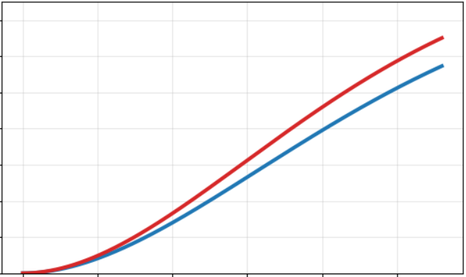
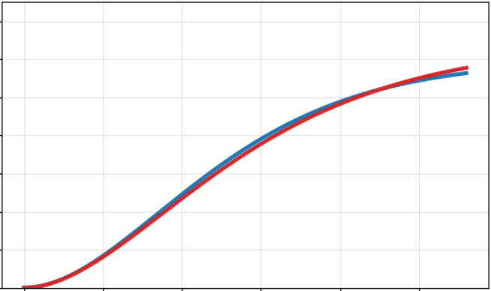
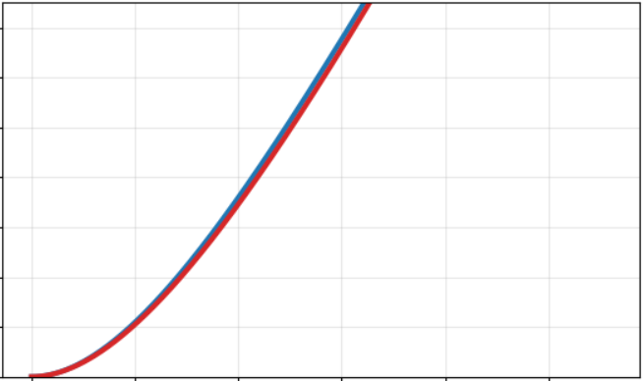
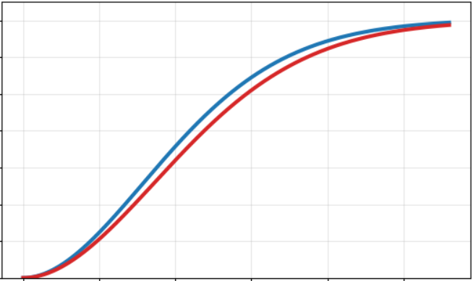
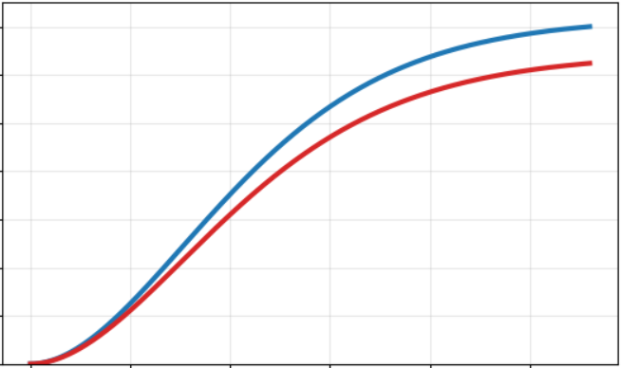
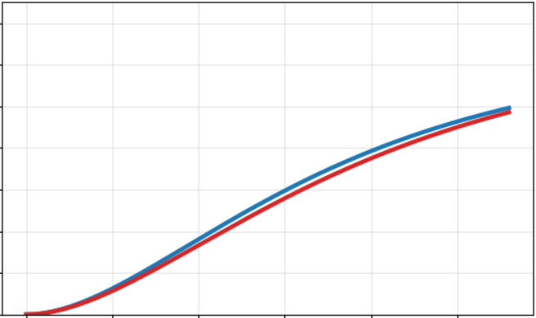
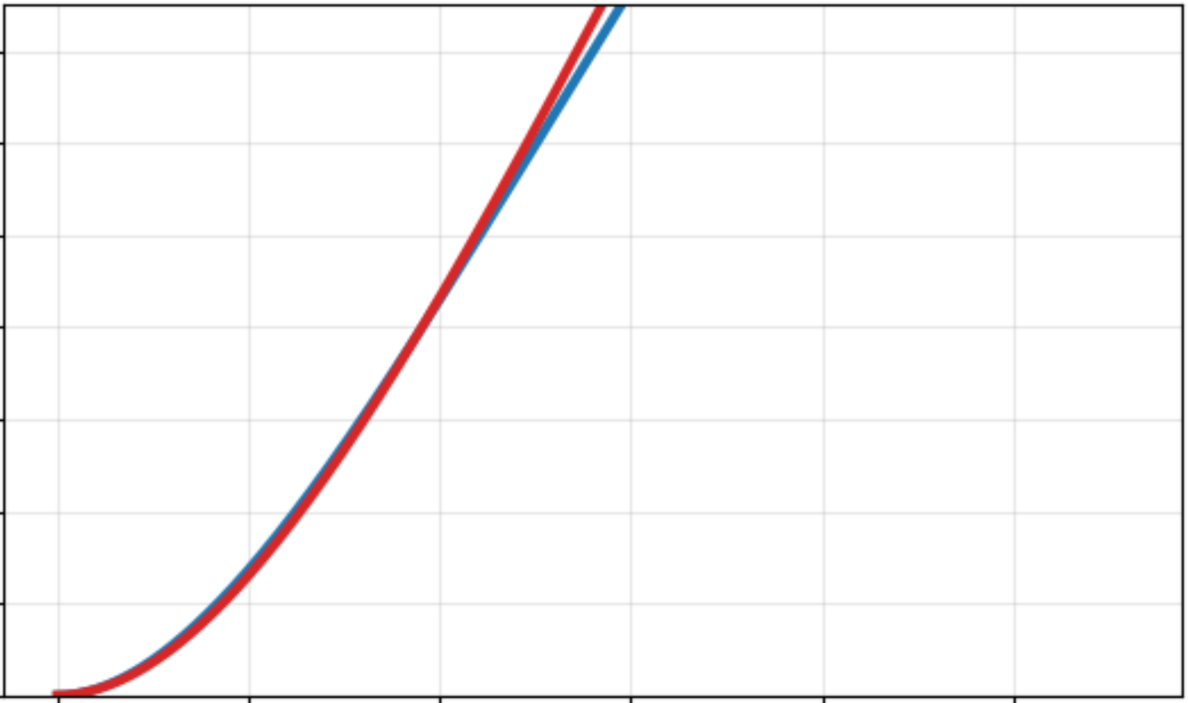
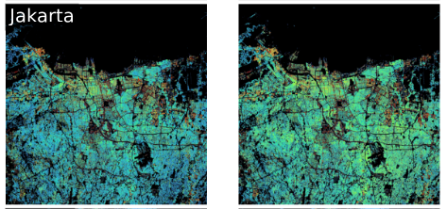
(10⁹ m³)
Kinshasa
Lagos
Bogota
Bangkok
1.5
1.5
1.5
1.5
1
1
1
1
0
10
20
30
0
10
20
30
0
10
20
30
0
10
20
30
Bangalore
(km)
Lima
Chennai
Jakarta
1.5
1.5
1.5
1.5
1
1
1
1
0
10
20
30
0
10
20
30
0
10
20
30
0
10
20
30

