Slide 1
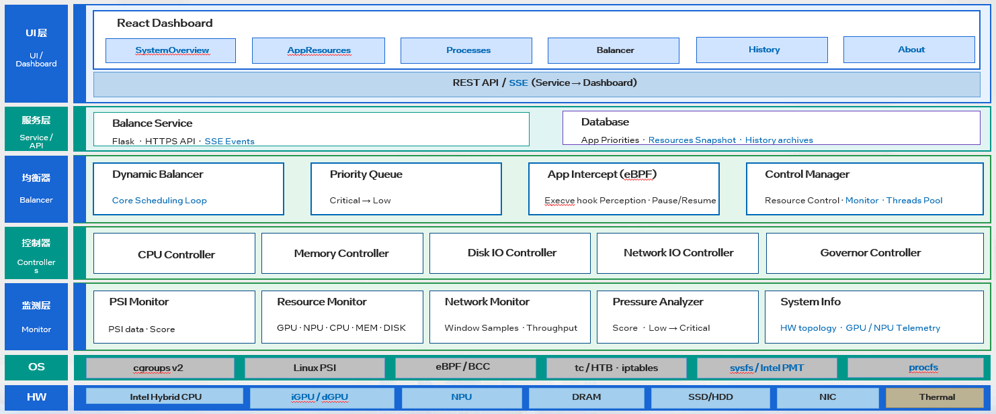
INTEL® EES PLATFORM / SMARTUNE 1.5
Q3'26 • PILOT
SmarTune 1.5
QUARTERLY BUSINESS
MILESTONE
ACHIEVED IN Q3 2026
BUSINESS IMPACT / CORE OPTIMIZATION LAYER
SmartTune is the central control layer for Intel® XPU workload optimization — converting system telemetry into balancing actions that improve stability, reduce manual tuning effort, and accelerate pilot deployment readiness.
SmartTune orchestrates platform telemetry, resource policies, and workload controls to keep Intel® XPU systems balanced, stable, and deployment-ready.
SMARTUNE
Optimization intelligence for Intel® XPU platforms.
EXECUTIVE VALUE SNAPSHOT
360°
PLATFORM VISIBILITY
AUTO
RESOURCE BALANCING
FAST
DEPLOYMENT READINESS
PILOT MILESTONE
Unified monitoring across CPU, memory, disk, GPU, and NPU telemetry.
Policy-based control with cgroups, queuing, and workload protection.
Shorter tuning cycles and more repeatable pilot rollout decisions.
1.5
Production-focused foundation for SmartTune adoption
RELEASE HIGHLIGHTS
01
PLATFORM READY
02
STABLE + ACTIONABLE
03
CUSTOMER-READY STORY
Integrated telemetry and balancing workflow aligned for pilot deployment.
Resource governance and workload visibility packaged for real operational use.
Executive-ready slide narrative and editable pilot-customer section included.
PILOT CUSTOMERS
铁威马 (TerraMaster)
海高特 (AWOL)
联想
畅网
威联通 (QNAP)
nimo
geakos

