Slide 1
Cats to the Max
(Owls to the Max)

Slide 2
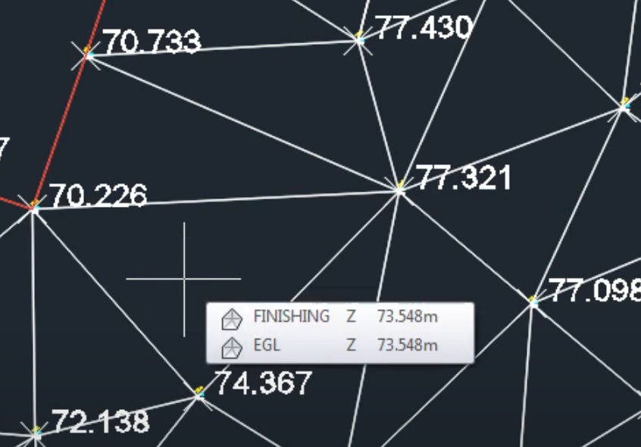
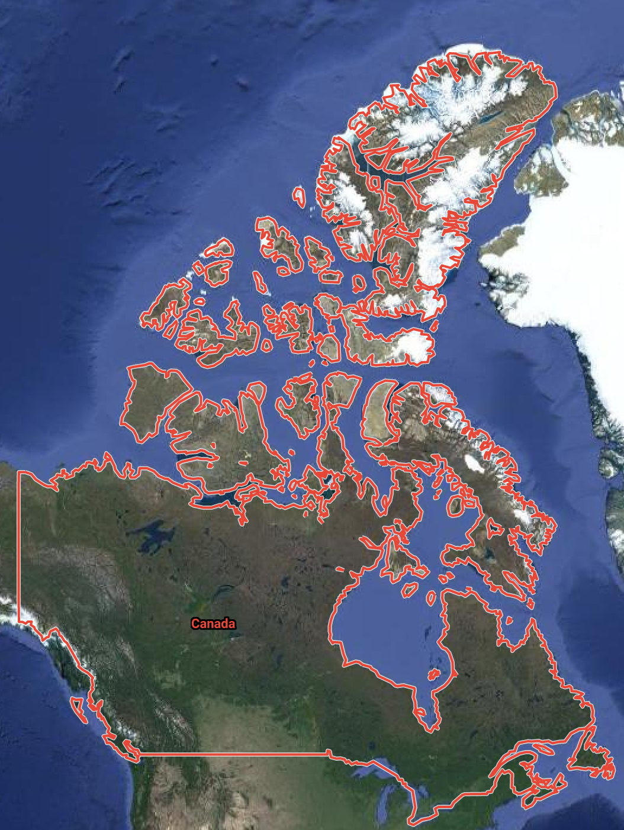
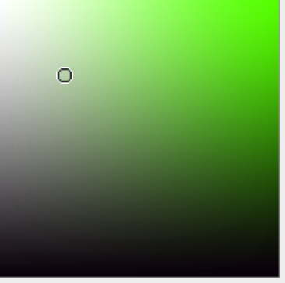
Interpolate
Using known points/values to estimate values at unknown points that are in between
Elevation
Rainfall
Color
Distance
Dates
Data

Slide 3
d3.interpolate(a,b)
Returns an interpolator between a and b, and the interpolator is purely based from the value b
No real copy is made
To save space and to speed things up
d3.interpolateArray(a,b)
d3.interpolateObject(a,b)
d3.interpolateNumber(a,b)
d3.interpolateRgb(a,b)
d3.interpolateHsl(a,b)
d3.interpolateString(a,b)
d3.interpolateRound(a,b)
d3.interpolateTransformCss(a,b)
Notes:
Fun fact:

Slide 4
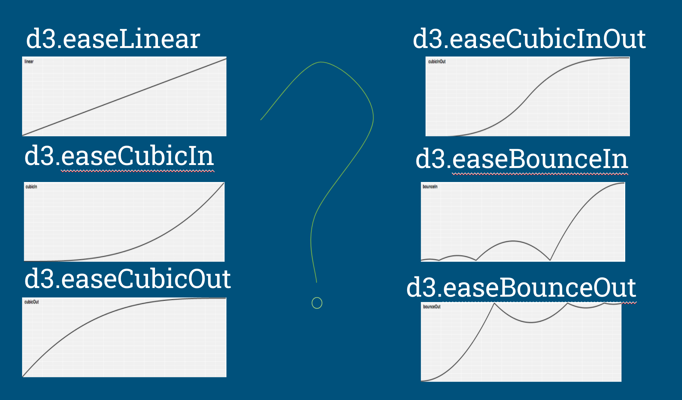
d3.ease(t)
distort time to control apparent motion in animation.
typically in the range [0,1]
Notes:
smoother and exhibit more plausible motion
Slow in slow out

Slide 5
Resources
https://bl.ocks.org/d3noob/1ea51d03775b9650e8dfd03474e202fe
https://observablehq.com/@mbostock/owls-to-the-max
https://github.com/d3/d3-ease

