Slide 1
tet4 / C3D4
x3=[0,0,1]
r[2]
r[1]
x2=[0,1,0]
r[0]
x0=[0,0,0]
x1=[1,0,0]

Slide 2
tet10 / C3D10
x3=[0,0,1]
r[2]
x9=[0,0.5,0.5]
r[1]
x8=[0.5,0,0.5]
x2=[0,1,0]
r[0]
x7=[0,0,0.5]
x5=[0.5,0.5,0]
x6=[0,0.5,0]
x0=[0,0,0]
x4=[0.5,0,0]
x1=[1,0,0]

Slide 3
tri6 surface element
r[1]
x2=[0,1]
r[0]
x4=[0.5,0.5]
x5=[0,0.5]
x0=[0,0]
x3=[0.5,0]
x1=[1,0]

Slide 4
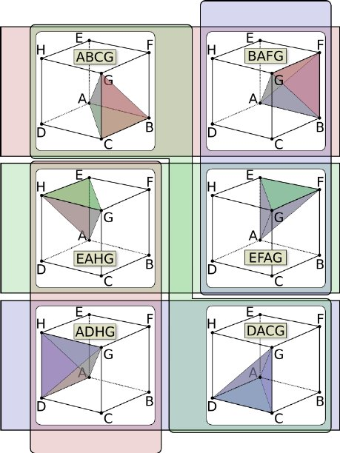
hex8 to tet4
7
4
6
6
[1,2,3,5]
[1,5,2,3]
5
5
[2,5,6,3]
[2,6,3,5]
3
2
3
2
0
1
7
7
4
6
[4,7,5,3]
[3,7,4,5]
5
5
[5,7,6,3]
[3,6,7,5]
3
3
4
[0,4,5,3]
[0,3,4,5]
5
5
[0,5,1,3]
[0,1,3,5]
3
3
0
0
1
https://www.researchgate.net/publication/269666018_GPU-ACELERATED_POLYGONIZATION_OF_IMPLICIT_SURFACES/figures?lo=1

Slide 5
7
6
4
5
3
2
0
1

Slide 6
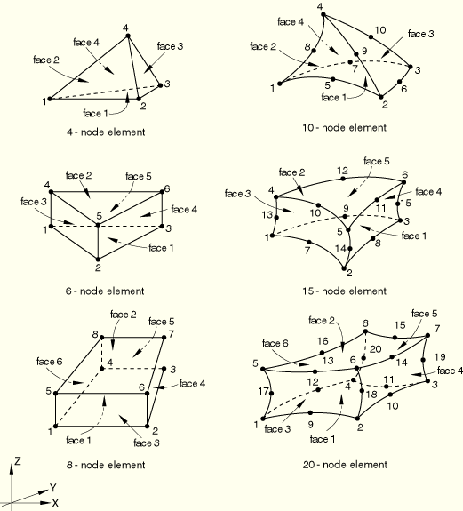
22.1.4 Three-dimensional solid element library

