Slide 1
JaveEE
Instructor:
Chandler Zhu
CGI Tech Lead
10+ years of software development experience

Slide 2
Introduction
Java EE was formerly known as Java 2 Platform, Enterprise Edition or J2EE. The platform uses the object-oriented Java programming language. Java EE extends the Java Platform, Standard Edition (Java SE), providing an API for object-relational mapping, distributed and multi-tier architectures, and web services.
JavaEE is a set of standards - not a programming language.

Slide 3
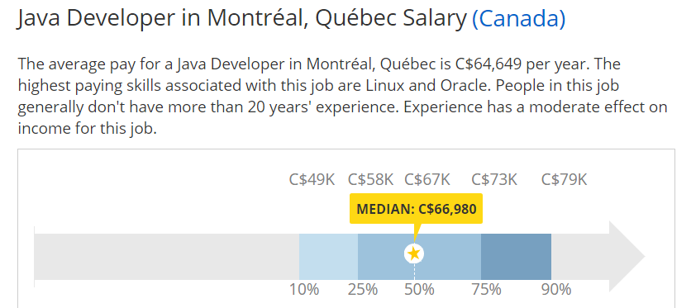
Job Market
Datasource: www.payscale.com
2017-09-10

Slide 4
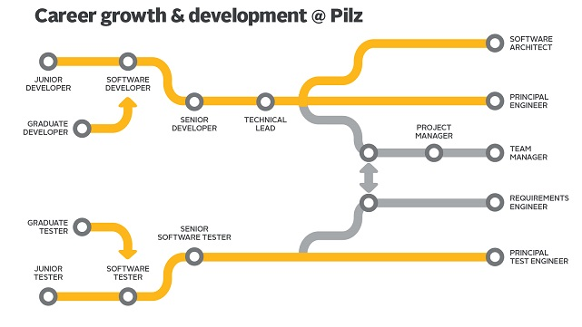
Career Path
Chart from: https://www.codefellows.org/blog/what-success-developer-looks-like/

Slide 5
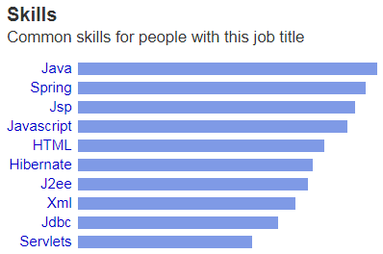
Top Skills
Most commonly required skills for a java developer.
Are we going to learn them all? Yes, we will and we have to!

Slide 6
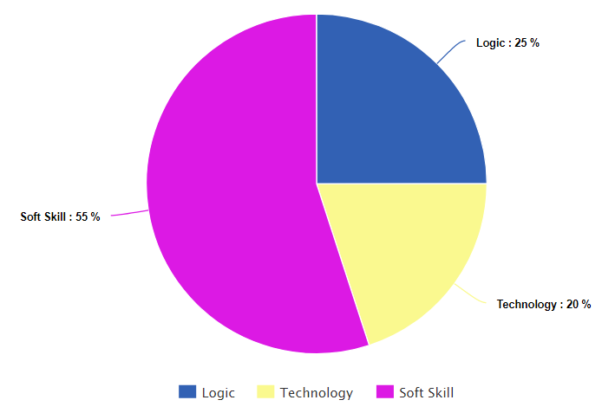
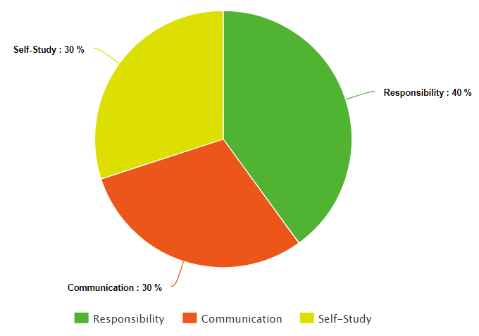
How to define a good developer?

Slide 7
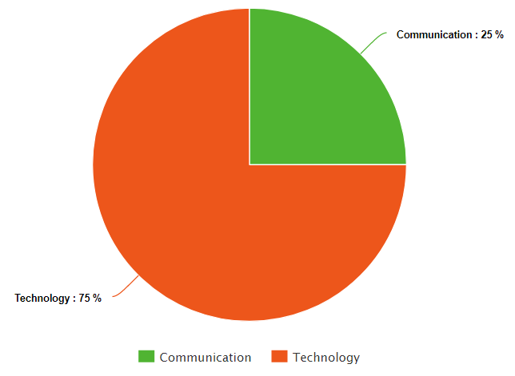
What matters for interview?
That’s why a lot of companies/projects fail.
Focus on Technology and Communication to get a job.
Focus on Soft Skills to advance your career!

Slide 8
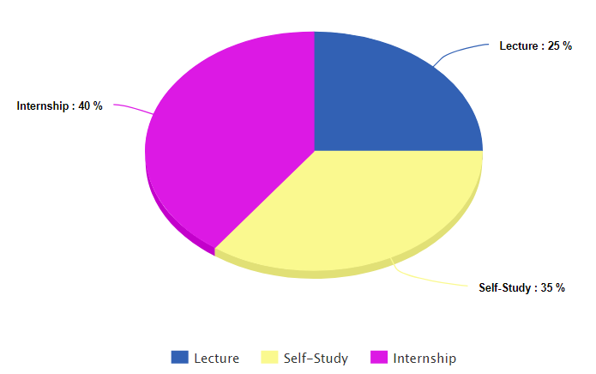
How to study this course?
How does this course help ?
Guide you the simplest way
No waste of time on theory
Core skills covered
Real-world experience
Homework is quite important for the study.
Internship/Project is the key to success!

Slide 9
Self Introduction
Please take 2-3 minutes to introduce yourself to the class and try to present relevant information.
Be a good listener!
It’s the time to show!

Slide 10
Git
Git is a free and open source distributed version control system designed to handle everything from small to very large projects with speed and efficiency. (https://git-scm.com/)
Why do we need Git?
Developers spread across multiple locations, time zones; Code tracking; Centralized control etc.
Install Git.

Slide 11
Advanced Java
Reflection: Soul of Spring
Multithreading:

Slide 12
Reflection
Java Reflection makes it possible to inspect classes, interfaces, fields, annotations and methods at runtime, without knowing the names of the classes, methods etc.
Spring uses Reflection to find annotated Java Classes, methods, variables etc.
Spring is not intrusive to Java code by using reflection.

Slide 13
Multithreading
Multithreading (Concurrency) allows the system to do more than one thing at a time.
Extends Thread, Implements Runnable, Implements Callable
Lambda expression
Synchronization
ConcurrentHashMap
Readwrite Locks

Slide 14
Iterator
Iterator pattern is very commonly used design pattern in Java. This pattern is used to get a way to access the elements of a collection object in sequential manner without any need to know its underlying representation.
Iterator is implemented by basic Java library.

Slide 15
Generics
Designed to extend Java's Type System to allow “a type or method to operate on objects of various types while providing compile-time type safety”.
It avoids ClassCastException in most cases.
A simple example:
Map<K,V>, K and V are Generics that can be replaced by any Class.
Map<Integer, String> map;
Map<int, String> does NOT work - primitive type is not allowed.

Slide 16
Regular Expression
Regular expression helps to match a specific sequence of Strings by pre-defined syntax.
[abc] a, b, or c (simple class)
[^abc] Any character except a, b, or c (negation)
. Any character (may or may not match line terminators)
\d A digit: [0-9]
\D A non-digit: [^0-9]

Slide 17
Regular Expression
String line = "JDK8u144k";
String pattern = "\\d+";
Pattern r = Pattern.compile(pattern);
Matcher m = r.matcher(line);
while (m.find( )) {
System.out.println("Found value: " + m.group() );
}

Slide 18
Stream
Stream makes Java Collection a pipeline that can be freely manipulated.
List<String> strings = Arrays.asList("abc", "", "bc", "efg", "abcd","", "jkl");
long count = strings.stream().filter(string -> string.length() == 3).count();
System.out.println("Strings of length 3: " + count);
strings.stream().map(s -> s.toUpperCase()).forEach(System.out::println);
System.out.println(strings.stream().reduce((a,b) -> a + b).get());

Slide 19
Annotation
In the Java computer programming language, an annotation is a form of syntactic metadata that can be added to Java source code.
It’s one of the most important feature that Spring relies on:
@SpringBootApplication
public class Boot {
public static void main(String[] args) throws Exception {
SpringApplication.run(Boot.class, args);
}}

Slide 20
Lambda
A lambda expression represents an anonymous function. The basic format is ()->{expression}
Callable<String> c = () -> {Thread.sleep(2000);return a.substring(1);};
Before Java 8, it’s so painful....
c = new Callable<String>() {
public String call() throws Exception {
Thread.sleep(2000);
return a.substring(1);
}};

Slide 21
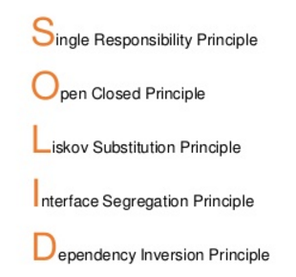
OOP and SOLID
Java is an Object-oriented programming language
Everything in the world can be considered an Object
A cat is an Object, but the nose, the legs of a cat are also Objects

Slide 22
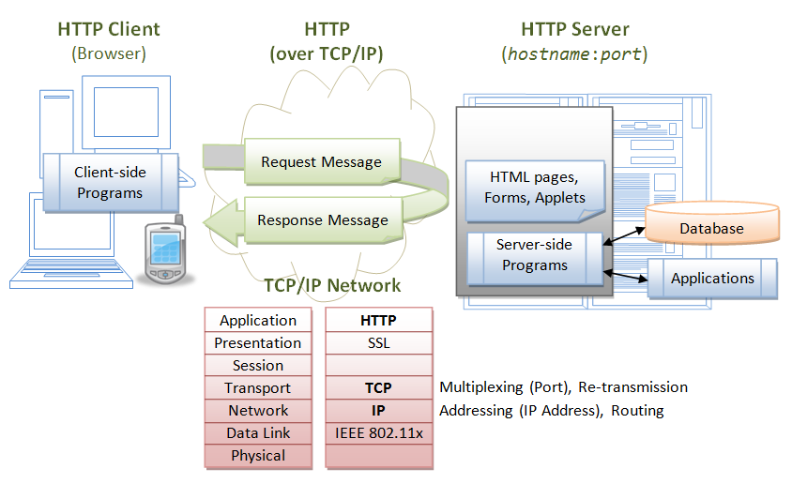
Web Application Architecture

Slide 23
Tomcat
The Apache Tomcat® software is an open source implementation of the Java Servlet, JavaServer Pages, Java Expression Language and Java WebSocket technologies.
Installation: http://tomcat.apache.org/

Slide 24
Tomcat for windows
Goto http://tomcat.apache.org ⇒ Under "Tomcat 8.5.{xx} Released" (where {xx} is the latest upgrade number) ⇒ Downloads ⇒ Under "8.5.{xx}" ⇒ Binary Distributions ⇒ Core ⇒ "ZIP" package (e.g., "apache-tomcat-8.5.{xx}.zip", about 9 MB).
Create your project directory, say "d:\myProject" or "c:\myProject". UNZIP the downloaded file into your project directory. Tomcat will be unzipped into directory "d:\myProject\apache-tomcat-8.0.{xx}".
For ease of use, we shall shorten and rename this directory to "d:\myProject\tomcat".
Take note of Your Tomcat Installed Directory. Hereafter, I shall refer to the Tomcat installed directory as <TOMCAT_HOME>.

Slide 25
Tomcat for Mac
Goto http://tomcat.apache.org ⇒ Under "Tomcat 8.5.{xx} Released" (where {xx} is the latest upgrade number) ⇒ Downloads ⇒ Under "8.5.{xx}"⇒ Binary distribution ⇒ Core ⇒ "tar.gz" package (e.g., "apache-tomcat-8.0.{xx}.tar.gz", about 9 MB).
To install Tomcat:
Goto "~/Downloads", double-click the downloaded tarball (e.g., "apache-tomcat-8.0.{xx}.tar.gz") to expand it into a folder (e.g., "apache-tomcat-8.0.{xx}").
Move the extracted folder (e.g., "apache-tomcat-8.0.{xx}") to "/Applications".
For ease of use, we shall shorten and rename this folder to "tomcat".
Take note of Your Tomcat Installed Directory. Hereafter, I shall refer to the Tomcat installed directory as <TOMCAT_HOME>.

Slide 26
Tomcat
Configure Server.xml
<Host name="localhost" appBase="webapps" unpackWARs="true" autoDeploy="true">
<Context deployOnStartup="true" docBase="/home/chandler/IdeaProjects/javaee/target" path="/javaee" reloadable="true" />
</Host>
Configure web.xml
<web-app>
<welcome-file-list>
<welcome-file>index.html</welcome-file>
</welcome-file-list>
</web-app>

Slide 27
JSP & Servlet
JavaServer Pages (JSP) is a technology for developing Webpages that supports dynamic content. This helps developers insert java code in HTML pages by making use of special JSP tags, most of which start with <% and end with %>.
Java Servlets are programs that run on a Web or Application server and act as a middle layer between a requests coming from a Web browser or other HTTP client and databases or applications on the HTTP server.

Slide 28
Spring
The Spring Framework is an application framework and inversion of control container for the Java platform. The framework's core features can be used by any Java application, but there are extensions for building web applications on top of the Java EE (Enterprise Edition) platform. Although the framework does not impose any specific programming model, it has become popular in the Java community as an addition to, or even replacement for the Enterprise JavaBeans (EJB) model. The Spring Framework is open source.

Slide 29
Spring Boot
Spring Boot is designed to get you up and running as quickly as possible, with minimal upfront configuration of Spring. Spring Boot takes an opinionated view of building production ready applications.

Slide 30
Spring MVC
Spring Web MVC is the original web framework built on the Servlet API and included in the Spring Framework from the very beginning. The formal name "Spring Web MVC" comes from the name of its source module spring-webmvc but it is more commonly known as "Spring MVC".

