Slide 1
JaveEE
Instructor:
Chandler Zhu
CGI Tech Lead
10+ years of software development experience

Slide 2
Introduction
Java EE was formerly known as Java 2 Platform, Enterprise Edition or J2EE. The platform uses the object-oriented Java programming language. Java EE extends the Java Platform, Standard Edition (Java SE), providing an API for object-relational mapping, distributed and multi-tier architectures, and web services.
JavaEE is a set of standards - not a programming language.

Slide 3
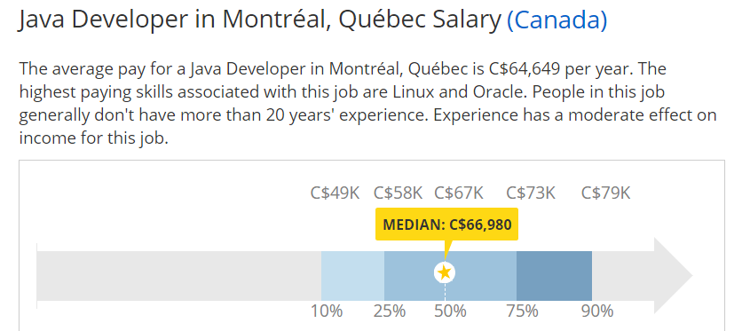
Job Market
Datasource: www.payscale.com
2017-09-10

Slide 4
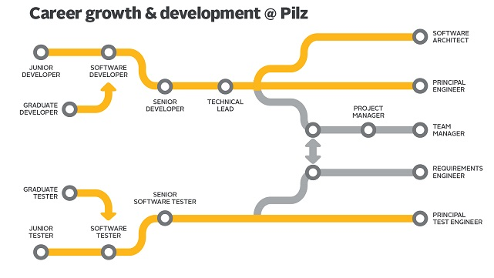
Career Path
Chart from: https://www.codefellows.org/blog/what-success-developer-looks-like/

Slide 5
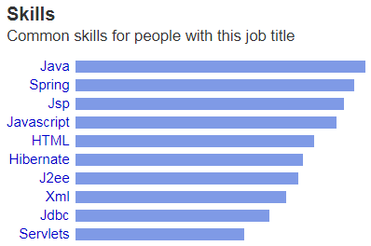
Top Skills
Most commonly required skills for a java developer.
Are we going to learn them all? Yes, we will and we have to!

Slide 6
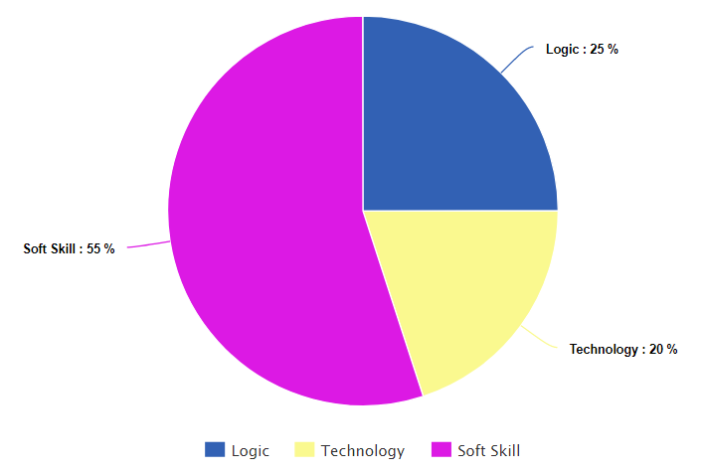
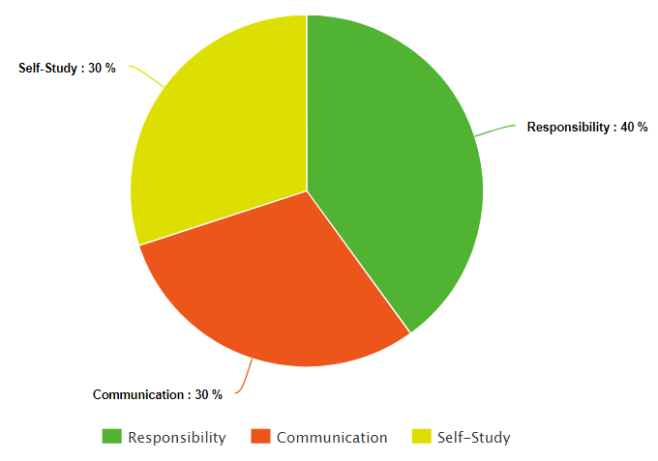
How to define a good developer?

Slide 7
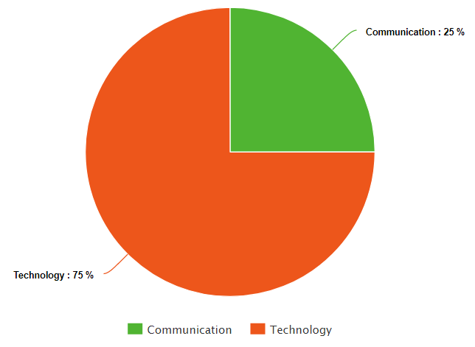
What matters for interview?
That’s why a lot of companies/projects fail.
Focus on Technology and Communication to get a job.
Focus on Soft Skills to advance your career!

Slide 8
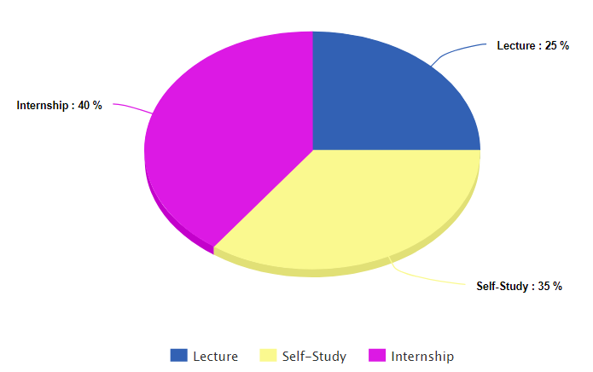
How to study this course?
How does this course help ?
Guide you the simplest way
No waste of time on theory
Core skills covered
Real-world experience
Homework is quite important for the study.
Internship/Project is the key to success!

Slide 9
Self Introduction
Please take 2-3 minutes to introduce yourself to the class and try to present relevant information.
Be a good listener!
It’s the time to show!

Slide 10
Git
Git is a free and open source distributed version control system designed to handle everything from small to very large projects with speed and efficiency. (https://git-scm.com/)
Why do we need Git?
Developers spread across multiple locations, time zones; Code tracking; Centralized control etc.
Install Git.

Slide 11
Advanced Java
Iterator: Actually a design pattern
@FunctionalInterface: Before learning Lambda
Lambda and Stream: Java 8 feature
Generics: Avoid runtime exceptions as much as possible
Multithreading: the most tricky part
Regular Expression: Smart way to parse Strings
Reflection: Soul of Spring
Annotations: Another important driver of Spring
OOP and SOLID: the way to become a master

Slide 12
Iterator
Iterator pattern is very commonly used design pattern in Java. This pattern is used to get a way to access the elements of a collection object in sequential manner without any need to know its underlying representation.
Iterator is implemented by basic Java library.

Slide 13
Generics
Designed to extend Java's Type System to allow “a type or method to operate on objects of various types while providing compile-time type safety”.
It avoids ClassCastException in most cases.
A simple example:
Map<K,V>, K and V are Generics that can be replaced by any Class.
Map<Integer, String> map;
Map<int, String> does NOT work - primitive type is not allowed.

Slide 14
Regular Expression
Regular expression helps to match a specific sequence of Strings by pre-defined syntax.
[abc] a, b, or c (simple class)
[^abc] Any character except a, b, or c (negation)
. Any character (may or may not match line terminators)
\d A digit: [0-9]
\D A non-digit: [^0-9]

Slide 15
Regular Expression
String line = "JDK8u144k";
String pattern = "\\d+";
Pattern r = Pattern.compile(pattern);
Matcher m = r.matcher(line);
while (m.find( )) {
System.out.println("Found value: " + m.group() );
}

Slide 16
Stream
Stream makes Java Collection a pipeline that can be freely manipulated.
List<String> strings = Arrays.asList("abc", "", "bc", "efg", "abcd","", "jkl");
long count = strings.stream().filter(string -> string.length() == 3).count();
System.out.println("Strings of length 3: " + count);
strings.stream().map(s -> s.toUpperCase()).forEach(System.out::println);
System.out.println(strings.stream().reduce((a,b) -> a + b).get());
Use parelleStream only if:
1. Huge amount of items within the collection
2. No “shared resources” and we are sure it’s thread-safe
3. Performance tuning required

Slide 17
Annotation
In the Java computer programming language, an annotation is a form of syntactic metadata that can be added to Java source code.
It’s one of the most important feature that Spring relies on:
@SpringBootApplication
public class Boot {
public static void main(String[] args) throws Exception {
SpringApplication.run(Boot.class, args);
}}

Slide 18
Reflection
Java Reflection makes it possible to inspect classes, interfaces, fields, annotations and methods at runtime, without knowing the names of the classes, methods etc.
Spring uses Reflection to find annotated Java Classes, methods, variables etc.
Spring is not intrusive to Java code by using reflection.

Slide 19
Multithreading
Multithreading (Concurrency) allows the system to do more than one thing at a time.
Extends Thread, Implements Runnable, Implements Callable
Lambda expression
Synchronization
ConcurrentHashMap
Readwrite Locks

Slide 20
Functional Interface
@FunctionalInterface annotation is useful for compilation time checking of your code. You cannot have more than one method besides static, default and abstract methods that override methods in Object in your @FunctionalInterface or any other interface used as a functional interface.
It’s not necessary to have @FunctionalInterface for lambda to work:
public interface Foo {
public void doSomething();
}

Slide 21
Lambda
A lambda expression represents an anonymous function. The basic format is ()→{expression}
Callable<String> c = () -> {Thread.sleep(2000);return a.substring(1);};
Before Java 8, it’s so painful....
c = new Callable<String>() {
public String call() throws Exception {
Thread.sleep(2000);
return a.substring(1);
}};

Slide 22
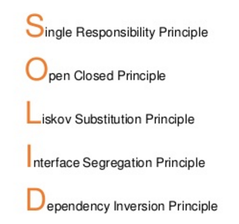
OOP and SOLID
Java is an Object-oriented programming language
Everything in the world can be considered an Object
A cat is an Object, but the nose, the legs of a cat are also Objects

Slide 23
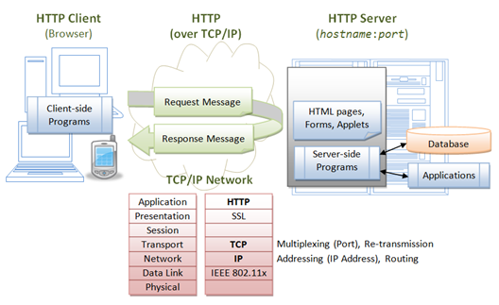
Typical web application architecture

Slide 24
Tomcat
Install and configuration
Check versions: https://tomcat.apache.org/whichversion.html
Download Zip/Tar: https://tomcat.apache.org/download-80.cgi
Configuration and Hello World!

Slide 25
Installing and Configuring Tomcat
Make sure you have the Java SDK installed on your PC
Configure Server.xml
<Host name="localhost" appBase="webapps" unpackWARs="true" autoDeploy="true">
<Context deployOnStartup="true" docBase="/home/chandler/IdeaProjects/javaee/target" path="/javaee" reloadable="true" />
</Host>
Configure web.xml
<web-app>
<welcome-file-list>
<welcome-file>index.html</welcome-file>
</welcome-file-list>
</web-app>

Slide 26
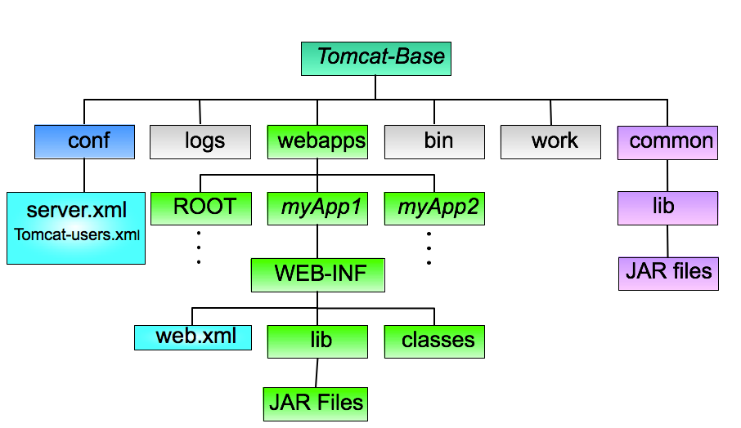

Slide 27
Run Tomcat
•In the Tomcat folder, open the bin folder.
•Click the startup.bat icon.
•You should see a black and white Java command window.
–You should not see any obvious java error messages.
•Open your browser and point to http://localhost:8080.
–You should see the Tomcat welcome page.
•Note startup.bat actually calls other scripts in the same directory (catalina.bat, particularly).

Slide 28
Linux or Mac User
The .sh files are for running Tomcat on Linux/Unix
chmod 755 *.sh
./startup.sh run

Slide 29
Tomcat Ports
•Tomcat 8’s default settings listen to three ports: 8080, 8005, 8009.
–8080 is the http port number.
–8005 is the shutdown port.
•You can contact this to shutdown Tomcat from another process.
–8009 is the AJP port for running Tomcat behind an Apache server.
•Not needed here, but port opened

Slide 30
Other ports
Tomcat can use
–8443 for SSL connections
•Commented out by default.
•Requires some additional configuration
–8082 is for proxy connections
•Redirecting HTTP to other servers.
•Commented out by default.
–You don’t have to edit these.
•For reference, use 9090, 9005, and 9009.

Slide 31
Web Archives
A WAR (Web ARchive) file is a JAR file that contains a whole Web-application directory
For example, to create a WAR file of myApp do:
cd webapps/myApp
jar cvf myApp.war * (don’t forget the filename! What would happen otherwise?)
Tomcat unpacks all WAR files found in $CATALINE_BASE/webapps/ at statup
The unpacked directory and context will be named as the WAR file name (without the .war extension) qThe WAR will not be unpacked if webapps/ already contains the directory and the WAR is not newer...

Slide 32
Tomcat manager
Deploy a Web application by posting a WAR file
Undeploy a deployed Web application
Start/stop a Web application (make it available/unavailable)
Reload an existing Web application (unpack new WARs)
Warning: while “stop” makes an application unavailable, “undeploy” deletes the application directory and WAR file from webapps/

Slide 33
Java Server-side Programming
JavaServer Page (JSP) is Java's answer to the popular Microsoft's Active Server Pages (ASP). JSP, like ASP, provides a simplified and fast mean to generate dynamic web contents.
It allows you to mix static HTML with dynamically generated HTML

Slide 34
JSP
JSP technology has facilitated the segregation of the work of a Web designer and a Web developer.
A Web designer can design and formulate the layout for the Web page by using HTML.
On the other hand, a Web developer working independently can use java code and other JSP specific tags to code the business logic.
The simultaneous construction of the static and dynamic content facilitates development of quality applications with increased productivity.

Slide 35
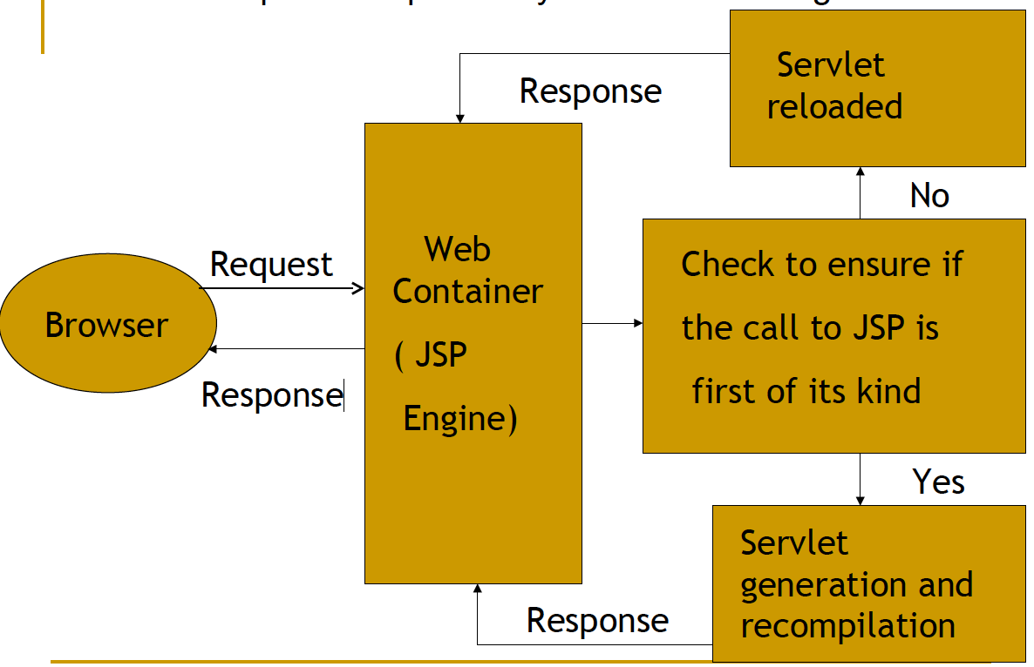
JSP Life Cycle

Slide 36
JSP Scripting Elements
JSP Comment <%-- comments -->
JSP Expression <%= Java Expression %>
JSP Scriptlet <% Java Statement(s) %>
JSP Directive <%@ page|include ... %>

Slide 37
Declaration tag (<%! %>)
This tag allows the developer to declare variables or methods.
Before the declaration you must have <%! And at the end of the declaration
the developer must have %>
Code placed in this must end in a semicolon(;).
Declarations do not generate output, so are used with JSP expressions or
scriptlets.

Slide 38
Example Of Declaration tag
<%!
private int counter = 0 ;
private String getAccount (int accountNo);
%>

Slide 39
Expression tag (<%= %>)
This tag allows the developer to embed any java expression
and is short for out.println().
A semicolon (;) does not appear at the end of the code inside
the tag.

Slide 40
Example Of Expression tag
Current Date and Time is :
<%= new java.util.Date() %>

Slide 41
Pre-defined variables
request: corresponds to the HTTP request message.
response: corresponds to the HTTP response message.
out: corresponds to the HTTP response message’s output stream

Slide 42
Spring framework
Introduction
The Spring Framework provides a comprehensive programming and configuration model for modern Java-based enterprise applications - on any kind of deployment platform. A key element of Spring is infrastructural support at the application level: Spring focuses on the "plumbing" of enterprise applications so that teams can focus on application-level business logic, without unnecessary ties to specific deployment environments.
Features
Dependency Injection
Aspect-Oriented Programming including Spring's declarative transaction management
Spring MVC web frameworks
Foundational support for JDBC, JPA, JMS
Much more…

Slide 43
Spring framework
Introduction
The Spring Framework provides a comprehensive programming and configuration model for modern Java-based enterprise applications - on any kind of deployment platform. A key element of Spring is infrastructural support at the application level: Spring focuses on the "plumbing" of enterprise applications so that teams can focus on application-level business logic, without unnecessary ties to specific deployment environments.
Features
Dependency Injection
Aspect-Oriented Programming including Spring's declarative transaction management
Spring MVC web frameworks
Foundational support for JDBC, JPA, JMS
Much more…

Slide 44
Spring Boot
Spring Boot makes it easy to create stand-alone, production-grade Spring based Applications that you can "just run". We take an opinionated view of the Spring platform and third-party libraries so you can get started with minimum fuss. Most Spring Boot applications need very little Spring configuration.
Hello world example, compare with the same example with plain Tomcat
Annotations: @SpringBootApplication

Slide 45
Spring MVC
Spring Web MVC is the original web framework built on the Servlet API and included in the Spring Framework from the very beginning. The formal name "Spring Web MVC" comes from the name of its source module spring-webmvc but it is more commonly known as "Spring MVC".
Annotations: @Controller @Service @Repository @Entity
Page forward: ModelAndView
Resources folder structure: /public or /static or /resources by default

Slide 46
Spring Security
Spring Security is a framework that focuses on providing both authentication and authorization to Java applications. Like all Spring projects, the real power of Spring Security is found in how easily it can be extended to meet custom requirements
CSRF check and Ajax

Slide 47
Spring MVC Project
A simple CRUD spring boot application for trading transactions persisted to files.
private BufferedReader readFile(String path) throws FileNotFoundException {
BufferedReader br = new BufferedReader(new FileReader(path));
return br;
}
try (BufferedReader br = this.readFile(DaoConstants.TRADE_FILE_PATH)) {
while ((line = br.readLine()) != null) {
// use comma as separator
String[] columns = line.split(DaoConstants.SEPARATOR);
...
}
}

Slide 48
Assignment: install MySql
Download: https://dev.mysql.com/downloads/mysql/
Please install at least MySql server and MySql Workbench
Create schema in MySql Workbench
Create a table under the schema

Slide 49
REST
Representational state transfer (REST) or RESTful web services is a way of providing interoperability between computer systems on the Internet. REST-compliant Web services allow requesting systems to access and manipulate textual representations of Web resources using a uniform and predefined set of stateless operations.
In a RESTful Web service, requests made to a resource's URI will elicit a response that may be in XML, HTML, JSON or some other defined format. The response may confirm that some alteration has been made to the stored resource, and it may provide hypertext links to other related resources or collections of resources. Using HTTP, as is most common, the kind of operations available include those predefined by the HTTP methods GET, POST, PUT, DELETE and so on.

Slide 50
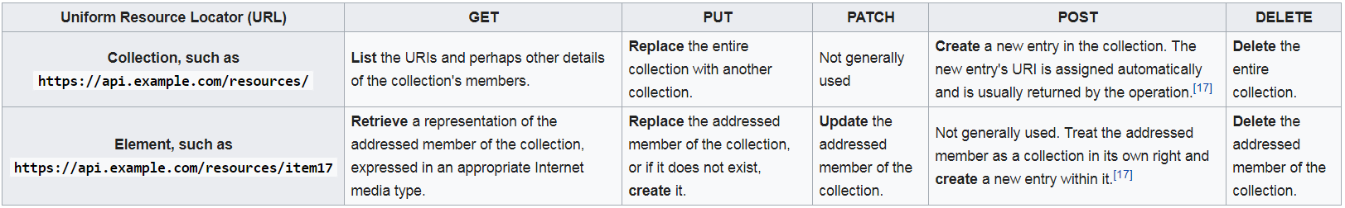
REST

Slide 51
RDBMS
RDBMS stands for Relational Database Management Systems..
All modern database management systems like SQL, MS SQL Server, IBM DB2, ORACLE, MySql and Microsoft Access are based on RDBMS.
It is called Relational Data Base Management System (RDBMS) because it is based on relational model introduced by E.F. Codd.
Popular DB engines:
https://db-engines.com/en/ranking

Slide 52
SQL
Basic SQL:
Select {column} from {table} where {conditions} order by {column}
Insert into {table} ({column1}, {column2},....) values ({value1}, {value2}, ….)
Update {table} set {column} = {value} where {conditions}
Advanced SQL:
Group by, Table Join, Distinct, count(), max(), min()
Date related functions: https://dev.mysql.com/doc/refman/5.7/en/date-and-time-functions.html

Slide 53
Database Normalization
Database normalization, or simply normalization, is the process of organizing the columns (attributes) and tables (relations) of a relational database to reduce data redundancy and improve data integrity. Normalization is also the process of simplifying the design of a database so that it achieves the optimal structure composed of atomic elements. It was first proposed by Edgar F. Codd, as an integral part of a relational model.

Slide 54
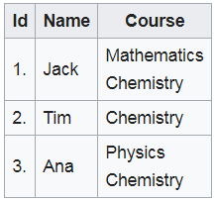
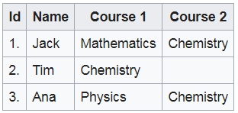
Unnormalized
Duplicate/redundant data

Slide 55
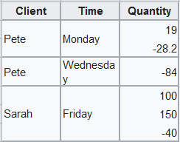
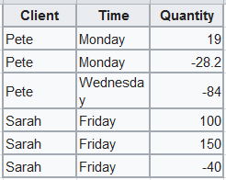
1nf - single value rule

Slide 56


1nf - single identity rule

Slide 57
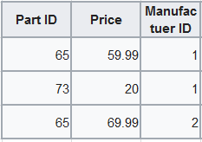
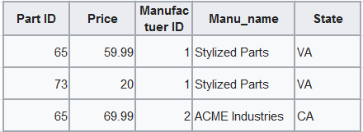
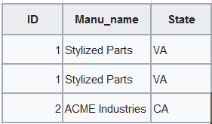
2nf - fully dependant to PK

Slide 58
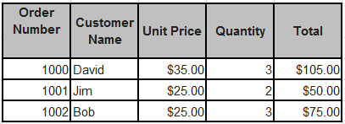
3nf - no dependency between columns
Total = Unit Price * Quantity
Remove Total to satisfy 3nf
Similar to OOP

Slide 59
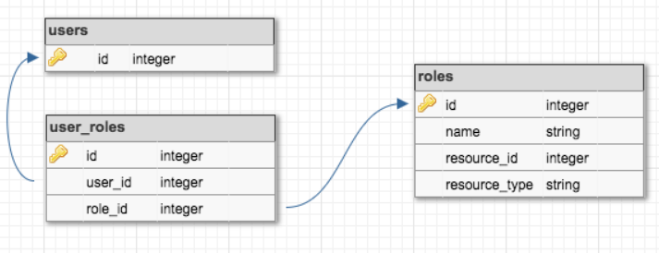
Database Design - User/Role
MySql workbench has the ability to visualize database design

Slide 60
JDBC
JDBC stands for Java Database Connectivity, which is a standard Java API for database-independent connectivity between the Java programming language and a wide range of databases.
The JDBC library includes APIs for each of the tasks mentioned below that are commonly associated with database usage.
Making a connection to a database.
Creating SQL or MySQL statements.
Executing SQL or MySQL queries in the database.
Viewing & Modifying the resulting records.

Slide 61
Database Transaction
A transaction is a sequence of operations performed as a single logical unit of work. A logical unit of work must exhibit four properties, called the atomicity, consistency, isolation, and durability (ACID) properties, to qualify as a transaction.

Slide 62
JPA
The Java Persistence API provides a POJO persistence model for object-relational mapping. The Java Persistence API was developed by the EJB 3.0 software expert group as part of JSR 220, but its use is not limited to EJB software components. It can also be used directly by web applications and application clients, and even outside the Java EE platform.
JPA implementations: Weblogic(JavaEE), Spring Data(Hibernate)

Slide 63
Spring Data
Spring Data’s mission is to provide a familiar and consistent, Spring-based programming model for data access while still retaining the special traits of the underlying data store.
For JPA/RDBMS, Hibernate is the default implementation.
Try to avoid using Hibernate specific syntax (Annotations, HibernateTemplate etc.)

Slide 64
Spring Data
Spring Data Commons - Core Spring concepts underpinning every Spring Data project.
Spring Data Gemfire - Provides easy configuration and access to GemFire from Spring applications.
Spring Data JPA - Makes it easy to implement JPA-based repositories.
Spring Data KeyValue - Map-based repositories and SPIs to easily build a Spring Data module for key-value stores.
Spring Data LDAP - Provides Spring Data repository support for Spring LDAP.
Spring Data MongoDB - Spring based, object-document support and repositories for MongoDB.
Spring Data REST - Exports Spring Data repositories as hypermedia-driven RESTful resources.
Spring Data Redis - Provides easy configuration and access to Redis from Spring applications.
Spring Data for Apache Cassandra - Spring Data module for Apache Cassandra.
Spring Data for Apache Solr - Spring Data module for Apache Solr.

Slide 65
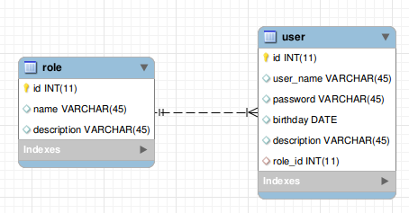
Spring Data ORM

Slide 66
Spring Data ORM
@Entity
public class User {
@Id
long id;
@Column(name = "user_name")
String userName;
String password;
String description;
Date birthday;
@ManyToOne
@JsonBackReference
Role role;
@Entity
public class Role {
@Id
long id;
String name;
String description;
@OneToMany(fetch= FetchType.EAGER, cascade = CascadeType.ALL, mappedBy="role")
@JsonManagedReference
Set<User> users;
Avoid using EAGER as much as possible.

Slide 67
Hibernate
The underlying implementation of the Spring Data is Hibernate
Try to avoid using Hibernate specific syntax to make the implementation switchable
Hibernate has two levels of cache
Second-level cache is very tricky

Slide 68
Unit Test
Unit testing is the act of testing a small component, or unit, of your software application. Because the scope of each individual unit test is so limited, the only way to achieve it is to write code that tests your code, usually using a framework like Junit.
Unit testing is intended to improve code quality and working efficiency
It’s very important to control the scope of unit testing
The word “unit testing” is very frequently misused
As a developer, we need to decide if we actually need to write unit test code
Test-driven development

Slide 69
Unit Test – write or not
Consider writing unit tests:
When the logic behind the method is complex enough that you feel you need to test extensively to verify that it works.
When a particular code function breaks and it takes longer than a minute or so to fix it.
Whenever it takes less time to write a unit test to verify that code works than to start up the system, log in, recreate your scenario, etc.
Consider avoiding unit tests:
When elaborate frameworks need to be created or installed (such as mock objects and dependency injection) just to get the tests to work.
When the tests are applied to code that, if broken, has very little bearing whatsoever on the overall software quality.
When the costs of maintaining the set of tests are higher than the costs of maintaining the actual product code.

Slide 70
Junit
JUnit is a unit testing framework for Java programming language. JUnit has been important in the development of test-driven development, and is one of a family of unit testing frameworks collectively known as xUnit, that originated with Junit.
public class TestJunit {
String message = "Hello World";
MessageUtil messageUtil = new MessageUtil(message);
@Test
public void testPrintMessage() {
assertEquals(message,messageUtil.printMessage());
}
}

Slide 71
Design Pattern
Creational: Factory, Builder, Singleton, Dependency Injection, Prototype
Structural: Adapter, Facade, Proxy, Composite, Decorator, Flyweight
Behavioral: Strategy, Visitor, Template, State, Observer, Memento, Mediator, Chain of Responsibility
OOP is the best “design pattern”.
More than 50% of time no pattern is required.

