Slide 1
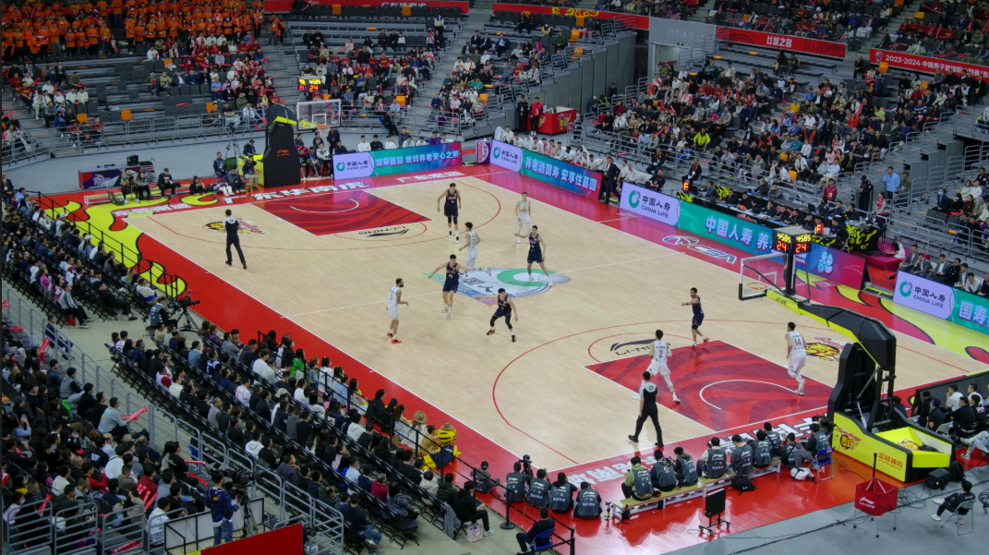

Slide 2
Multi-view Video Sequence

Slide 5
Reference Clip

Slide 6

Reference Clip
Source Clip
Source Clip

Slide 7
Reference Clip

Slide 8
Reference Clip Training Stage

Slide 9

Reference Clip Training Stage
frames of ${CLIP}_{0}$

Slide 10
Reference Clip Training Stage
frames of ${CLIP}_{0}$
Intra-CLIP

Slide 11
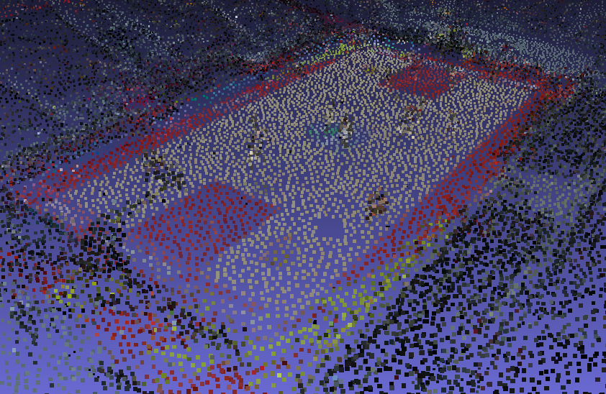

Reference Clip Training Stage
frames of ${CLIP}_{0}$
anchors $A_{0}$
Intra-CLIP

Slide 12



Reference Clip Training Stage
frames of ${CLIP}_{0}$
anchors $A_{0}$
$${SFT}_{0}$$
time
Intra-CLIP
Trainable

Slide 13

Reference Clip Training Stage
frames of ${CLIP}_{0}$
anchors $A_{0}$
$${SFT}_{0}$$
time
dynamic feature $f_{d,0}$
Intra-CLIP
Trainable

Slide 14

Reference Clip Training Stage
frames of ${CLIP}_{0}$
anchors $A_{0}$
$${SFT}_{0}$$
time
dynamic feature $f_{d,0}$
Static feature $f_{s,0}$
Intra-CLIP
Trainable

Slide 15
Reference Clip Training Stage
frames of ${CLIP}_{0}$
anchors $A_{0}$
$${SFT}_{0}$$
time
dynamic feature $f_{d,0}$
C
Static feature $f_{s,0}$
C
Concat
Intra-CLIP
Trainable

Slide 16

Reference Clip Training Stage
frames of ${CLIP}_{0}$
anchors $A_{0}$
$${SFT}_{0}$$
time
dynamic feature $f_{d,0}$
C
Static feature $f_{s,0}$
Decoder $d$
C
Concat
Intra-CLIP
Trainable

Slide 17
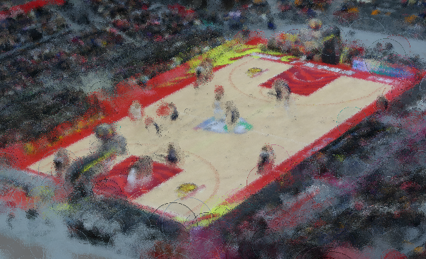
Reference Clip Training Stage
frames of ${CLIP}_{0}$
anchors $A_{0}$
Temporal GS
$${SFT}_{0}$$
time
dynamic feature $f_{d,0}$
C
Static feature $f_{s,0}$
Decoder $d$
C
Concat
Intra-CLIP
Trainable

Slide 18
Reference Clip Training Stage
frames of ${CLIP}_{0}$
rendering
anchors $A_{0}$
Temporal GS
$${SFT}_{0}$$
time
dynamic feature $f_{d,0}$
C
Static feature $f_{s,0}$
Decoder $d$
C
Concat
Intra-CLIP
Trainable

Slide 19
Reference Clip Training Stage
Loss
frames of ${CLIP}_{0}$
rendering
anchors $A_{0}$
Temporal GS
$${SFT}_{0}$$
time
dynamic feature $f_{d,0}$
C
Static feature $f_{s,0}$
Decoder $d$
C
Concat
Intra-CLIP
Trainable

Slide 20
Reference Clip Training Stage
frames of ${CLIP}_{0}$
rendering
anchors $A_{0}$
Temporal GS
$${SFT}_{0}$$
time
dynamic feature $f_{d,0}$
C
Static feature $f_{s,0}$
Decoder $d$
C
Concat
Intra-CLIP
Trainable

Slide 21
Reference Clip Training Stage
frames of ${CLIP}_{0}$
rendering
anchors $A_{0}$
Temporal GS
$${SFT}_{0}$$
time
dynamic feature $f_{d,0}$
C
Static feature $f_{s,0}$
Decoder $d$
C
Concat
Intra-CLIP
Trainable

Slide 22
Reference Clip Training Stage
Source Clips Training Stage
frames of ${CLIP}_{0}$
rendering
anchors $A_{0}$
Temporal GS
$${SFT}_{0}$$
time
dynamic feature $f_{d,0}$
C
Static feature $f_{s,0}$
Decoder $d$
C
Concat
Intra-CLIP
Trainable

Slide 23

Reference Clip Training Stage
Source Clips Training Stage
frames of ${CLIP}_{0}$
rendering
frames of ${CLIP}_{1}$
anchors $A_{0}$
Temporal GS
$${SFT}_{0}$$
time
dynamic feature $f_{d,0}$
C
Static feature $f_{s,0}$
Decoder $d$
C
Concat
Intra-CLIP
Trainable

Slide 24
Reference Clip Training Stage
Source Clips Training Stage
frames of ${CLIP}_{0}$
rendering
frames of ${CLIP}_{1}$
anchors $A_{0}$
Temporal GS
$${SFT}_{0}$$
time
dynamic feature $f_{d,0}$
C
Static feature $f_{s,0}$
Decoder $d$
C
Concat
Intra-CLIP
Trainable

Slide 25

Reference Clip Training Stage
Source Clips Training Stage
frames of ${CLIP}_{0}$
rendering
frames of ${CLIP}_{1}$
D
D
anchors $A_{0}$
Temporal GS
anchors $A_{1}$
$${SFT}_{0}$$
time
dynamic feature $f_{d,0}$
C
Static feature $f_{s,0}$
Decoder $d$
Concat
Deduplication
Inter-CLIP
Trainable
C
D
Intra-CLIP

Slide 26

Reference Clip Training Stage
Source Clips Training Stage
frames of ${CLIP}_{0}$
rendering
frames of ${CLIP}_{1}$
D
D
anchors $A_{0}$
Temporal GS
anchors $A_{1}$
$${SFT}_{0}$$
time
$${SFT}_{ 1}$$
time
dynamic feature $f_{d,0}$
C
Static feature $f_{s,0}$
Decoder $d$
Concat
Deduplication
Inter-CLIP
Trainable
C
D
Intra-CLIP

Slide 27

Reference Clip Training Stage
Source Clips Training Stage
frames of ${CLIP}_{0}$
rendering
frames of ${CLIP}_{1}$
D
D
anchors $A_{0}$
Temporal GS
anchors $A_{1}$
$${SFT}_{0}$$
time
$${SFT}_{ 1}$$
time
dynamic feature $f_{d,0}$
dynamic feature $f_{d,1}$
C
Static feature $f_{s,0}$
Decoder $d$
Concat
Deduplication
Inter-CLIP
Trainable
C
D
Intra-CLIP

Slide 28
Reference Clip Training Stage
Source Clips Training Stage
frames of ${CLIP}_{0}$
rendering
frames of ${CLIP}_{1}$
D
D
anchors $A_{0}$
Temporal GS
anchors $A_{1}$
$${SFT}_{0}$$
time
$${SFT}_{ 1}$$
time
dynamic feature $f_{d,0}$
dynamic feature $f_{d,1}$
C
Static feature $f_{s,0}$
Decoder $d$
Concat
Deduplication
Inter-CLIP
Trainable
C
D
Intra-CLIP

Slide 29




Reference Clip Training Stage
Source Clips Training Stage
frames of ${CLIP}_{0}$
rendering
frames of ${CLIP}_{1}$
D
D
anchors $A_{0}$
Temporal GS
anchors $A_{1}$
$${SFT}_{0}$$
time
$${SFT}_{ 1}$$
time
dynamic feature $f_{d,0}$
dynamic feature $f_{d,1}$
C
Decoder $d$
$$f_{s,1}$$
Static feature $f_{s,0}$
I
I
$$f_{s,0}$$
Concat
Deduplication
Inheritance
Inter-CLIP
Frozen
Trainable
C
D
I
Intra-CLIP

Slide 30
Reference Clip Training Stage
Source Clips Training Stage
frames of ${CLIP}_{0}$
rendering
frames of ${CLIP}_{1}$
D
D
anchors $A_{0}$
Temporal GS
anchors $A_{1}$
$${SFT}_{0}$$
time
$${SFT}_{ 1}$$
time
dynamic feature $f_{d,0}$
dynamic feature $f_{d,1}$
C
C
Decoder $d$
$$f_{s,1}$$
Static feature $f_{s,0}$
I
I
$$f_{s,0}$$
Concat
Deduplication
Inheritance
Inter-CLIP
Frozen
Trainable
C
D
I
Intra-CLIP

Slide 31

Reference Clip Training Stage
Source Clips Training Stage
frames of ${CLIP}_{0}$
rendering
frames of ${CLIP}_{1}$
D
D
anchors $A_{0}$
Temporal GS
anchors $A_{1}$
$${SFT}_{0}$$
time
$${SFT}_{ 1}$$
time
dynamic feature $f_{d,0}$
dynamic feature $f_{d,1}$
C
C
Decoder $d$
$$f_{s,1}$$
Decoder $d$
Static feature $f_{s,0}$
I
I
I
I
$$f_{s,0}$$
$$d$$
Concat
Deduplication
Inheritance
Inter-CLIP
Frozen
Trainable
C
D
I
Intra-CLIP

Slide 32
Reference Clip Training Stage
Source Clips Training Stage
frames of ${CLIP}_{0}$
rendering
frames of ${CLIP}_{1}$
D
D
anchors $A_{0}$
Temporal GS
anchors $A_{1}$
Temporal GS
$${SFT}_{0}$$
time
$${SFT}_{ 1}$$
time
dynamic feature $f_{d,0}$
dynamic feature $f_{d,1}$
C
C
Decoder $d$
$$f_{s,1}$$
Decoder $d$
Static feature $f_{s,0}$
I
I
I
I
$$f_{s,0}$$
$$d$$
Concat
Deduplication
Inheritance
Inter-CLIP
Frozen
Trainable
C
D
I
Intra-CLIP

Slide 33
Reference Clip Training Stage
Source Clips Training Stage
frames of ${CLIP}_{0}$
rendering
frames of ${CLIP}_{1}$
rendering
D
D
anchors $A_{0}$
Temporal GS
anchors $A_{1}$
Temporal GS
$${SFT}_{0}$$
time
$${SFT}_{ 1}$$
time
dynamic feature $f_{d,0}$
dynamic feature $f_{d,1}$
C
C
Decoder $d$
$$f_{s,1}$$
Decoder $d$
Static feature $f_{s,0}$
I
I
I
I
$$f_{s,0}$$
$$d$$
Concat
Deduplication
Inheritance
Inter-CLIP
Frozen
Trainable
C
D
I
Intra-CLIP

Slide 34
Reference Clip Training Stage
Source Clips Training Stage
Loss
frames of ${CLIP}_{0}$
rendering
frames of ${CLIP}_{1}$
rendering
D
D
anchors $A_{0}$
Temporal GS
anchors $A_{1}$
Temporal GS
$${SFT}_{0}$$
time
$${SFT}_{ 1}$$
time
dynamic feature $f_{d,0}$
dynamic feature $f_{d,1}$
C
C
Decoder $d$
$$f_{s,1}$$
Decoder $d$
Static feature $f_{s,0}$
I
I
I
I
$$f_{s,0}$$
$$d$$
Concat
Deduplication
Inheritance
Inter-CLIP
Frozen
Trainable
C
D
I
Intra-CLIP

Slide 35
Reference Clip Training Stage
Source Clips Training Stage
frames of ${CLIP}_{0}$
rendering
frames of ${CLIP}_{1}$
rendering
D
D
anchors $A_{0}$
Temporal GS
anchors $A_{1}$
Temporal GS
$${SFT}_{0}$$
time
$${SFT}_{ 1}$$
time
dynamic feature $f_{d,0}$
dynamic feature $f_{d,1}$
C
C
Decoder $d$
$$f_{s,1}$$
Decoder $d$
Static feature $f_{s,0}$
I
I
I
I
$$f_{s,0}$$
$$d$$
Concat
Deduplication
Inheritance
Inter-CLIP
Frozen
Trainable
C
D
I
Intra-CLIP

Slide 36
Reference Clip Training Stage
Source Clips Training Stage
frames of ${CLIP}_{0}$
rendering
frames of ${CLIP}_{1}$
rendering
D
D
anchors $A_{0}$
Temporal GS
anchors $A_{1}$
Temporal GS
$${SFT}_{0}$$
time
$${SFT}_{ 1}$$
time
dynamic feature $f_{d,0}$
dynamic feature $f_{d,1}$
C
C
Decoder $d$
$$f_{s,1}$$
Decoder $d$
Static feature $f_{s,0}$
I
I
I
I
$$f_{s,0}$$
$$d$$
Concat
Deduplication
Inheritance
Inter-CLIP
Frozen
Trainable
C
D
I
Intra-CLIP

Slide 37






Reference Clip Training Stage
Source Clips Training Stage
frames of ${CLIP}_{0}$
rendering
frames of ${CLIP}_{1}$
rendering
frames of ${CLIP}_{N−1}$
rendering
D
D
D
anchors $A_{0}$
Temporal GS
anchors $A_{1}$
Temporal GS
anchors $A_{N−1}$
Temporal GS
$${SFT}_{0}$$
time
$${SFT}_{ 1}$$
time
$${SFT}_{ N−1}$$
time
dynamic feature $f_{d,0}$
dynamic feature $f_{d,1}$
dynamic feature $f_{d,N−1}$
C
C
C
Decoder $d$
$$f_{s,1}$$
Decoder $d$
$$f_{s,N−1}$$
Decoder $d$
Static feature $f_{s,0}$
I
I
I
I
I
I
$$f_{s,0}$$
$$d$$
$$f_{s,0}$$
$$d$$
Concat
Deduplication
Inheritance
Inter-CLIP
Frozen
Trainable
C
D
I
Intra-CLIP

