Slide 1
CX1015
DATA SCIENCE AND ARTIFICIAL INTELLIGENCE MINI PROJECT
Team Members: Arjun, Casuarina, Liang Jing

Slide 2
World Happiness Report
Objective:
Explore & use the supporting factors to understand the
happiness of Foreign born & Local born

Slide 3
Exploratory Data Analysis
1

Slide 4
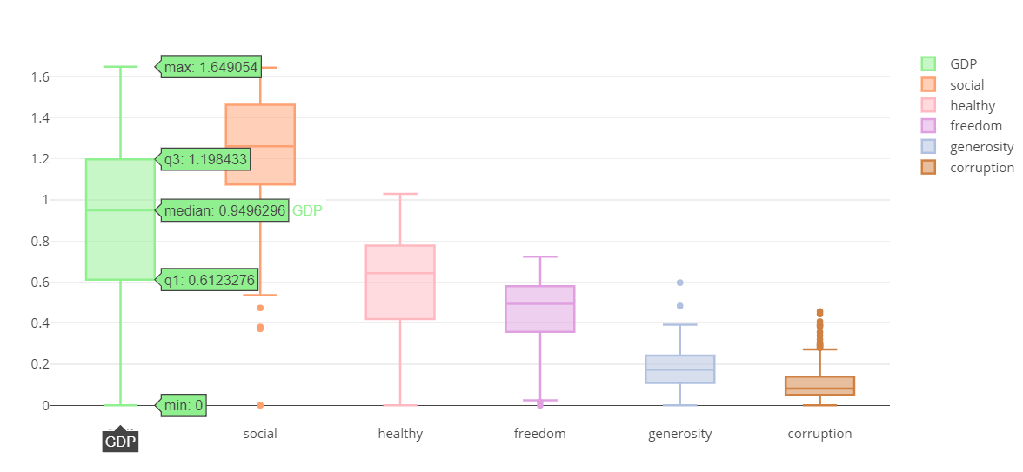
Exploratory Data Analysis
In general, GDP is the key factor of happiness.

Slide 5
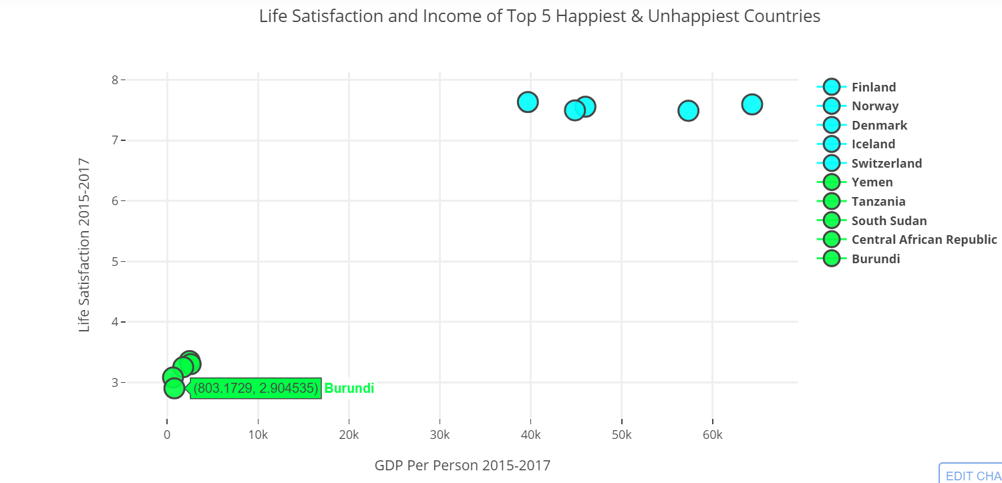
Exploratory Data Analysis
Countries with high life satisfaction tend to have relatively higher GDP per person compared to countries with low life satisfaction (life satisfaction also known as Life Ladder)

Slide 6
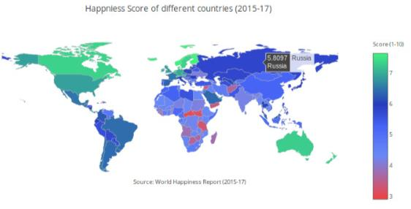
Exploratory Data Analysis
North American countries had higher happiness scores, whereas
African countries had relatively way lower scores

Slide 7
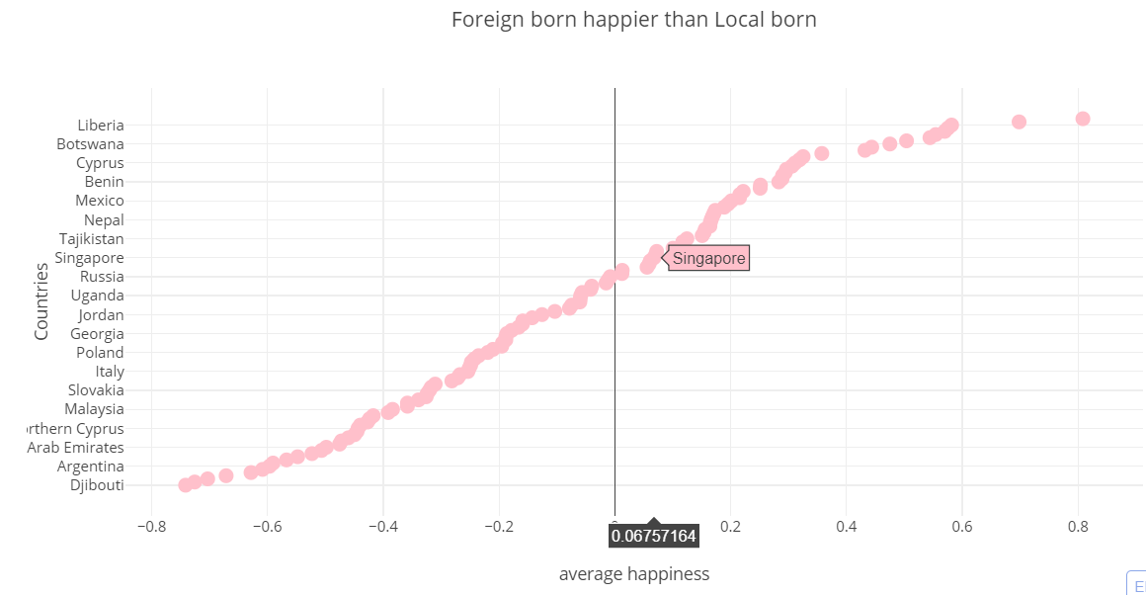
Exploratory Data Analysis
There were more countries with happier local born (67/117)
Singapore is one of the countries with happier foreign born

Slide 8
Cleaning the data
2

Slide 9
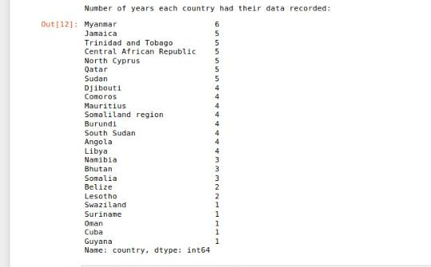
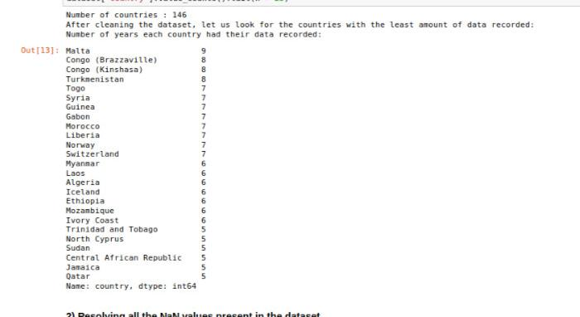
Cleaning the Datasets
Less Data for specific countries

Slide 10
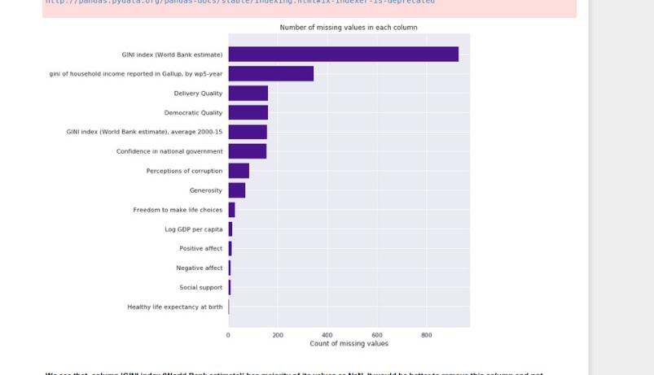
Cleaning the Datasets
2) Dealing with the NaN values
> Removing GINI Index column

Slide 11
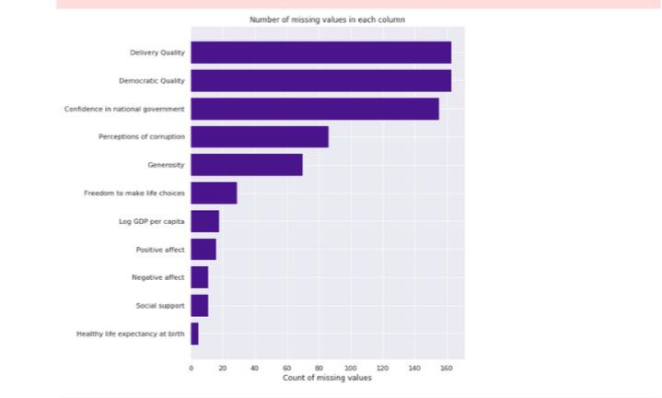
Cleaning the Datasets
> Filling the others with the mean values to not affect the basic statistics.

Slide 12
Types of Machine Learning
3

Slide 13
Types of Machine Learning used
Linear Regression on Singaporean’s happiness
Linear Regression on local vs foreign born happiness
Anomaly Detection on happiness score vs supporting variables

Slide 14
How is it going to reach our objective?
Linear Regression on local vs foreign born happiness
Figure out which supporting factors play the big part on making
local born happier
foreign born happier
Predict the happiness using the supporting factors
countries with happier local born
countries with happier foreign born

Slide 15
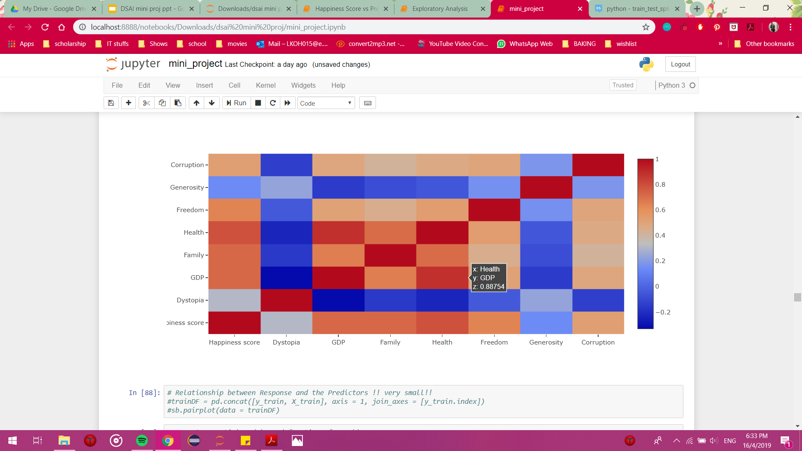
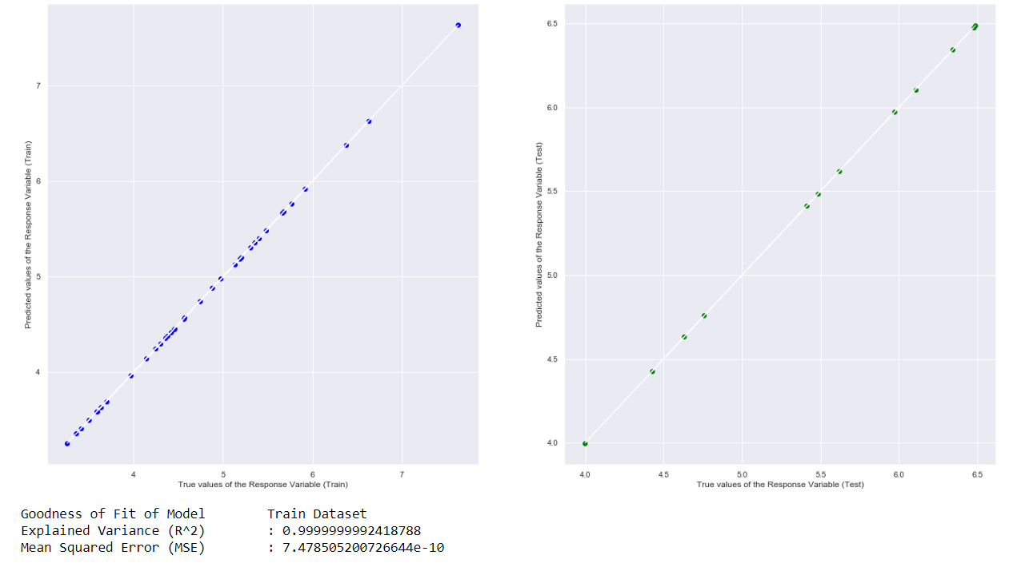
Linear Regression on Countries with happier foreign born

Slide 16
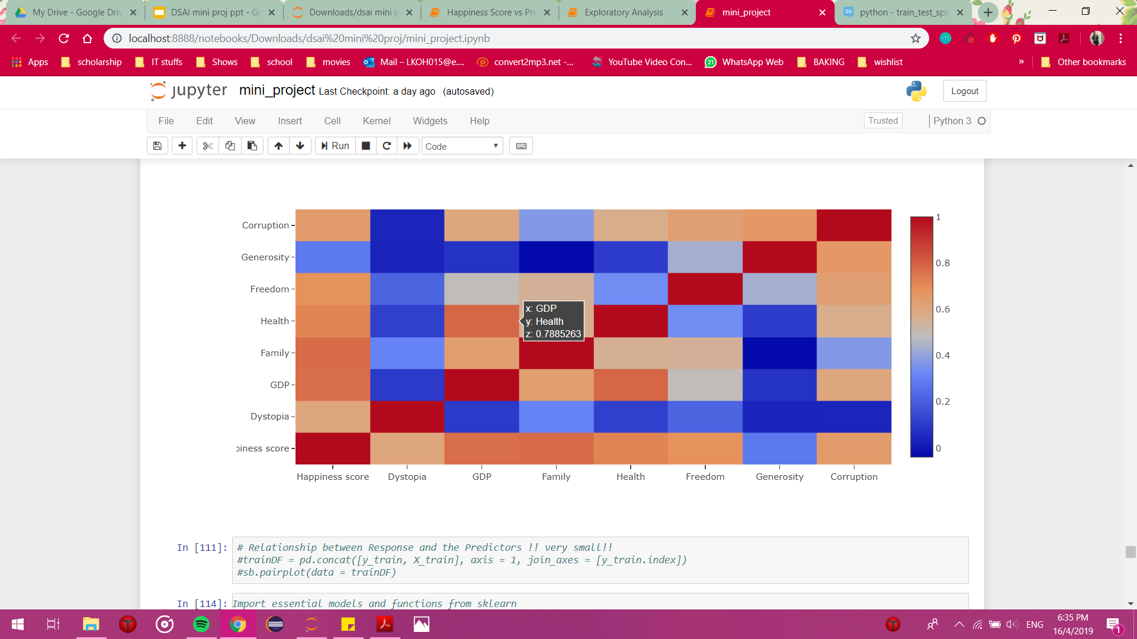
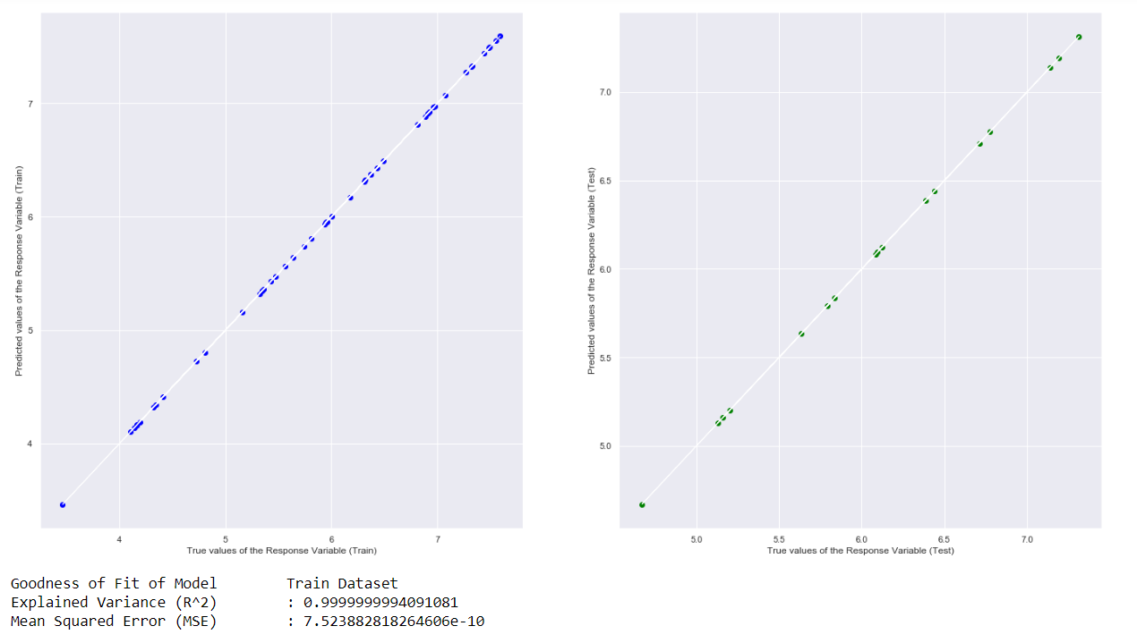
Linear Regression on Countries with happier local born

Slide 17
How did everything tie together?
Local vs foreign born happiness
Singaporean’s happiness
Singapore has happier foreign born
The strongest correlated factors for happier foreign born countries were health & economy
We want to see if Singapore has the same strongest correlated factors

Slide 18
How is it going to reach our objective?
Linear Regression on Singaporean’s happiness
Figure out which factors is strongly correlated to happiness score of countries
Predict Singapore’s happiness score in the next 5 years using the approximated predicted happiness score

Slide 19
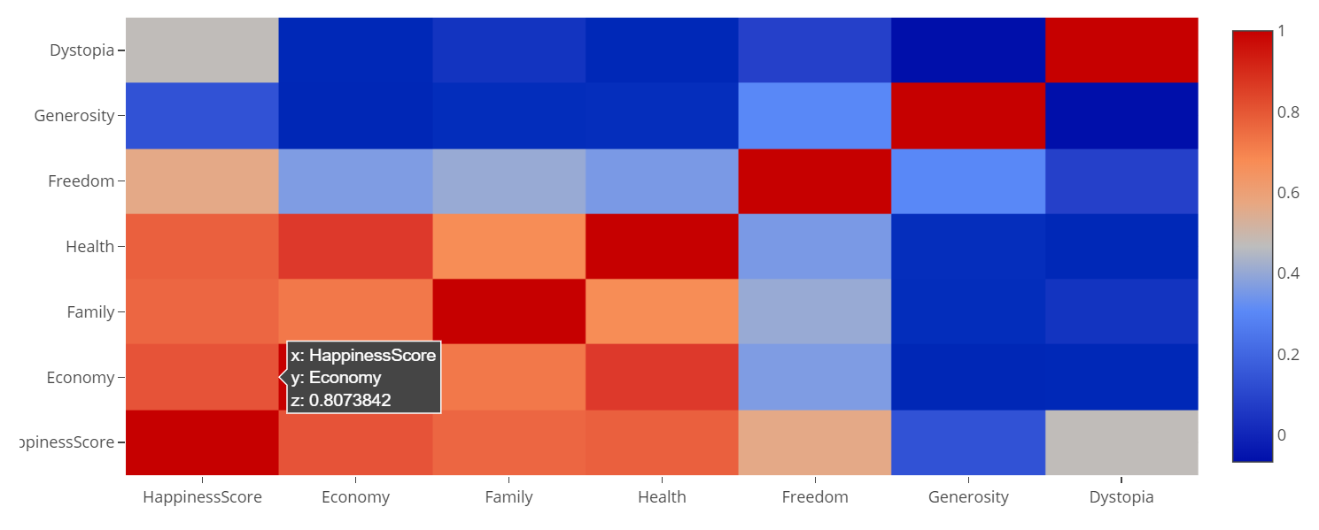
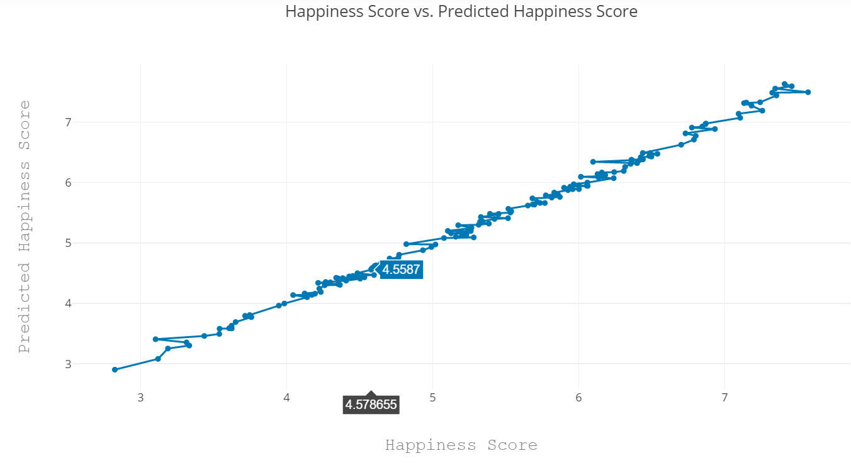
Linear Regression on Singaporean’s happiness

Slide 20
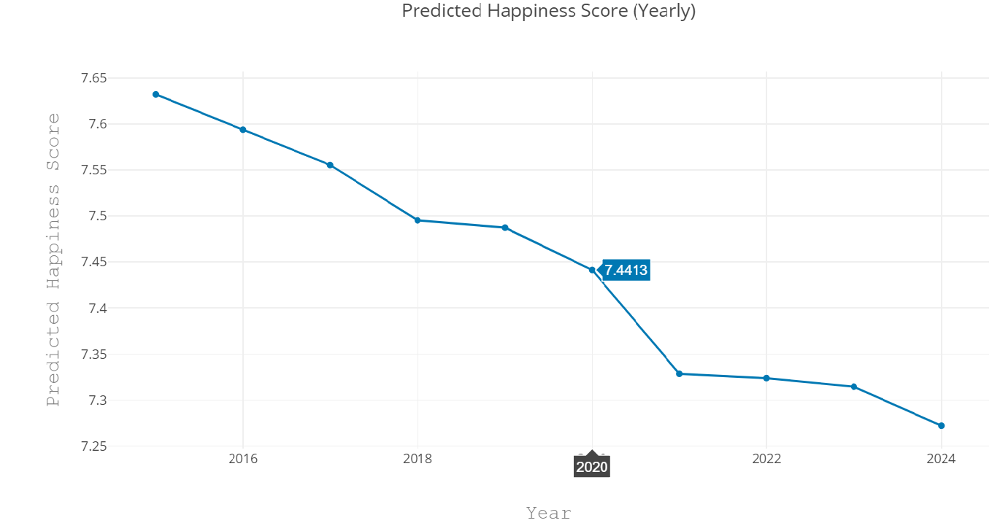
Singapore’s Predicted Happiness Score for the next 5 years
Approximated happiness score of ±0.8

Slide 21
How did everything tie together?
Singaporean’s happiness
Happiness Score vs supporting factors
Local vs foreign born happiness
We have been using Supporting Factors in both of the Linear regression
It is time to understand the factors itself

Slide 22
How is it going to reach our objective?
Anomaly Detection.
Bivariate anomaly detection on Happiness Score with:
GDP per capita
Social support
Freedom to make life choices
Generosity
Perceptions of corruption

Slide 23
Anomaly detection
Fraction of anomalies : 0.128 (Why?)
Number of neighbours : 20
Library used for anomaly detection :
> Import LocalOutlierFactor from sklearn.neighbors

Slide 24
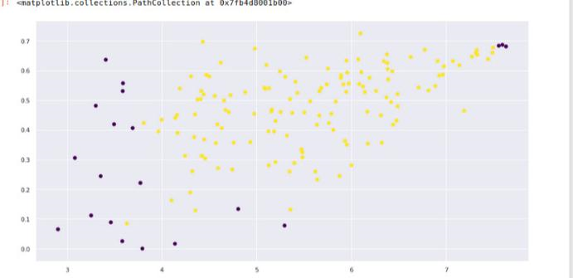
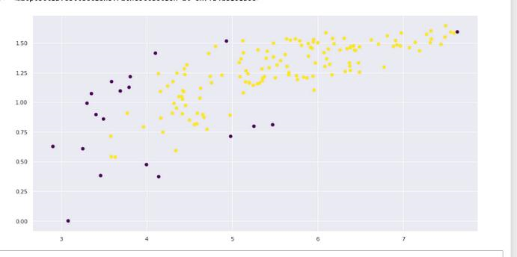
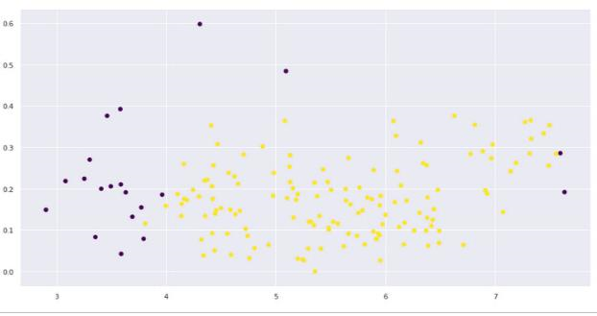
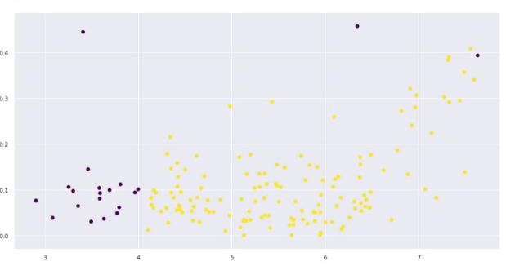
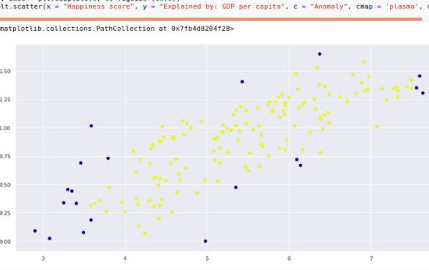
Anomaly detection (Happiness Score vs Supporting Factors )
Generosity
Freedom to make life choices
Social support
Perceptions of corruption
GDP per capita

Slide 25
How did we apply ML to reach the objective?
Anomaly Detection on Happiness Score vs supporting factors to give us an idea of how these variables act when country has high or extremely low happiness score
Check for other special cases or data which can be ignored.

Slide 26
How did we prepare the data?
Local vs Foreign
Finding the happiness difference for each individual country
Separate the countries with happier local born and the countries with happier foreign born
Inner join to get the supporting factors
Singapore
Filter out other countries data except for Singapore to focus specifically on it
Dropping any categorical variables for the prediction
Supporting factors
Replace the NaN values with the mean value so as to not affect the basic statistics.
Drop the GINI Index column due to large NaN values present.

Slide 27
What else did we learn/try?
Local vs Foreign
Plot.ly taught me that I can transform my data within each code (eg. group by, filter, aggregate)
While cleaning up the data I started to understand the different kind of joins (eg. outer join, inner join)
Singapore
Learnt more in depth on how to make use of linear regression for predictive modelling
Gained more knowledge on how to use Plotly graphic objects and their functions
Supporting factors
Learnt about interesting visualisations such as chloropleth.
Explored different ways of cleaning the dataset, and found the most suitable ones.

Slide 28
Countries happier foreign born and countries with happier local born
Singaporean happiness prediction
Understanding of supporting factors
Outcome of our project
Explore & use the supporting factors to understand the happiness of Foreign born & Local born

Slide 29
Our Roles
LiangJing
Casuarina
Arjun
Local vs Foreign
Linear Regression on countries with happier
Foreign born
Local born
Singapore
Linear Regression on predicted happiness score
Prediction of Singapore’s happiness score
Supporting Factors
Anomaly detection on happiness score vs supporting factors
Cleaning of data

Slide 30
THANK
YOU

Slide 31

Want big impact?
USE BIG IMAGE

Slide 32
89,526,124
Whoa! That’s a big number, aren’t you proud?

Slide 33
PRESENTATION DESIGN
This presentation uses the following typographies and colors:
Titles: Roboto Condensed
Body copy: Roboto Condensed
You can download the fonts on this page:
https://material.io/guidelines/resources/roboto-noto-fonts.html
Navy #3f5378 · Dark navy #263248 · Yellow #ff9800
You don’t need to keep this slide in your presentation. It’s only here to serve you as a design guide if you need to create new slides or download the fonts to edit the presentation in PowerPoint®

Slide 34
SlidesCarnival icons are editable shapes.
This means that you can:
Resize them without losing quality.
Change line color, width and style.
Isn’t that nice? :)
Examples:

Slide 35
😉
Now you can use any emoji as an icon!
And of course it resizes without losing quality and you can change the color.
How? Follow Google instructions https://twitter.com/googledocs/status/730087240156643328
✋👆👉👍👤👦👧👨👩👪💃🏃💑❤😂😉😋😒😭👶😸🐟🍒🍔💣📌📖🔨🎃🎈🎨🏈🏰🌏🔌🔑 and many more...

