Slide 1

quid pro quo educational analogies between superconducting circuit QED and quantum optics
by R-Lab Best Lab

Slide 2
Introducing the quid pro quo educational project
quid pro quo (latin) = something for something
We are taking something from the superconducting quantum hardware to educate about something from the quantum optics world in the project named
quantum information demos promoting quantum optics

Slide 3
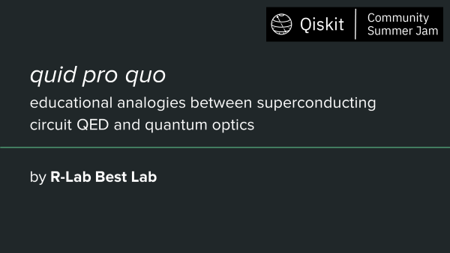
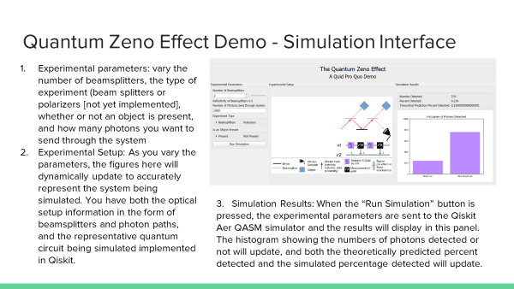

Slide 4
Motivation
Optical quantum information can benefit by using the more commonly understood quantum circuit notation to describe experiments. This notation provides a compact and accessible method of conveying information about microwave and optical pulse control¹
Qiskit already has robust quantum circuit building and simulation capabilities
The quantum optics community can make use of these pre-existing capabilities to further research in our field
The physics behind quantum technologies is often difficult to understand and often taught with a heavy focus on math rather than physical meaning
Using optical systems like color centers or beamsplitters and mirrors, we can provide examples of quantum optical systems, simulated in Qiskit, as open access materials to educators
Nguyen, C. T., et al. “An Integrated Nanophotonic Quantum Register Based on Silicon-Vacancy Spins in Diamond.” Physical Review B, vol. 100, no. 16, 2019

Slide 5
The Project
The Project has 2 main parts:
Proof of concept: Take an interesting quantum system, break it down into base parts, and rebuild it as an analogous Qiskit circuit
Test thoroughly to see if the circuit simulations hold up to mathematical predictions
User Interface: Take our new quantum analogs and build a user-friendly interface to run our simulations and provide explanations
We used PyQt5 to build desktop applications that will be able to run in the lab or the classroom to lower barriers to access
We decided to attempt to implement 3 systems
The Quantum Zeno Effect, first described in 1977 by Misra and Sudarshan²; this phenomenon demonstrates how quantum systems evolve differently under measurement (interaction) and non-measurement (non-interaction) conditions
Spin-Photon Entanglement, describing a solid state spin-qubit entanglement with the time-bin photon emission, as seen in diamond NV center experiments³
Rabi and Ramsey oscillation experiments for various quantum emitters, as seen in diamond SiV center manipulations⁴
2. Misra, B., and E. C. G. Sudarshan. “The Zeno’s Paradox in Quantum Theory.” Journal of Mathematical Physics, vol. 18, no. 4, 1977, pp. 756–763. 3. Hensen, B. et al, "Loophole-free Bell inequality violation using electron spins separated by 1.3 kilometres." Nature 526, no. 7575 (2015): 682-686. 4. Zhang, JL, et al, "Complete coherent control of silicon vacancies in diamond nanopillars containing single defect centers." Optica 4, no. 11 (2017): 1317-1321.

Slide 6


Quantum Zeno Effect Demo - Analogy
The Quantum Zeno Effect Demo aims to show the importance of the observer in quantum physics.
We do this by providing two simulations, the first consists of several beamsplitters in series acting on a photon with no observer, except the one measurement by a detector at the end; the second with multiple observations after each beamsplitter in the form of an object interacting with the system.
In the first case, the photon almost always ‘leaks’ into the ‘dark’ state where it will not be seen by our detector.
In the second case, the photon will more often than not remain in the ‘bright’ state where it will be seen by the detector.
Increasing the number of beamsplitters in the system makes the difference in final measurements even more pronounced. This can be explained by using Malus’s Law for N elements, I ⍺ (cos²Θ)^{N}, as N goes to infinity, I goes to one.
We implemented these two scenarios in Qiskit to enable quantum simulations
Beamsplitters can be described by the unitary operator:
Ry rotation gates can be described by the unitary operator
Setting phase shift ϕ = 0, we have an equivalency between Beamsplitters and Ry Gates
To mimic the act of the object collapsing the wavefunction after every beamsplitter, we instead take a measurement of the system, which collapses the wavefunction of the qubit.

Slide 7
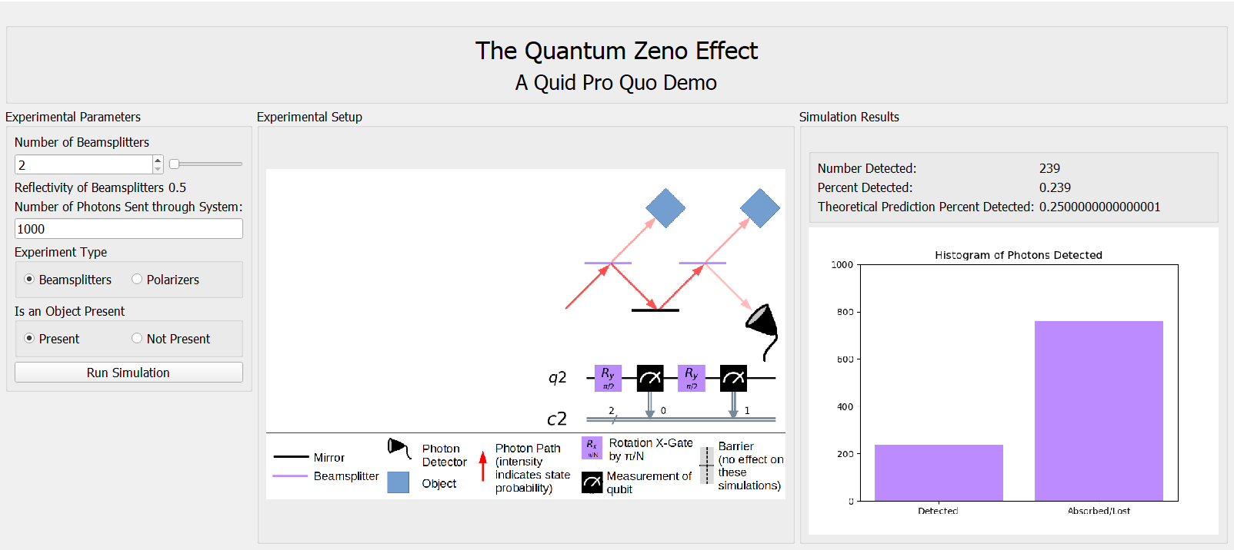
Quantum Zeno Effect Demo - Simulation Interface
Experimental parameters: vary the number of beamsplitters, the type of experiment (beam splitters or polarizers [not yet implemented], whether or not an object is present, and how many photons you want to send through the system
Experimental Setup: As you vary the parameters, the figures here will dynamically update to accurately represent the system being simulated. You have both the optical setup information in the form of beamsplitters and photon paths, and the representative quantum circuit being simulated implemented in Qiskit.
3. Simulation Results: When the “Run Simulation” button is pressed, the experimental parameters are sent to the Qiskit Aer QASM simulator and the results will display in this panel. The histogram showing the numbers of photons detected or not will update, and both the theoretically predicted percent detected and the simulated percentage detected will update.

Slide 8
Spin-photon entanglement demo
The demo aims at explaining the protocol used to entangle the time bin of photon emission and the electronic spin of a nitrogen vacancy in diamond.
Three qubits are used in the demo. Qubits 0, 1, 2 correspond to electronic spin, ‘Early’ photon and ‘Late’ photon respectively.
Different steps in the protocol has an equivalence to gate in the quantum circuit:
Microwave pulse for π/2 rotation - π/2 rotation gate about y-axis
Laser pulse - CX gate between Qubit 0 and the Qubit 1 or 2 depending on the first or second excitation laser pulse.
Microwave pulse for π rotation - π rotation gate about y-axis

Slide 9
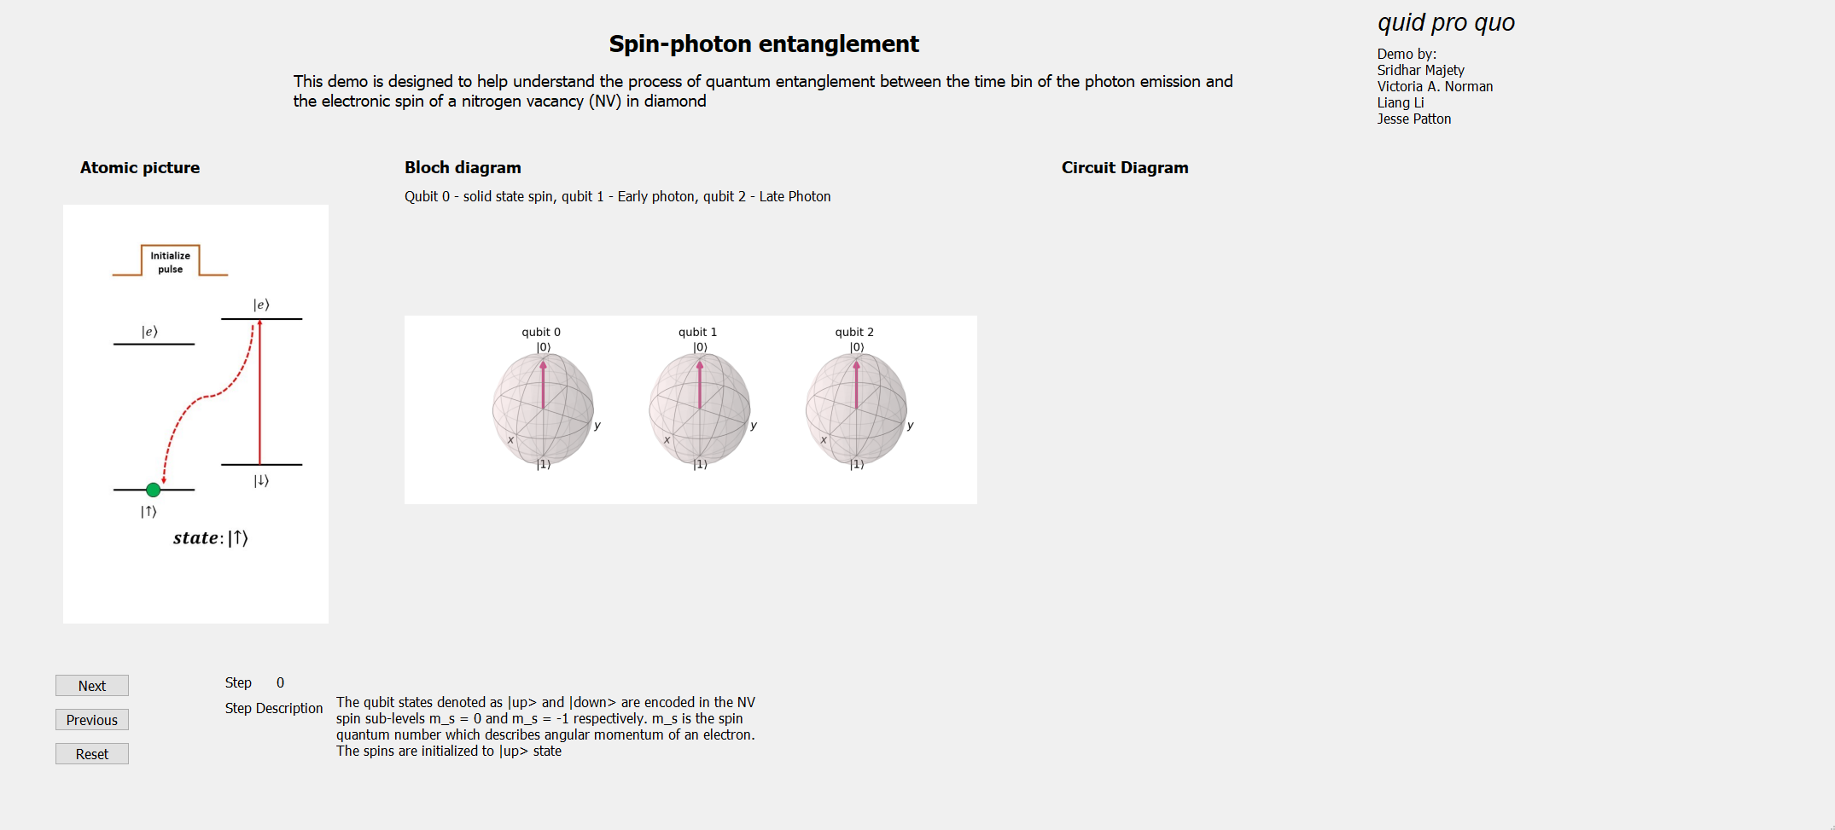
Spin-photon entanglement - Interface

Slide 10
Spin-photon entanglement - Interface
The interface has three boxes showing the atomic picture, Bloch diagram of each qubit, circuit implementation of the protocol.
Qiskit.tools.visualization is used to generate the Bloch sphere and matplotlib is used to generate the circuit diagrams.
The protocol has Step 0-4 and the user can go back and forth between the steps using the ‘Next’ and ‘Previous’ buttons and a ‘Reset’ button to reset the demo.
Labels are provided to denote the step number of the protocol and a description of each step is included.
Upon complete implementation of the protocol (Step 4), the user can measure the statistics by choosing from ‘Number of Trials’ and clicking ‘Click here for Histogram’ to display a histogram which is generated using the qasm simulator and the choice from ‘Number of Trials’ is the input for ‘number of shots’ for qasm.

Slide 11
Rabi and Ramsey oscillation experiments simulator
The simulator is based on Qiskit OpenPulse^{5, 6}, and it allows one to see how a laser pulse drives the qubit to change its state for different photon emitters.
The user can adjust the pulse length, amplitude, and the time delay (for Ramsey oscillation) to see how those parameters affect the frequency and likelihood of the qubit oscillates between |0> and |1> states.
For Rabi oscillation, the plot shows the relationship between the qubit state and the square root of the laser power. For Ramsey oscillation, the plot shows the relationship between the qubit state and the time delay between two x90 pulses.
5. H. Abraham, I. Y. Akhalwaya, et al. “Qiskit: An open-source framework for quantum computing,” 2019.
6. D. C. McKay, T. Alexander, et al. “Qiskit backend specifications for OpenQASM and OpenPulse experiments,” 2018.

Slide 12
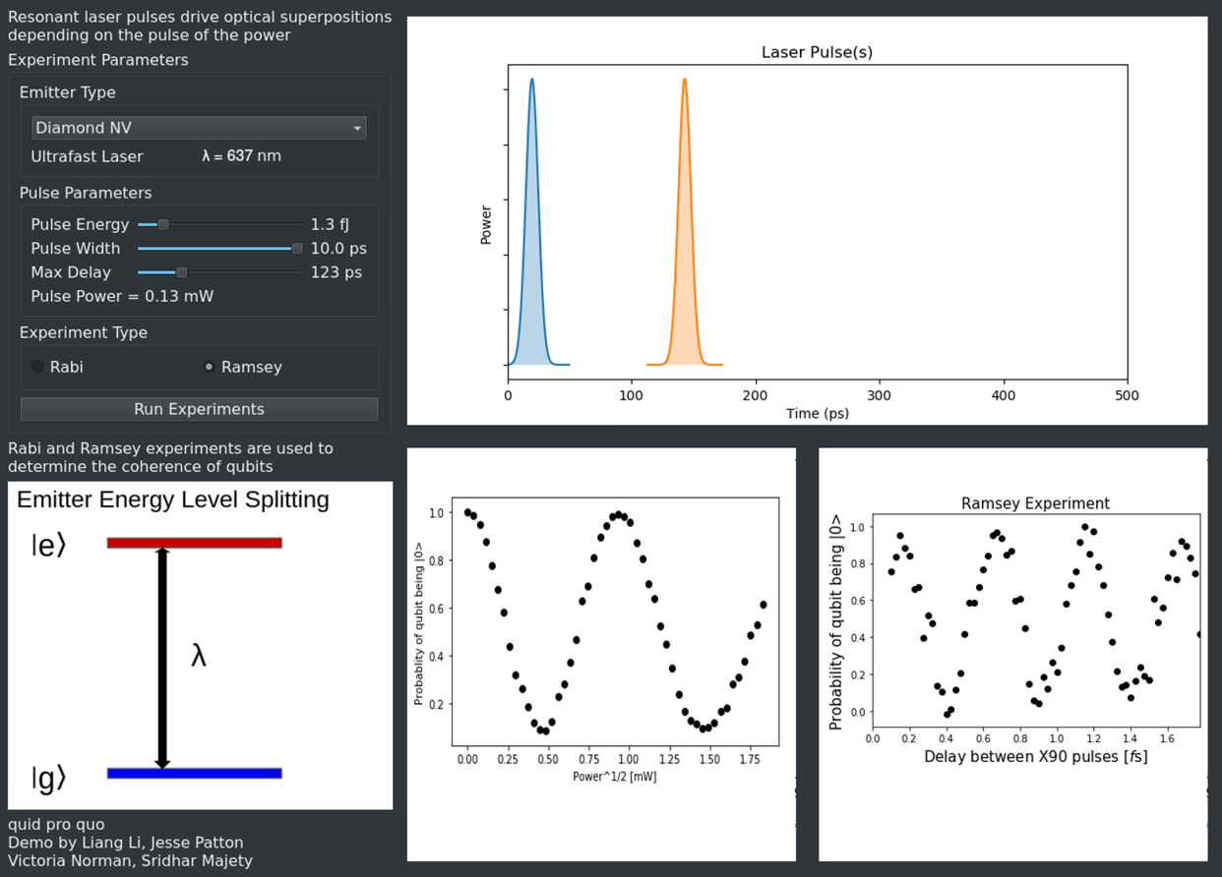
Rabi and Ramsey oscillation simulator - Interface

Slide 13
Future Work
Bundle the three demos together as a single program for ease of use
Would require threading the simulations to avoid improve app responsiveness
Expand the demo library of the quantum optics phenomena
Linear quantum optics, boson sampling, etc.
Click and drag quantum optical circuit builder
A longer-term goal, this will be difficult to implement compactly
Introduce simulations on real quantum computers to app
Need to work out how IBM Q permissions would be handled

Slide 14
quid pro quo - try it out!
Suitable for quantum coursework, K-12 outreach, lab experiment visualization, and more

Slide 15
References
Nguyen, C. T., et al. “An Integrated Nanophotonic Quantum Register Based on Silicon-Vacancy Spins in Diamond.” Physical Review B, vol. 100, no. 16, 2019, doi:10.1103/physrevb.100.165428.
Misra, B., and E. C. G. Sudarshan. “The Zeno’s Paradox in Quantum Theory.” Journal of Mathematical Physics, vol. 18, no. 4, 1977, pp. 756–763., doi:10.1063/1.523304.
Biagioni, P., et al. “Experimental Demonstration of the Optical Zeno Effect by Scanning Tunneling Optical Microscopy.” Optics Express, vol. 16, no. 6, 2008, p. 3762., doi:10.1364/oe.16.003762.
Chao, Liu, et al. “High-Efficiency Interaction-Free Measurement with an Unbalanced Mach–Zehnder Interferometer.” Laser Physics Letters, vol. 15, no. 6, 2018, p. 065211., doi:10.1088/1612-202x/aab2b2.
H. Abraham, I. Y. Akhalwaya, et al. “Qiskit: An open-source framework for quantum computing,” 2019.
D. C. McKay, T. Alexander, et al. “Qiskit backend specifications for OpenQASM and OpenPulse experiments,” 2018.

