Slide 1
ACPD – CA Search Function, Local Autofocus Throughput Improvement

Slide 2
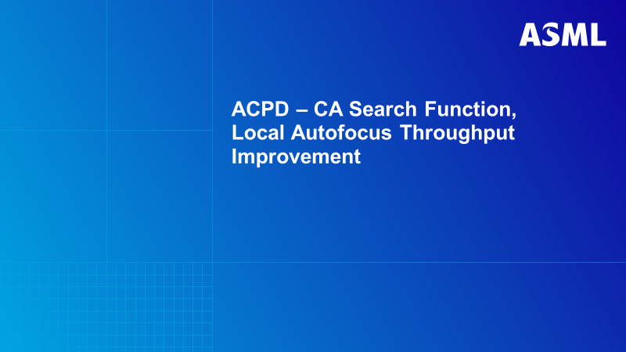
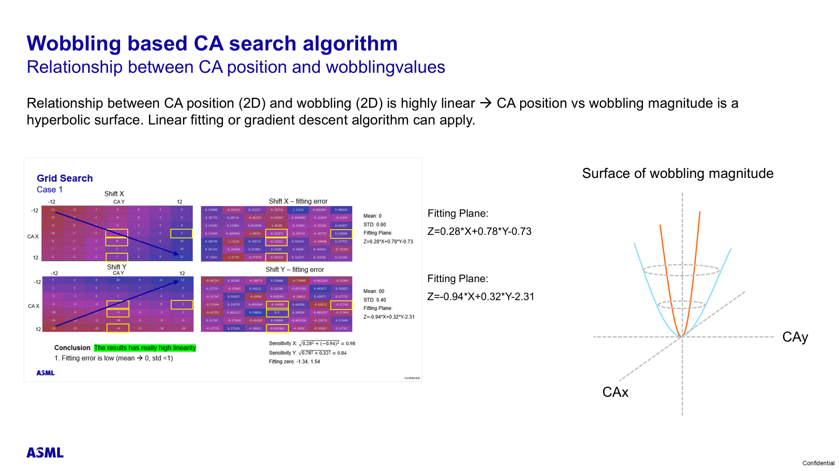

Slide 3
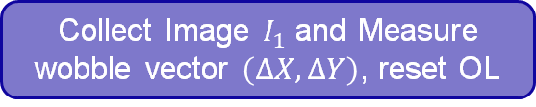


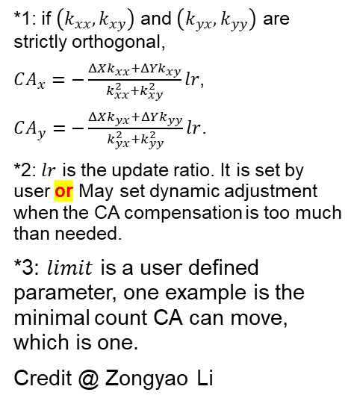
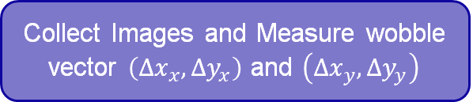


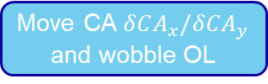
Collect Image $I_{0}$
Collect Images and Measure wobble vector $\left(Δx_{x}, Δy_{x}\right)$ and $\left(Δx_{y}, Δy_{y}\right)$
*1: if $\left(k_{xx},k_{xy}\right)$ and $\left(k_{yx}, k_{yy}\right)$ are strictly orthogonal,
$CA_{x}=−\frac{ΔXk_{xx}+ΔYk_{xy}}{k_{xx}^{2}+k_{xy}^{2}}lr$,
$CA_{y}=−\frac{ΔXk_{yx}+ΔYk_{yy}}{k_{yx}^{2}+k_{yy}^{2}}lr$.
*2: $lr$ is the update ratio. It is set by user or May set dynamic adjustment when the CA compensation is too much than needed.
*3: $limit$ is a user defined parameter, one example is the minimal count CA can move, which is one.
Credit @ Zongyao Li
Wobble OL
Calculate the effect of CA move on OL wobble vector as^{*1}:
$\left(k_{xx},k_{xy}\right)=\left(\frac{Δx_{x}−ΔX}{δCA_{x}},\frac{Δy_{x}−ΔY}{δCA_{x}}\right)$ ,
$\left(k_{yx},k_{yy}\right)=\left(\frac{Δx_{y}−ΔX}{δCA_{y}},\frac{Δy_{y}−ΔY}{δCA_{y}}\right)$.
Collect Image $I_{1}$ and Measure wobble vector $\left(ΔX, ΔY\right)$, reset OL
? Wobble vector large enough
False
Calculate CA compensation as^{*2}:
$Update_CA_{x}=−\frac{ΔXk_{yy}−ΔYk_{yx}}{k_{xx}k_{yy}−k_{xy}k_{yx}} lr$,
$Update_CA_{y}=−\frac{ΔXk_{xy}−ΔYk_{xx}}{k_{yx}k_{xy}−k_{yy}k_{xx}} lr$.
True
? Wobble vector direction changed
False
? $Update_CA_{x}<limit \& Update_CA_{y}<limit$ ^{*3}
Move CAy
True
END
New wobbleshift
True
Move CAx
Move CA $δCA_{x}/δCA_{y}$ and wobble OL
Original wobble shift
False
Reset OL and move CA accordingly
Notes:
Change count to actual distance.
The terminating distance may need to be tested.
Change forward flow to True.

