Slide 1
Win10 install combinato
Mingli Liang
Brett Gu
Aug 25 2022

Slide 2
https://github.com/jniediek/combinato/wiki/Installation-on-Windows

Slide 3
1 Installing Python
Any distribution of Python3 should work. We use Combinato with Anaconda for Windows. You can download Anaconda from https://www.anaconda.com/products/individual.
I installed with this version
2021.11 anaconda
https://repo.anaconda.com/archive/Anaconda3-2021.11-Windows-x86_64.exe

Slide 4
2 Getting the Combinato code
If you use git, clone the repository:
git clone https://github.com/jniediek/combinato.git
If you do not use git, download Combinato from https://github.com/jniediek/combinato/archive/refs/heads/main.zip
Save the repository to a convenient place, for example C:\Users\YourUsername\combinato.

Slide 5
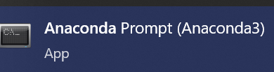
3 Setting Paths
To automatically select the correct file for your operating system,
Open Anaconda Prompt
navigate your shell to the Combinato repository by typing
cd C:\Users\YourUsername\combinato
and run “python setup_options.py”

Slide 6
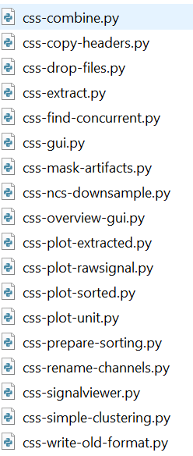
4. Change filenames
Go to C:\Users\YourUsername\combinato
Add suffix “.py” to all the css files,
so that they look like this

Slide 7

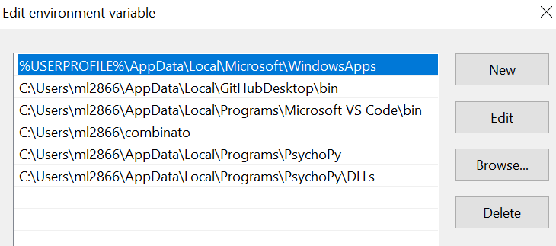
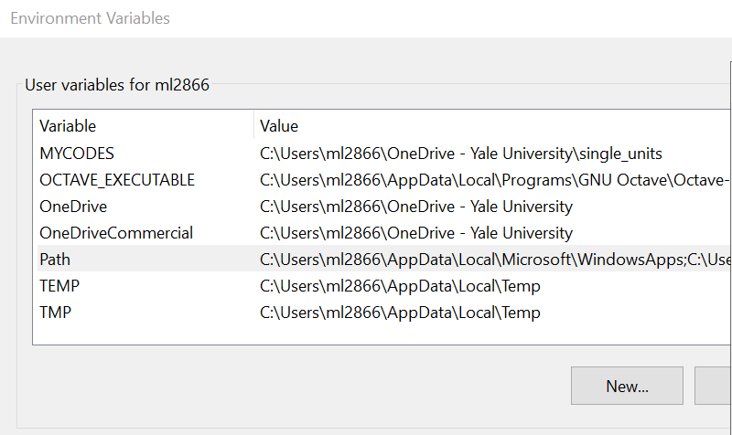
Add combinato to Python search path
Open Advanced Settings
Click the Environment Variables down right
Double click Path and PYTHONPATH
Add the following path, hit OK
C:\Users\YourUsername\combinato

Slide 8
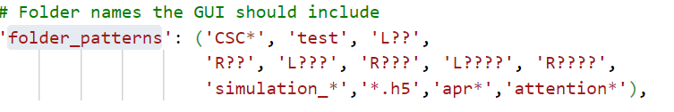
5 edit options.py
Go to C:\Users\YourUsername\combinato\combinato
Edit Options.py
edit CLUS_BINARY and replace all the backward slashes to forward slashes.
Edit folder_patterns , so it includes your data name patterns
This is mine
If you want raster, set RunGuiWithRaster to be TRUE to enable

Slide 9
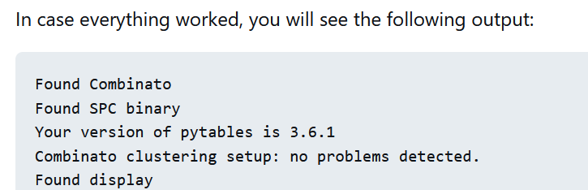
6 Testing the Installation
Open Anaconda Prompt
navigate your shell to the Combinato repository by typing
cd C:\Users\YourUsername\combinato
and run “python tools/test_installation.py ”

Slide 10
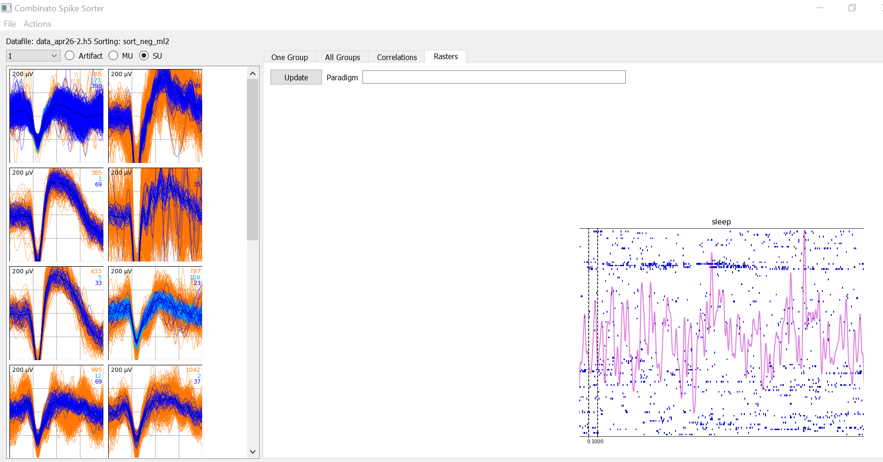
Raster plots

Slide 11
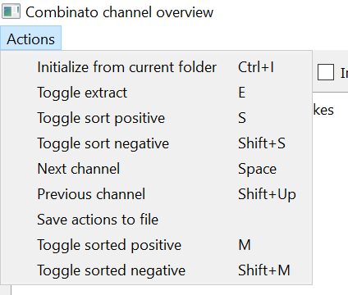
How to use combinato with H5 files
In anaconda, navigate to the data folder containing NS5 files or converted H5 files
cd D:\h5data
get list of H5 files
dir *.h5 /b > do_extract.txt
spike detection
python C:\Users\ml2866\combinato\css-extract.py --h5 --h5alignstart --matfile-scale-factor 0.25 --h5sr 30000 --start 111668460 --stop 651668460 --jobs do_extract.txt
artifact rejection prior to sorting
python C:\Users\ml2866\combinato\css-find-concurrent.py
python C:\Users\ml2866\combinato\css-mask-artifacts.py
Generate txt file for next step
python C:\Users\ml2866\combinato\css-overview-gui.py
save action to files, generate do_sort_neg.txt
Start sorting
python C:\Users\ml2866\combinato\css-prepare-sorting.py --neg --jobs do_sort_neg.txt
python C:\Users\ml2866\combinato\css-cluster.py --jobs sort_neg_ml2.txt
Python C:\Users\ml2866\combinato\css-combine.py --jobs sort_neg_ml2.txt
Plot overview spikes
Python C:\Users\ml2866\combinato\css-plot-extracted.py
python C:\Users\ml2866\combinato\css-overview-gui.py
Inspect results
copy do_sort_neg.txt do_manual_neg.txt
python C:\Users\ml2866\combinato\css-gui.py

Slide 12
How to use combinato with blackrock NSx files
In anaconda, navigate to the data folder containing NS5 files
cd D:\h5data
get list of H5 files
dir *.h5 /b > do_extract.txt
spike detection
python C:\Users\ml2866\combinato\css-extract.py --ns5 --ns5_elec_start 193 --ns5_elec_end 200 --jobs test_ns5.txt --ns5jname attention
Generate txt file for next step
python C:\Users\ml2866\combinato\css-overview-gui.py
save action to files, generate do_sort_neg.txt
Start sorting
python C:\Users\ml2866\combinato\css-prepare-sorting.py --neg --jobs do_sort_neg.txt
python C:\Users\ml2866\combinato\css-cluster.py --jobs sort_neg_ml2.txt
Python C:\Users\ml2866\combinato\css-combine.py --jobs sort_neg_ml2.txt
Inspect results
copy do_sort_neg.txt do_manual_neg.txt
python C:\Users\ml2866\combinato\css-gui.py

