Slide 1
PaxoSim
Yuetao Xu
Liang Liang

Slide 2
Introduction
PaxoSim == Paxos Simulator
A JavaScript Framework to simulate failures on
Nodes
Connections
Our Paxos is implemented on the framework

Slide 3
Paxos
Based on Lamport’s paper
Generating N (assume 100 nodes)
Paxos-0: 0, 100, 200, 300, …
Paxos-1: 1, 101, 201, 301, …
Paxos-99: 99, 199, 299, 399
Timeout
Resend prepare message
Crash Recovery
Record state on node storage before sending any messages

Slide 4
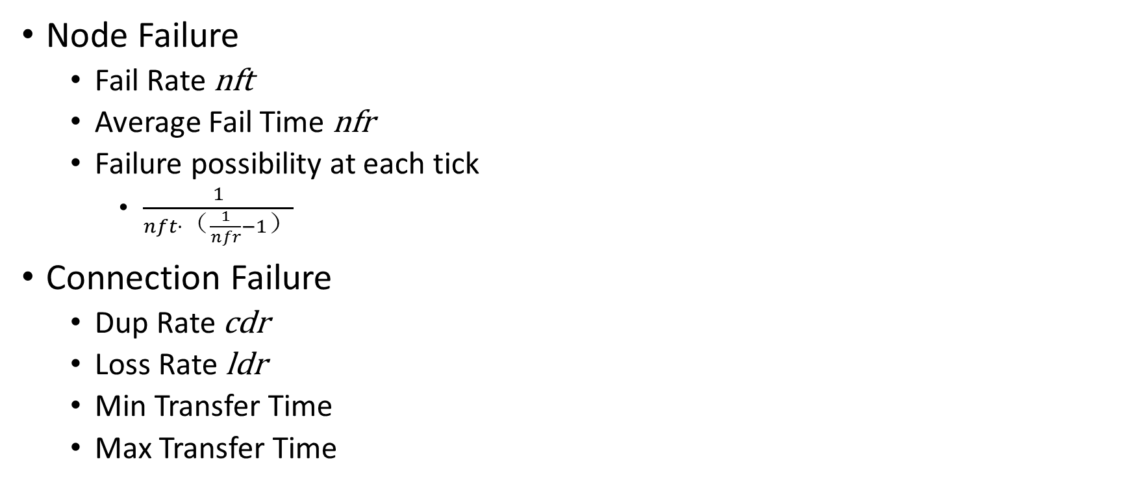
Definition of Failures
Node Failure
Fail Rate nft
Average Fail Time nfr
Failure possibility at each tick
$\frac{1}{nft·（\frac{1}{nfr}−1）}$
Connection Failure
Dup Rate cdr
Loss Rate ldr
Min Transfer Time
Max Transfer Time
Function SendWithFailure(clr, cdr) If rand() < cdr: SendWithFailure(clr, cdr) If rand() < clr Return SendMessage()

Slide 5
Experiment 1: Node Failure Only
Average Consensus Rounds | P = 3 | 10 | 30 | 100
X = 0 | 1.00 | 1.00 | 1.00 | 1.00
0.1 | 1.09 | 1.01 | 1.06 | 1.06
0.2 | 1.33 | 1.21 | 1.09 | 1.18
0.3 | 1.87 | 1.47 | 1.24 | 1.31
0.4 | 2.9 | 2.13 | 1.48 | 1.42
0.5 | 5.01 | 4.08 | 3.21 | 3.65
Timeout: 100 ms Message deliver time: 5 – 20 ms Node fail time: 0 – 100 ms Message loss rate: 0 Message duplicate rate: 0 Proposer number: 1 Node fail rate: X

Slide 6
Experiment 2: Connection Failure Only
Average Consensus Rounds | N = 3 | 10 | 30 | 100
X = 0 | 1.00 | 1.00 | 1.00 | 1.00
0.1 | 1.44 | 1.06 | 1.00 | 1.00
0.2 | 2.03 | 1.28 | 1.01 | 1.00
0.3 | 2.36 | 2.16 | 1.16 | 1.01
0.4 | 3.11 | 2.52 | 1.82 | 1.17
0.5 | 3.62 | 3.70 | 2.96 | 2.35
Message deliver time: 5 – 20 ms Node failure rate: 0 Message loss rate: X Message duplicate rate: X Proposer number: 1

Slide 7
Experiment 3: Node and Connection Failure
Average Consensus Rounds | N = 3 | 10 | 30 | 100
X = 0 | 1.00 | 1.00 | 1.00 | 1.00
0.1 | 1.63 | 1.16 | 1.06 | 1.07
0.2 | 3.17 | 2.43 | 1.23 | 1.16
0.3 | 4.74 | 7.18 | 6.34 | 6.69
0.4 | 12.42 | 25.96 | 87.05 | TLE
0.5 | 27.83 | 171.82 | TLE | TLE
Message deliver time: 5 – 20 ms Node fail time: 0 – 100 ms Node failure rate: X Message loss rate: X Message duplicate rate: X Proposer number: 1

Slide 8
Experiment 4: Multiple Proposers
Average Consensus Rounds | N = 3 | 10 | 30 | 100
X = 1 | 5.08 | 6.18 | 5.06 | 5.02
2 | 5.91 | 6.72 | 5.94 | 7.34
3 | 6.38 | 6.53 | 5.6 | 6.53
10 | N/A | 8.39 | 6.3 | 5.88
30 | N/A | N/A | 5.33 | 6.47
100 | N/A | N/A | N/A | 4.30
Message deliver time: 5 – 20 ms Node fail time: 0 – 100 ms Node failure rate: 0.3 Message loss rate: 0.3 Message duplicate rate: 0.3 Proposer number: X

Slide 9
Thank You

