Slide 1
BC1 Patch-Budget Experiment
How many context patches are needed—and which selection strategy works best?
5 metrics
4 budgets
4 strategies
CCC · PCC(M) · PCC(H)
MSE · MAE
K = 5 · 10 · 15 · 20
Baseline = 25
Random · Similarity
Diversity · ST Hard
BC1 · 8-fold patient-level cross-validation · K includes the target patch

Slide 2
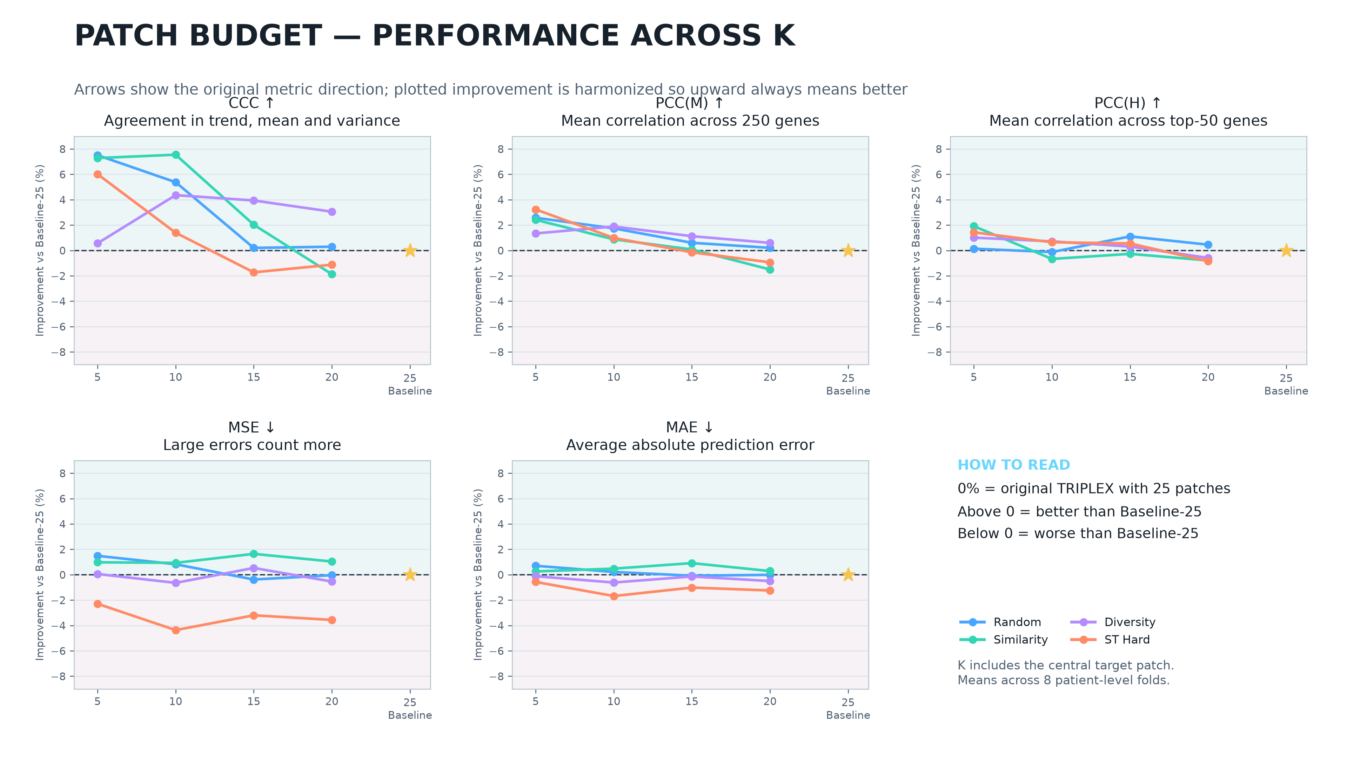

Slide 3
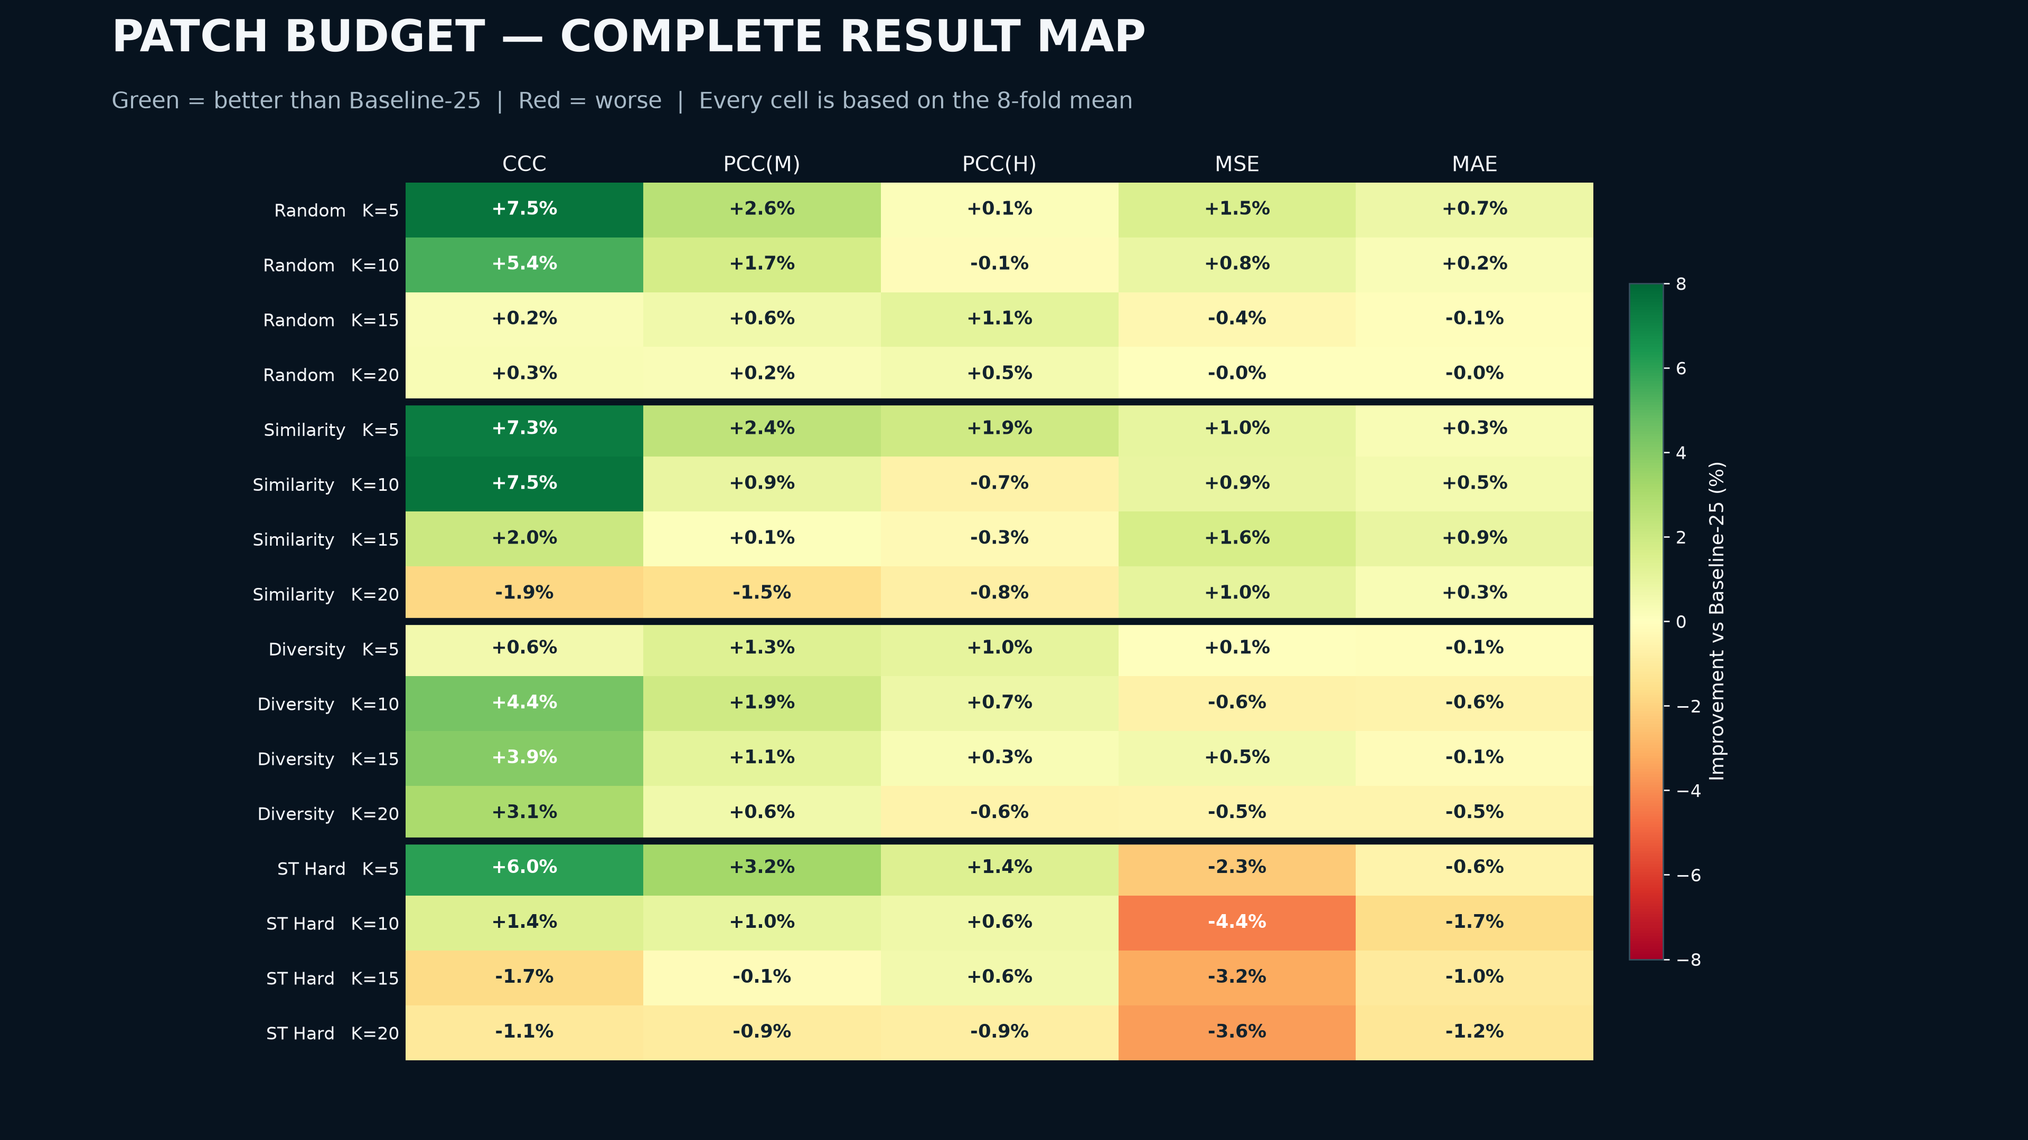

Slide 4
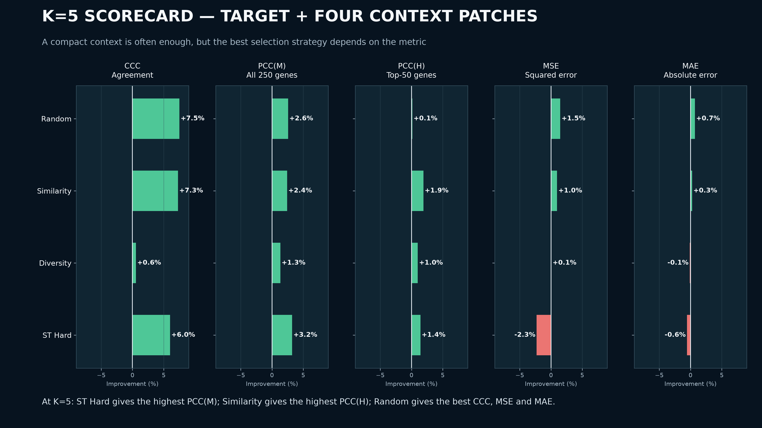

Slide 5
