Slide 1
CHAP 2 Nonlinear Finite Element Analysis Procedures
Nam-Ho Kim

Slide 2
Goals
What is a nonlinear problem?
How is a nonlinear problem different from a linear one?
What types of nonlinearity exist?
How to understand stresses and strains
How to formulate nonlinear problems
How to solve nonlinear problems
When does nonlinear analysis experience difficulty?

Slide 3
Nonlinear Structural Problems
What is a nonlinear structural problem?
Everything except for linear structural problems
Need to understand linear problems first
What is linearity?
Example: fatigue analysis
Input x
(load, heat)
Output y
(displ, temp)
x₁
y₁
x₁
x₂
x₂
y₂
2x₁
2y₁
Y
2x₁ +3x₂
2y₁+3y₂

Slide 4
What is a linear structural problem?
Global
Local
Local
Global
Force
Linear
Stress
Linear
Strain
Linear
Displacement
A₀
A
σ
σ = Eε
F/2
L₀
δL
F/2
L
E
ε
Linearity is an approximation
Assumptions:
Infinitesimal strain (<0.2%)
Infinitesimal displacement
Small rotation
Linear stress-strain relation

Slide 5
Observations in linear problems
Which one will happen?
Will this happen?
M
M
Truss
Truss
F

Slide 6
What types of nonlinearity exist?
It is at every stage of analysis

Slide 7
Linear vs. Nonlinear Problems
Linear Problem:
Infinitesimal deformation:
Linear stress-strain relation:
Constant displacement BCs
Constant applied forces
Nonlinear Problem:
Everything except for linear problems!
Geometric nonlinearity: nonlinear strain-displacement relation
Material nonlinearity: nonlinear constitutive relation
Kinematic nonlinearity: Non-constant displacement BCs, contact
Force nonlinearity: follow-up loads
Undeformed coord.
Constant

Slide 8
Nonlinearities in Structural Problems
Displacement
Strain
Stress
Nonlinear displacement-strain
Nonlinear stress-strain
Nonlinear displ. BC
Nonlinear force BC
Prescribed displacement
Applied force
More than one nonlinearity can exist at the same time

Slide 9
Geometric Nonlinearity
Relations among kinematic quantities (i.e., displacement, rotation and strains) are nonlinear
Displacement-strain relation
Linear:
Nonlinear:
Tip displacement
8.
6.
4.
2.
0.
C₁
C₂
C₀
C₃
0.0 0.2 0.4 0.6 0.8 1.0
Normalized couple
When du/dx is small
H.O.T. can be ignored

Slide 10
Geometric Nonlinearity cont.
Displacement-strain relation
E has a higher-order term
(du/dx) << 1 → ε(x) ~ E(x).
Domain of integration
Undeformed domain Ω₀
Deformed domain Ω_{x}
0.35
0.30
0.25
0.20
0.15
0.10
0.05
0
E
Strain
e
0 0.05 0.10 0.15 0.20 0.25 0.30
du/dx
Deformed domain is unknown

Slide 11
Material Nonlinearity
Linear (elastic) material
Only for infinitesimal deformation
Nonlinear (elastic) material
[D] is not a constant but depends on deformation
Stress by differentiating strain energy density U
Linear material:
Stress is a function of strain (deformation): potential, path independent
More generally, {σ} = {f(ε)}
σ
Nonlinear spring
E
σ
1
ε
E
Linear spring
ε
Linear and nonlinear elastic spring models

Slide 12
Material Nonlinearity cont.
Elasto-plastic material (energy dissipation occurs)
Friction plate only support stress up to σ_{y}
Stress cannot be determined from stress alone
History of loading path is required: path-dependent
Visco-elastic material
Time-dependent behavior
Creep, relaxation
σ
E
σ_{Y}
s_{Y}
σ
E
ε
Elasto-plastic spring model
η
σ
E
Eε
σ
time
Visco-elastic spring model

Slide 13
Boundary and Force Nonlinearities
Nonlinear displacement BC (kinematic nonlinearity)
Contact problems, displacement dependent conditions
Nonlinear force BC (Kinetic nonlinearity)
d_{max}
Force
Contact boundary
Displacement

Slide 14
Mild vs. Rough Nonlinearity
Mild Nonlinear Problems
Continuous, history-independent nonlinear relations between stress and strain
Nonlinear elasticity, Geometric nonlinearity, and deformation-dependent loads
Rough Nonlinear Problems
Equality and/or inequality constraints in constitutive relations
History-dependent nonlinear relations between stress and strain
Elastoplasticity and contact problems

Slide 15
Nonlinear Finite Element Equations
Equilibrium between internal and external forces
Kinetic and kinematic nonlinearities
Appears on the boundary
Handled by displacements and forces (global, explicit)
Relatively easy to understand (Not easy to implement though)
Material & geometric nonlinearities
Appears in the domain
Depends on stresses and strains (local, implicit)
Linear problems
Stress Strain
Loads

Slide 16
Solution Procedure
We can only solve for linear problems …

Slide 17
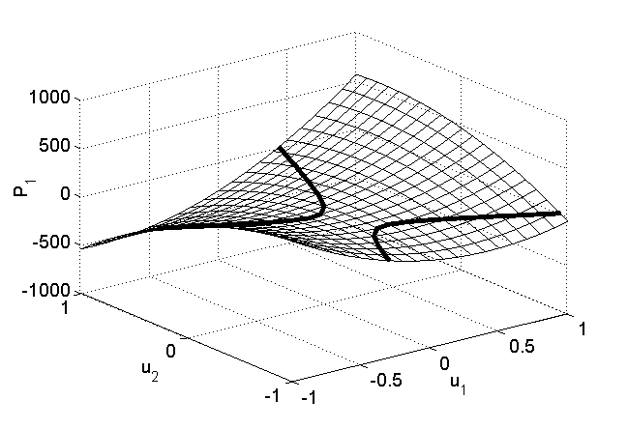
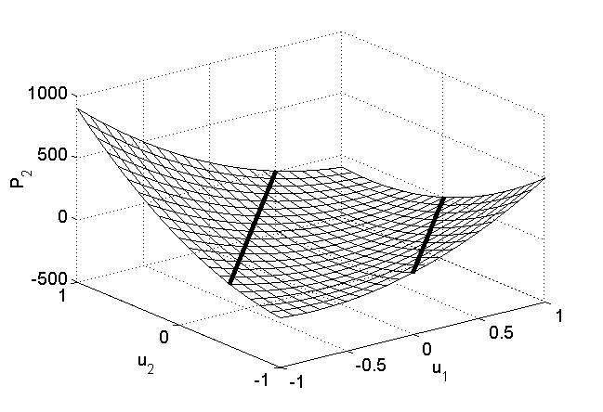
Example – Nonlinear Springs
k₁
k₂
Spring constants
k₁ = 50 + 500u k₂ = 100 + 200u
Governing equation
Solution is in the intersection between two zero contours
Multiple solutions may exist
No solution exists in a certain situation
F
u₁
u₂
P₁
P₂

Slide 18
Solution Procedure
Linear Problems
Stiffness matrix K is constant
If the load is doubled, displacement is doubled, too
Superposition is possible
Nonlinear Problems
How to find d for a given F?
2F
K
F
d
2d
F
K_{T}
Incremental Solution Procedure
d^{i}
d

Slide 19
Newton-Raphson Method
Most popular method
Assume d^{i} at i-th iteration is known
Looking for d^{i+1} from first-order Taylor series expansion
: Jacobian matrix or Tangent stiffness matrix
Solve for incremental solution
Update solution
F
P(d)
Solution
P(d^{i+1})
P(d^{i})
Δd^{i+1}
d^{i}
d^{i+1}
d^{i+2}
d^{n}
d

Slide 20
N-R Method cont.
Observations:
Second-order convergence near the solution (Fastest method!)
Tangent stiffness is not constant
The matrix equation solves for incremental displacement
RHS is not a force but a residual force
Iteration stops when conv < tolerance
Or,

Slide 21
N-R Algorithm
Set tolerance = 0.001, k = 0, max_iter = 20, and initial estimate u = u₀
Calculate residual R = f – P(u)
Calculate conv. If conv < tolerance, stop
If k > max_iter, stop with error message
Calculate Jacobian matrix K_{T}
If the determinant of K_{T} is zero, stop with error message
Calculate solution increment Δu
Update solution by u = u + Δu
Set k = k + 1
Go to Step 2

Slide 22
Example – N-R Method
Iteration 1

Slide 23
Example – N-R Method cont.
Iteration 2
Iteration 3

Slide 24
Example – N-R Method cont.
Iteration 4
Residual
Iter | ||R||
0 | 17.263
1 | 4.531
2 | 0.016
3 | 0.0
Iteration
Quadratic convergence

Slide 25
When N-R Method Does Not Converge
Difficulties
Convergence is not always guaranteed
Automatic load step control and/or line search techniques are often used
Difficult/expensive to calculate
Solution
P(d)
F
d^{i+2}
d^{i}
d^{n}
d^{i+1}
d

Slide 26
When N-R Method Does Not Converge cont.
Convergence difficulty occurs when
Jacobian matrix is not positive-definite
Bifurcation & snap-through require a special algorithm
P.D. Jacobian: in order to increase displ., force must be increased
F
F_{C}
C
B
A
F_{B}
B
D
Force
C
D
E
A
E
Displacement

Slide 27
Modified N-R Method
Constructing and solving is expensive
Computational Costs (Let the matrix size be N x N)
L-U factorization ~ N³
Forward/backward substitution ~ N
Use L-U factorized repeatedly
More iteration is required, but each iteration is fast
More stable than N-R method
Hybrid N-R method
F
P(d)
Solution
d^{i}
d^{i+1}
d^{n}
d

Slide 28
Example – Modified N-R Method
Solve the same problem using modified N-R method
Iteration 1

Slide 29
Example – Modified N-R Method cont.
Iteration 2
Residual
Iter | ||R||
0 | 17.263
1 | 4.5310
2 | 0.3584
3 | 0.0831
4 | 0.0204
5 | 0.0051
6 | 0.0013
7 | 0.0003
Iteration

Slide 30
Incremental Secant Method
Secant matrix
Instead of using tangent stiffness, approximate it using the solution from the previous iteration
At i-th iteration
The secant matrix satisfies
Not a unique process in high dimension
Start from initial K_{T} matrix, iteratively update it
Rank-1 or rank-2 update
The textbook has Broyden’s algorithm (Rank-1 update)
Here we will discuss BFGS method (Rank-2 update)
F
P(d)
Solution
Secant stiffness
d⁰
d¹
d²
d³
d^{n}
d

Slide 31
Incremental Secant Method cont.
BFGS (Broyden, Fletcher, Goldfarb and Shanno) method
Stiffness matrix must be symmetric and positive-definite
Instead of updating K, update H (saving computational time)
Become unstable when the No. of iterations is increased

Slide 32
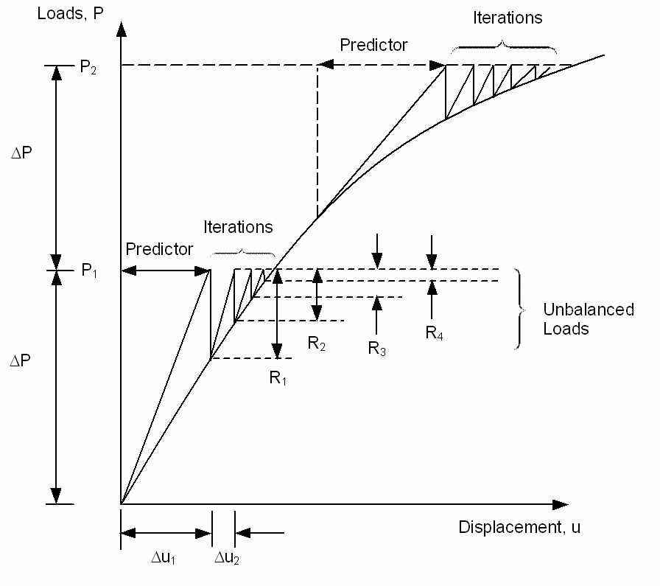
Incremental Force Method
N-R method converges fast if the initial estimate is close to the solution
Solid mechanics: initial estimate = undeformed shape
Convergence difficulty occurs when the applied load is large (deformation is large)
IFM: apply loads in increments. Use the solution from the previous increment as an initial estimate
Commercial programs call it “Load Increment” or “Time Increment”

Slide 33
Incremental Force Method cont.
Load increment does not have to be uniform
Critical part has smaller increment size
Solutions in the intermediate load increments
History of the response can provide insight into the problem
Estimating the bifurcation point or the critical load
Load increments greatly affect the accuracy in path-dependent problems

Slide 34
Load Increment in Commercial Software
Use “Time” to represent load level
In a static problem, “Time” means a pseudo-time
Required Starting time, (T_{start}), Ending time (T_{end}) and increment
Load is gradually increased from zero at T_{start} and full load at T_{end}
Load magnitude at load increment T^{n}:
Automatic time stepping
Increase/decrease next load increment based on the number of convergence iteration at the current load
User provide initial load increment, minimum increment, and maximum increment
Bisection of load increment when not converged

Slide 35
Force Control vs. Displacement Control
Force control: gradually increase applied forces and find equilibrium configuration
Displ. control: gradually increase prescribed displacements
Applied load can be calculated as a reaction
More stable than force control.
Useful for softening, contact, snap-through, etc.
F
F
P(u)
F_{n}
F_{C}
P(u)
F₃
F_{B}
F₂
F₁
F_{A}
u
u
u₁
u₂
u₃
u_{n}
u_{A}
u_{B}
u_{C}
u_{D}

Slide 36
Nonlinear Solution Steps
Initialization:
Residual Calculation
Convergence Check (If converged, stop)
Linearization
Calculate tangent stiffness
Incremental Solution:
Solve
State Determination
Update displacement and stress
Go To Step 2

Slide 37
Nonlinear Solution Steps cont.
State determination
For a given displ d^{k}, determine current state (strain, stress, etc)
Sometimes, stress cannot be determined using strain alone
Residual calculation
Applied nodal force − Nodal forces due to internal stresses
Weak form:
Discretization:
Residual:

Slide 38
Example – Linear Elastic Material
Governing equation (Scalar equation)
Collect
Residual
Linear elastic material
F
K_{T}
d

Slide 39
Example – Nonlinear Bar
Rubber bar
Discrete weak form
Scalar equation
120
100
80
60
40
20
0
Stress
1
2
F = 10kN
x
L = 1m
0 0.01 0.02 0.03 0.04 0.05
Strain

Slide 40
Example – Nonlinear Bar cont.
Jacobian
N-R equation
Iteration 1
Iteration 2

Slide 41
N-R or Modified N-R?
It is always recommended to use the Incremental Force Method
Mild nonlinear: ~10 increments
Rough nonlinear: 20 ~ 100 increments
For rough nonlinear problems, analysis results depends on increment size
Within an increment, N-R or modified N-R can be used
N-R method calculates K_{T} at every iteration
Modified N-R method calculates K_{T} once at every increment
N-R is better when: mild nonlinear problem, tight convergence criterion
Modified N-R is better when: computation is expensive, small increment size, and when N-R does not converge well
Many FE programs provide automatic stiffness update option
Depending on convergence criteria used, material status change, etc

Slide 42
Accuracy vs. Convergence
Nonlinear solution procedure requires
Internal force P(d)
Tangent stiffness
They are often implemented in the same routine
Internal force P(d) needs to be accurate
We solve equilibrium of P(d) = F
Tangent stiffness K_{T}(d) contributes to convergence
Accurate K_{T}(d) provides quadratic convergence near the solution
Approximate K_{T}(d) requires more iteration to converge
Wrong K_{T}(d) causes lack of convergence

Slide 43
Convergence Criteria
Most analysis programs provide three convergence criteria
Work, displacement, load (residual)
Work = displacement * load
At least two criteria needs to be converged
Traditional convergence criterion is load (residual)
Equilibrium between internal and external forces
Use displacement criterion for load insensitive system
Force
Use load criterion
Use displacement criterion
Displacement

Slide 44
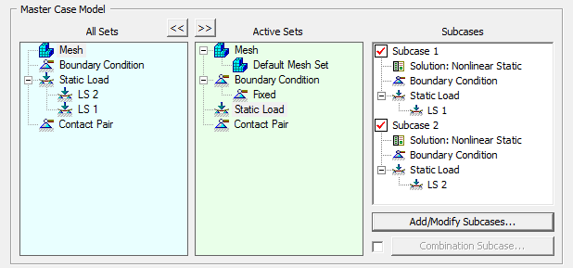
Solution Strategies
Load Step (subcase or step)
Load step is a set of loading and boundary conditions to define an analysis problem
Multiple load steps can be used to define a sequence of loading conditions
Load
LS1
LS2
Time
NASTRAN
SPC = 1
SUBCASE 1
LOAD = 1
SUBCASE 2
LOAD = 2

Slide 45
Solution Strategies
300
Load Increment (substeps)
Linear analysis concerns max load
Nonlinear analysis depends on load path (history)
Applied load is gradually increased within a load step
Follow load path, improve accuracy, and easy to converge
Convergence Iteration
Within a load increment, an iterative method (e.g., NR method) is used to find nonlinear solution
Bisection, linear search, stabilization, etc
250
Loading
200
150
Force
100
50
0
-50
Unloading
-100
0
0.2
0.4
0.6
0.8
1
Displacement
F
Fª
4
5
3
2
1
u

Slide 46
Solution Strategies cont.
Automatic (Variable) Load Increment
Also called Automatic Time Stepping
Load increment may not be uniform
When convergence iteration diverges, the load increment is halved
If a solution converges in less than 4 iterations, increase time increment by 25%
If a solution converges in more than 8 iterations, decrease time increment by 25%
Subincrement (or bisection)
When iterations do not converge at a given increment, analysis goes back to previously converged increment and the load increment is reduced by half
This process is repeated until max number of subincrements

Slide 47
When nonlinear analysis does not converge
NR method assumes a constant curvature locally
When a sign of curvature changes around the solution, NR method oscillates or diverges
Often the residual changes sign between iterations
Line search can help to converge

Slide 48
When nonlinear analysis does not converge
Displacement-controlled vs. force-controlled procedure
Almost all linear problems are force-controlled
Displacement-controlled procedure is more stable for nonlinear analysis
Use reaction forces to calculate applied forces
F
C
F_{C}
B
A
F_{B}
B
D
Force
C
D
E
A
E
Displacement

Slide 49
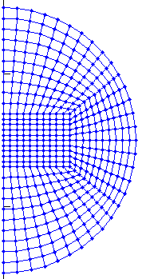
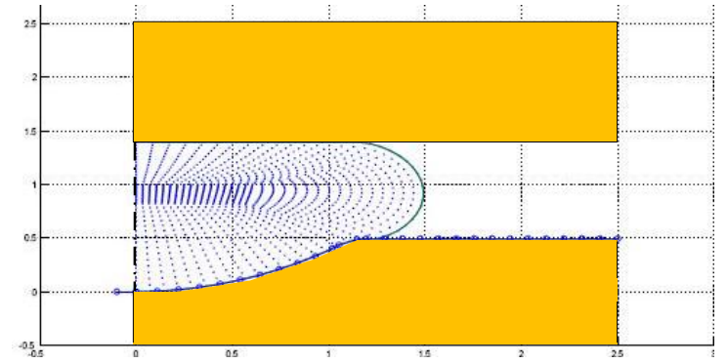
When nonlinear analysis does not converge
Mesh distortion
Most FE programs stop analysis when mesh is distorted too much
Initial good mesh may be distorted during a large deformation
Many FE programs provide remeshing capability, but it is still inaccurate or inconvenient
It is best to make mesh in such a way that the mesh quality can be maintained after deformation (need experience)
Initial mesh

Slide 50
MATLAB Code for Nonlinear FEA

Slide 51
NLFEA.m
Nonlinear finite element analysis program
Incremental force method with N-R method
Bisection method when N-R is failed to converge
Can solve for linear elastic, hyperelastic and elasto-plastic material nonlinearities with large deformation
Global arrays
Name | Dimension | Contents
GKF | NEQ x NEQ | Tangent matrix
FORCE | NEQ x 1 | Residual vector
DISPTD | NEQ x 1 | Displacement vector
DISPDD | NEQ x 1 | Displacement increment
SIGMA | 6 x 8 x NE | Stress at each integration point
XQ | 7 x 8 x NE | History variable at each integration point

Slide 52
Input data
Update history variables
Print stress & displacement
T = T + ΔT
Bisection control
Final time?
Yes
Stop
No
Increase load & BC
T = T – ΔT
ΔT = ΔT/2
ITER = 0
Calculate R & K
Displacement BC
Converged?
Yes
No
Yes
Max ITER?
No
ITER=ITER + 1
Solve ΔU = K\R
U = U + ΔU

Slide 53
NLFEA.m cont.
Nodal coordinates and element connectivity
the node numbers are in sequence
nodal coordinates in XYZ(NNODE , 3)
eight-node hexahedral elements LE(NELEN, 8)
Applied forces and prescribed displacements
EXTFORCE(NFORCE, 3): [node, DOF, value] format
SDISPT(NDISPT, 3)
Load steps and increments
TIMS(NTIME,5): [T_{start}, T_{end}, T_{inc}, LOAD_{init}, LOAD_{final}] format
Material properties
Mooney-Rivlin hyperelasticity (MID = -1), PROP = [A10, A01, K]
infinitesimal elastoplasticity (MID = 1), PROP = [LAMBDA, MU, BETA, H, Y0]

Slide 54
NLFEA.m cont.
Control parameters
ITRA: maximum number of convergence iterations
if residual > ATOL, then solution diverges, bisection starts
The total number of bisections is limited by NTOL
The convergence iteration converges when residual < TOL
Program prints out results to NOUT after convergence
function NLFEA(ITRA,TOL,ATOL,NTOL,TIMS,NOUT,MID,PROP,EXTFORCE,SDISPT,XYZ,LE)
%***********************************************************************
% MAIN PROGRAM FOR HYPERELASTIC/ELASTOPLASTIC ANALYSIS
%***********************************************************************

Slide 55
Extension of a Single Element Example
%
% Nodal coordinates
XYZ=[0 0 0;1 0 0;1 1 0;0 1 0;0 0 1;1 0 1;1 1 1;0 1 1];
%
% Element connectivity
LE=[1 2 3 4 5 6 7 8];
%
% External forces [Node, DOF, Value]
EXTFORCE=[5 3 10.0; 6 3 10.0; 7 3 10.0; 8 3 10.0];
%
% Prescribed displacements [Node, DOF, Value]
SDISPT=[1 1 0;1 2 0;1 3 0;2 2 0;2 3 0;3 3 0;4 1 0;4 3 0];
%
% Load increments [Start End Increment InitialLoad FinalLoad]
TIMS=[0.0 0.5 0.1 0.0 0.5; 0.5 1.0 0.1 0.5 1.0]';
%
% Material properties
%PROP=[LAMBDA MU BETA H Y0]
MID=1;
PROP=[110.747, 80.1938, 0.0, 5., 35.0];
%
% Set program parameters
ITRA=20; ATOL=1.0E5; NTOL=5; TOL=1E-6;
%
% Calling main function
NOUT = fopen('output.txt','w');
NLFEA(ITRA, TOL, ATOL, NTOL, TIMS, NOUT, MID, PROP, EXTFORCE, SDISPT, XYZ, LE);
fclose(NOUT);

Slide 56
Tension of Elastoplastic Bar Example
Material properties
x₃
11kN
11kN
λ | μ | σ_{Y} | H
110.7 GPa | 80.2 GPa | 400 MPa | 100 MPa
9
11kN
11kN
12
10
11
Uniaxial stress condition σ₃₃ ≠ 0
When F_{i} = 10 kN, σ = 400 MPa (Elastic limit)
Elastoplastic when F_{i} = 10 ~ 11kN
5
8
6
7
%
% Two-element example
%
% Nodal coordinates
XYZ=[0 0 0; 1 0 0; 1 1 0; 0 1 0;
0 0 1; 1 0 1; 1 1 1; 0 1 1;
0 0 2; 1 0 2; 1 1 2; 0 1 2]*0.01;
%
% Element connectivity
LE=[1 2 3 4 5 6 7 8;
5 6 7 8 9 10 11 12];
%
% Prescribed displacements [Node, DOF, Value]
SDISPT=[1 1 0;1 2 0;1 3 0;2 2 0;2 3 0;3 3 0;4 1 0;4 3 0];
1
4
x₂
2
x₁
3
x₂
u=w=0
w=0
4
3
1
2
x₁
u=v=w=0
v=w=0

Slide 57
Tension of Elastoplastic Bar Example
%
% External forces [Node, DOF, Value]
EXTFORCE=[9 3 10.0E3; 10 3 10.0E3; 11 3 10.0E3; 12 3 10.0E3];
%
% Load increments [Start End Increment InitialFactor FinalFactor]
TIMS=[0.0 0.8 0.4 0.0 0.8; 0.8 1.1 0.1 0.8 1.1]';
%
% Material properties PROP=[LAMDA MU BETA H Y0]
MID=1;
PROP=[110.747E9 80.1938E9 0.0 1.E8 4.0E8];
%
% Set program parameters
ITRA=70; ATOL=1.0E5; NTOL=6; TOL=1E-6;
%
% Calling main function
NOUT = fopen('output.txt','w');
NLFEA(ITRA, TOL, ATOL, NTOL, TIMS, NOUT, MID, PROP, EXTFORCE, SDISPT, XYZ, LE);
fclose(NOUT);
Force (kN)
10kN * 1.1 = 11kN
11
10
9
8
4
0
0.4
Time
0.8
0.9
1
1.1

Slide 58
Tension of Elastoplastic Bar Example
Convergence iteration outputs (output.txt)
Time Time step Iter Residual
0.40000 4.000e-01 2 3.80851e-12
Time Time step Iter Residual
0.80000 4.000e-01 2 4.32010e-12
Time Time step Iter Residual
0.90000 1.000e-01 2 3.97904e-12
Time Time step Iter Residual
1.00000 1.000e-01 2 3.63798e-12
Time Time step Iter Residual
1.10000 1.000e-01 2 6.66390e+02
3 1.67060e-09
Linear elastic region
Elastoplastic region
Load factor | u_{5z} | u_{9z} | S₃₃ Elem1 | S₃₃ Elem2 | State
0.4 | 7.73×10⁻⁶ | 1.55×10⁻⁵ | 160 MPa | 160 MPa | Elastic
0.8 | 1.55×10⁻⁵ | 3.09×10⁻⁵ | 320 MPa | 320 MPa | Elastic
0.9 | 1.74×10⁻⁵ | 3.48×10⁻⁵ | 360 MPa | 360 MPa | Elastic
1.0 | 1.93×10⁻⁵ | 3.87×10⁻⁵ | 400 MPa | 400 MPa | Elastic
1.1 | 4.02×10⁻³ | 8.04×10⁻³ | 440 MPa | 440 MPa | Plastic

