Slide 1
CHAP 5 Finite Element Analysis of Contact Problem
Nam-Ho Kim

Slide 2
Introduction
Contact is boundary nonlinearity
The graph of contact force versus displacement becomes vertical
Both displacement and contact force are unknown in the interface
Objective of contact analysis
Whether two or more bodies are in contact
Where the location or region of contact is
How much contact force or pressure occurs in the interface
If there is a relative motion after contact in the interface
Finite element analysis procedure for contact problem
Find whether a material point in the boundary of a body is in contact with the other body
If it is in contact, the corresponding contact force must be calculated

Slide 3
Introduction
Equilibrium of elastic system:
finding a displacement field that minimizes the potential energy
Contact condition (constrained minimization)
the potential is minimized while satisfying the contact constraint
Convert to unconstrained optimization
Can be solved using either the penalty method or Lagrange multiplier method
Slave-master concept for contact implementation
the nodes on the slave boundary cannot penetrate the surface elements on the master boundary

Slide 4
Goals
Learn the computational difficulty in boundary nonlinearity
Understand the concept of variational inequality and its relation with the constrained optimization
Learn how to impose contact constraint and friction constraints using penalty method
Understand difference between Lagrange multiplier method and penalty method
Learn how to integrate contact constraint with the structural variational equation
Learn how to implement the contact constraints in finite element analysis
Understand collocational integration

Slide 5
1D Contact Examples
5.2

Slide 6
Contact Problem – Boundary Nonlinearity
Contact problem is categorized as boundary nonlinearity
Body 1 cannot penetrate Body 2 (impenetrability)
Why nonlinear?
Both contact boundary and contact stress are unknown!!!
Abrupt change in contact force (difficult in NR iteration)
Body 2
Body 1
Contact stress (compressive)
Contact boundary
Contact force
Penetration

Slide 7
Why are contact problems difficult?
Unknown boundary
Contact boundary is unknown a priori
It is a part of solution
Candidate boundary is often given
Abrupt change in force
Extremely discontinuous force profile
When contact occurs, contact force cannot be determined from displacement
Similar to incompressibility (Lagrange multiplier or penalty method)
Discrete boundary
In continuum, contact boundary varies smoothly
In numerical model, contact boundary varies node to node
Very sensitive to boundary discretization
Body 1
Body 2
Contact force
Penetration

Slide 8
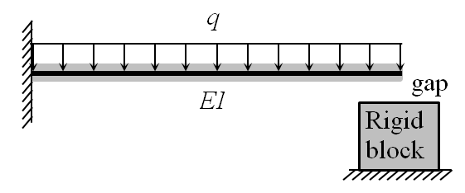
Contact of a Cantilever Beam with a Rigid Block
q = 1 kN/m, L = 1 m, EI = 10⁵ N∙m², initial gap δ = 1 mm
Trial-and-error solution
First assume that the deflection is smaller than the gap
Since v_{N}(L) > δ, the assumption is wrong, the beam will be in contact

Slide 9
Cantilever Beam Contact with a Rigid Block cont.
Trial-and-error solution cont.
Now contact occurs. Contact in one-point (tip).
Contact force, λ, to prevent penetration
Determine the contact force from tip displacement = gap

Slide 10
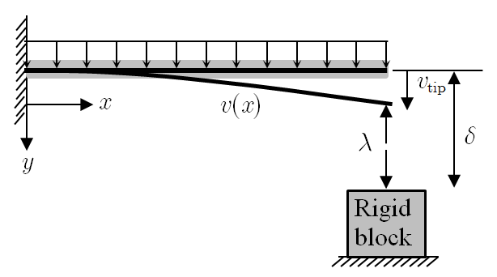
Cantilever Beam Contact with a Rigid Block cont.
Solution using contact constraint
Treat both contact force and gap as unknown and add constraint
When λ = 0, no contact. Contact occurs when λ > 0. λ < 0 impossible
Gap condition:

Slide 11
Cantilever Beam Contact with a Rigid Block cont.
Solution using contact constraint cont.
Contact condition
No penetration: g ≤ 0
Positive contact force: λ ≥ 0
Consistency condition: λg = 0
Lagrange multiplier method
When λ = 0N → g = 0.00025 > 0 → violate contact condition
When λ = 75N → g = 0 → satisfy contact condition
Lagrange multiplier, λ, is the contact force

Slide 12
Cantilever Beam Contact with a Rigid Block cont.
Penalty method
Small penetration is allowed, and contact force is proportional to it
Penetration function
Contact force
From
Gap depends on penalty parameter
φ_{N} = 0 when g ≤ 0
φ_{N} = g when g > 0
K_{N}: penalty parameter

Slide 13
Cantilever Beam Contact with a Rigid Block cont.
Penalty method cont.
Large penalty allows small penetration
Penalty parameter | Penetration (m) | Contact force (N)
3×10⁵ | 1.25×10⁻⁴ | 37.50
3×10⁶ | 2.27×10⁻⁵ | 68.18
3×10⁷ | 2.48×10⁻⁶ | 74.26
3×10⁸ | 2.50×10⁻⁷ | 74.92
3×10⁹ | 2.50×10⁻⁸ | 75.00

Slide 14
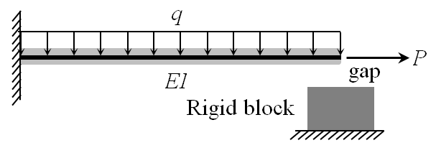
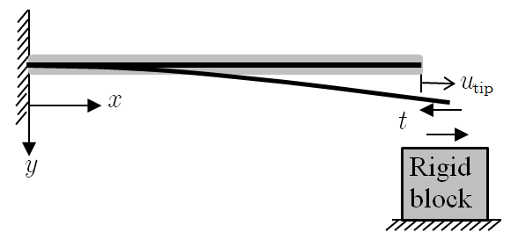
Beam Contact with Friction
Sequence: q is applied first, followed by the axial load P
Assume no friction
Frictional constraint
Stick condition:
Slip condition:
Consistency condition:
P=100N, μ=0.5
t: tangential friction force

Slide 15
Beam Contact with Friction cont.
Trial-and-error solution
First assume stick condition
Violate
Next, try slip condition
Satisfies u_{tip} > 0, therefore, valid

Slide 16
Beam Contact with Friction cont.
Solution using frictional constraint (Lagrange multiplier)
Use consistency condition
Choose u_{tip} as a Lagrange multiplier and t-μλ as a constraint
When u_{tip} = 0, t = P, and t – μλ = 62.5 > 0, violate the stick condition
When
t = λμ and the slip condition is satisfied, valid solution

Slide 17
Beam Contact with Friction cont.
Penalty method
Penalize when t – μλ > 0
Slip displacement and frictional force
When t – μλ < 0 (stick), u_{tip} = 0 (no penalization)
When t – μλ > 0 (slip), penalize to stay close t = μλ
Friction force
K_{T}: penalty parameter for tangential slip

Slide 18
Beam Contact with Friction cont.
Penalty method cont.
Tip displacement
For large K_{T},
Penalty parameter | Tip displacement (m) | Frictional force (N)
1×10⁻⁴ | 5.68×10⁻⁴ | 43.18
1×10⁻³ | 6.19×10⁻⁴ | 38.12
1×10⁻² | 6.24×10⁻⁴ | 37.56
1×10⁻¹ | 6.25×10⁻⁴ | 37.50
1×10⁰ | 6.25×10⁻⁴ | 37.50

Slide 19
Observations
Due to unknown contact boundary, contact point should be found using either direct search (trial-and-error) or nonlinear constraint equation
Both methods requires iterative process to find contact boundary and contact force
Contact function replace the abrupt change in contact condition with a smooth but highly nonlinear function
Friction force calculation depends on the sequence of load application (Path-dependent)
Friction function regularizes the discontinuous friction behavior to a smooth one

Slide 20
General Formulation of Contact Problems
5.3

Slide 21
General Contact Formulation
Contact between a flexible body and a rigid body
Point x  Ω contacts to x_{c}  rigid surface (param ξ)
How to find x_{c}(ξ)
Closest projection onto the rigid surface
Unit tangent vector
Ω
Γ_{c}
x
e_{n}
g_{n}
e_{t}
x_{c}⁰
x_{c}
Rigid Body
ξ
g_{t}

Slide 22
Contact Formulation cont.
Gap function
Impenetrability condition
Tangential slip function
boundary that has a possibility of contact
Parameter at the previous contact point
Ω
Γ_{c}
x
e_{n}
g_{n}
e_{t}
x_{c}⁰
x_{c}
Rigid Body
ξ
g_{t}

Slide 23
Ex) Project to a Parabola
Projection of x={3, 1} to y = x²
Let x_{c} = {ξ, ξ²}^{T}
Projection point
Gap
4
3
y = x²
2
x_{c}
e_{n}
g_{n}
1
x
0
0
1
2
3
4
ξ_{c} = 1.29
x_{c} = {1.29, 1.66}

Slide 24
Variational Inequality
Governing equation
Contact conditions (small deformation)
Contact set 😐 (convex)
satisfies all kinematic constraints (displacement conditions)

Slide 25
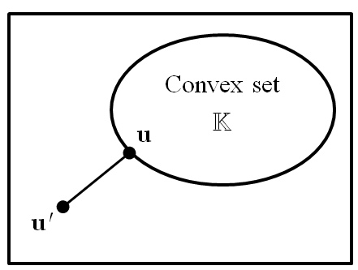
Variational Inequality cont.
Variational equation with ū = w – u (i.e., w is arbitrary)
Since it is arbitrary, we don’t know the value, but it is non-negative
Variational inequality for contact problem

Slide 26
Illustration of Projection
If the solution u’ is out of set 😐, it is projected to u on 😐
Beam deflection example (rigid block with initial gap of 1mm)
v’(x): beam deflection without rigid block
Contact condition is violated (penetration to the block)
v(x): projection of v’(x) onto convex set 😐
by applying the contact force
0
x 10
-3
0.4
v(x)
0.8
v'(x)
1.2
Rigid block
0
0.2
0.4
0.6
0.8
1

Slide 27
Variational Inequality cont.
For large deformation problem
Variational inequality is not easy to solve directly
We will show that V.I. is equivalent to constrained optimization of total potential energy
The constraint will be imposed using either penalty method or Lagrange multiplier method

Slide 28
Potential Energy and Directional Derivative
Potential energy
Directional derivative
Directional derivative of potential energy
For variational inequality

Slide 29
Equivalence
V.I. is equivalent to constrained optimization
For arbitrary w  😐
Thus, Π(u) is the smallest potential energy in 😐
Unique solution if and only if Π(w) is a convex function and set 😐 is closed convex
non-negative

Slide 30
Constrained Optimization
PMPE minimizes the potential energy in the kinematically admissible space
Contact problem minimizes the same potential energy in the contact constraint set 😐
The constrained optimization problem can be converted into unconstrained optimization problem using the penalty method or Lagrange multiplier method
If g_{n} < 0, penalize Π(u) using
penalty parameter

Slide 31
Constrained Optimization cont.
Penalized unconstrained optimization problem
constrained
unconstrained
Solution space w/o contact 
😐
Contact force
u
u_{NoContact}

Slide 32
Ex) Beam Deflection with Rigid Block
q = 1 kN/m, L = 1 m, EI = 10⁵ N∙m², initial gap δ = 1 mm
Assumed deflection:
Penalty function:
Penalized potential energy

Slide 33
Ex) Beam Deflection with Rigid Block
Stationary condition
Penetration: a₂ + a₃ + a₄ − δ
Contact force: −ω_{n}g_{n}
Penalty parameter | a₁ | a₂ | a₃ | Penetration (m) | Contact force (N)
3×10⁵ | 2.31×10⁻³ | -1.60×10⁻³ | 4.17×10⁻⁴ | 1.25×10⁻⁴ | 37.50
3×10⁶ | 2.16×10⁻³ | -1.55×10⁻³ | 4.17×10⁻⁴ | 2.27×10⁻⁵ | 68.18
3×10⁷ | 2.13×10⁻³ | -1.54×10⁻³ | 4.17×10⁻⁴ | 2.48×10⁻⁶ | 74.26
3×10⁸ | 2.13×10⁻³ | -1.54×10⁻³ | 4.17×10⁻⁴ | 2.50×10⁻⁷ | 74.92
3×10⁹ | 2.13×10⁻³ | -1.54×10⁻³ | 4.17×10⁻⁴ | 2.50×10⁻⁸ | 75.00
True value | 2.13×10⁻³ | -1.54×10⁻³ | 4.17×10⁻⁴ | 0.0 | 75.00

Slide 34
Variational Equation
Structural Equilibrium
Variational equation
need to express in terms of u and ū

Slide 35
Frictionless Contact Formulation
Variation of the normal gap
Normal contact form

Slide 36
Linearization
It is clear that b_{N} is independent of energy form
The same b_{N} can be used for elastic or plastic problem
It is nonlinear with respect to u (need linearization)
Increment of gap function
We assume that the contact boundary is straight line Δe_{n} = 0
This is true for linear finite elements
Rigid surface

Slide 37
Linearization cont.
Linearization of contact form
N-R iteration

Slide 38
Ex) Frictionless Contact of a Block
Calculate displacement, penetration and contact force at the contact interface.
EA = 10⁵N, ν = 0, q = 1.0kN/m, plane strain
Plane strain:
Contact boundary:
Gap function:
Contact form:
Penalized potential energy
y
q
Contact boundary
Elastic body
0
1
x
Rigid body

Slide 39
Ex) Frictionless Contact of a Block
From ν = 0, D becomes a diagonal matrix, decoupled x & y
Since load is only y-direction, ε_{xx} = γ_{xy} = 0
Linear displacement in y-direction
Penalized potential
Need to satisfy for arbitrary
As ω_{n} increases, penetration decreases but
contact force remains constant

Slide 40
Frictional Contact Formulation
frictional contact depends on load history
Frictional interface law – regularization of Coulomb law
Friction form
-μω_{n}g_{n}
ω_{t}
g_{t}

Slide 41
Friction Force
During stick condition, f_{T} = ω_{t}g_{t} (ω_{t}: regularization param.)
When slip occurs,
Modified friction form

Slide 42
Linearization of Stick Form
Increment of slip
Increment of tangential vector
Incremental slip form for the stick condition

Slide 43
Linearization of Slip Form
Parameter for slip condition:
Friction form:
Linearized slip form (not symmetric!!)

Slide 44
Ex) Frictional Slip of a Cantilever Beam
Distributed load q → axial load P, ω_{t} = 106, μ = 0.5
Contact force: F_{c} = –ω_{n}g_{n} = 75N
Penalized potential energy (axial alone)
P=100N

Slide 45
Ex) Frictional Slip of a Cantilever Beam
Linear axial displacement field: u(x) = a₀ + a₁x
Tangential slip in terms of displacement
Parametric coordinate ξ has an origin at x = L, and it has the same length as the x-coordinate
Assume the stick condition:
The assumption is violated!!

Slide 46
Ex) Frictional Slip of a Cantilever Beam
Assume the slip condition:
With contact force = 70N,

Slide 47
Finite Element Formulation of Contact Problems
5.4

Slide 48
Finite Element Formulation
Slave-Master contact
The rigid body has fixed or prescribed displacement
Point x is projected onto the piecewise linear segments of the rigid body with x_{c} (ξ = ξ_{c}) as the projected point
Unit normal and tangent vectors
Flexible body
x
g
ξ⁰
e_{n}
x₁
x_{c}⁰
x₂
ξ
x_{c}
e_{t}
Rigid body
L

Slide 49
Finite Element Formulation cont.
Parameter at contact point
Gap function
Penalty function
Note: we don’t actually integrate the penalty function. We simply added the integrand at all contact node
This is called collocation (a kind of integration)
In collocation, the integrand is function value × weight
Impenetrability condition

Slide 50
Finite Element Formulation cont.
Contact form (normal)
(ωg_{n}): contact force, proportional to the violation
Contact form is a virtual work done by contact force through normal virtual displacement
Linearization
Heaviside step function
H(x) = 1 if x > 0
= 0 otherwise
Contact stiffness

Slide 51
Finite Element Formulation cont.
Global finite element matrix equation for increment
Since the contact forms are independent of constitutive relation, the above equation can be applied for different materials
A similar approach can be used for flexible-flexible body contact
One body being selected as a slave and the other as a master
Computational challenge in finding contact points (for example, out of 10,000 possible master segments, how can we find the one that will actually in contact?)

Slide 52
Finite Element Formulation cont.
Frictional slip
Friction force and tangent stiffness (stick condition)
Friction force and tangent stiffness (slip condition)

Slide 53
Contact Analysis Procedure and Modeling Issues
5.6

Slide 54
Types of Contact Interface
Weld contact
A slave node is bonded to the master segment (no relative motion)
Conceptually same with rigid-link or MPC
For contact purpose, it allows a slight elastic deformation
Decompose forces in normal and tangential directions
Rough contact
Similar to weld, but the contact can be separated
Stick contact
The relative motion is within an elastic deformation
Tangent stiffness is symmetric,
Slip contact
The relative motion is governed by Coulomb friction model
Tangent stiffness become unsymmetric

Slide 55
Contact Search
Easiest case
User can specify which slave node will contact with which master segment
This is only possible when deformation is small and no relative motion exists in the contact surface
Slave and master nodes are often located at the same position and connected by a compression-only spring (node-to-node contact)
Works for very limited cases
General case
User does not know which slave node will contact with which master segment
But, user can specify candidates
Then, the contact algorithm searches for contacting master segment for each slave node
Time consuming process, because this needs to be done at every iteration

Slide 56
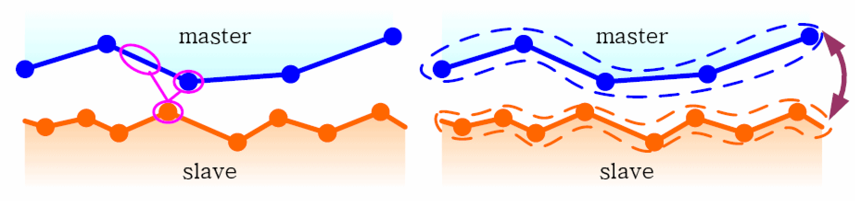
Contact Search cont.
Node-to-surface contact search
Surface-to-surface contact search

Slide 57
Slave-Master Contact
Theoretically, there is no need to distinguish Body 1 from Body 2
However, the distinction is often made for numerical convenience
One body is called a slave body, while the other body is called a master body
Contact condition: the slave body cannot penetrate into the master body
The master body can penetrate into the slave body (physically not possible, but numerically it’s not checked)
Master
Slave

Slide 58
Slave-Master Contact cont.
Contact condition between a slave node and a master segment
In 2D, contact pair is often given in terms of {x, x₁, x₂}
Slave node x is projected onto the piecewise linear segments of the master segment with x_{c} (ξ = ξ_{c}) as the projected point
Gap:
g > 0: no contact
g < 0: contact
Slave
x
ξ⁰
g
x₁
e_{n}
x_{c}⁰
x₂
ξ
x_{c}
e_{t}
L
Master

Slide 59
Contact Formulation (Two-Step Procedure)
Search nodes/segments that violate contact constraint
Apply contact force for the violated nodes/segments (contact force)
Body 1
Violated nodes
Contact candidates
Body 2
Contact force

Slide 60
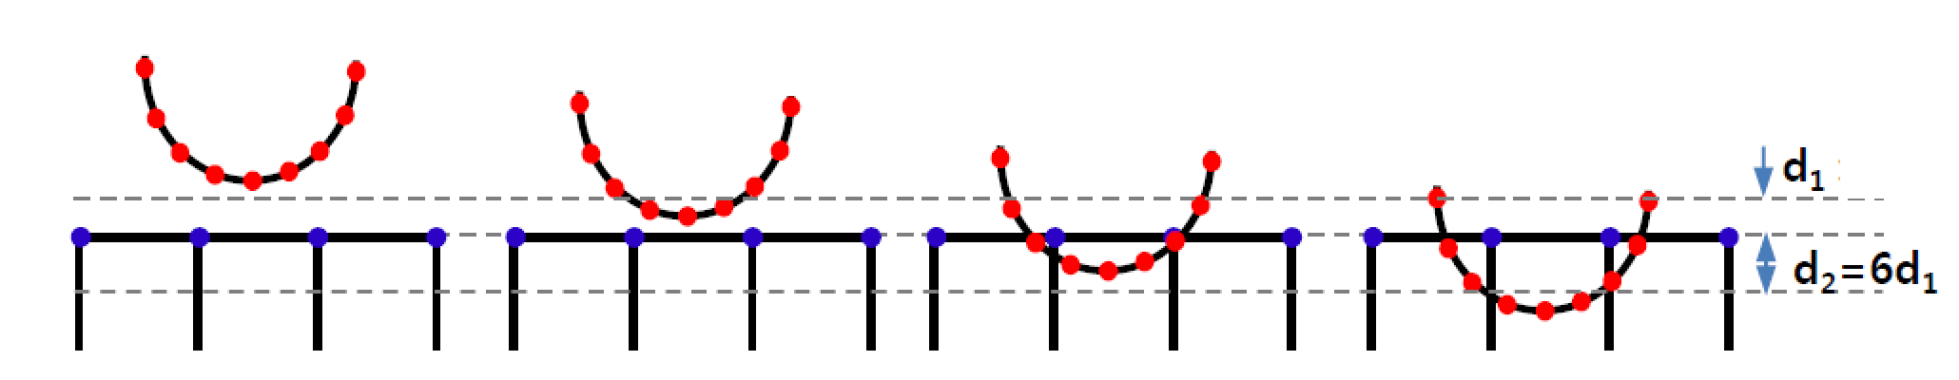
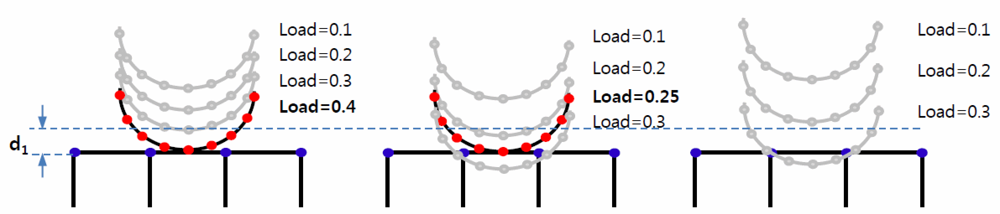
Contact Tolerance and Load Increment
Contact tolerance
Minimum distance to search for contact (1% of element length)
Load increment and contact detection
Too large load increment may miss contact detection
Out of contact
Within tolerance
Out of contact

Slide 61
Contact Force
For those contacting pairs, penetration needs to be corrected by applying a force (contact force)
More penetration needs more force
Penalty-based contact force (compression-only spring)
Penalty parameter (Kn): Contact stiffness
It allows a small penetration (g < 0)
It depends on material stiffness
The bigger Kn, the less allowed penetration
x₁
x_{c}
x₂
g < 0
x
F_{C}

Slide 62
Contact Stiffness
Contact stiffness depends on the material stiffness of contacting two bodies
Large contact stiffness reduces penetration, but can cause problem in convergence
Proper contact stiffness can be determined from allowed penetration (need experience)
Normally expressed as a scalar multiple of material’s elastic modulus
Start with small initial SF and increase it gradually until reasonable penetration

Slide 63
Lagrange Multiplier Method
In penalty method, the contact force is calculated from penetration
Contact force is a function of deformation
Lagrange multiplier method can impose contact condition exactly
Contact force is a Lagrange multiplier to impose impenetrability condition
Contact force is an independent variable
Complimentary condition
Stiffness matrix is positive semi-definite
Contact force is applied in the normal direction to the master segment

Slide 64
Observations
Contact force is an internal force at the interface
Newton’s 3rd law: equal and opposite forces act on interface
Due to discretization, force distribution can be different, but the resultants should be the same
F
p_{C1}
p_{C2}
q_{C1}
q_{C2}
q_{C2}
F

Slide 65
Contact Formulation
Add contact force as an external force
Ex) Linear elastic materials
Contact force depends on displacement (nonlinear, unknown)
F
p_{C1}
p_{C2}
Internal force
External force
Contact force
q_{C1}
q_{C2}
q_{C2}
F
Tangent stiffness
Residual
Contact stiffness

Slide 66
Friction Force
So far, contact force is applied to the normal direction
It is independent of load history (potential problem)
Friction force is produced by a relative motion in the interface
Friction force is applied to the parallel direction
It depends on load history (path dependent)
Coulomb friction model
Body 1
Friction force
Friction force
Contact force
Relative motion

Slide 67
Friction Force cont.
Coulomb friction force is indeterminate when two bodies are stick (no unique determination of friction force)
In reality, there is a small elastic deformation before slip
Regularized friction model
Similar to elasto-perfectly-plastic model
K_{t}: tangential stiffness
Friction force
μF_{C}
K_{t}
Relative motion

Slide 68
Tangential Stiffness
Tangential stiffness determines the stick case
It is related to shear strength of the material
Contact surface with a large Kt behaves like a rigid body
Small Kt elongate elastic stick condition too much (inaccurate)
Friction force
μF_{C}
K_{t}
Relative motion

Slide 69
Selection of Master and Slave
Contact constraint
A slave node CANNOT penetrate the master segment
A master node CAN penetrate the slave segment
There is not much difference in a fine mesh, but the results can be quite different in a coarse mesh
How to choose master and slave
Rigid surface to a master
Convex surface to a slave
Fine mesh to a slave
Master
Slave
Slave
Master

Slide 70
Selection of Master and Slave
How to prevent penetration?
Can define master-slave pair twice by changing the role
Some surface-to-surface contact algorithms use this
Careful in defining master-slave pairs
Master-slave pair 2
Master-slave pair 1

Slide 71
Flexible or Rigid Bodies?
Flexible-Flexible Contact
Body1 and Body2 have a similar stiffness and both can deform
Flexible-Rigid Contact
Stiffness of Body2 is significantly larger than that of Body1
Body2 can be assumed to be a rigid body (no deformation but can move)
Rubber contacting to steel
Why not flexible-flexible?
When two bodies have a large difference in stiffness, the matrix becomes ill-conditioned
Enough to model contacting surface only for Body2
Friction in the interface
Friction makes the contact analysis path-dependent
Careful in the order of load application

Slide 72
Effect of discretization
Contact stress (pressure) is high on the edge
Contact stress is sensitive to discretization
Uniform pressure
Slave body
Non-uniform contact stress

Slide 73
Rigid-Body Motion
Contact constraint is different from displacement BC
Contact force is proportional to the penetration amount
A slave body between two rigid-bodies can either fly out or oscillate between two surfaces
Always better to remove rigid-body motion without contact
Rigid master
Rigid master
Rigid master
Rigid master

Slide 74
Rigid-Body Motion
When a body has rigid-body motion, an initial gap can cause singular matrix (infinite/very large displacements)
Same is true for initial overlap
Rigid master
Rigid master

Slide 75
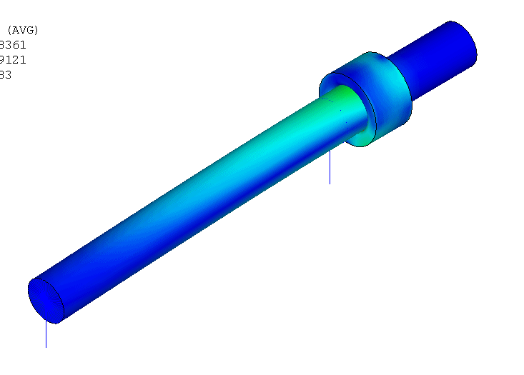
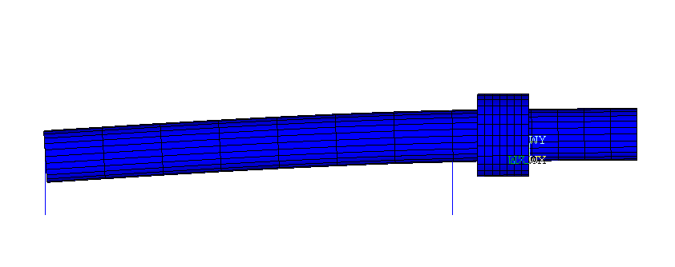
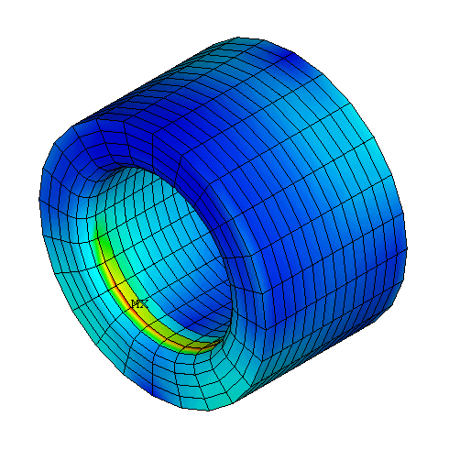
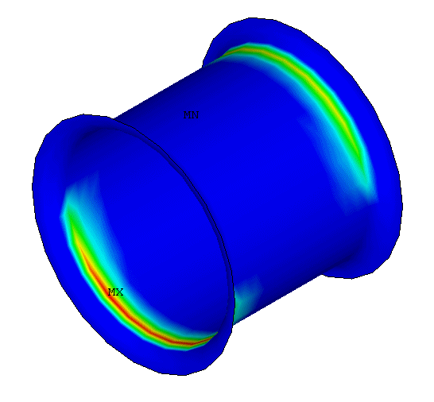
Rigid-Body Motion
Removing rigid-body motion
A small, artificial bar elements can be used to remove rigid-body motion without affecting analysis results much
Contact stress at bushing due to shaft bending

Slide 76
Convergence Difficulty at a Corner
Convergence iteration is stable when a variable (force) varies smoothly
The slope of finite elements are discontinuous along the curved surface
This can cause oscillation in residual force (not converging)
Need to make the corner smooth using either higher-order elements or many linear elements
About 10 elements in 90 degrees, or use higher-order elements

Slide 77
Curved Contact Surface
Curved surface
Contact pressure is VERY sensitive to the curvature
Linear elements often yield unsmooth contact pressure distribution
Less quadratic elements is better than many linear elements
Linear elements
Quadratic elements

Slide 78
Summary
Contact condition is a rough boundary nonlinearity due to discontinuous contact force and unknown contact region
Both force and displacement on the contact boundary are unknown
Contact search is necessary at each iteration
Penalty method or Lagrange multiplier method can be used to represent the contact constraint
Penalty method allows a small penetration, but easy to implement
Lagrange multiplier method can impose contact condition accurately, but requires additional variables and the matrix become positive semi-definite
Numerically, slave-master concept is used along with collocation integration (at slave nodes)
Friction makes the contact problem path-dependent
Discrete boundary and rigid-body motion makes the contact problem difficult to solve

