Slide 1


Peeking Behind the Curtains of Serverless Platforms
Liang Wang¹ , Mengyuan Li², Yinqian Zhang² ,
Thomas Ristenpart³, Michael Swift¹
¹ UW-Madison, ² The Ohio State University, ³ Cornell Tech

Slide 2
Providers do more, tenant do less
Serverless
(FaaS)
IaaS
PaaS
APP
APP
APP
APP
Server
Scaling
Uptime
Server
Scaling
Uptime
Server
Scaling
Uptime
…
…
…
…
VM
VM
VM
Physical Machine
Physical Machine
Physical Machine
Non-controllable
Controllable
Notes:
Cloud computing evolves quickly and follows a trend that providers do more and more on behalf of the tenants.
For example, in IaaS, tenants can run customized servers in customized VMs and control how to scale their apps
PaaS: the tenants no control over the VM hosts of the application server but they can still decide how to scale and run the applications.
A new type of cloud computing service, which is called serverless or FaaS, takes a step further: the server management and even some application management tasks are left to the provider

Slide 3



Benefits of serverless
Function: Standalone, small application dedicated to specific tasks
Serverless provider
Tenant
Function
Function
Deploy
Minimal configuration
No efforts on server management
Low cost
Notes:
In serverless, the tenants focus on developing functions, which are xxxx, and deploy the functions in the serverless platforms.
They have very minimal configuration access to the function execution environment and spend no efforts on managing the backend infrastructures. The tenant is charged based on the execution time, and memory or CPU used by the functions. The costs are low.

Slide 4
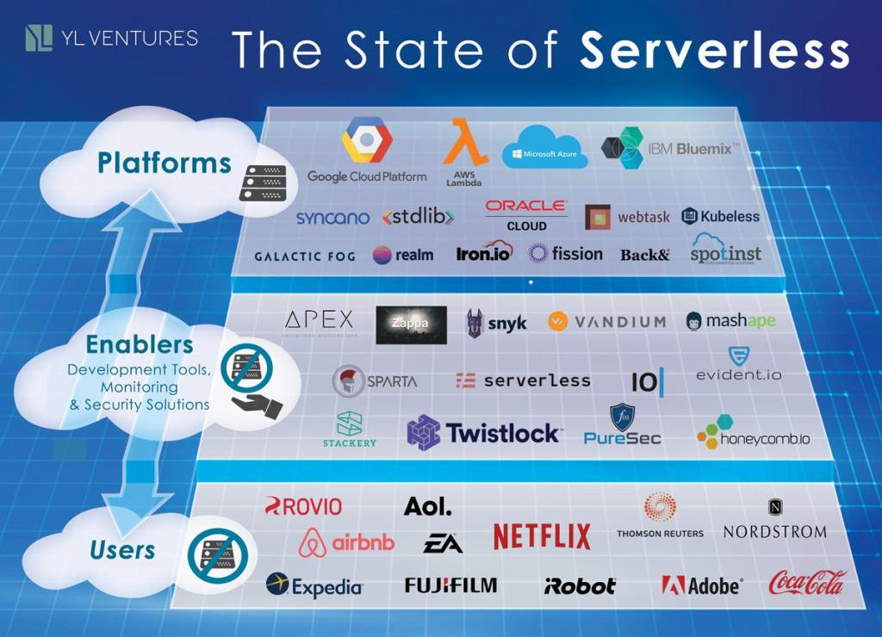
Serverless ecosystem
Source: https://venturebeat.com/2017/10/22/the-big-opportunities-in-serverless-computing/
Notes:
So serverless is great for infrequent tasks. And it is also treated as a general application development pattern and becomes popular. There are many serverless platforms with a large amount of users and numerous tools to facilitate serverless development.

Slide 5
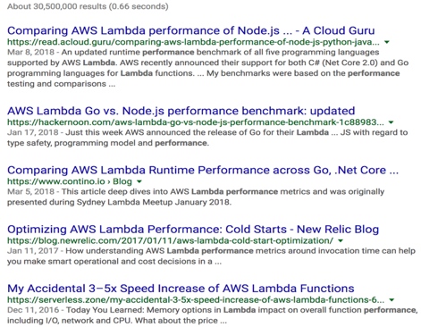
Lots of questions about serverless
Are applications resistant to DDos attacks in serverless?
Are functions secure in serverless?
Can serverless providers deliver guaranteed performance?
…
We need better methodology and more systematic measurement to answer these questions
Notes:
More and more users want to move to serverless. However the serverless computing platforms usually are blackboxes to tenants. So performance and security concerns arise. For example xxx. A simple google search on serverless performance or security shows lots of related research. This shows that people care about these questions. However, most of these works were conducted by developers using ad-hoc methods. And we also tried some method and found they lead to inaccurated results. . Like they ignored the time sync issues during measurement.
So we need a better methodology and more systematic experiments to examine these questions.

Slide 6



Contributions
In-depth study of resource management and performance isolation in
Identify opportunities to improve serverless platforms
AWS: Bad performance isolation, function consistency issue, …
Azure: Unpredictable performance, tenant isolation issues, …
Google: Resource accounting bug, …
Open-source measurement tool
(https://github.com/liangw89/faas_measure)
AWS Lambda
Azure Functions
Google Cloud Functions
Notes:
So in our work, we conduct an in-depth study to understand architectures, resource utilization, and the performance isolation efficiency of three modern serverless computing platforms. We found various issues, like xxxx, and show that there is room for improvement in serverless. We also offer an open-source tool xxxx

Slide 7
Overview
Background
Methodology
Highlighted results
Serverless architectures
Resource scheduling
Performance isolation
Bugs
Notes:
In this talk, I will first introduce how serverless works, and our measurement methodology. I will talk about the potential sec and perf issues we found

Slide 8


How serverless works
A function runs in a container (function instance) launched by the provider with limited CPU/memory/execution time
Serverless provider
User
Request
Function
VM
Container
Launch
Response
Function
Notes:
So how does serverless work? When a request is sent to a deployed function, the provider will launch a function instance, which is a container or sandbox, from a prebuilt image to execute the function. The function instance has only limited resources, for example, it might only have a few hundreds MB of memory and can run for a few minutes

Slide 9

How serverless works
The function instance will be frozen after returning from invocation
Serverless provider
User
Function
VM
Container
Pause
New requests: Reactivated
Tenants don’t need to pay while instances are paused
Function
Notes:
After the function processed the request, the provider will pause the instance and wait for the next request. The paused instance still use memory but no CPU. and the tenants don’t need to pay for the CPU consumed by the paused instances. This is different from PaaS in which applications are always-running. Usually one instance can handle one request at a time.

Slide 10

How serverless works
Providers manage backend infrastructures and resource for tenants
User
Serverless provider
Concurrent requests
Function
VM
VM
Responses
Scale up
Notes:
One benefit of using serverles is the provider will manage backend infrastructures and resource allocation for tenants. For example, when there are concurrent requests, the provider will automatically launch multiple instance to handle requests.

Slide 11




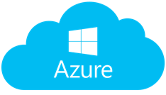



Methodology
Invoke measurement functions many times (50K+) under various settings from vantage points in the same cloud region
Measurement function
Collect information via procfs/cmd/env
Execute performance tests
AWS Lambda
Setting variables:
Function memory
Function language
Request frequency
Concurrent request
Azure Functions
Time:
July–Dec 2017, May 2018
Google Cloud Functions
Notes:
To understand resource management efficacy and performance .
To do so, we xxx

Slide 12


Tool 1: Map requests to instances
Which instance handled the request?
Instance identification:
Write a unique file on /tmp → persistent during instance lifetime
Request 1
Result + “inst1.txt”
(new inst!)
Inst1
Inst2
Request 2
inst1.txt
inst2.txt
Result + “inst1.txt”
(inst1 ran again!)
Request 3
Result + “inst2.txt”
(new inst!)
Notes:
To enable richer analysis, we want to identify which instance handles a given request. To do so, we write a unique file on the /tmp and use it as the inst ID. The inst Id file won’t be modified or deleted until the instance is terminated. More specific, if the inst ID file does not exist on the /tmp, the measurement function will create a new one and return it in the response; otherwise it will just return the existing one. With this tool we are able to label insts and figure out whether a request is handled by a new instance or not

Slide 13

Tool 2: Map instances to VMs
Are instances on the same VM?
VM identification:
AWS: An entry in the /proc/self/cgroup
Azure: The WEBSITE_INSTANCE_ID environment variable
Google: Unknown
Verified via I/O-based and Flush-Reload coresidency tests
VM ID = abc
VM1
VM2
Requests
VM ID = abc
VM ID = xyz
Results
+ Inst ID
+ VM ID
Notes:
Next, we found there are information can be used to id VM. In AWS, it’s …, Azure it’s …. Verifed
In google we didn’t find such info. Our coresidency tests failed because performance varied greatly in Google. So now we can map instances to VMs in AWS and Azure and answer the basic questions like how many instances are on the same VM.

Slide 14
Highlighted results
Serverless architectures
Resource scheduling
Performance isolation
Bugs
Notes:
With the these tools, we are able to partially reverse eng the archs of serverless

Slide 15


Do multiple tenants’ instances run on the same VM?
AWS
Azure
VM1
VM2
VM1
Tenant A
func1
Tenant A
Tenant B
Tenant B
func3
Tenant A
func2
func1
func2
AWS: No → VM only hosts functions from single tenant
Azure:
2017: Yes → VM hosts functions from multiple tenants
2018: No. But other platforms still do this: Spotinst, stdlib, webtask.io
Google: Unknown
Cross-tenant VM sharing make applications
vulnerable to side-channel attacks
Notes:
Our first finding is in AWS xxx while in Azure xxx.
VM sharing could be risky. An recent report shows there are 100s of code-execution vulnerabilities in Linux container and attacker might leverage them to escape isolation. Besides, this could make applications vul to side channel attacks.
Azure has fixed the issue in 2018 but we still found other services uses this pattern.

Slide 16
Do VMs have the same configurations?
Methodology: Examine procfs and env variables of the host VMs of 50 K function instances
AWS: 5 CPU configurations (1 or 2 vCPUs, 4 CPU models)
Azure: 9 configurations ( 1 or 2 or 4 vCPUs, 4 CPU models)
Google: 4 configurations (4 CPU models)
Azure
AWS
Google
model
version
Different types of VMs could result in different instance performance
Notes:
Further examining the confs of the VMs, we find they use a variety of confs. For example, in AWS and Google the VMs have diff CPU models. Particularly, in Azure VMs uses diff no of vCPUs: more than half of instances we launched got 1-vCPU VMs and 20\% got 4-vCPU VMs.
Diff type -> diff perf and our measurement confirmed this. Discuss later.

Slide 17
Highlighted results
Serverless architectures
Resource scheduling
Performance isolation
Bugs
Notes:
We then answer several questions that have been discussed a lot by the serverless users.

Slide 18
Can the platforms effectively handle concurrent requests?
Methodology: send N concurrent requests and examine the number of instances
running concurrently
AWS: N
# Instance
Google: N / 2
Azure: 10
N
# Requests
Azure/Google: Don’t deliver promised scalability
Notes:
In serverless scalability of the function is managed by the provider and better sca means the app is more resistant to Ddos attacks. However, only AWS …, Azure/google failed to deliver promised scalability. Most of the requests are handled seq ly even for those long-running tasks. For example, in one test, we sent 200 request to a that function would run for 15 seconds, it took more than 5 mins to finish all the requests

Slide 19
How long does it take to launch an instance?
Median coldstart latency of 1000 instances
Median coldstart latency per hour over
7 days (2017)
AWS: 160 ms
Google: 500 ms (2017)
→ 2000 ms (2018)
Azure: 3600 ms (2017)
→ 300 ms (2018)
ms
ms
ms
Coldstart might affect tail latencies
Notes:
The first is coldstart, which is the time needed to launch a new inst to handle a request
AWS achieves the best cold start, followed by Google and Azure in 2017. If we look at the coldstart over 7 days, we can see AWS have the most stable coldstart latency while in Azure it changes over time and unpredictable. We measured the cold start again in 2018: 4x longer in google and has been improved a lot in Azure. So in order to better measure char of serverless platforms long term is necessary. And our measurement tool could facilitate this.
In conclusion Apps might have varied coldstart latencies. there are other factors other than network could cause long latency.

Slide 20
Highlighted results
Serverless architectures
Resource scheduling
Performance isolation
Bugs
Notes:
Now let’s look at these factors

Slide 21
What can affect performance?
CPU share: fraction of 1000-ms time period for which the instance can use CPU
IO throughput: Write 512 KB of data to the local disk 1,000 times (via dd or scripts)
Network throughput: Use iperf3 to run the throughput test for 10 seconds
Factors affecting performance:
 | AWS | Azure | Google
Coresidency | Yes | Yes | Unknown
VM configuration | No | Yes | No
Notes:
We examined three metrics: xx, xx, xx
And in network throughput test, each inst talks to different iperf server that in the same cloud region so server-side bandwidth won’t be a bottleneck.
Two factors could affect performance. The first is cosidency level which is the No. of instances on the same VM that perform the same tasks.

Slide 22
How instances are placed on VMs
AWS: Bin-packing; use at most 3328 MB VM memory
Azure: Random
Google: Unknown
25 * 128 MB insts: 1 VM
50 * 128 MB insts: 2 VMs
…
200 * 128 MB insts: 8 VMs
AWS Lambda VM
memory utilization: 85-100%
AWS: Easy for instances from the same tenant to be coresident
Notes:
Before talk about the performance, I want to introduce how insts are scheduled on the VMs. We launch a certain number of instances and examine the resulting VMs. We found Azure just randomly place insts on VMs.
And Google: again, since we didn’t have VM info, we don’t know how this work in google.
AWS uses bin-packing like placement. They will try to max memory util on vms by packing as many insts as possible. For example xxx
Even launching a random number of functions of random memory. The VM util is high
This is good for VM resource util. but instances in AWS tend to be coresident.

Slide 23
Coresident instances contend for VM resources
same
3x -
4x -
5x -
6x -
19x -
(Estimated based on the median performance across coresident instances, over 50 rounds)
Resources are allocated per VM
More co-residency decreases resources per function
Notes:
And we found as more instances on the VM performed the same operations the insts will suffer from performance dg
The situation become worse in AWS as it’s very easy to achieve coresidency. So when there are concurrent requests, because of AWS placement strategy, all the instances might end up running on the same VM and contend for the same VM. We didn’t show in the figure but in fact the coldstart is 7x longer in AWS when launching 20 instances at the same time.
We need better mech that can consider both VM resource utilization and perf isolation

Slide 24
Coresident instances contend for VM resources
same
3x -
4x -
5x -
6x -
19x -
(Estimated based on the median performance across coresident instances, over 50 rounds)
Resources are allocated per VM
More co-residency decreases resources per function
Notes:
You might notice that the coresident will not affect CPU share in AWS

Slide 25
AWS/Google: CPU share is proportional to memory
AWS: Functions of 128 MB memory can use CPU for 80 ms in 1000 ms
Functions of 1.5 GB memory can use CPU for 900 ms in 1000 ms
AWS
Google
More memory --> More CPU --> Better performance
Notes:
This is because in AWS and Google, CPU share is proportional to function memory
For examine in AWS 128 MB function can only use CPU for 80 ms, while 1.5GB memory it can use 900 ms

Slide 26
What can affect performance?
CPU share: fraction of 1000-ms time period for which the instance can use CPU
IO throughput: Write 512 KB of data to the local disk 1,000 times (via dd or scripts)
Network throughput: Use iperf3 to run the throughput test for 10 seconds
Factors affecting performance:
 | AWS | Azure | Google
Coresidency | Yes | Yes | Unknown
VM configuration | No | Yes | No
Notes:
The second is Vm conf like what kind of CPU model a VM used.
But it will not affect IO and network in AWS and Google.
The network IO in AWS stable; google are variable BUT are not related to VM configuration

Slide 27
Azure: VM configurations affect performance
Azure:
CPU share
4-vCPU VMs get 1.5x IO throughput,
2x network throughput,
and more CPU than other types of VMs
Same function + fewer resources
= longer running time = more money
Notes:
In Azure, instances on 4 vCPU VMs tend to get more CPU than the instances on 1 or 2 vCPU VMs.
Besides, insances on 4 vCPU VMs have higher I/O and network throughput
This is undesired for tenants as they have no control over which VM their instances are running on. So if the function is placed on the VMs with… suffer from degraded performance and costs more.

Slide 28
Highlighted results
Serverless architectures
Resource scheduling
Performance isolation
Bugs
Notes:
we found two specific bugs in providers

Slide 29
Can AWS propagate function updates correctly?
Methodology:
func
50 concurrent requests
1
Instance set A
Memory
IAM roles
Environment variable
Function code
func
func’
Update
1 of:
2
func’
50 concurrent requests
3
Instance set B
Did any instances in set B run func instead of func’?
Notes:
The first is the consistency issue in AWS.

Slide 30
AWS: Inconsistent function usage
3.8% (out of 20K) ran an inconsistent or outdated function
Notes:
consistent issues in meta data store
request dispatching issues
Incons result might cause perf and security issue
You cannot expect the updates to be effective immediately, extra efforts might be necessary

Slide 31
AWS: Inconsistent function usage
3.8% (out of 20K) ran an inconsistent or outdated function
Case 1: New instances ran outdated functions (0.1%)
Notes:
consistent issues in meta data store
request dispatching issues
Incons result might cause perf and security issue
You cannot expect the updates to be effective immediately, extra efforts might be necessary

Slide 32
AWS: Inconsistent function usage
3.8% (out of 20K) ran an inconsistent or outdated function
Case 1: New instances ran outdated functions (0.1%)
Case 2: Requests handled by the instances for outdated functions (3.7%)
Notes:
consistent issues in meta data store
request dispatching issues
Incons result might cause perf and security issue
You cannot expect the updates to be effective immediately, extra efforts might be necessary

Slide 33
AWS: Inconsistent function usage
3.8% (out of 20K) ran an inconsistent or outdated function
Case 1: New instances ran outdated functions (0.1%)
Case 2: Requests handled by the instances for outdated functions (3.7%)
Inconsistent responses to users
Notes:
consistent issues in meta data store
request dispatching issues
Incons result might cause perf and security issue
You cannot expect the updates to be effective immediately, extra efforts might be necessary

Slide 34
Google: Stealthy background process
Processes can run after function invocation concluded
Nodejs will execute line B without waiting for user_task returns
Method:
exports.handler = function handler(req, res) {
// run asynchronous task here.
line A: user_task();
// send back results.
line B: res.status(http_code).send(user_data);
}
Processes can stay alive for to 21 hours
No billing → Use extra resources for free!
Notes:
Another issue is xxx. We leverage the async feature of nodejs and run a process for 21 hours.
Can you image how many bitcoins we can mine
We have submitted a bug report to Google but this bug has not been solved according to the bug tracking system.

Slide 35
Google: Stealthy background process
Processes can run after function invocation concluded
Nodejs will execute line B without waiting for user_task returns
Method:
exports.handler = function handler(req, res) {
// run asynchronous task here.
line A: user_task();
// send back results.
line B: res.status(http_code).send(user_data);
}
Google should monitor the resource usage of the entire function instance rather than the Nodejs processes

Slide 36
Summary
In-depth measurement study that discover various issues in three serverless computing platforms
Unpredictable performance
Bad performance isolation
Consistency issues
Performance baselines and design considerations for future design of serverless platforms
Responsible disclosure
Notes:
In summary, tenants used to believe serverless is ready but measurements suggest it’s not

