Slide 1
Seeing through Network-Protocol Obfuscation
Liang Wang¹, Kevin P. Dyer², Aditya Akella¹,
Thomas Ristenpart³, Thomas Shrimpton⁴
¹ University of Wisconsin-Madison, ² Portland State University, ³ Cornell Tech, ⁴ University of Florida

Slide 2
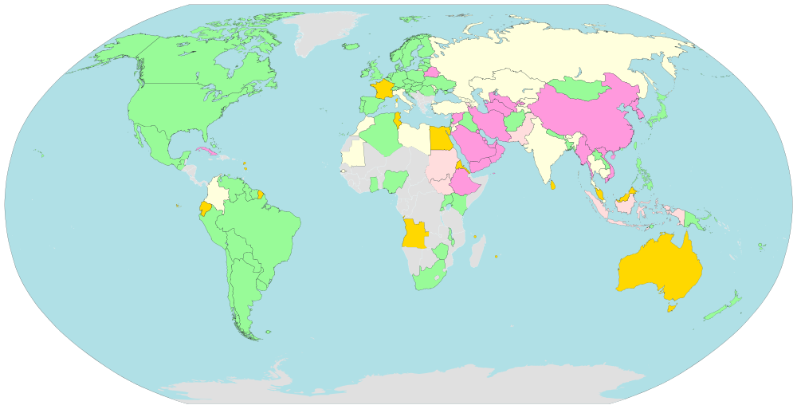

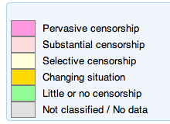
Current Estimates of Internet Censorship
Magenta-colored countries are “internet black holes”:
have heavy censorship of political, social, and news sites,
internet tools, etc.
Figure source: OpenNet Initiative (ONI), Reporters Without Borders (via wikipedia; updated Jan 6, 2014)

Slide 3
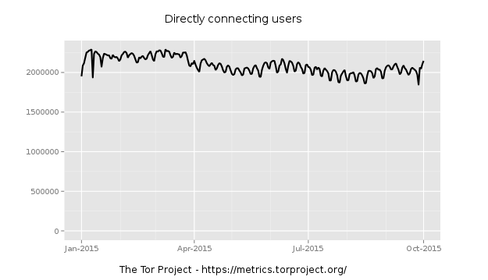
How to bypass censorship
Tor -- the most popular low-latency, anonymous network
About 2M users/day!
However, Tor can be detected, and is blocked in some countries

Slide 4





Approaches to blocking Tor
Destination IP is in blacklist. Drop it!
Tor client
Censor
Tor relay
What censors can do:
IP filtering
Deep packet inspection
Active probing
What censors can see:
source address
destination address/port
application-level protocols
keywords in payloads
…

Slide 5
Approaches to blocking Tor
Cipher Suites (24 suites)
Cipher Suite: TLS_ECDHE_ECDSA_WITH_AES_128_GCM_SHA256 (0xc02b)
Cipher Suite: TLS_ECDHE_RSA_WITH_AES_128_GCM_SHA256 (0xc02f)
Cipher Suite: TLS_ECDHE_ECDSA_WITH_AES_256_CBC_SHA (0xc00a)
Cipher Suite: TLS_ECDHE_ECDSA_WITH_AES_128_CBC_SHA (0xc009)
……
Match its known Tor cipher suites fingerprint.
Drop it!
Tor client
Censor
Tor relay
What censors can do:
IP filtering
Deep packet inspection
Active probing
What censors can see:
source address
destination address/port
application-level protocols
keywords in payloads
…

Slide 6

Censorship vs. censorship circumvention
Censorship Circumvention tools
Censors
Identity the traffic from Censorship Circumvention tools:
VS.
Prevent censors from identifying its traffic effectively:
HIGH true-positive rate (TPR)
LOW false-positive rate (FPR)
LOW true-positive rate
HIGH false-positive rate
protocol
 | Censored | Not censored
Censored | TP | FP
Censor
label
Network Protocol Obfuscation
Prevent censors from recognizing the protocol
Cause censors to misidentify flows of a censored protocol as a “benign” protocol
Types: Randomizer, Protocol mimicry, Tunneling

Slide 7
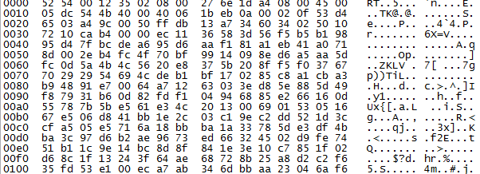
Network protocol obfuscation
Randomizer: Dust, Obfsproxy3, Obfsproxy4 – “Look like nothing”
Don’t know what it is. Let it go
Obfsproxy3
Network monitor
Wiley, Brandon. "Dust: A blocking-resistant internet transport protocol." 2014-03-26], http://blanu. net/Dust. pdf (2011).

Slide 8

Network protocol obfuscation
Protocol Mimicry: SkypeMorph, Stegotorus, FTE proxy
It’s just HTTP.
Let it go
FTE
Network monitor
Weinberg, Zachary, et al. "StegoTorus: a camouflage proxy for the Tor anonymity system." CCS 2012
Mohajeri Moghaddam, Hooman, et al. "Skypemorph: Protocol obfuscation for tor bridges." CCS 2012
Dyer, Kevin P., et al. "Protocol misidentification made easy with format-transforming encryption." CCS 2013.

Slide 9
Network protocol obfuscation
Tunneling: meek – leverage genuine TLS connection and Cloud
It’s just TLS.
Let it go
meek
Network monitor
TLS
HTTP
Tor
Fifield, David, et al. "Blocking-resistant communication through domain fronting." PETS 2015

Slide 10
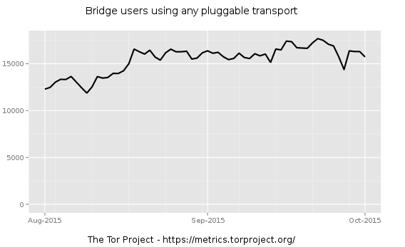
Network protocol obfuscation
Some obfuscators such as obfsproxy3, obfsproxy4, FTE and meek are deployed in the Tor Browser Bundle as Tor Pluggable Transport (PT) and in use
10K+ users /day
Can censors detect the obfuscators reliably?

Slide 11
Proposed Attacks against Tor Pluggable Transports
Name | Type | Used in Tor? | Proposed Attack | Source
Obfsproxy3 | Randomizer | Yes | NONE
Obfsproxy4 | Randomizer | Yes | NONE
meek | Tunneling | Yes | NONE
FTE | Mimicry | Yes | Semantics-based attacks | Dyer et al., 2013
SkypeMorph | Mimicry | No | Semantics-based attacks, traffic analysis | Houmansadr et al., 2013 J. Geddes et al., 2013
Stegotorus | Mimicry | No | Semantics-based attacks | Houmansadr et al., 2013
Semantics-based attacks: looking for the deviations of a target system from expected behaviors
Value in Content-length field ≠ real content length.
Blacklist it!
FTE
Censors
FTE bridge

Slide 12
Proposed Attacks against Tor Pluggable Transports
Name | Type | Used in Tor? | Proposed Attack | Source
Obfsproxy3 | Randomizer | Yes | NONE
Obfsproxy4 | Randomizer | Yes | NONE
meek | Tunneling | Yes | NONE
FTE | Mimicry | Yes | Semantics-based attacks | Dyer et al., 2013
SkypeMorph | Mimicry | No | Semantics-based attacks, traffic analysis | Houmansadr et al., 2013 J. Geddes et al., 2013
Stegotorus | Mimicry | No | Semantics-based attacks | Houmansadr et al., 2013
Proposed attacks have not been evaluated in terms of false positives
No attacks against obfsproxy3, obfsproxy4 and meek!

Slide 13
Our contributions
Analysis of false-positive rates of attacks on terabytes of network traces
-- Old attacks: Semantics-based
-- New attacks: Entropy-based, ML-based
New attacks against deployed Tor PTs that achieve:
-- High true-positive rates
-- False-positive rates <= 0.2%
Obfuscator | TPR | FPR
Obfsproxy3 | 100% | 0.2%
Obfsproxy4 | 100% | 0.2%
FTE | 100% | 0.003%
meek-amazon | 98% | 0.02%
meek-google | 98% | 0.006%

Slide 14







Synthetic dataset for TPR
Tor Dataset:
Campus network
Alexa top 5K
Home network
Internet
Home network
15,000 traces of each of obfsproxy3, obfsproxy4, FTE, meek-google, meek-amazon

Slide 15


Real network traces from UW-Madison for FPR
Campus Dataset:
Office network
Border router
Internet
Border router
Campus networks
AWS
Azure
Access point
Campus networks
Internet
Networks contains 320K hosts
A total of 14M TCP flows

Slide 16
Proposed Attacks against Tor Pluggable Transports
What are the false-positive rates of the proposed attacks?
Name | Type | Used in Tor? | Proposed Attack | Source
Obfsproxy3 | Randomizer | Yes | NONE
Obfsproxy4 | Randomizer | Yes | NONE
meek | Tunneling | Yes | NONE
FTE | Mimicry | Yes | Semantics-based attacks | Dyer et al., 2013
SkypeMorph | Mimicry | No | Semantics-based attacks, traffic analysis | Houmansadr et al., 2013 J. Geddes et al., 2013
Stegotorus | Mimicry | No | Semantics-based attacks | Houmansadr et al., 2013

Slide 17
Semantics-based attack against FTE
DPI test: value in Content-Length field
≠ real content length → Block it.
FPR = 1.4%: 1.4% of HTTP messages from campus dataset have incorrect Content-Length fields
Early terminated connection
Web browser bugs
Non-ASCII characters
Web application bugs
Transfer-Encoding fields
Causes?
Dyer, Kevin P., et al. "Protocol misidentification made easy with format-transforming encryption." CCS 2013.

Slide 18






Semantics-based attack against Stegotorus
DPI test: a PDF has incorrect xref table → Block it
FPR = 43%: 43% of the 10,847 PDFs from campus datasets have incorrect xref tables
A breakdown of false positives
HTTP range requests or byte-serving
Multiple
connections
Get 1-1023 bytes
Get 1024-2047 bytes
View a PDF
Get 2048- 3072 bytes
reconstruction
censor
Houmansadr, Amir, et al. "The parrot is dead: Observing unobservable network communications." IEEE SP 2013.

Slide 19
Semantics-based attacks may be hard to deploy, so…
We develop new attacks!
High true-positive rate
Low false-positive rate
Good performance

Slide 20
Overview of new attacks
Obfuscator | Attack | TPR | FPR
Obfsproxy3 | entropy + length | 100% | 0.2%
Obfsproxy4 | entropy + length | 100% | 0.2%
FTE | URI entropy + length | 100% | 0.003%
meek-amazon | decision tree | 98% | 0.02%
meek-google | decision tree | 98% | 0.006%

Slide 21
Overview of new attacks
Obfuscator | Attack | TPR | FPR
Obfsproxy3 | entropy + length | 100% | 0.2%
Obfsproxy4 | entropy + length | 100% | 0.2%
FTE | URI entropy + length | 100% | 0.003%
meek-amazon | decision tree | 98% | 0.02%
meek-google | decision tree | 98% | 0.006%

Slide 22
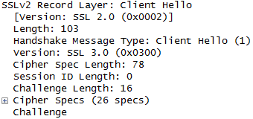
Entropy-based attacks
Inspect the handshake message (the first message sent)
Conventional encryption protocols (e.g, TLS): plaintext + random bytes
Obfsproxy3/4:
encrypted, a random string
VS.
Length of handshake message: >= 146 bytes

Slide 23
Entropy-based attack for Obfsproxy3/4
Possible tests
Shannon entropy
Kolmogorov-Smirnov two sample test (KS-2) on blocks
KS-2 test on bytes
Sequential probability ratio test (SPRT)
Winner = KS-2 test on 8-byte blocks + payload length check
White, Andrew M., et al. "Clear and Present Data: Opaque Traffic and its Security Implications for the Future." NDSS 2013
Everspaugh, Adam, et al. "Not-so-random numbers in virtualized Linux and the Whirlwind RNG." IEEE SP 2014.

Slide 24
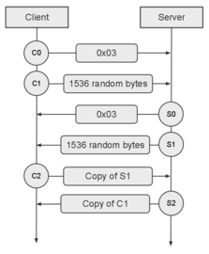
Entropy-based attack for Obfsproxy3/4
DPI test: message length >= 146 +
Pass KS-2 test on 8-byte blocks → Block it
FPR = 0. 2%: 36 K (0.2%) false positives out of 14 M flows
Real Time Messaging Protocol

Slide 25
Entropy-based attacks
Inspect the handshake message (the first message sent)
HTTP
FTE: the URI is an encrypted and encoded message, more random than ordinary URIs
GET /docs/pluggable-transports.html.en
VS.
GET /GPk9Rtx58CWMO.H07vbaCA2JlmfpXfbwpIQHpRWfQGKvTjx4Q/kBlYNOY4YCR5fua/sq.2SONRQ8VC6ID9R0pcmsRbuXHlkil.d0b.sspZbb0Int87a8bwUVsZXD7KA9UU.AVz8cesOIyjIHOHhQWyyLzZ2hMtsrMH62LlzWrSi3VMIqAV1JdOQZX.Y.k1YAPL.pjXg8czoI.YPFrfZRVVmEz/lx8ZM5MyFveEY5I
GET /ccs/CCS2015/
GET /download
……
Length of URI = 234 bytes

Slide 26
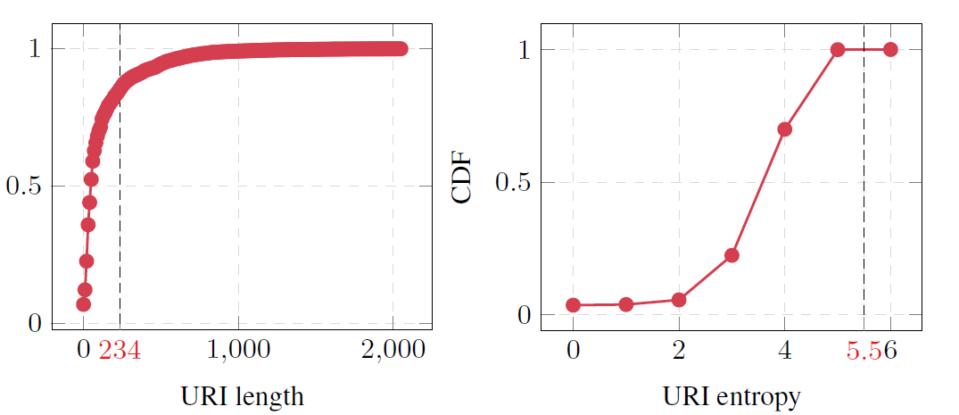
Entropy-based attack for FTE
DPI test: URI length = 234 +
URI Shannon entropy > 5.5 → Block it
FPR = 0. 003%: 264 (0.003%) false positives out of 10 M URIs
Only use length:
FPR = 15%
Only use entropy:
FPR = 0.5%
CDF of length and entropy distribution of the 10M URIs from the campus dataset

Slide 27
Overview of new attacks
Obfuscator | Attack | TPR | FPR
Obfsproxy3 | entropy + length | 100% | 0.2%
Obfsproxy4 | entropy + length | 100% | 0.2%
FTE | URI entropy + length | 100% | 0.003%
meek-amazon | decision tree | 98% | 0.02%
meek-google | decision tree | 98% | 0.006%

Slide 28
Meek client will poll meek server periodically
meek-client
TLS
meek-server
HTTP
Tor
Internet
Any data received?
ACK + response: No!
Any data received?
ACK + response: No!
Any data received?
Data
ACK + response: Yes!
Data
Any data received?
……
See lots of TCP ACKs
censor
Tor project. Tor meek. https://trac.torproject. org/projects/tor/wiki/doc/meek, 2015.

Slide 29
Traffic analysis via ML
How many packets of a flow are used for feature extractions?
Time-based or Packet-count
What features are used?
Timing-based, Entropy-based, or Packet-header
What classification algorithm is used?
KNN, Naive Bayes, or CART
A total of about 1.3K possible combinations

Slide 30
Performance of ML attacks on Tor datasets
Winner = Decision tree + features based on entropy and packet header + first 30 packets for feature extraction
Average TPR: 97.6%
Decision tree complexity: 6 – 13 comparisons

Slide 31
False positives of ML attacks on campus datasets
Decision tree + features based on entropy and
packet header + first 30 packets for feature extraction
False-positive rate (out of 14 M TCP flows) for each target:
The aggregated false-positive rate across all targets is 0.98%

Slide 32
Challenge and future work
ML-based attacks: Portability
How to reduce FPs?
Challenge &
future work
Sufficient low FPRs for censors?
……

Slide 33





Are the false positives too many for censors?
Censors could use a two-stage detection pipeline (as the Great Firewall of China) to reduce false positives
Run our tests
Fast path
IP = A
IP = B
Blacklist B
Could not make a decision:
submit B to slow path
Slow path
Active probe
Traffic analysis
….
More accurate attacks

Slide 34
Conclusion
Questions?
Obfuscators used in Tor can be detected by DPI-based censors reliably with high TPRs and low FPRs
Obfuscator | Attack | TPR | FPR
Obfsproxy3 | entropy + length | 100% | 0.2%
Obfsproxy4 | entropy + length | 100% | 0.2%
FTE | URI entropy + length | 100% | 0.003%
meek-amazon | decision tree | 98% | 0.02%
meek-google | decision tree | 98% | 0.006%
First false-positive rate analysis of DPI-based Tor-obfuscator attacks
Open questions: portability of ML attacks, lower FPs?

