Slide 1
Next Stop, the Cloud: Understanding Modern Web Service Deployment in EC2 and Azure
Keqiang He, Alexis Fisher, Liang Wang, Aaron Gember, Aditya Akella, Thomas Ristenpart
University of Wisconsin-Madison

Slide 2










Move to IaaS clouds
Private Datacenters
Co-location
Centers

Slide 3

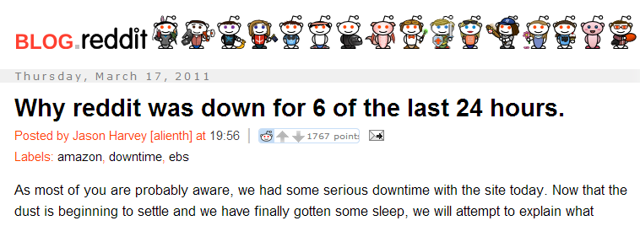
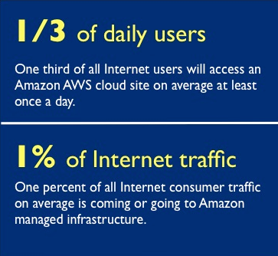
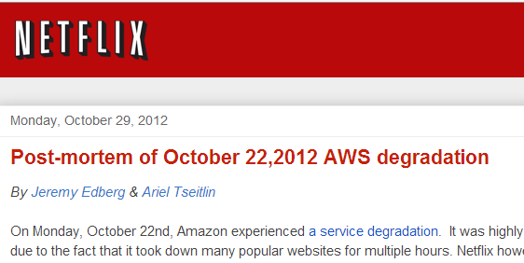
Incomplete view of cloud use
Want a global, in-depth understanding of IaaS cloud usage patterns

Slide 4
Fundamental questions
Who is using public IaaS clouds?
Traffic patterns; network design/traffic engineering
How are these services using the cloud?
Impact of failures; ways to improve availability
Design of new systems/services
How can quality of experience be improved?
Deployment design (e.g., ideal region/zone usage)

Slide 5

First in-depth empirical study examining IaaS cloud usage patterns and identifying ways tenants could better leverage IaaS clouds

Slide 6

IaaS cloud environments
DNS Server
Platform-as-a-Service (PaaS)
VM
VM
LB Proxy
VM
PaaS Node
CDN

Slide 7










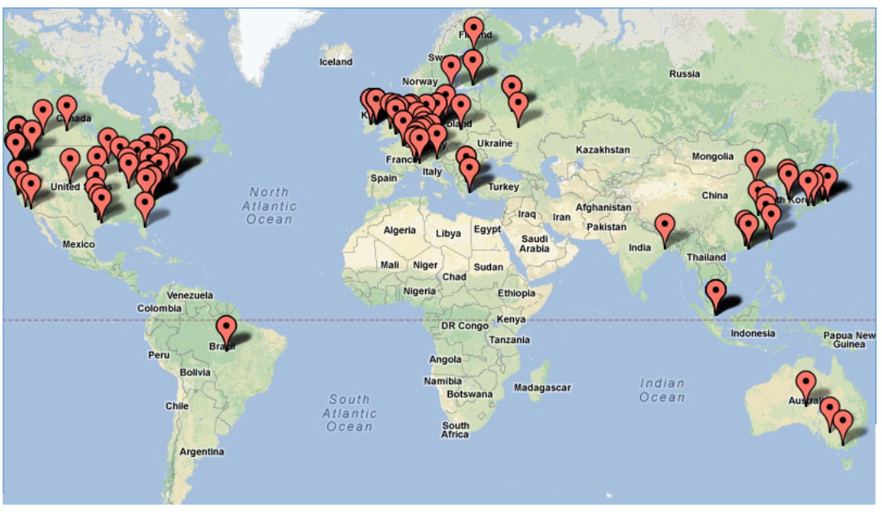

Datasets
University packet capture
Deep, but possibly atypical, perspective
Alexa subdomains DNS records
Broad, high-level perspective
IP Ranges
Conn records
Campus Traffic
1.4TB Capture
Zone transfer
Top 1 million
DNS records
Subdomains
Notes:
Alexa subdomain DNS records, 34 million DNS records
Univeristy dataset , 1 week worth packet trace . Captured at the our campus network borader
Alexa web service info: customer location, page view etc
EC2 sampling instances: self-run instances in EC2, about 5000 instances setup, record instance type, private/public Ips and AMI info.
Wide area network performance measurement. Measurement data from worldwide locations to cloud for several days.
More info about measurement methodology and details later. We will talk about how we get the dataset and how we use these datasets later, combined with the questions we will be investigating

Slide 8
Fundamental questions
Who is using public IaaS clouds?
Traffic patterns; network design/traffic engineering
How are these services using the cloud?
Impact of failures; ways to improve availability
Design of new systems/services
How can quality of experience be improved?
Deployment design (e.g., ideal region/zone usage)

Slide 9




How many popular web services use the cloud?
43% in top 250K domains
Cloud-using domains
Cloud availability and performance issues may impact over 4% of popular web services
9.
13.
29.
35.
36.
2 of 68
Non-cloud-using domains
3 of 142
4 of 181
18 of 24
14 of 89
9
Notes:
The first interesting question we try to answer is: what fraction of the web services are hosted in public clouds currently?
We took the following steps to answer this question:
1)Get the top 1M websites ranked by Alexa. As you know, Alexa is a very popular website ranking service provider.
2)We use zone transfer and brute-force subdomain discovery tools (Knock and DNSmap) to find the subdomains for each websites.
3)We perform globally distributed DNS lookups to get the IP address associated with each subdomain. Please note that distributed DNS queries help ensure that we gather a comprehensive set of DNS records for each cloud-using subdomain and capture any geo-location-specific cloud usage. This figure shows our DNS lookup testbed. It is implemented on Planetlab.
Finally, we got about 34 millions DNS records.
4)Identify the EC2 and/or Azure-using domains/subdomains. If the subdomain’s IP address is within the IP address blocks published by AWS EC2 and Windows Azure, we say that this subdomain is hosted in EC2 and/or Azure. If any of the subdomains of a domain is using EC2 and/or Azure, then we say this domain is EC2 and/or Azure-using domain.
To the end, we identify that about 4% of the Alexa 1M websites are using EC2 or Azure.
Interestingly, the majority of the cloud-using domains are in AWS EC2, while a considerable small fraction are hosted in Windows Azure.

Slide 10






Which (locally) popular web services use the cloud?
Traffic Volume (Bytes)
68.2%
atdmt.com
3.1%
1.7%
2.4%
1.1%
msecnd.net
2.3%
0.7%
1.5%
0.6%
s-msn.com
1.4%
Cloud availability and performance affects a substantial fraction of popular web services
Notes:
3) We also identify the high traffic volume domains in EC2 and Azure. We find that the top traffic contributors in EC2 are more diverse than those in Azure. EC2 top traffic contributors include: dropbox (storage), netflix (video ), truste (advertising), pinterest (social networking), zynga (gaming) and instagram (photo shaing) etc.
On the other hand, Azure top traffic contributors are usually Microsoft-related servicers or products such as MSN. Please note that “atdmt” is Microsoft cookie service and “msecnd” is Microsoft’s Content Distribution Network.

Slide 11







What type of content is served by (locally) popular web services?
Compression could be employed to save WAN bandwidth and improve delivery latency
HTTP Content Type
24.1%
text/html
text/plain
image/jpeg
app/flash
app/octet-stream
23.4%
Top 100 cloud-using domains account for
10.6%
≈80% ≈100%
8.7%
7.8%
of HTTP flows

Slide 12
Fundamental questions
Who is using public IaaS clouds?
Traffic patterns; network design/traffic engineering
How are these services using the cloud?
Impact of failures; ways to improve availability
Design of new systems/services
How can quality of experience be improved?
Deployment design (e.g., ideal region/zone usage)

Slide 13
IaaS cloud environments
DNS Server
PaaS
VM
VM
LB Proxy
VM
PaaS Node
CDN

Slide 14
Which front ends are used?
VM
DNS Server
VM
?
sub.abc.com | A | 72.44.32.1
VM
sub.abc.com | CNAME | abc.elb.aws.com
abc.elb.aws.com | A | 72.44.42.1
LB Proxy
LB Proxy
?
VM
sub.abc.com | CNAME | proxy.heroku.com
proxy.heroku.com | A | 72.44.62.1
String matching on CNAME
DNS records
PaaS Node
PaaS Node
?
Notes:
We now proceed to uncover the deployment posture of the cloud tenants.
IaaS usually offers the tenant a handful of features to enhance the performance and availability of their services.
Beside Virtual Machine, they (or by third parties) offer PaaS (platform as a service),
Load balancer and CDN (Content distribution network) etc.
In the figure shown in this slide, we illustrate the steps involved in a client accessing an EC2-hosted web service that is using one or more of the aforementioned features. When a client wants to access a web service, It first performs a DNS lookup of the service’s domain name. The response may contain an IP address associated with a VM (P1), a load balancer (P2), or a platform-as-a-service (P3).
With P2, the client request is subsequently directed to a VM. Tenants using P1–P3 may also rely on additional VMs or systems (dashed lines) to handle a client’s request; these additional components may or may not be in the same region or availability zone (indicated by the gray boxes). An object returned to a client (e.g., a web page) may sometimes require the client to obtain additional objects (e.g., a video) from a content-distribution network (P4).
We focus on studying the front end portions of web service deployments within the above four deployment patterns (indicated by the thicker lines in Figure). These portions are encountered within the initial few steps of a client making a request.

Slide 15

Which front ends are used?
There is limited uptake of value-added features
≈60% of ELB-using subdomains resolve to 2+ ELB IPs
≈4% of ELB IPs are shared by 10+ subdomains
Notes:
Our major observations for Q3 are listed here:
We estimate that, currently, 72% EC2-using subdomain uses VM front end4% of EC2-using subdomain use ELB front end; 8% use PaaS front end; ~1% use CDN (CloudFront).
Among the subdomains leverages PaaS front end, 97% of them use heroku and only 3% uses Elasticbanstalk
For the subdomains that leverage Load Balancer, we found that ~4% of the physical ELB instances are shared by 10 or more subdomains.
72% of the subdomains make use VM front end, but, about 10% of the domains which use front end VMs in EC2 use 3 or more front end VMs in total
---------------------------------------backup-----------------------
We also found that only 5% of the cloud-based web services’ DNS name servers are hosted within VMs in the cloud. The majority of DNS servers used by cloud-using subdomains reside outside of EC2 or Azure.
The usage of Load Balancer and DNS name server follow a long-tailed distribution. The majority of the subdomains just use a few.
For example, more than 80% of the subdomains use just about 3 name servers.

Slide 16
Which front ends are used?
9.
13.
29.
35.
36.
Failures of value-added features will impact the most popular EC2-using subdomains
LB
PaaS
LB
PaaS
CDN
VM
VM
LB

Slide 17



Which locations are used?
DNS records
Match IP against region ranges

Slide 18

How many and which regions are used?

Slide 19

How many and which regions are used?

Slide 20




How many and which regions are used?
Single region failures can take down a large fraction of cloud-using subdomains
9.
13.
29.
35.
36.
1
7.
18.
20.
31.
3
2
5
1
1
1
5
2
Notes:
Then, we calculate how many regions are being used by each subdomains. Surprisingly, we find that
Over 97% of EC2-using and 92% of Azure-using subdomains exclusively use one region.
We also exam the top ranked domains. Even them just use quite limited number of regions (Table 10 in the paper, not shown here for brevity).
Current deployment posture makes Web services vulnerable to single region failure caused by Hurricane etc. We estimate that EC2 US East region failure can take down about 61% of the EC2-based domains!

Slide 21
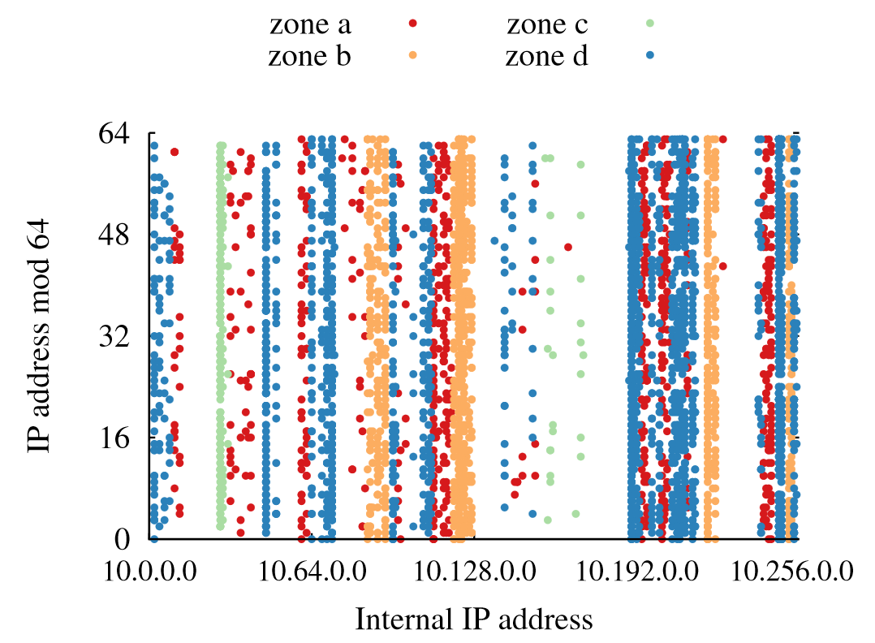
How many and which availability zones are used?
Latency measurements
Low latency => instances are in same zone
High coverage, low accuracy (noisy)
IP address correlation
IPs are in the same /16 subnet => instances are in the same zone
Higher accuracy, low coverage
Notes:
To answer this question, we gradually came up with three solutions.
The first one is latency based approach. The basic idea is to first set up probing instances in each EC2 zone. There are 20 zones when we conducted our experiments. We performed DNS lookup within each EC2 region to get the private IP address for each subdomain’s public IP.
For example, suppose a subdomain “movie.abc.com” has only one public IP address: A.B.C.D. We judge which region the IP is hosted by checking it against the published IP address blocks for each region. Here we assume A.B.C.D is in US East region.
Then we can construct this subdomain’s EC2-formating domain name by obeying some naming rules. Then we conduct DNS lookup in US east region to get A.B.C.D’s private IP address.
Finally, we measure the RTT between the probing instances and the target private IP. We found that lowest RTT implies that the target private IP is hosted in the same zone as the probing instance.
The second approach is IP address approximation method. The basic idea is that the IP addresses (private IP address) within the same /16 IP block tend to be in the same zone. So we first set up sampling instances (5096 instances in total) and compare the private IP address with the instance’s IP we run. In this way, we can tell which zone a particular private IP is because we know in which zone our own instance is!
The third approach is a combined method. In other words, if we can judge the zone assignment based on IP approximation, then it is down. Otherwise, we use latency based approach. The reason is that the IP approximation method has better accuracy but lower coverage. On other hand, latency based method has higher coverage but lower accuracy.

Slide 22

How many and which availability zones are used?
Single zone failures can take down 16% of subdomains and cripple many others
9.
13.
29.
35.
36.
4
5
1
3
5
Notes:
We found that the majority of EC2-using subdomains only use one or two zones.
And, the subdomains using a give EC2 region are not evenly spread across the availability zones of that region.
Combined our findings on region usage, we find that current Web service deployment posture is quite vulnerable to single zone failures!

Slide 23
Fundamental questions
Who is using public IaaS clouds?
Traffic patterns; network design/traffic engineering
How are these services using the cloud?
Impact of failures; ways to improve availability
Design of new systems/services
How can quality of experience be improved?
Deployment design (e.g., ideal region/zone usage)
Many popular web services are not deployed optimally for their users

Slide 24
Future measurements
Use of other clouds (e.g., Rackspace)
Use of other EC2 and Azure features
Back end deployments
Packet captures from other vantage points

Slide 25
Summary
Systematic method for studying IaaS cloud use
4% of popular web services use EC2/Azure
VMs are the most popular EC2 front end, but value-added features are used by top domains
Limited region and zone use (and diversity) makes web services vulnerable to failures
Notes:
Finally, we summarize the main findings of our work here:
1)
2)
3) A considerable large fraction of Web services are not optimally deployed near their customers, a large fraction of client traffic needs to travel further than necessary.
4)

Slide 26
Are web services deployed near users?
Compare a domain’s customer country (according to Alexa) and region usage
47% of subdomains are not deployed in the same country as users
32% subdomains are not deployed on the same continent as users
Notes:
The 6th question we tried to answer is Web service deployment vs. customer location. In other words, we want to know this interesting question—Are the cloud-using web services deployed near their customers?
To answer this question, we first use Alexa web information service to identify a domain’s “customer country”. For example, Alexa reported that 47% of clients accessing pinterest.com are from the United States, 10.4% from India, 3.2% from the United Kingdom, 3.1% from Canada, and 2.1% from Brazil. In this example, US is “pinterest.com”’s customer country. Because Alexa does not report subdomain’s customer country, so we assume that the subdomain’s customer country equals to its domain’s customer country.
Finally, we compare subdomain customer country and its deployment location.

Slide 27
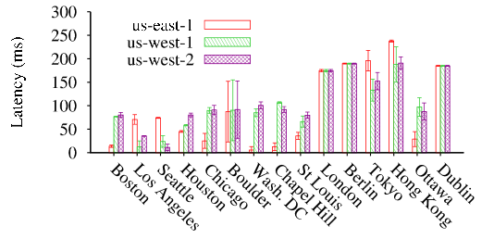
What is the user perceived network performance for different regions/zones?
Regions should be selected based on users’ locations
Notes:
We found that Performance among different regions vary greatly while performance among different region of the same region is almost the same. Throughput and latency is mainly affected by distance.
Recall our observations on Web service deployment versus its customer location. We argue that the tenant need to rethinking their region selection!
Other issues affect region selection 1)cost 2)region built time

