Slide 1
WhoWas: A Platform for Measuring Web Deployments on IaaS Clouds
Liang Wang*, Antonio Nappa⁺, Juan Caballero⁺, Thomas Ristenpart*, Aditya Akella*
* University of Wisconsin-Madison
+ IMDEA Software Institute
Notes:
Good afternoon everyone, I am Liang Wang from UW-­Madison. My advisors AA and TR. Today I am going to introduce a new measurement platform for measuring web deployments on Infrastructure as a service clouds. We call it Whowas. This is a joint work with AN and JC from IMDEA software institute.

Slide 2






Motivation
An increasing number services are using clouds
Understanding cloud usage pattern is important
How many instances are used by a website?
What is the usage pattern of a website?
Do tenants leverage elasticity?
Is piratebay using EC2?
Are there OpenVPN servers in EC2?
- Design new services & applications
- Design provisioning & scaling algorithm
Notes:
(2) In recent years, cloud services become more and more important. An increasing number of services are using clouds, such as netflix and dropbox. Understanding cloud usage pattern is very important. There are a bunch of questions about usage patterns, from general to specific, we don’t have answers yet.
For example, what is the usage pattern of a particular website? How tenants leverage elasticity? And so on. Knowing the answers to these questions can help people to design new S&A, and help datacenters to design new P&S alog.

Slide 3
Motivation
Little research about how tenants use public clouds
Deepfield, 2012: 1/3 of daily users, 1% of Internet traffic are associated with AWS
He et al., IMC 2013: 4% of the Alexa top million are in EC2/Azure
Answer the question: Who is using public clouds?
Technique: Investage DNS entries for Alexa top websites and network packet capture data.
No insight into changes to deployment pattern over time
Bermudez et al, INFOCOM 2013: Exploring the cloud from passive measurements: The Amazon AWS case
We need more measurement tools
Notes:
(3) Unfortunately, there are few research about how tenants use public clouds. In 2012, deepfield reported that one third of all internet users will access the websites in Amazon AWS cloud on average at least once a day. About 1% of internet traffic is coming from or going to Amazon AWS services. However, we don’t know what methodology they used to get these results. In 2013, my colleague and I had investigated DNS entries for Alexa top 1m domains and used network packet capture data that collected at campus to answer the question: Who is using public clouds. And we found about 4% of the Alexa top 1 million domains are using EC2/Azure. In that project, we have some visibility of cloud but didn't provide insights into changes to deployment pattern over time. There are other studies also use network packet capture data to study the clouds. We realized to get a broader view of clouds, we may need to collect data at larger ISPs or even in side the datacenter, which is hard.
To get a deep understanding of cloud usage pattern, we need more measurement tools, techniques and datasets.

Slide 4
Contributions
We develop a new measurement platform, WhoWas, to facilitate measurement studies of public cloud services
High churn rates of IPs used by services each day
Quantify growth in usage of
EC2 & Azure
Most of web services use a single IP
WhoWas
Small number of malicious websites in clouds
New software adopted slowly. Outdated software popular
Notes:
(4) We develop a new measurement platform, WhoWas, to facilitate measurement studies of public clouds.
Using whowas, we get lots of interesting results about cloud usage patterns. For example, we quantify growth in usage of EC2/Azure; We study the churn rates of IP used by web services each day, and more about deployment pattern, security and web software ecosystem.

Slide 5






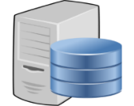



The WhoWas Platform
Lightweight probing to associate content to IPs over time
Analysis
APIs
TCP SYN Probes
Analysis
HTTP GET:
http(s)://1.1.1.1/
WhoWas
DB
IP ranges
IP=1.1.1.1
At most 3 probes for an IP per day
At most two GET requests for an IP per day
Feature Generator
Clustering Engine
VPC Map
Notes:
(5) So how does WhoWas works? We ran the whowas platform on two measure machines in UW-Madison campus. Whowas takes public IP ranges of clouds as input and exclude those IPs that requested not to be probed. For a target IP, whowas sends TCP SYN probes to the default ports for HTTP and HTTPs. If the ports are open, we assume web service are running at the target IP, and send HTTP GET request to a URL that is constructed based on IP address, to collect the HTML page content. The collected content will go through whowas analysis engine and the analysis results will be stored into a MySQL database. WhoWas also provides programmatic interfaces that can be used to get the detailed information such as HTML contents on a given IP or aggregated stats such as number of webpages have the same title field.

Slide 6
Ethical Measurement Design
Lightweight, low-frequency probing
Robots.txt checking
Note in the User-Agent
IP exclusion list
Collected data kept private
Servers are not designed to be public (many tenants didn’t realize their servers are public)
Providers charge tenants based on traffic
Privacy issues
Notes:
(6) We want to conduct the measurement study ethically. so we decide to follow ethical guidelines in the whowas design. First we use lightweight, low-frequency probing to reduce the burden on the target server and cloud networks. Remember that clouds providers charge tenants based on traffic. The traffic from whowas, even though very small, still is unwelcome for some users. And We will check and respect robots.txt to follow website access policy. Then we leave a note in the User-Agent field of the requests sent by whowas. The web operators can contact us If they don’t want their servers being scanned. We will exclude those IPS of their servers from future probing. Finally, we decide to keep the collect data in private due to some private concerns such as tenants may not want the IPs of their server to be public.

Slide 7
Data Collection & DataSets
EC2: 4,702,208 IPs Oct 2013 – Dec 2013 51 rounds
Azure: 495,872 IPs Nov 2013 – Dec 2013 46 rounds
About 900 GB data in total
Overall growth of No. of IPs responding to probes:
4.9% in EC2 and 7.7% in Azure
24.4% of all IPs
22.6% of all IPs
No. of clusters
24.3% of all IPs
22.6% of all IPs
Notes:
(7) We conduct the measurement in EC2 for 3 months and in Azure for 2 months. In one round of scanning whowas will visit all the IP addresses input to WhoWas. We finished 51 rounds of scanning in EC2 and 46 rounds in Azure. And we collected a total of 900GB data.
The figure shows the number of IPs respond to probes in each round. We see the numbers various over time. The overall growth is 4.9\% in EC2 and 7.7% in Azure, but it didn’t increase progressively. We also observed fluctuations during the measurement in both clouds. We have see at least about 23% of all IPs respond to probes and at most 24% across all rounds. This is just the lower bound of servers running in the clouds, we expect the total number of the running servers is much more larger.

Slide 8
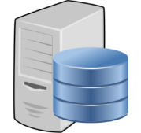

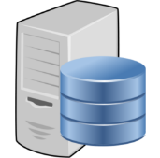



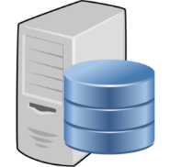

WhoWas Engines--Clustering
How to find IPs being operated by the same website?
Webpage Clustering
…
…
WhoWas offers a new clustering heuristic
8
Notes:
(8) To enable more rich analysis, we want to associate IP address to website. We assume similar webpages belong to the same websites, so IPs hosted the similar webpages are being operated by the same website. Then, we can use webpage clustering to associate IPs to websevices. We inspect several methods for webpage similarity comparison and clustering, and deviate from these prior work to build our customized clustering heuristic. How does the heuristic work?

Slide 9

WhoWas Engines--Clustering
Fingerprint (six-item tuple)
HTML contents
Title
Keywords
Template
Google Analytics ID
Simhash of HTML textual content
Server version
Feature
Extractor
Title
Keywords
Template
Google Analytics ID
Server version
Simhash of HTML textual content
Clusters
Yes
Same top level clusters
Use simhash
<IP, Round Number, Fingerprint>
<IP, Round Number, Fingerprint>
For two fingerprints, check if :
title1=title2 & keyword1=keyword2 & template1=template2 & server1=server2 & GID1=GID2?
Unsupervised clustering + Elbow method
Different clusters
No
Notes:
(9) (Process+ Limitations!!!!) For the HTML content collected from an IP on a given round , feature extractor will extract 6 features of interest to construct a fingerprint. Then we group the fingerprints based on five features to form top-level clusters. The fingerprints in the same top-level cluster have the same title, keywords, template, server, and google analytics ID. In each top-level cluster, we further use hierarchical clustering with the hamming distances of simhash feature as the metric to clustering the fingerprint. Simhash is a type of locality sensitive hashing, which is a lightweight way to compare the similarity of two contents. Then we use the elbow method to automatically decide the best number of clusters. Each of the final clusters represents a website or web services. In this way, we are able to associate IPs on a given round to some web services. //To develop this pipeline needs lots of manual works. We manually select the features, tuning the heuristics, and manually check 100s of clusters to verify the outcome. The thresholds chosen in the heuristics are conservative. So there are lots of room for improving this heuristics. One of our ongoing work is to evaluate the clustering results with a more systematic method. But we think it is a good heuristics, and we have high confidence that the heuristics does a good job.

Slide 10

WhoWas Engines--Clustering
EC2: 1,767,072 simhashes 243,164 clusters
Azure: 210,418 simhashes 31,728 clusters
The No. of clusters increased by：
3.3% in EC2 and 6.2% in Azure
Notes:
(10) We get about 240K clusters in EC2 and 31K clusters in Azure. We also saw an increase of clusters, about 3.3% in EC2 and 6.2% in Azure over the measurement periods. And similar to the IPs respond to probes, we also observed fluctuations in the number of clusters over time. So what is the characteristics of these clusters?

Slide 11
WhoWas Engines--Clustering
About 80% use 1 IP, 0.1% use more than 50 IPs
Large clusters tend to leverage cloud elasticity
Total #IP | Mean #IP/Round | Min #IP | Max #IP
51,211 | 33,145 | 30,624 | 34,509
15,283 | 5,597 | 5,435 | 5,785
3,869 | 2,029 | 1,724 | 2,228
22,226 | 1,167 | 179 | 2,501
8,488 | 617 | 57 | 1,837
Top 5 clusters by average number of IP addresses used per round (EC2)
Notes:
(11) Using whowas to examine these clusters, we found 80% of these clusters only use one IP while only 0.1% of them use more than 50 IPs. However, the 0.1% can use as many as 30K IPs per round. The table shows the top 5 clusters in EC2 based on the mean number of IPs a cluster used per round. We actually inspect the top 5 clusters to make sure all the webpages in a cluster belong to the same website. Just for interest, the top one is a Platform as a service website. So there are millions of applications are running at it. So the number of web services we found is only the lower bound of actual the web service deployed in the clouds.
Using whowas, we are also able to provide evidences of large clusters are taking advantage of elasiticity of public clouds. Take the top one for example, the number of IPs it used per round ranges from 30K to 34K. The mean number of IPs it used per round is about 33K, but the total number of IP address it used across all rounds is 51K. It indicates the websites frequently launch and shutdown instances.

Slide 12
More Results from WhoWas
Feature Adoption
Malicious Activity
Cloud Availability
Software Adoption
Notes:
(12) We use whowas to study following 4 aspects of clouds.
Due to time limitations, I will only present some details on the first two, and refer you to the paper for the much broader set of results.

Slide 13
More Results from WhoWas
Feature Adoption
Malicious Activity
Cloud Availability
Software Adoption
Notes:
(13)

Slide 14


Virtual Private Cloud Mapping
DNS
Resolve Host A
Resolve Host B
Get a Private IP != a
Always Get Public IP b
Default DNS hostname
=region specific string + IP
Host B, Public IP=b
Host A, Public IP=a
Classic network
VPC networks
EC2 Data Center
Notes:
(14) Amazon Virtual Private Cloud or VPC is one important feature of EC2. VPC allows users to create a fully­-controllable and easy-­to-­customized virtual networking. It provides many benefits in different aspects such as in management and security. Amazon has encouraged users to use VPC. Using Whowas, we can exam how tenants leverage this new feature. The first thing we need to do is to figure out how many IPs are allocated for VPC.
In EC2, the public DNS hostname associated with a public IP has a regular pattern. After knowing the DNS hostnames of all public IPs, we can leverage the behaviors of the default DNS servers inside clouds to figure out an IP is in VPC or in classic. In each EC2 region, first we need to launch an instance in the classic network, and we try to resolve the DNS hostnames of the other public IPs in the same region. We send DNS request to the default DNS server from the instance we launched. For a target IP, if its hostname is resolved to a private IP, we know the target IP is in classic networks. Otherwise, its hostname is resolved to the public IP, which is the same as the target IP, we know the target IP is using VPC networks.

Slide 15
EC2 VPC usage increase whereas classic decrease
classic-only
VPC-only
mixed clusters
Change over time in classic-only, VPC-only, and mixed clusters in EC2
Notes:
(15) After labeling all the IPs in EC2 as classic or VPC, we defined 3 types of clusters based on what types of IPs a cluster used, and examine the changes of different types of clusters. We can see that the clusters only use IPs in classic networks decrease slowly, while the clusters only use IPs in VPC networks and the clusters use IPs in both networks increase stably. We actually observed that in EC2 the VPC usage increase while the classic usage decrease. We have more evidences in our paper.

Slide 16
More Results from WhoWas
Feature Adoption
Malicious Activity
Cloud Availability
Software Adoption
Notes:
(16) Then I want to talk about some results about the malicious activity in clouds

Slide 17





Lifetime of malicious IP is long
WhoWas
DB
IP is malicious
Webpage from an IP
URLs in webpage
Safe Browsing API
IP is benign
EC2: 1,393 malicious URLs 196 malicious IPs
Azure: 14 malicious URLs 13 malicious IPs
90+ days!
60% up for
7+ days
Notes:
(17) We extract all the URLs contained in web pages collected by Whowas in a round and check each URL with GSA after each round of scanning. The GSA will label each URL as malicious or benign. If an IP is hosting malicious URLs, we call the IP malicious IP. Then we define the lifetime of a malicious IP as the time between the first time and the last time we saw the IP hosted malicious URLs. We found the lifetime of a malicious IP can be very long. About 60% of malicious IPs hosted malicious URLs for more than 7 days. Some IPs, hosted malicious URLs for more than 90 days. In EC2, we also saw few malicious IPs hosted web pages that aggregate many malicious URLs under different domains. These IPs usually have a long time lifetime.

Slide 18
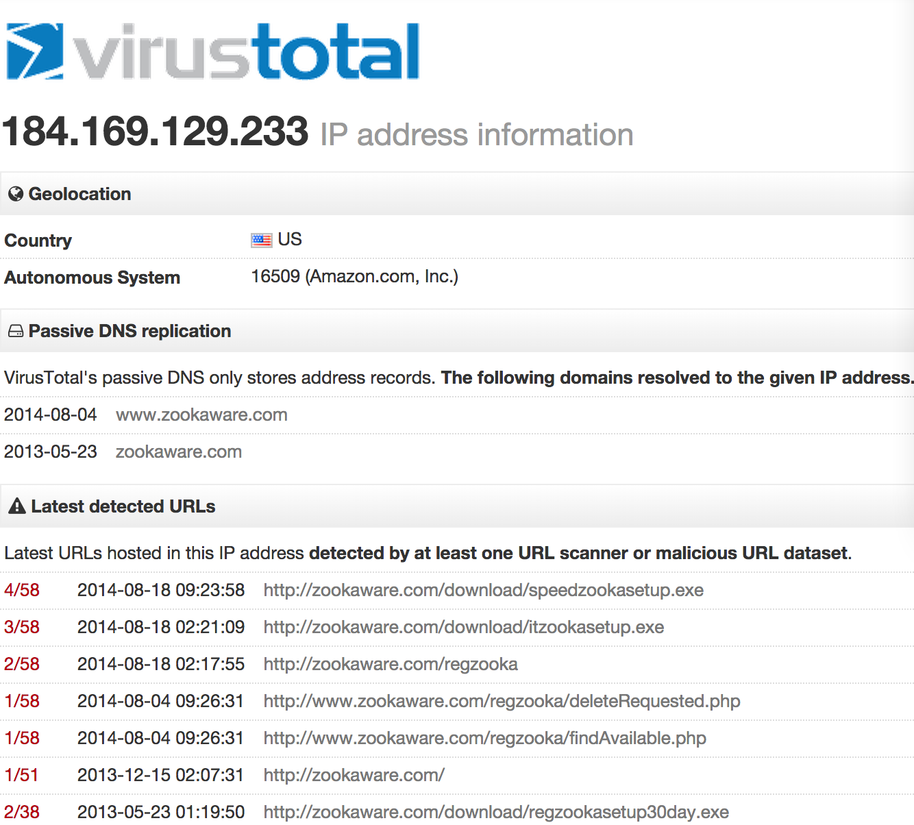

File hosting services are used for distributing malicious contents
IP ranges
VirusTotal API
Malicious activity history
EC2: 2,070 malicious IPs 13,752 malicious URLs
Azure: No malicious IPs!
Domain | # of URLs flagged as malicious
dl.dropboxusercontent.com | 993
dl.dropbox.com | 936
download-instantly.com | 295
tr.im | 268
www.wishdownload.com | 223
Notes:
(18) And we also use VirusTotal API to check the malicious activity history of all the IPs in clouds. The VirusTotal API takes an IP address as input and output a report that has the detail info of the malicious URLs hosted on that IP in the last 3 months. Surprisingly, we didn’t find any malicious IP reported by VirusTotal in Azure. In EC2, we extract the domains from the malicious URLs, 4 of the top 5 most seen domains are providing file hosting services, and we saw about 25,00 URLs associated with these domains. Tr.im is a URL shorten service. The result indicates URL-shorten services are used for hiding malicious URLs.

Slide 19



Cloud Measurement Challenge and Future
Only see a portion of web servers
Only see a portion of web sites’ pages
Lower bound on number of IPs used by web services
VM
VPC
VM
No default HTTP(S) Port
Other websites
VM
1.1.1.1
Backend VM
No public IP
Default website
VM
VM
Frontend VM
Public IP = 1.1.1.1
Website: deny IP access
Firewall
VM
Website
Able to find
Fail to find
Notes:
(19) Finally, I want to talk about the challenges and future works in the cloud measurement. In our project, we design whowas to measure the public facing cloud instances and web services. There are lots of situations IP probing fail to work. And there are more challenges to get a broader view of the public clouds. For example, we can only see a portion of running web servers. Instances may be placed behind firewall or use non-default HTTP port. Could we find such instances with lightweight method? Then, an instance may host multiple websites. Could we find such type of instances and estimate the number of websites on a given instance?. Besides, cloud measurement usually only see the public, front-end instances. For example, operators can hide backend instances in the VPC networks without assigning any public IPs. Is that possible to distinguish front and backend? How to infer if a website has backend instances and guess the number of backend instances? There are more interesting questions we are looking forward to answer.

Slide 20
Other results are in the paper!
Visit our website: www.cloudwhowas.org
to get more information!
Notes:
(20) We want whowas can help, that’s why we publish the tool on our website. We would like people to improve the tool, gather their own dataset and find more interesting results.

Slide 21
Conclusion
WhoWas: new measurement platform
Lightweight probing to associate content to IPs over time
Used WhoWas for several first-of-their-kind measurements:
Growth rates of IP usage
Identification of malicious websites
Software adoption rate in clouds
…
Questions?
www.cloudwhowas.org
Notes:
(21) In conclusion, we design whowas, a new measurement platform that use lightweight probing to associate content to IPs over time. We used whowas for several first-of-kind measurement in two popular public clouds, for example, growth rates of IP usage, identification of malicious websites, software adoption rate in the public clouds, and more. Thank you for listening and I would like to answer any questions now.

Slide 22
Conclusion
WhoWas: new measurement platform
Lightweight probing to associate content to IPs over time
Used WhoWas for several first-of-their-kind measurements:
Growth rates of IP usage
Identification of malicious websites
Software adoption rate in clouds
…
Questions?
www.cloudwhowas.org
Notes:
How to figure out the IP ranges: on the website
Is harder?: no because, cloud provider won’t do that, default behaviors
Access policy: This a just a lower bound

