Slide 1
Malicious Messages Detector Based on Neural Network
Supervisor: Jean-Philippe MONTEUUIS
Guodong SUN
Liang WANG

Slide 2
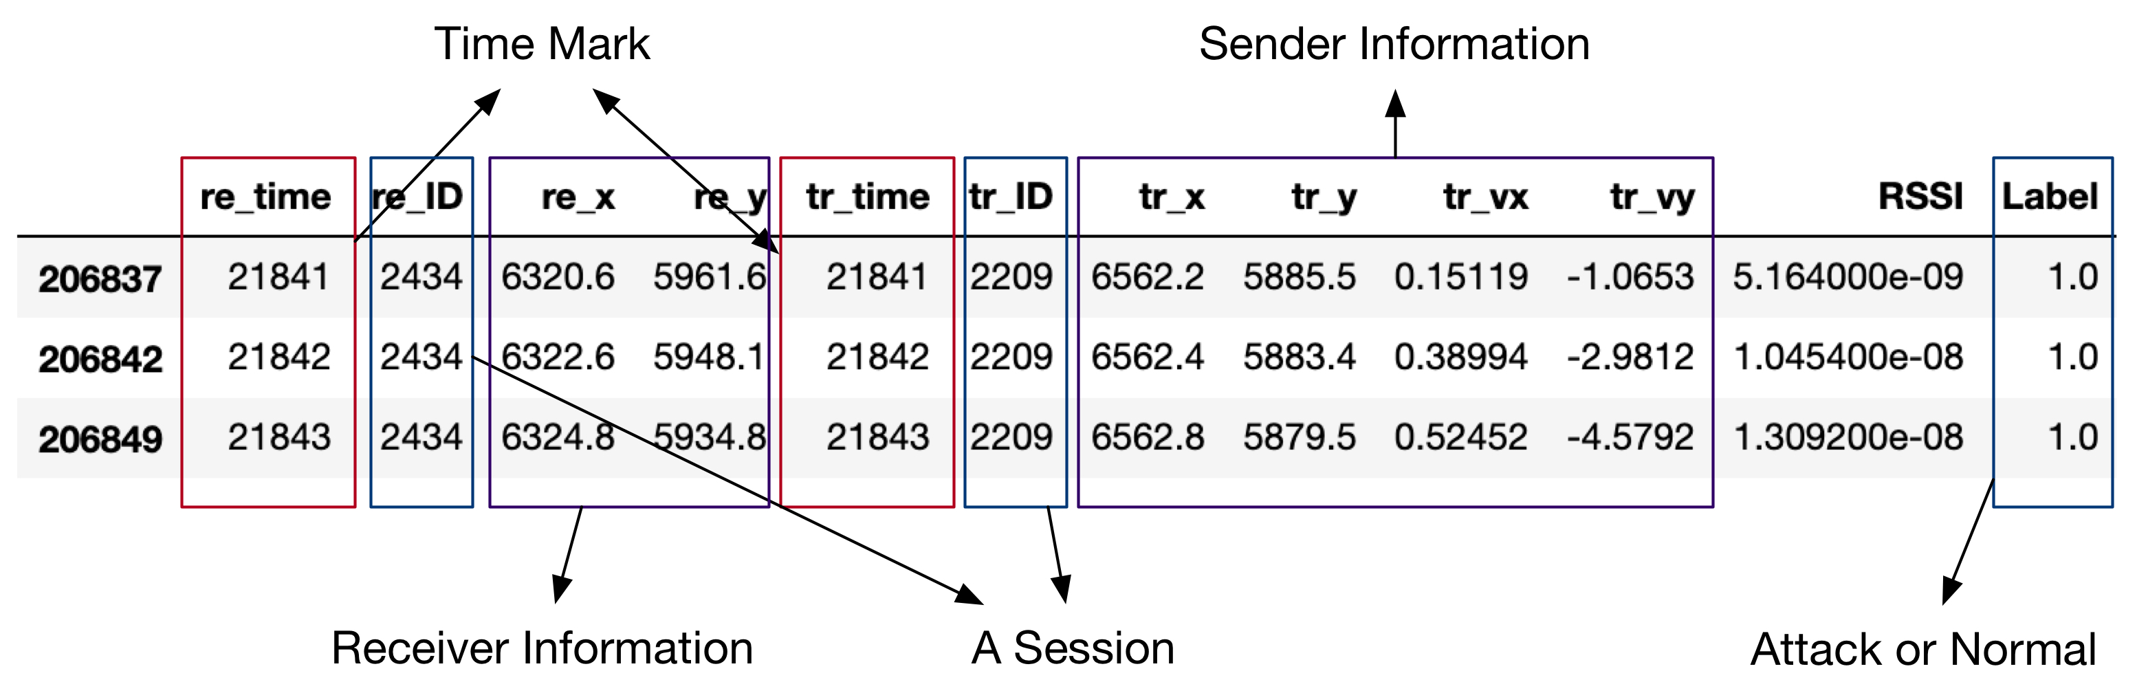
The datasets

Slide 3
Statistics

Slide 4
Attackers
-Constant :Attacker report a false position which is a constant value.
-Constant Offset :Attacker transmits a fixed offset added to the real position.
-Random :Attacker sends a random position inside the simulation area.
-Random Offset :Attacker sends a random position within a rectangle around the vehicle.
-Eventual Stop :Attackers behave normally for some time and then attacks by transmitting the same position repeatedly.

Slide 5
Feature Vector

Slide 6
Splitting the data set

Slide 7
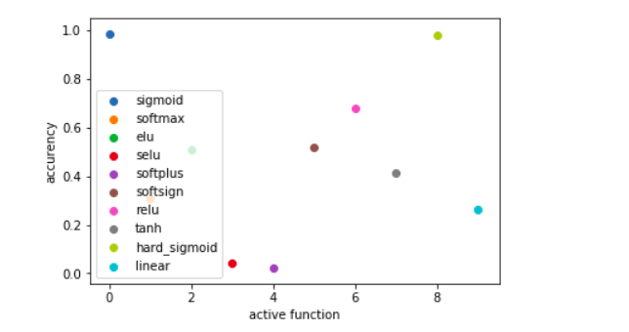
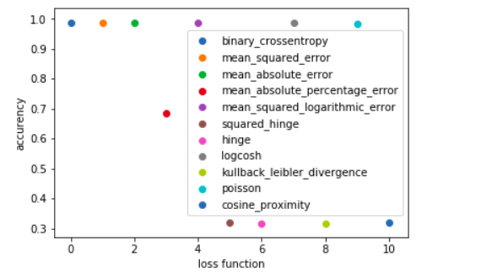
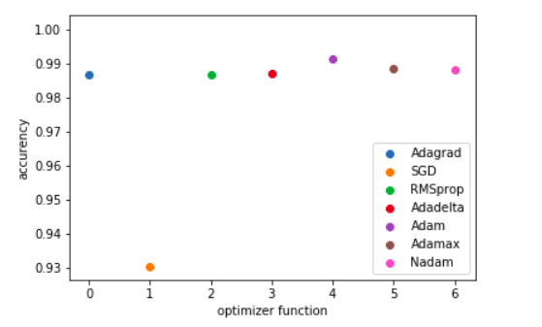
Chose of parameters
According to the expirement, we find best parameters in active function, loss function and optimizer function.

Slide 8
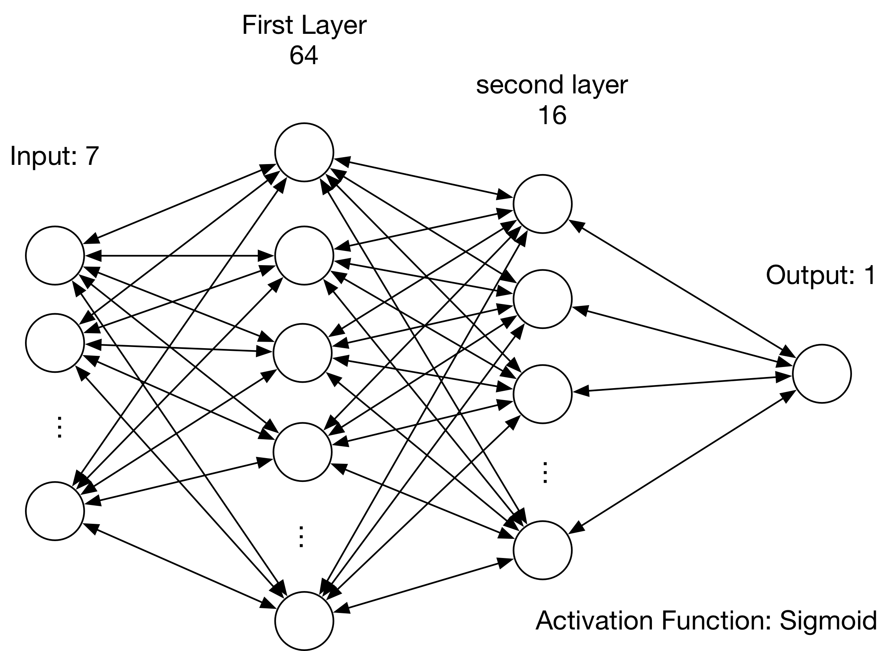
Detector Model
Loss function: Mean_Absolute_Error
Optimizer: RMSprop

Slide 9
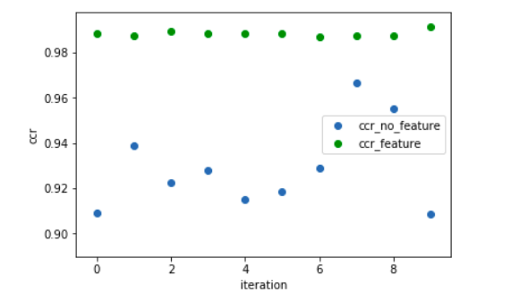
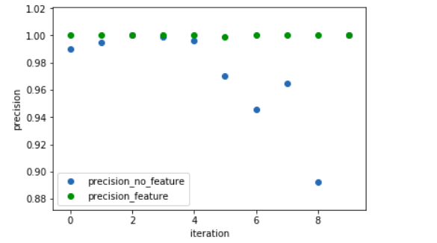
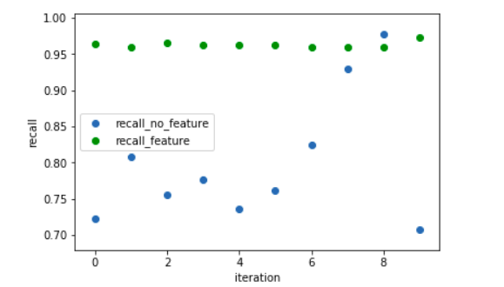
Comparison: dataset with feature and original dataset

Slide 10
Experiment Results: attack 1,2,4,8,16

Slide 11
Experiment Results: overall attack

Slide 12
Classification
 | Type 1 (Predict) | Type 2 (Predict) | Type 4 (Predict) | Type 8 (Predict) | Type 16 (Predict)
Type 1 (real) | 0.7623 | 0.0212 | 0.0779 | 0.0191 | 0.1145
Type 2 (real) | 0.0016 | 0.9401 | 0.0096 | 0.0444 | 0.0043
Type 4 (real) | 0.0005 | 0 | 0.9909 | 0.0068 | 0.0018
Type 8 (real) | 0 | 0.0458 | 0.0040 | 0.9259 | 0.0243
Type 16 (real) | 0.2707 | 0.0620 | 0.0344 | 0.0450 | 0.5879
***Note that it is invalid for Type 2 attacker, because the first step, i.e. identifying whether the session
is malicious or does not success.

Slide 13
Test:

Slide 14
Thanks!

