Slide 1
Malicious Messages Detector Based on Neural Network
Supervisor: Jean-Philippe MONTEUUIS
Guodong SUN
Liang WANG

Slide 2
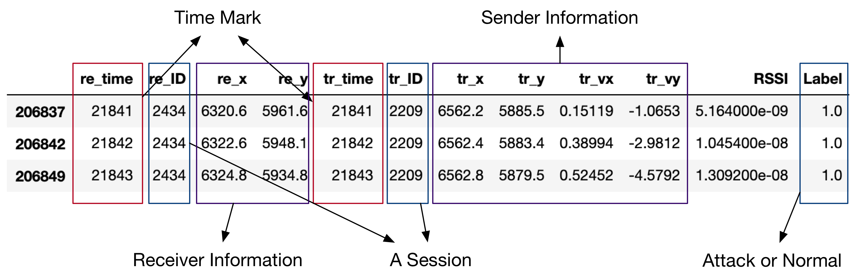
The datasets

Slide 3
Statistics

Slide 4
Attackers

Slide 5
Feature Vector

Slide 6
Splitting the data set

Slide 7
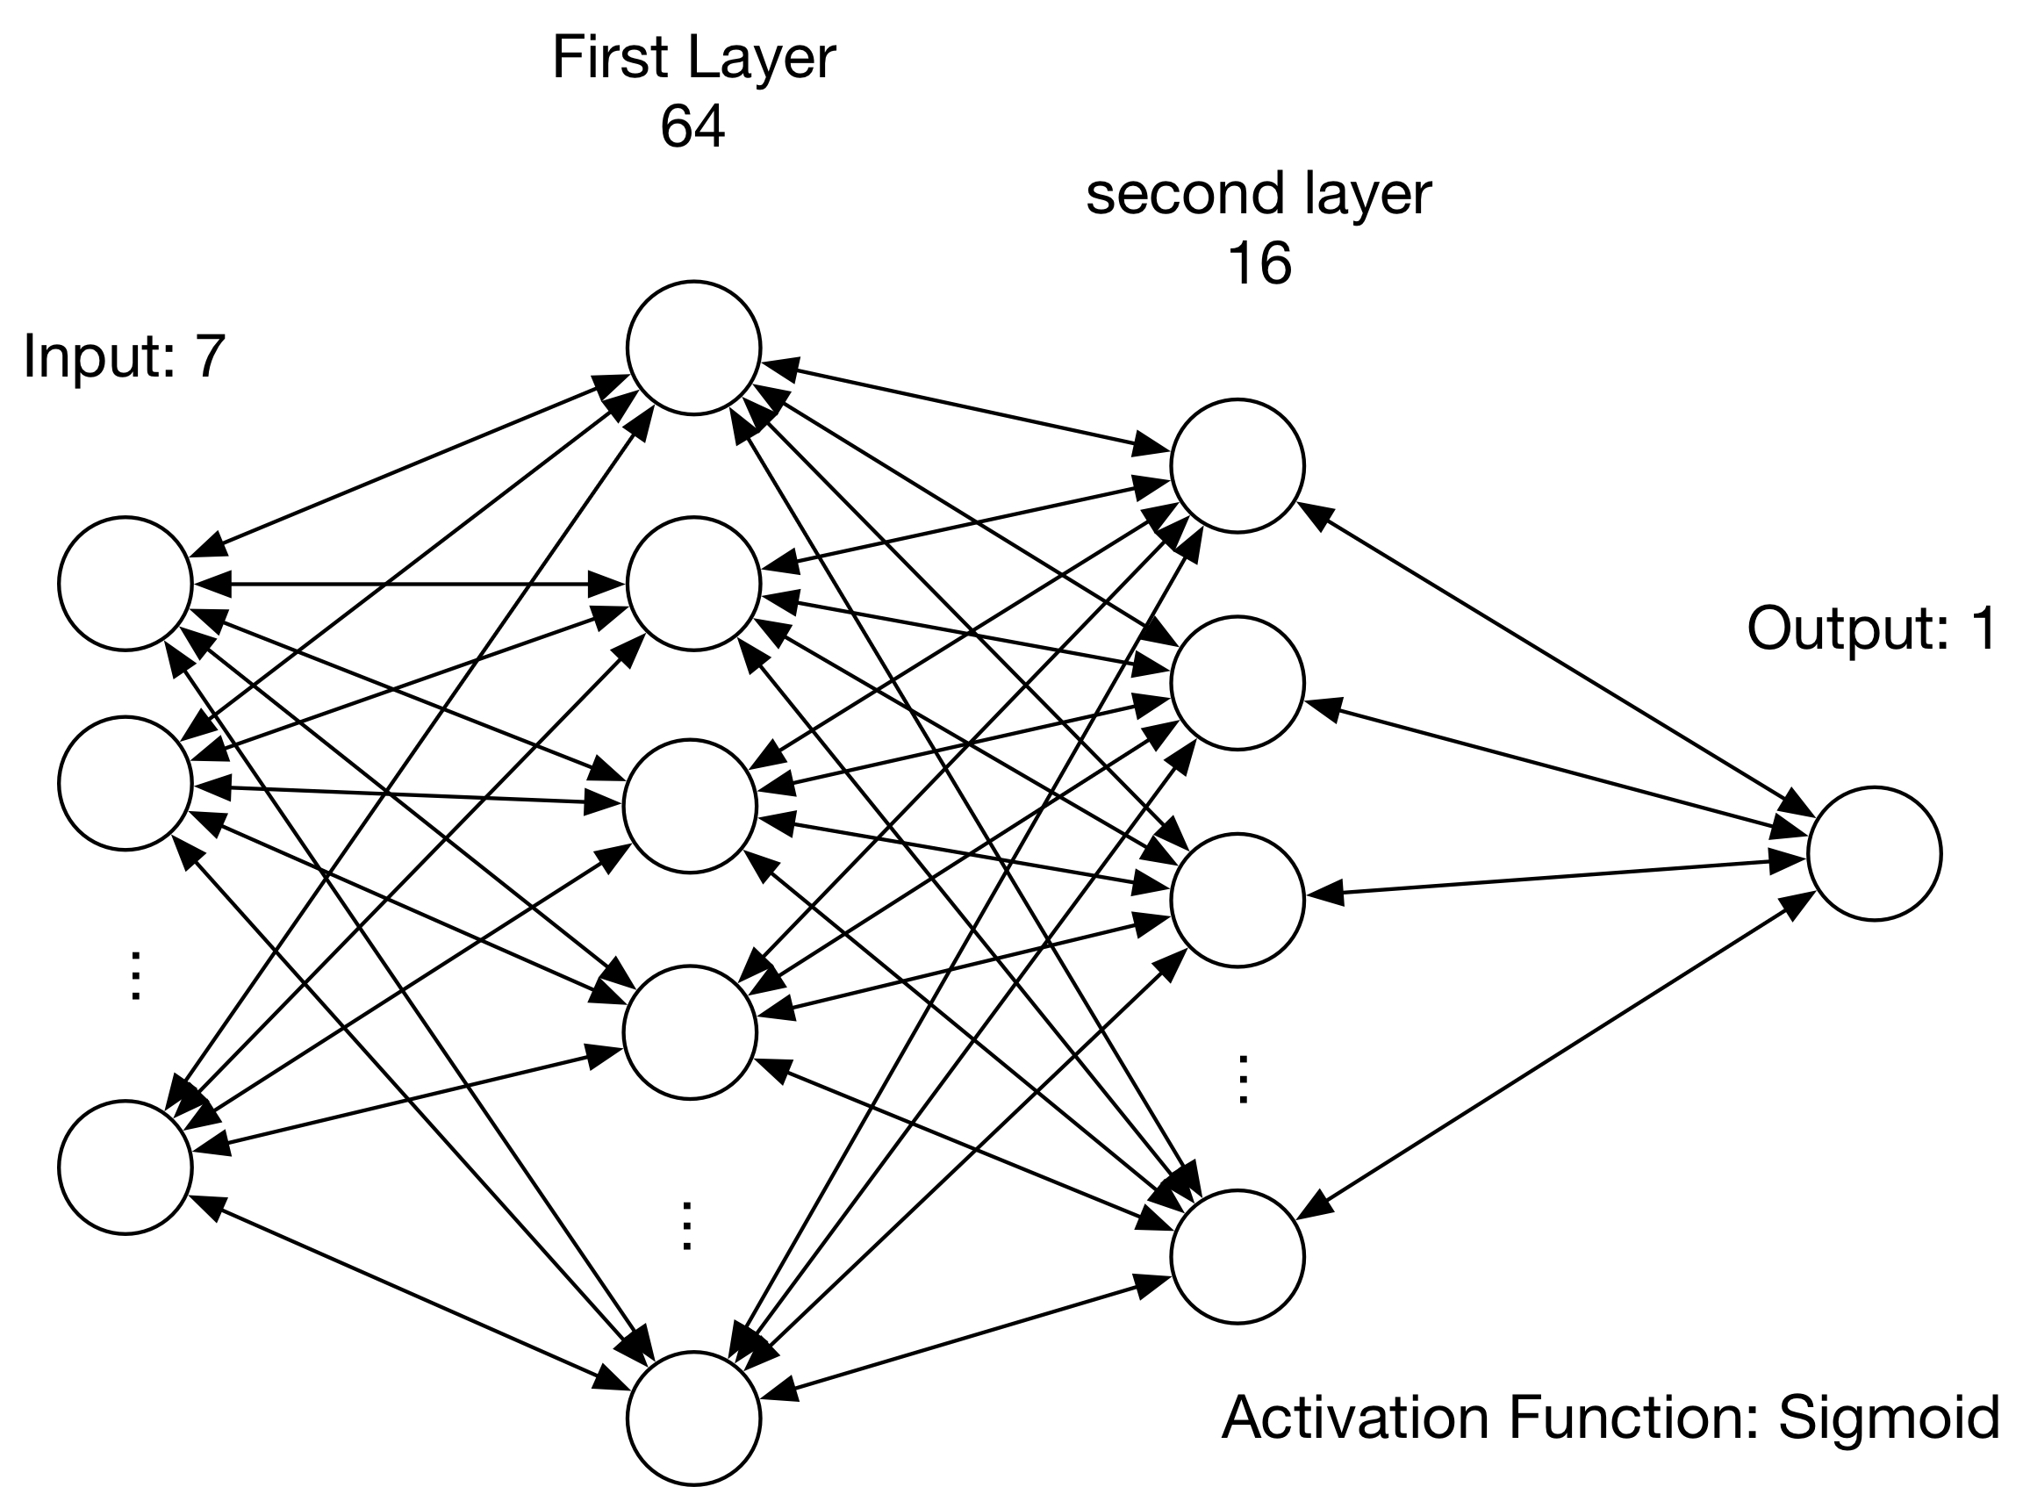
Detector Model
Loss function: Mean_Absolute_Error
Optimizer: RMSprop

Slide 8
Experiment Results: attack 1,2,4,8,16

Slide 9
Experiment Results: overall attack

Slide 10
Classification
 | Type 1 (Predict) | Type 2 (Predict) | Type 4 (Predict) | Type 8 (Predict) | Type 16 (Predict)
Type 1 (real) | 0.7623 | 0.0212 | 0.0779 | 0.0191 | 0.1145
Type 2 (real) | 0.0016 | 0.9401 | 0.0096 | 0.0444 | 0.0043
Type 4 (real) | 0.0005 | 0 | 0.9909 | 0.0068 | 0.0018
Type 8 (real) | 0 | 0.0458 | 0.0040 | 0.9259 | 0.0243
Type 16 (real) | 0.2707 | 0.0620 | 0.0344 | 0.0450 | 0.5879
***Note that it is invalid for Type 2 attacker, because the first step, i.e. identifying whether the session
is malicious or does not success.

Slide 11
Test:

Slide 12
Thanks!

